Slide 1
🛒 E-COMMERCE RETAIL ANALYTICS
Turning Data into Business Insights & Intelligent Decisions
A Complete Data Analytics & Machine Learning Project
📊 Excel & Power BI | 🐍 Python | 🗄️ SQL | 🤖 Machine Learning | 💬 AI Chatbot | 🌐 Streamlit
Presented By
Anitha R
NIIT Capstone Project — 2026
From Raw Data → Analysis → Insights → Prediction → Business Action

Slide 2

01
E-COMMERCE REVIEW
From e-commerce
data to
business action
Evidence-led signals for growth, experience, and execution.
ANALYTICAL REVIEW
COMMERCIAL SIGNAL
CUSTOMER JOURNEY
NEXT ACTIONS

Slide 3
REVIEW MAP
The review follows the evidence
02
Read the commercial signal
01
Frame the analysis
What the review set out to answer.
Where revenue and demand concentrate.
Four moves from question to action.
03
Trace the customer journey
04
Act within the evidence
What payment, pricing, and operations reveal.
What to do next—and what remains uncertain.

Slide 4
01
SECTION 01
Frame the analysis
Define the commercial questions before reading the signals.

Slide 5
SCOPE / ANALYTICAL FRAME
The project connects commercial performance to customer experience
One review brings sales and behavior into the same decision frame.
Measure the business
Find the signal
Test, then translate
Sales, customer behavior, product performance, order status, payment methods, reviews, and geography.
High- and low-performing categories, segment revenue, payment preferences, pricing relationships, review patterns, and regional sales differences.
Validate selected assumptions with statistical analysis, then translate the findings into recommendations.
COMMERCIAL PERFORMANCE
ACTION STANDARD
PATTERN DISCOVERY
EVIDENCE STANDARD
Observed patterns become business action only after selected relationships are tested.

Slide 6

SECTION 02
THE COMMERCIAL
SIGNAL
Revenue concentration, portfolio demand, and the next growth lever.
SECTION 02 / COMMERCIAL PERFORMANCE

Slide 7
COMMERCIAL SIGNAL / CONCENTRATION
REVENUE IS CONCENTRATED IN A FEW CLEAR GROWTH LEVERS
Furniture leads category revenue. Selected brands and products contribute disproportionately. Higher-value products matter.
OBSERVED PATTERN · CATEGORY · BRAND · PRODUCT · PRICE

Slide 9
PORTFOLIO DECISION / COMPARISON LEDGER
Focus investment where the portfolio already proves demand
Portfolio signal | Invest in | Before adding spend
High-performing categories | Inventory, visibility, promotions, and recommendations. | Protect proven demand.
High-performing brands/products | Greater homepage and campaign exposure. | Scale what already converts.
Underperforming categories | Diagnose the gap. | Investigate customer preference, pricing, competition, availability, and marketing.
RECOMMENDATION
Protect the winners while diagnosing the gaps.

Slide 10
CUSTOMER VALUE / ACQUISITION → RETENTION
The acquisition engine is strong; retention is the next unlock
Acquire
Convert
Retain
New customers generated higher revenue than loyal customers in the analyzed data.
Strengthen acquisition campaigns and first-purchase offers.
Build repeat behavior with personalized offers, loyalty rewards, and cross-selling.
Growth comes from pairing acquisition strength with repeat behavior.

Slide 12
03
SECTION 03
THE CUSTOMER
JOURNEY
PAYMENT · PRICING · EXPERIENCE · EXECUTION

Slide 13
CUSTOMER JOURNEY / PAYMENT
BUSINESS IMPLICATION
UPI is the clearest convenience signal
Optimize checkout
Make UPI reliable and low friction.
OBSERVED PATTERN
UPI
OPERATIONAL WATCHOUT
Track cancellations and returns by product, category, and region.
The most frequently used payment method.

Slide 15

CUSTOMER JOURNEY / PRICING + REVIEWS
Pricing explains revenue more directly than ratings do
Cost price and selling price showed an extremely strong positive relationship. Unit price and revenue showed a strong positive relationship. Review score and revenue showed almost no correlation.
USE PRICE
USE REVIEWS
As a direct revenue signal.
To monitor satisfaction, not as the sole revenue predictor.

Slide 16
EXECUTION / REGIONAL + ORDER SIGNALS
OPERATING VIEW
Regional demand and order status are execution signals
Demand is local. Leakage is operational.
Signal | What it reveals | Action
Geography | Sales and revenue differ across regions. | tune regional campaigns and inventory allocation to local demand.
Order status | Delivered, cancelled, shipped, and returned orders reveal where revenue and satisfaction can leak. | Find the operational break.
Execution | Delivery performance shapes the customer experience. | Reduce cancellations and improve delivery performance.
REGION · STATUS · DELIVERY · RETURNS

Slide 17
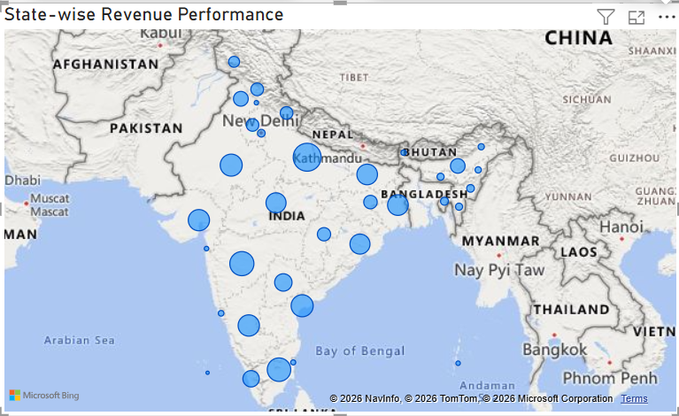

Slide 18
04
SECTION 04
Evidence, limits,
next steps
Move from pattern to proof, then act within the boundary.

Slide 19
METHOD / FOUR MOVES
The analytical chain moves from pattern to proof to action
01
Explore
Category, segment, payment, pricing, review, geography, and order-status patterns.
02
Validate
Selected relationships with a t-test and chi-square test.
03
Compare
Model performance with the analytical findings.
04
Translate
Validated insights into commercial and operational recommendations.
EVIDENCE ROUTE · EXPLORATION → VALIDATION → COMPARISON → RECOMMENDATION

Slide 20
LIMITS / DATA QUALITY + INTERPRETATION
The conclusions are useful, but the data sets boundaries
01
Missing values
Order approval, shipping, delivery, and estimated delivery dates were incomplete.
02
Outliers
Quantity, prices, discounts, shipping cost, weight, and review score required investigation and preprocessing.
03
Unobserved drivers
Competitor pricing, advertising, campaigns, income, browsing behavior, and availability history were not available.
04
Interpretation
Correlation does not imply causation, and statistical results depend on data quality.

Slide 21
ROADMAP / DECISION SYSTEM
Future scope turns the review into a decision system
NOW
THEN
Near-real-time KPI dashboard
Broader context
Revenue, orders, delivery, cancellations, returns, average order value, segments, and category revenue.
Seasonal analysis, competitor analysis, and a more capable AI chatbot.
1
2
3
NEXT
Advanced decision support
Customer segmentation, sales forecasting, product recommendations, and churn prediction.
FROM REVIEW TO REPEATABLE OPERATING SYSTEM

Slide 22
CLOSING / THREE PRIORITIES
Three priorities make the insight actionable
01
Concentrate inventory and visibility on high-performing products and categories.
02
Pair acquisition strength with personalized retention and cross-selling.
03
Use regional, pricing, payment, and operational signals together rather than relying on a single metric.
OVERALL IMPLICATION
Combine product focus, acquisition, retention, regional targeting, optimized pricing, payment convenience, and operational monitoring.

Slide 23
SOURCE REGISTER
SOURCES
The review is grounded in the prepared insights document.
01
PHASE 10 — INSIGHTS DOCUMENT

Slide 24
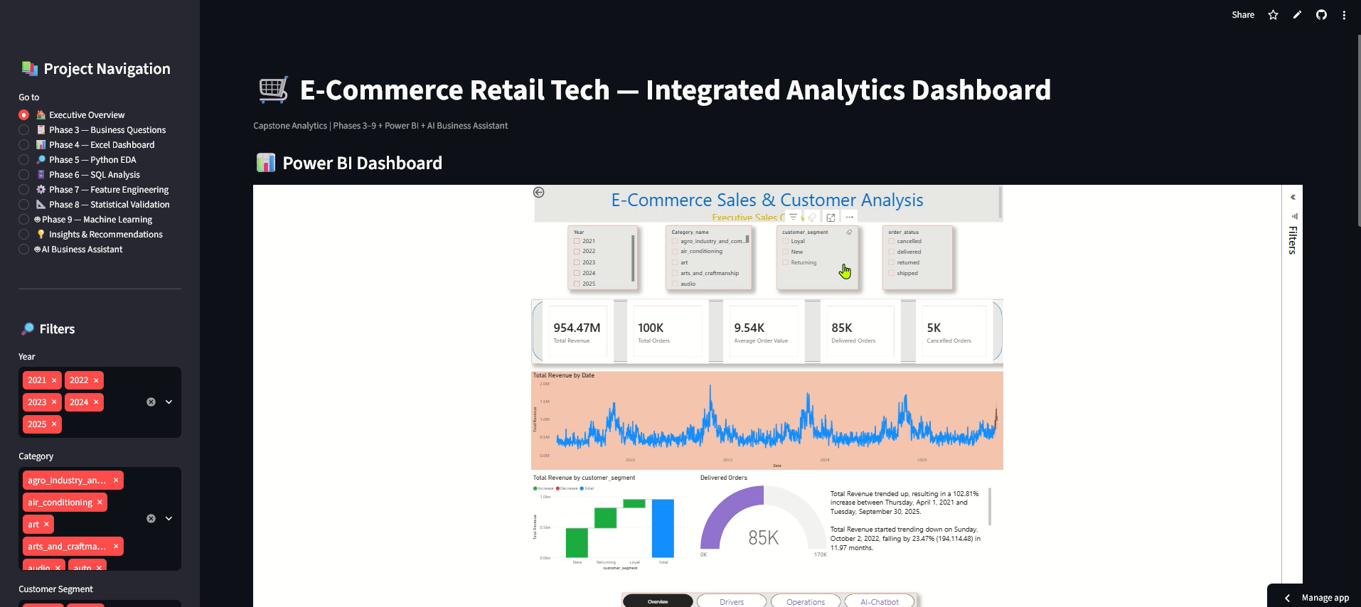

Slide 25
✨ THANK YOU ✨
━━━━━━━━━━━━━━━━━━━
Turning Data into
Meaningful Insights
━━━━━━━━━━━━━━━━━━━
💡 📊 🚀
E-Commerce Analytics
& ML Project
“Data tells the story.
Insights drive action.”

