Slide 1
Infosys Global Hackathon 2019
POC on Online Food Ordering system and Personalized Food Recommendations

Slide 2
Problem Statement
Goal is to create an online Food Ordering application that allows us to Order Anywhere which in turn help us to reduce the queue in Food Courts
To create Personalized Food Recommendations to end user in the application

Slide 3
Solution Approach
Application to enable user to select food court, vendor and order the food and get notified once the food is ready
Personalize food recommendations using Content based recommender to display the foods that are similar to the ones liked by the user in the past and for new user display the top selling items
Technology Stack:
Python, Sqlite, Machine Learning

Slide 4
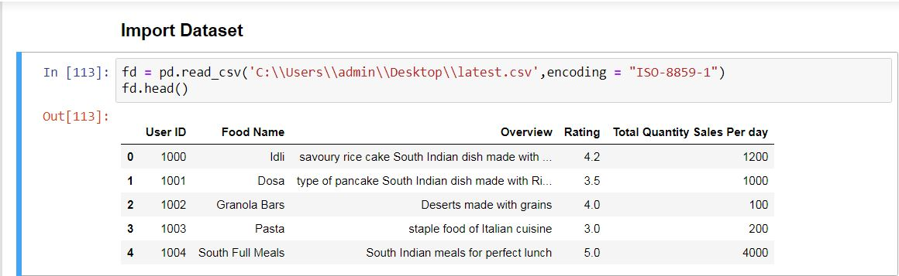
Dataset Curation
Capture the past behavior of a customer and the food details and their description to calculate the similarity between items, in order to recommend food which the users might be likely to buy.

Slide 5
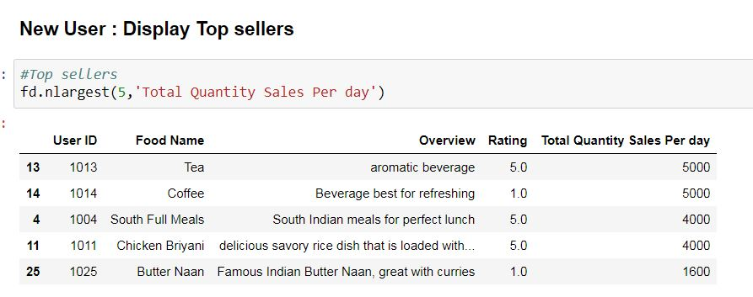
Personalized Recommendation
New User : Top Sellers based on total quantity sold

Slide 6
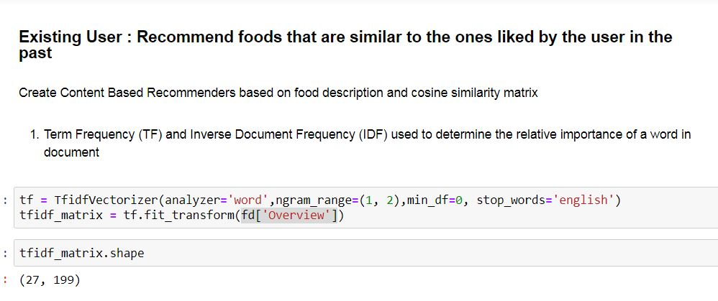
Existing User
Method 1 : Calculate Similarity between food items in data set with help of Term Frequency Inverse Document Frequency and Cosine Similarity matrix
Based on Similarity Matrix get top similar food items and display
Method 2 : We can also use Count Vectorizer instead of Term Frequency Inverse Document Frequency

Slide 7
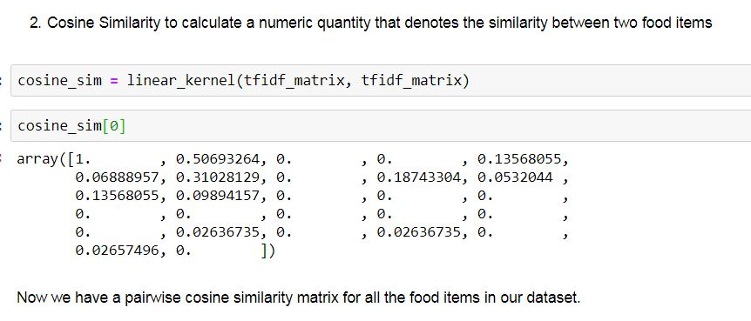
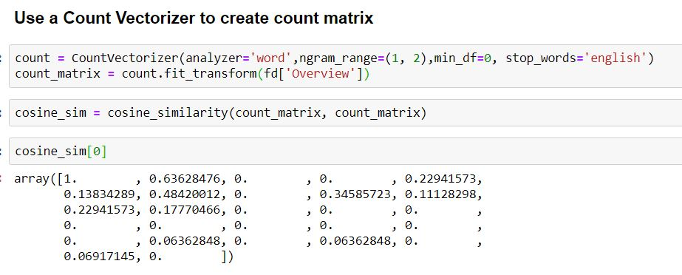
Similarity Matrix of Food item Description

Slide 8
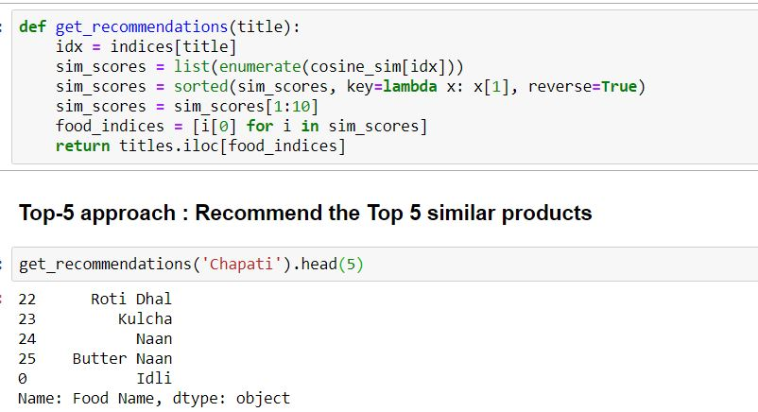
Top 5 Recommendations

Slide 9
Future Enhancements
For Recommendation Engine : This model can be enhanced by taking feedback from user for food item, budget, cuisine and rating into account
For Application :
Adding Time Estimate for Delivery
Predict weekend/Festival time food preparation quantity levels based on past data

