Slide 1

HSF Feb, 2017
Configuration BOT
POC Variants

Slide 2


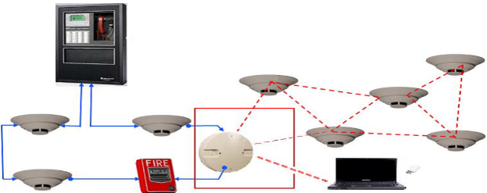

Fire System Configuration using Chatbots
Need ,Opportunity & Value Add
Solution Concept
Opportunity
A Config Chatbot is an AI based assistant to help a Commissioning Engineer perform his job at a site right and fast
Value Add
AI induced commissioning based on data analytics of similar type of sites
Commissioning options like battery calculations shall be completed through a chatbot conversation
Simulating the configured options shall be done by command driven from chatbot
Voice/Text interactive data output from commissioning tool to the user in smartphone/any hand held device
Business Impact
Opportunity for SaaS based models for recurring revenue
Notifications on situational awareness can be pushed to a mobile device through a chat bot
Context based suggestions to perform time consuming troubleshooting and manual error prone activities
Safe and secure way of collaboration than social networks
ChatBot
AI
Database
The Big Idea
Commissioning Engineer/ Installer coming to a Site can use the chatbot which would be a guided approach and would require lesser pre work and manual plotting and paper work
Chat bot would provide a user friendly interface to do a commissioning to the system at a given site
AI driven commissioning

Slide 3
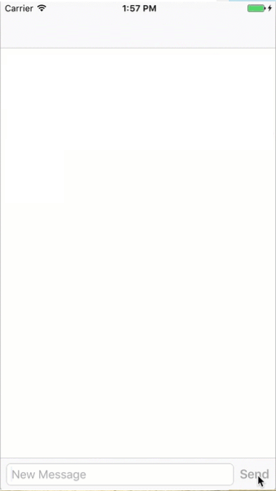
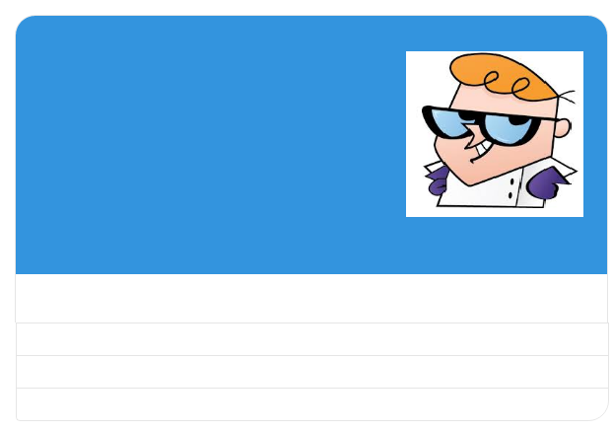
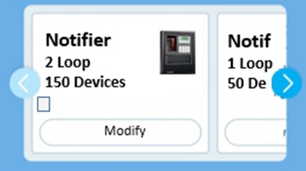
CREATE CONFIGURATION FILE
Select a Panel to configure
OPEN CONFIGURATION FILE
RECEIVE FROM PANEL
Smart Configuration
Assistant
Create Configuration File
That’s Cool!!!Let us go ahead and create a project. What shall we call this?
Holiday INN
Hello I’m your fire panel configuration assistant.
Sounds good. Where is this Site located?
Get Started
GET CURRENT LOCATION
Notifier..2 Loop..150 Devices
SKIP
Cool..!! Panel Configured..!!!
SKIP
Thanks.. Can you tell me what is the Venue like?
It’s an OFFICE
It’s a SHOPPING MALL
It’s a THEATRE
It’s an AIRPORT
You could also type if you do not find the proper match….
It’s an AIRPORT

Slide 4
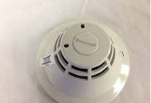
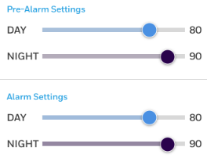
Let’s make it very easy for you to configure your device. Send me a picture of the Device
Oh!! You have a SMOKE DETECTOR with you…
This device has been used in airports earlier with the below settings.
Do you want to go with this? If not modify the details
Save this Setting

Slide 5
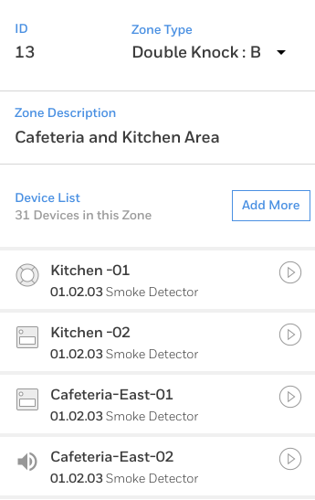
What area does this device associate with?
The following Device IDs are available for the device to fit in. Choose one of them
SUMMARY
CREATE CONFIGURATION FILE
01.02.11
OPEN CONFIGUATION FILE
01.02.24
RECEIVE FROM PANEL
01.02.19
(or)
Create Configuration File
It’s alright use the same ID
That’s Cool!!!Let us go ahead and create a project. What shall we call this?
You have chosen 01.02.11 and the same has been saved.
Holiday INN
Sounds good. Where is this Site located?
Modify Config
Configure other panel
CURRENT LOCATION
See Summary
SKIP
Create copy of this Device
See Summary
Thanks.. Can you tell me what is the Venue like?
It’s an OFFICE
It’s a SHOPPING MALL
It’s a THEATRE
It’s an AIRPORT
You could also type if you do not find the proper match….
It’s an AIRPORT
Sync Panel
You could also type if you do not find the proper match….
Save the configuration File
See Summary
Lobby- Front
Reception Desk
Waiting Room 1

