Slide 1
Situational Awareness
Presented by
P. ANITHA

Slide 2
Complex / Mall
Scan and take a photo of the person while entering into the building.
Send it to the computing device.
Analyze it with all social network contacts (Analytics – analyze the matching profile)
Find the information of that person.
Store information such as contacts , email id and social network information which are publicly available for an emergency notification

Slide 3
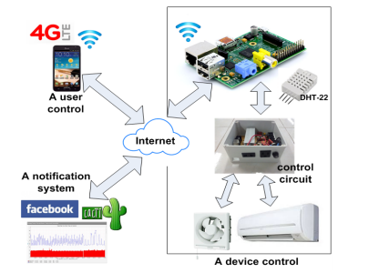
Devices integration with social networks
The figure shows that circuit part has been setup and connected between home devices and Raspberry PI in order to control devices from mobile phones or tablets anytime and anywhere.
This framework is a proof of concept and tested at home and the laboratory of Department of Computer Engineering, Prince of Songkla University, Phuket Campus, Thailand.

Slide 4
Devices integration with social networks
It consists of 3 parts:
(1) a device control,
(2) a notification system (Facebook integration)
(3) a user control.

Slide 5
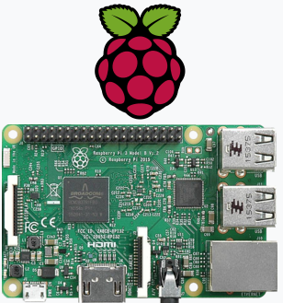
Raspberry Pi 3 Model B (latest version)
The Raspberry Pi is a series of credit card-sized single-board computers developed in the United Kingdom by the Raspberry Pi Foundation

Slide 6
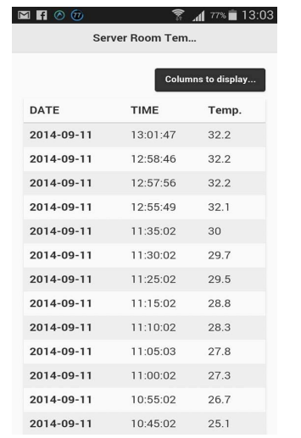
Raspberry Pi 3 Model B (latest version)
It is a microcontroller to interface with various sensors and devices via control circuit.
Raspberry PI uses GPIO pins to read various sensor data and sends control status to command connected sensors or devices.
These processes are implemented by Python programming language.
In addition, Raspberry PI stores sensor data in the database (e.g., mySQL) periodically.
In the case that a temperature is higher than a pre-defined threshold, the system will automatically trigger a notification system.
Moreover, Raspberry PI provides WiFi/LAN to connect to the Internet. It is always connected to related users
Figure below (as implemented on the responsive web based) shows that the temperature in a server room is recorded in every 5-10 minutes (this value can be reconfigured).

Slide 7
Notification System
A notification system runs on Raspberry PI by Cacti. Cacti is a front-end RRDtool that gets the data from a database server and generates graphs.
Facebook is chosen as a notification system since Facebook allows us to create a custom group and adds responsible members to receive alert or notification.
It is added and linked to the notification system by Cacti using a custom email
When an email is trigged, Facebook will alert users immediately and automatically. In a similar manner, Twitter and Google plus provide application programming interfaces that can post notification messages to users directly

Slide 8
At Office
As a facility manager/ monitor , he can find that
how many people are in and out?
Movements including human breathing
Activate the visual display system (Digital Signage) automatically, guide and send alerts via (….,)
Directions to exit
Internal and external emergency contact numbers
Oxygen mask
Recognize the voice and help them ( Voice Recognition )
Activate the doors open , emergency voice evacuation system, firefighter telephone system

Slide 9
Browser based pop-up alerts (At office)
Messages can be disseminated to networked desktops and laptops via browser-based pop-up alerts
These will pop up regardless of the application in use on screen.
Mobile dashboards enable users to respond to alerts or initiate alerting and response plans with the touch of a button on their mobile device.
It can be a direction leading them to a new re-route, nearest exit signs or the location of fire extinguishers in case of fire.

Slide 10
Digital signage
Projection screens and TVs can display emergency broadcasts onscreen and provide the proper instructions.
If there’s a fire, the message may instruct people to find the closest exit (and even show them how to get to that exit) and leave the building
The great thing about digital signage is that it can change instantaneously. As new information comes in about the incident, it can be displayed and seen by groups of people in common areas, classrooms, offices, and boardrooms.

Slide 11
Asset Management Software
To send messages to various display devices on a campus/corporate network, including smartboards, projectors and displays, digital room signage, and in-room touch panels.
From a central monitoring interface available to facilities staff, messages can be delivered to these devices at the level of an entire campus, or a building, or a floor, wing, etc. as the situation arises.

Slide 12
At Outside
With social networks (such as Facebook) we can find
friends and people nearby you , chat with them and guide them
Emergency rescue services and make a call or text via WhatsApp, Facebook, Skype, etc.

Slide 13
THANK YOU

