Slide 1
Chatbot
Presented By,
P.ANITHA

Slide 2
7 Best Online AI Chatbots
Cleverbot
Jabberwacky
Evie
Elbot the robot
Alice
Igod
Splotchy

Slide 3
Six of the best chatbot building platforms for developers
Microsoft’s ‘ Bot Platform ’
ChatScript
Pandorabots
Facebook’s ‘ Bot for Messenger ’
Rebot.me
Imperson

Slide 4
Programming Languages
The programming languages which are mostly used in developing the bots for Messenger, Telegram and Slack includes,
Python,
PHP,
Java,
NodeJS (JavaScript),
C#,
Objective-C, Swift, and Go.

Slide 5
List of programming languages for artificial intelligence
AIML – Artificial Intelligence Markup Language
IPL
Lisp
Smalltalk
Prolog
STRIPS
Planner
POP-11
Python
Haskell
C++
MATLAB

Slide 6
Microsoft’s ‘Bot Platform’ Creating a Microsoft Teams bot
Register the bot with the Microsoft Bot Framework, and make sure you add Microsoft Teams as a channel.
When you first register a bot it will be in preview, which means that it is only available to users in Microsoft Teams via side loading of the bot ID or via add button.
Build a bot using the C# SDK, Node.js SDK or Microsoft Bot Connector API.
Test it using the Bot Framework Emulator
Deploy the bot to a cloud service, such as Microsoft Azure
Add the bot to a Microsoft Teams 1:1 chat, and test.

Slide 7
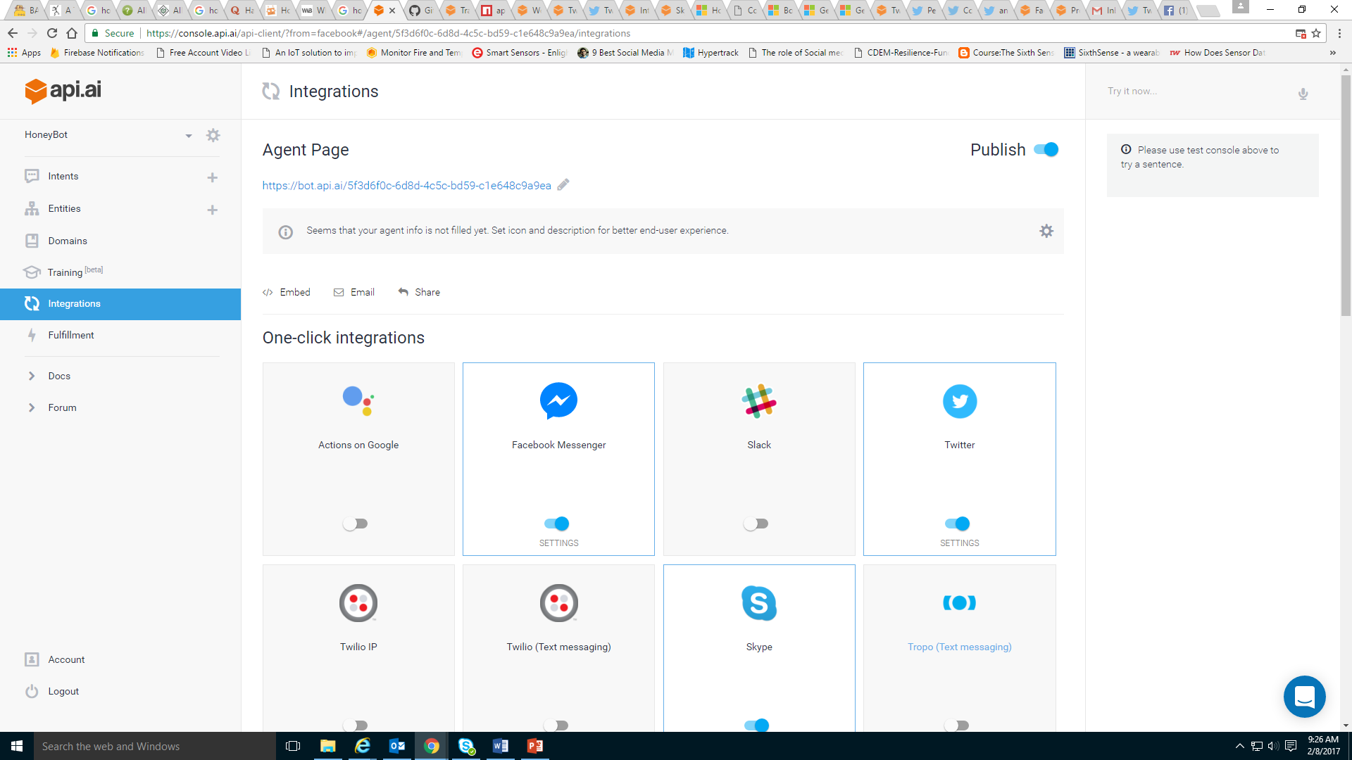
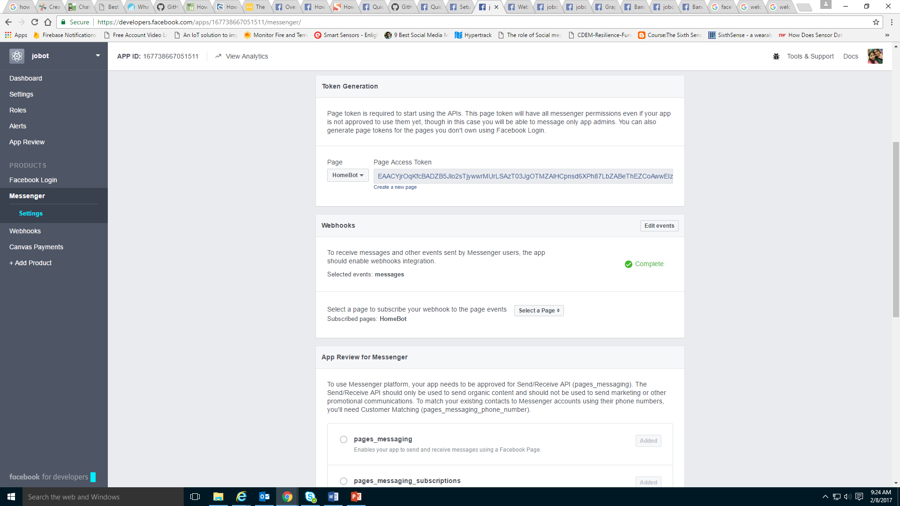
Bot using API.AI

Slide 8
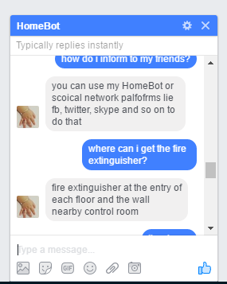
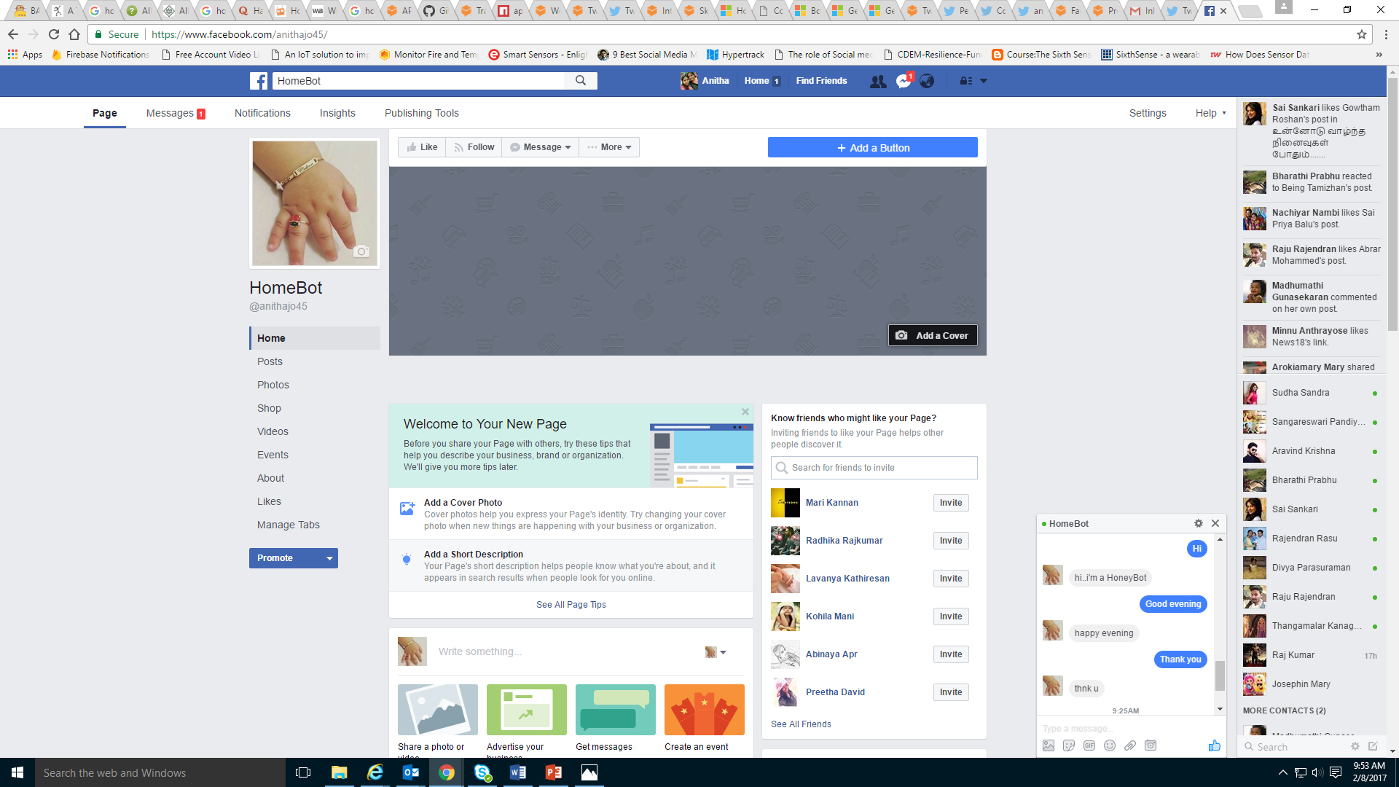
Testing bot in Facebook Messenger

Slide 9
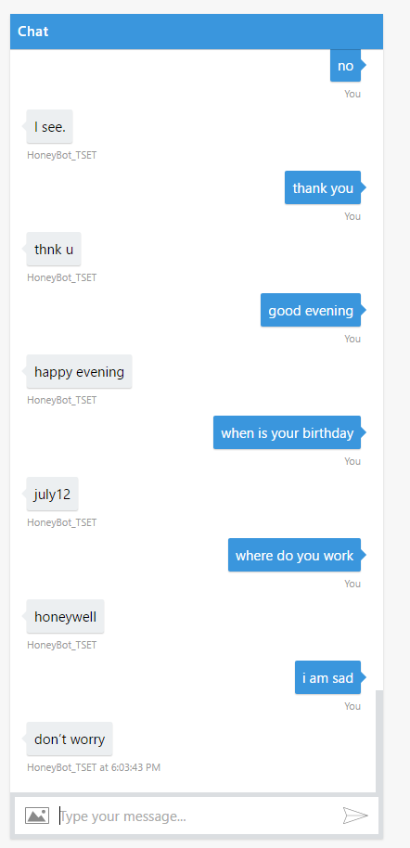
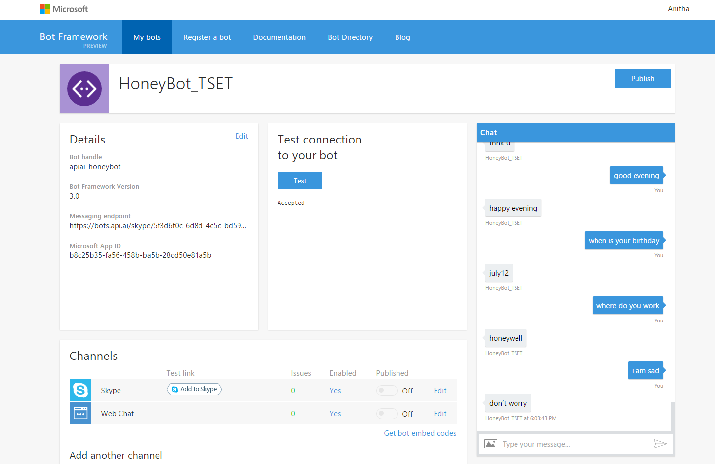
Testing bot in Bot Framework

Slide 10
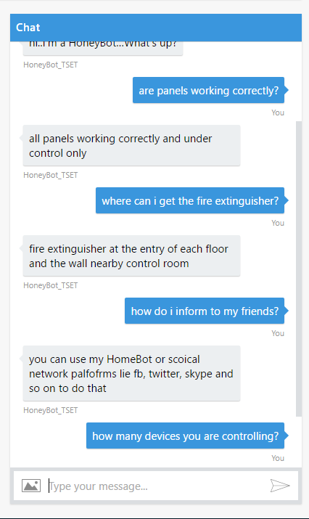
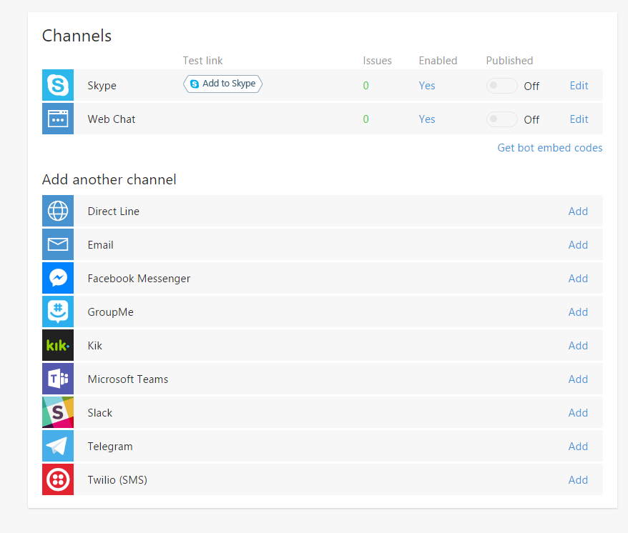
Bot framework channels

Slide 11


Ai/ Services | chatfuel | Botsify | smooch | Fb messenger platform | Beep boop | Api.ai | Telegram Bots | BotKit | Init.ai
No Coding
FB |  | paid
Telegram |  | paid
Hyperlink
Text
Social Network Integrations
Paid Version

