Slide 1

React Fundamentals

Slide 2
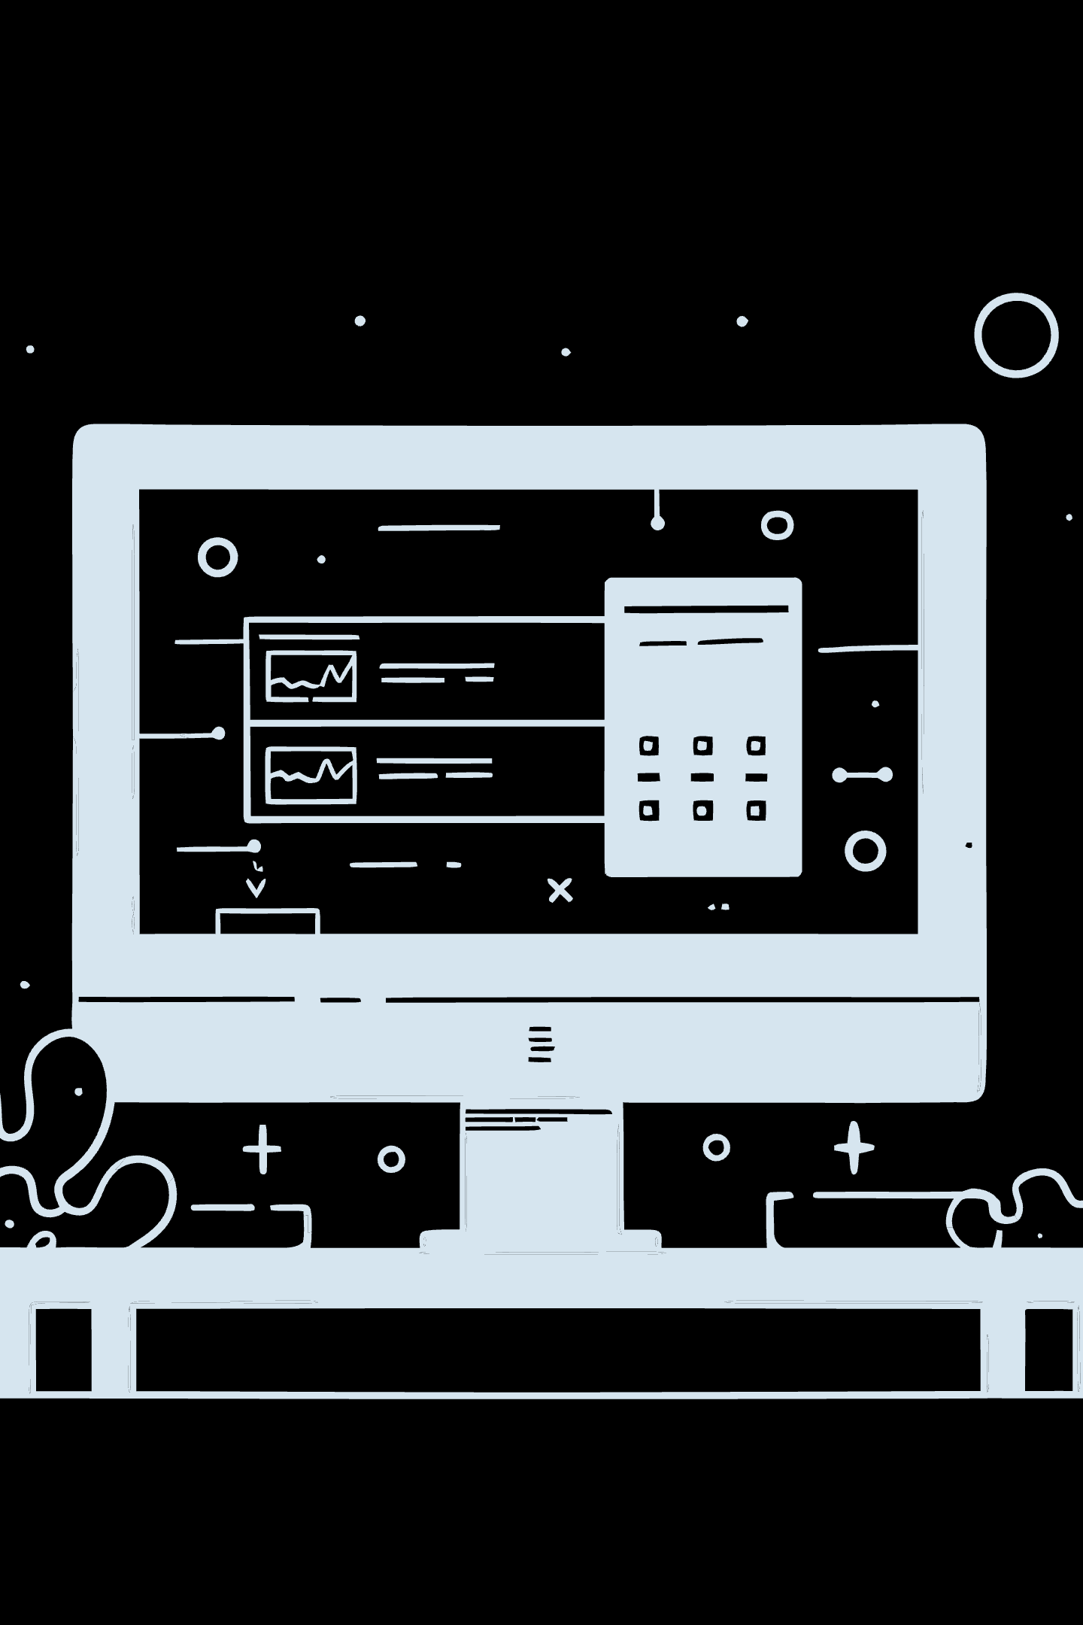
What is React?
React is a JavaScript Library used to build User Interfaces — everything a user can see and interact with on a website or application.
UI Elements
Origins
Buttons & Forms
Navigation Bars
Cards & Dashboards
Full Web Pages
Developed by Facebook, React is now one of the most widely used libraries in modern web development.
Used By
Facebook & Instagram
Netflix
Airbnb
And many more

Slide 3

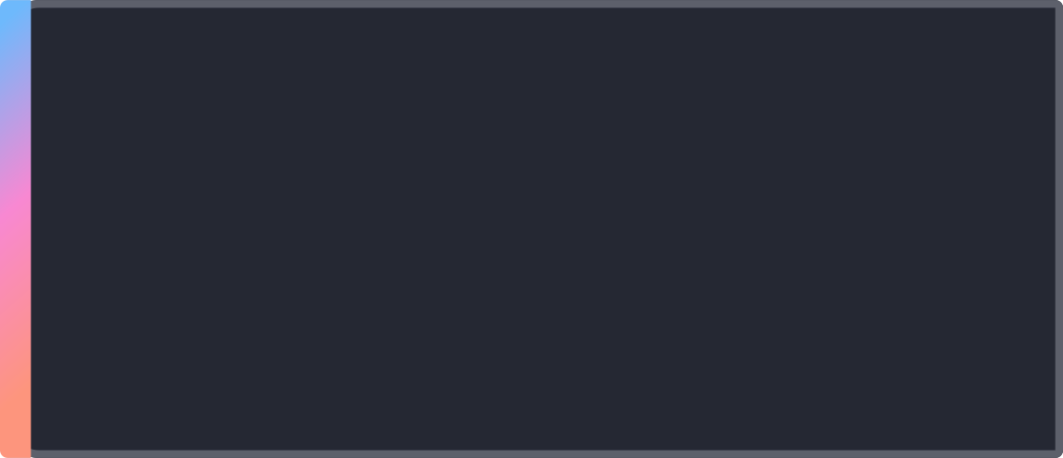
Why React?
Component-Based Architecture
Without React, large applications become difficult to manage and maintain. React solves this by dividing the UI into small, reusable pieces called Components.
Reusable Components
Easy Maintenance
Faster Development
Write once, use everywhere across your app
Isolate and fix issues without breaking the whole app
Better code organization and improved user experience

Slide 4




Project Setup — Tools You Need
Before creating a React project, make sure you have the following tools installed on your machine:
Node.js
JavaScript Runtime Environment — runs JavaScript outside the browser, enabling server-side execution and tooling.
npm
Node Package Manager — like a Play Store for Developers. Install, manage, and share JavaScript packages.
Vite
Frontend Build Tool — creates React projects, runs a dev server, and provides Hot Reloading for instant feedback.
Verify your installations by running:
node -v
npm -v

Slide 5
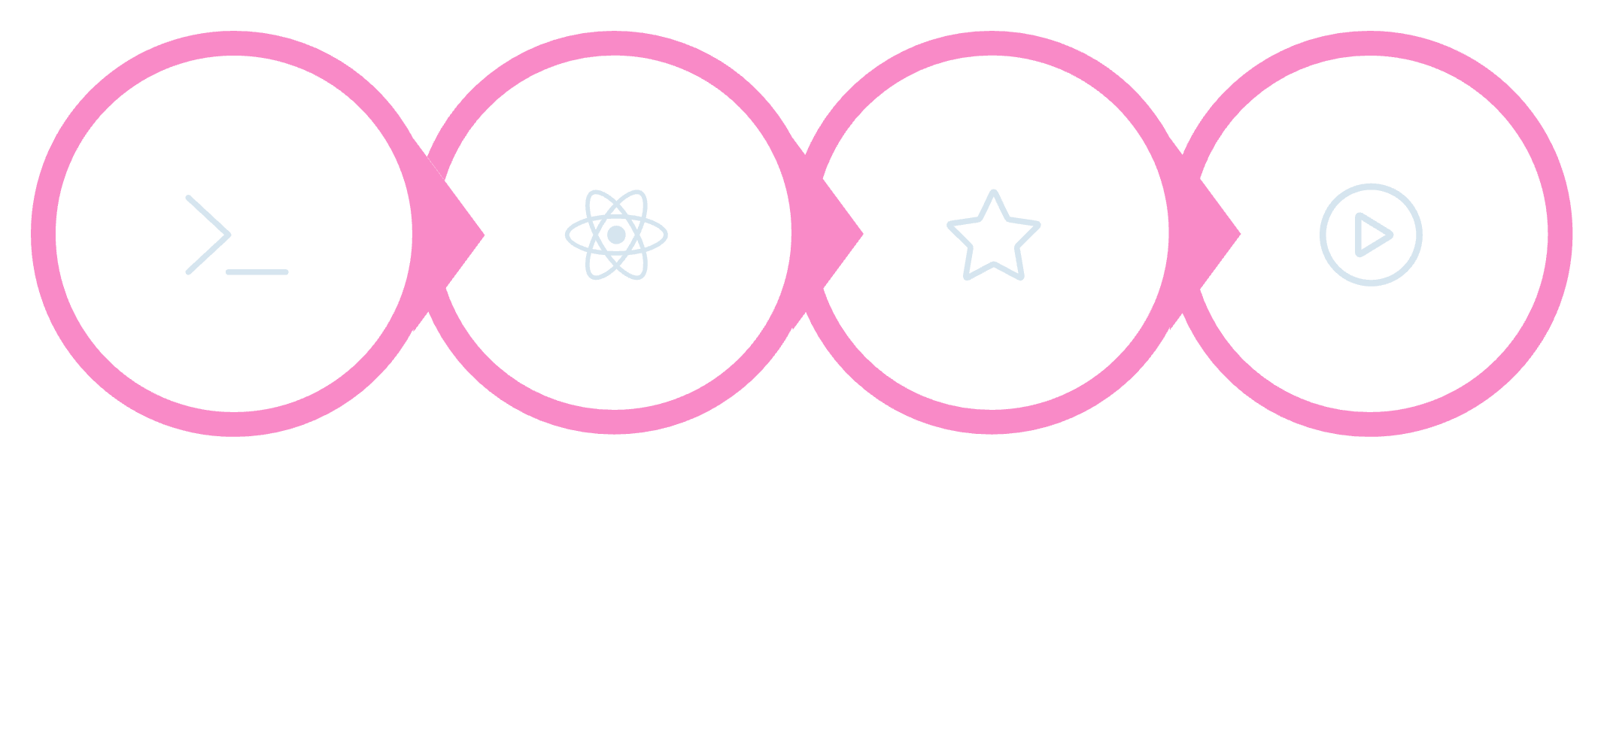

Creating a React Project with Vite
Run These Commands
npm create vite@latest my-app
cd my-app
npm install
npm run dev
Open your browser at: http://localhost:5173
Init Vite
Select React
Install
Start Dev
When prompted, select Framework: React and Variant: JavaScript to scaffold your new project.

Slide 6






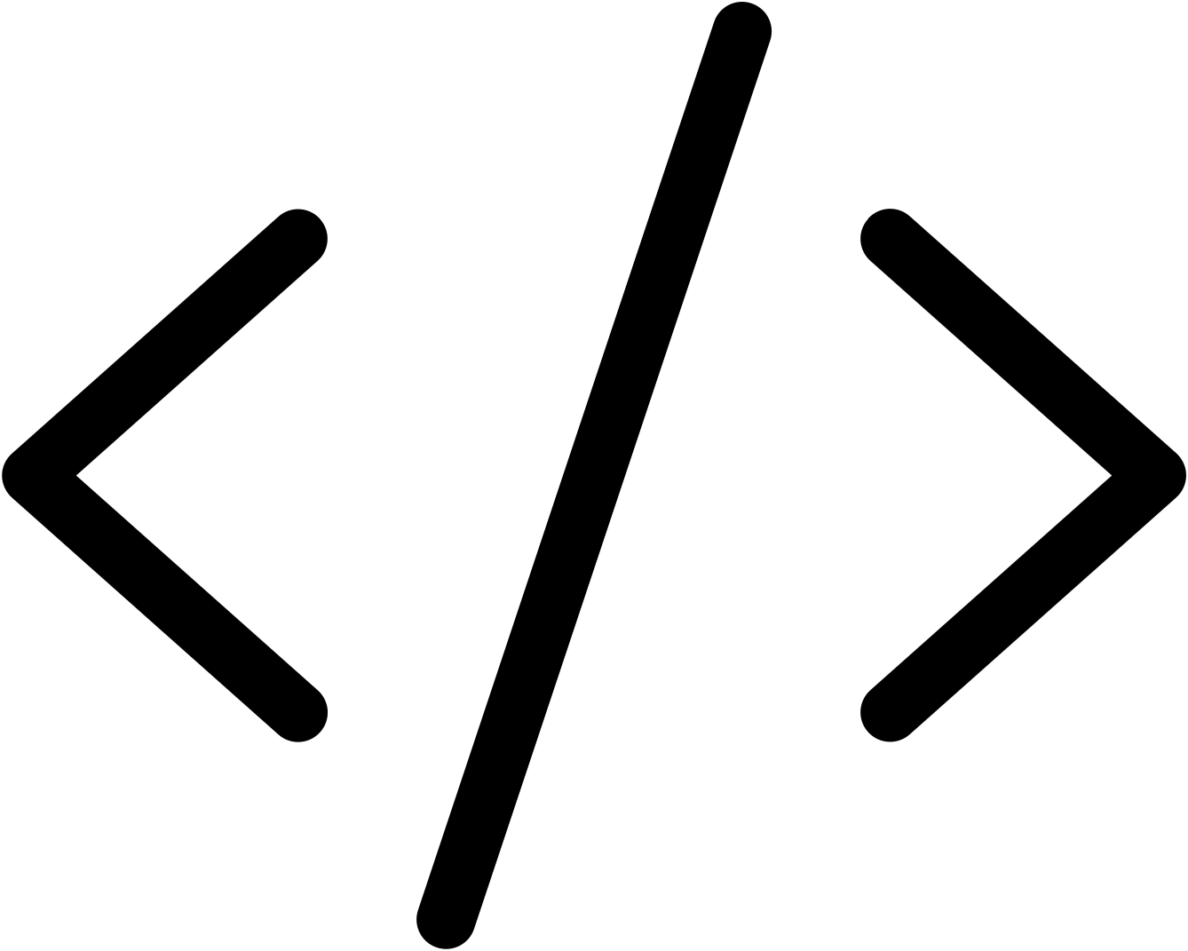

Understanding Project Structure
my-app
├── node_modules → Installed packages
├── public → Static files (images, logos)
├── src → Application source code
│ └── App.jsx → Main React Component
└── package.json → Project info, dependencies, scripts
node_modules
public
All installed third-party packages live here. Never edit manually.
Static assets like images and logos served directly.
src / App.jsx
package.json
Your main application source code and root React component.
Project metadata, dependencies list, and npm scripts.

Slide 7



Part 1 — JSX
JSX stands for JavaScript XML — it allows us to write HTML-like syntax directly inside JavaScript files.
function App() {
return (
<div>
<h1>Hello Students</h1>
<p>Welcome to React</p>
</div>
);
}
Rule 1: JSX must have one parent element wrapping all other elements.
Rule 2: Use className instead of class — the word class is reserved in JavaScript.

Slide 8
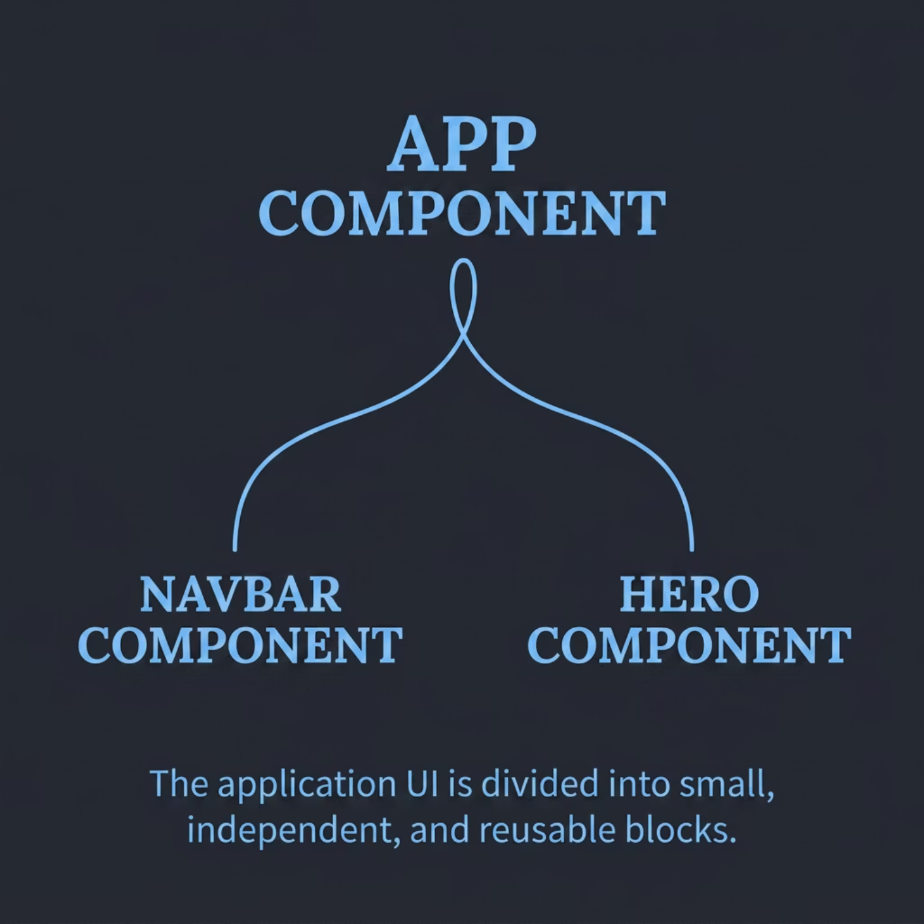
Part 2 — Components
A Component is a reusable piece of UI — think Navbar, Footer, Login Form, or Product Card. Components are the building blocks of every React application.
Navbar.jsx
function Navbar() {
return <h1>DriveReady</h1>;
}
App.jsx
import Navbar from "./Navbar";
import Hero from "./Hero";
function App() {
return (
<div>
<Navbar />
<Hero />
</div>
);
}
This demonstrates Component-Based Architecture — divide your UI into small, reusable, independently managed blocks.

Slide 9


Part 3 — Props
Props (Properties) allow you to pass data from a Parent Component to a Child Component, making components dynamic and reusable.
Student.jsx
function Student(props) {
return <h1>{props.name}</h1>;
}
Rendered output
Parent: App.jsx
Displays <h1>Anitha</h1>
Defines name prop value
App.jsx
Prop Flow: Parent to Child
<Student name="Anitha" />
<Student name="Ravi" />
<Student name="Priya" />
Child: Student.jsx
Passing prop
Receives props.name and renders
App uses <Student name="Anitha" />
Output: Anitha / Ravi / Priya — the same component renders different data each time!
Props make components dynamic — one component definition, infinite possibilities.

Slide 10
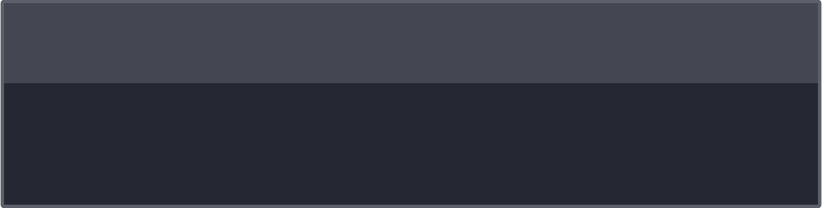
Part 4 — Conditional Rendering
Display different UI based on a condition using the ternary operator.
const isLoggedIn = true;
return (
<div>
{isLoggedIn
? <h1>Welcome User</h1>
: <h1>Please Login</h1>}
</div>
);
Real-World Use Cases
1
Login Systems
Show dashboard or login page based on auth state
2
E-Commerce Apps
Show cart contents or empty state message
3
Student Portals
Display grades or enrollment prompts conditionally
Today We Covered
1
React Intro
JavaScript library for building UIs
2
Node & npm
Setup tools and package manager
3
Vite
Project creation and dev server
4
JSX
HTML-like syntax in JavaScript
5
Components
Reusable UI building blocks
6
Props
Passing data between components
7
Conditional Rendering
Dynamic UI based on conditions

