Slide 1
Automated Flood Detection and Alert System for Villagers
Presented By: B. Anitha
Trade: AI Programming Assistant
Institute: NSTI(W), Vidyanagar

Slide 2
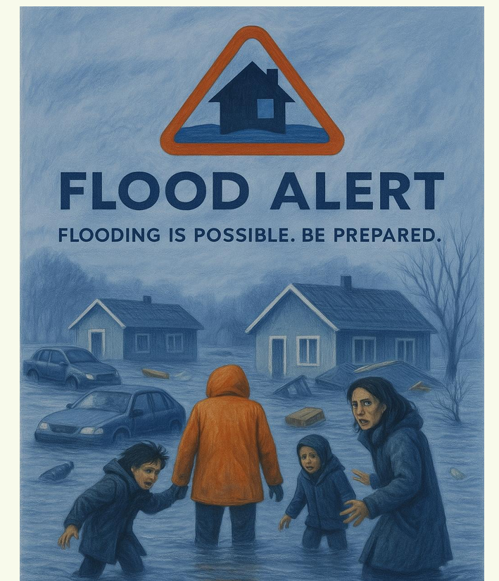

Slide 3
Problem Statement
India frequently faces seasonal floods that lead to severe loss of life, infrastructure, and economic activity—especially in low-lying and underdeveloped regions. Current alert systems are:
• Delayed due to manual coordination
• Non-personalized and broad in scope
• Unavailable to people without internet access
• Ineffective due to language barriers
These limitations leave millions, especially in rural and vulnerable areas, unprepared to act in time.

Slide 4
Solution Overview
Our project bridges this gap using AI and real-time data to create a localized, efficient flood alert system. The solution offers:
• Live Flood Risk Prediction using real-time weather inputs
• MultiOutput Decision Tree Classifier to determine flood type and severity
• SMS Alerts via Twilio
• Multilingual Support with Google Translate
• Flask Web App for city-specific weather and alerts

Slide 5
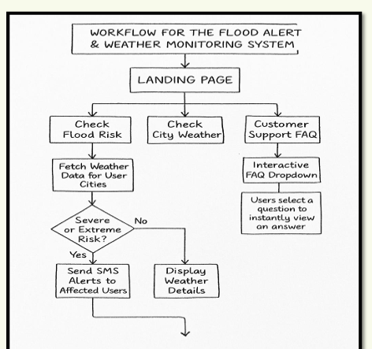

Slide 6
Project Demo (Flask Web Interface)
Features:
• Web interface to check flood risk or city-specific weather
• Real-time weather data from OpenWeatherMap
• Flood predictions with timestamp
• SMS alerts in local languages
• Built-in FAQ support system
Example:
City: Delhi | Rainfall: 0 mm | Humidity: 58% | Wind: 2.6 km/h
→ Flood Type: None, Flood Risk: Moderate

Slide 7
System Architecture & Workflow
1. Data Preparation: flood_data.csv & user_data.csv
2. Model Training: MultiOutput Decision Tree Classifier
3. Weather Data Fetching: OpenWeatherMap API
4. Prediction & Alerts: Model + Twilio SMS
5. Flask Interface: Display & Route Handling

Slide 8
Future Scope
• Voice-based support
• Mobile-first Android/iOS app
• Satellite/radar integration
• Real-time user feedback
• Government integration

Slide 9
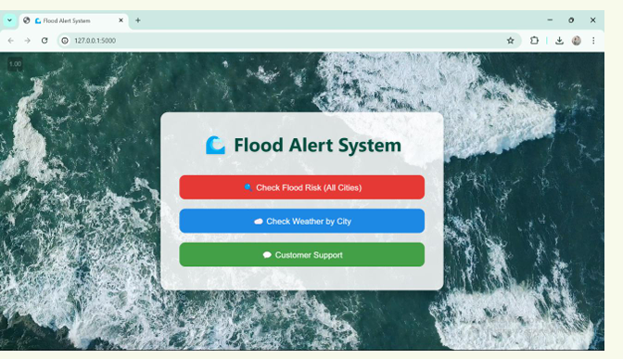

Slide 10
Conclusion
The system:
• Offers intelligent, fast flood prediction
• Delivers alerts in local languages
• Is scalable, low-cost, and highly impactful
A real-world AI solution to protect vulnerable communities.

