Slide 1

G2M insight for Cab Investment firm Data Analyst Virtual Internship
Submitted by : Anitha Venkatachalam
Date:10/11/2022

Slide 2

Agenda
Executive Summary
Problem Statement
Approach
EDA
EDA Summary
Hypothesis Testing
Building Models
Recommendations

Slide 3
Description:
XYZ is a private equity firm in US. Due to remarkable growth in the Cab Industry in last few years and multiple key players in the market, it is planning for an investment in Cab industry.
Provide actionable insights to help XYZ firm in identifying the right company for making investment.
Cab Companies:
Yellow Cab
Pink Cab
The Analysis include :
Data Understanding,
Data Visualization,
Creating multiple hypothesis,
Building models and finding the best fit model based on Accuracy.

Slide 4
Data Preparation:
There are 4 datasets:
Cab_Data.csv – this file includes details of transaction for 2 cab companies.
Customer_ID.csv – this is a mapping table that contains a unique identifier which links the customer’s demographic details.
Transaction_ID.csv – this is a mapping table that contains transaction to customer mapping and payment mode.
City.csv – this file contains list of US cities, their population and number of cab users.

Slide 5
EXPLORATORY
DATA
ANALYSIS

Slide 6
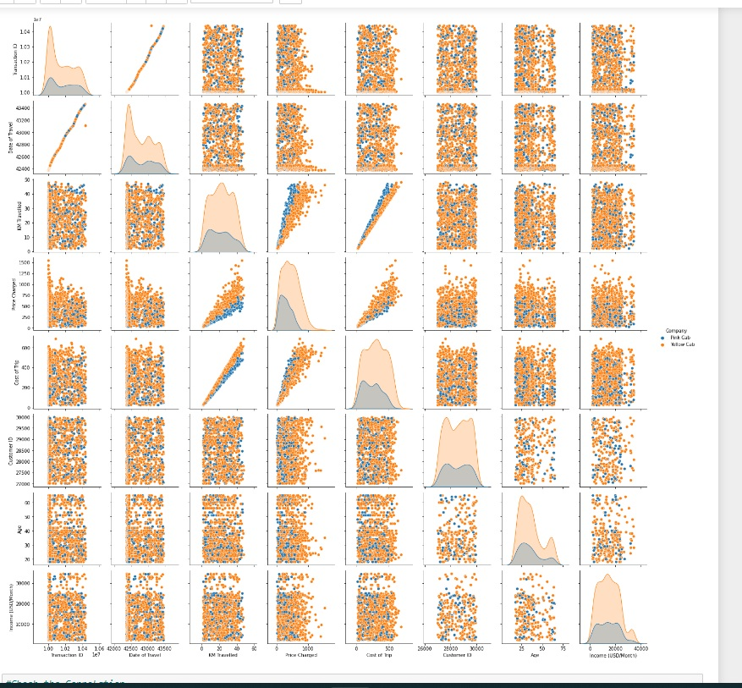
Relationships Between Variables:

Slide 7
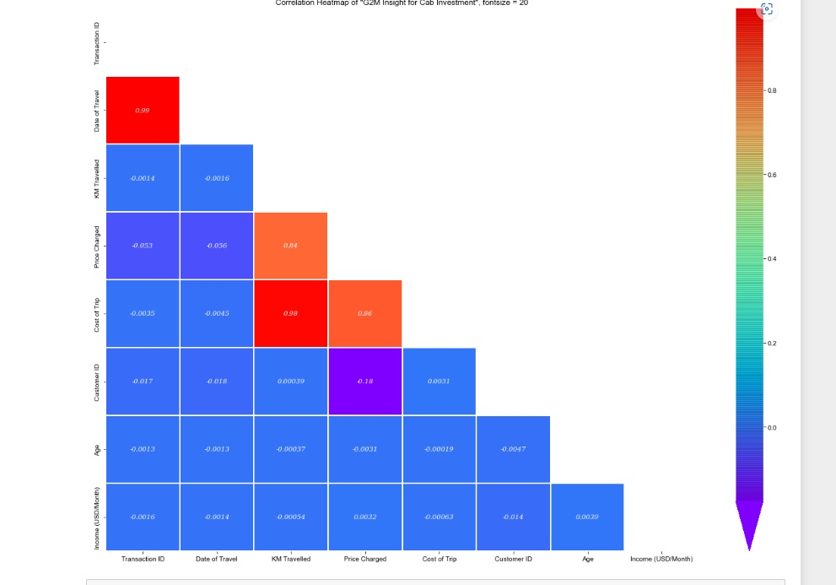
Correlation Between Variables:

Slide 8
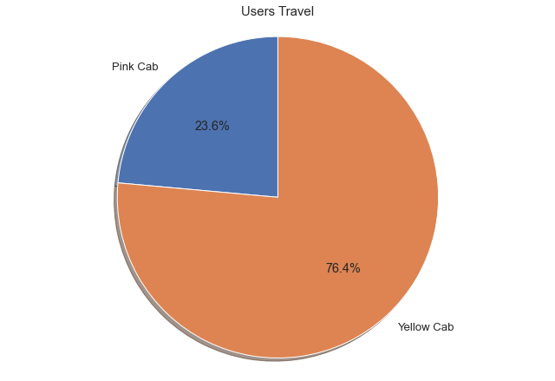
Which cab have more users :
From the above graphs, we can see that for Yellow Cab most of the rides are in the range of 76.4% and pink cab is 23.6%

Slide 9
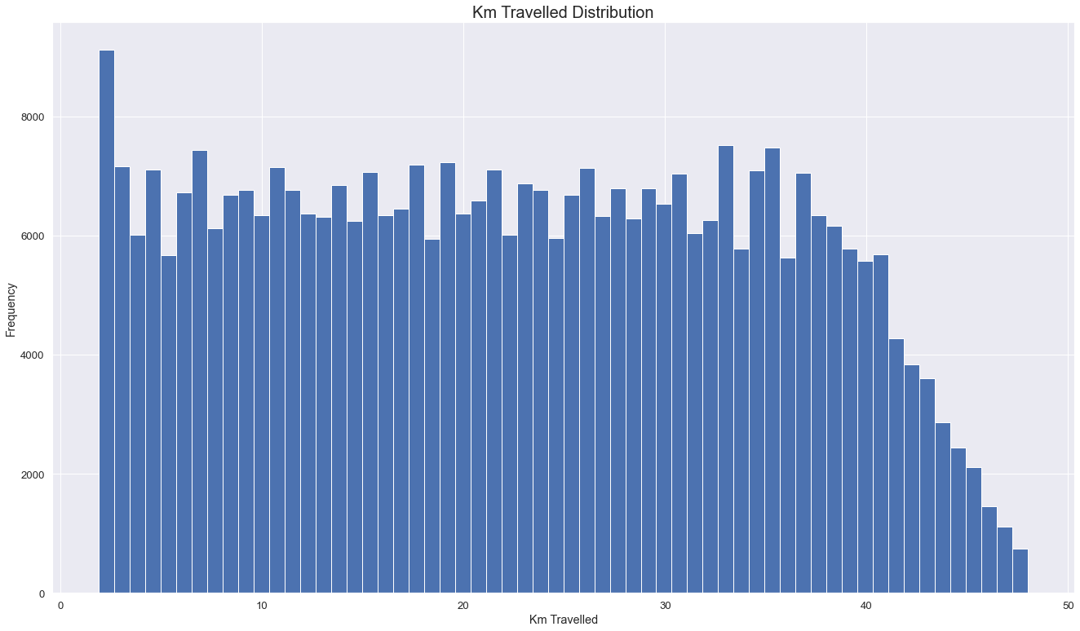
Distribution of KM Travelled for both Cabs:
From the above graphs, we can see that for both Pink and Yellow Cab most of the rides are in the range of approximately 2 to 48 KM.

Slide 10
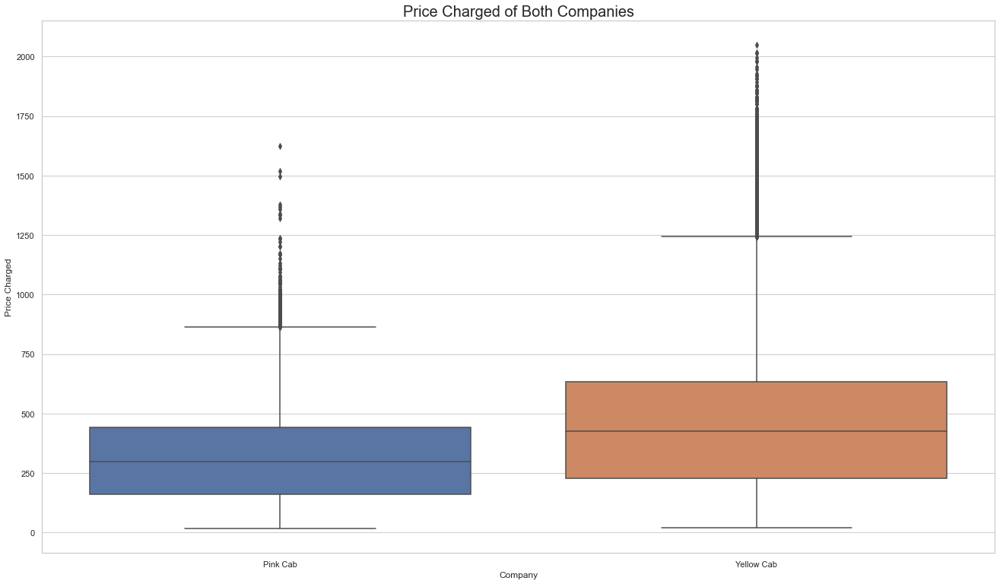
Distribution of Price Charged for both Cabs:
The Price Charge range for Yellow cab is more than the Pink cab.
The outliers are due to use of high-end cars.

Slide 11
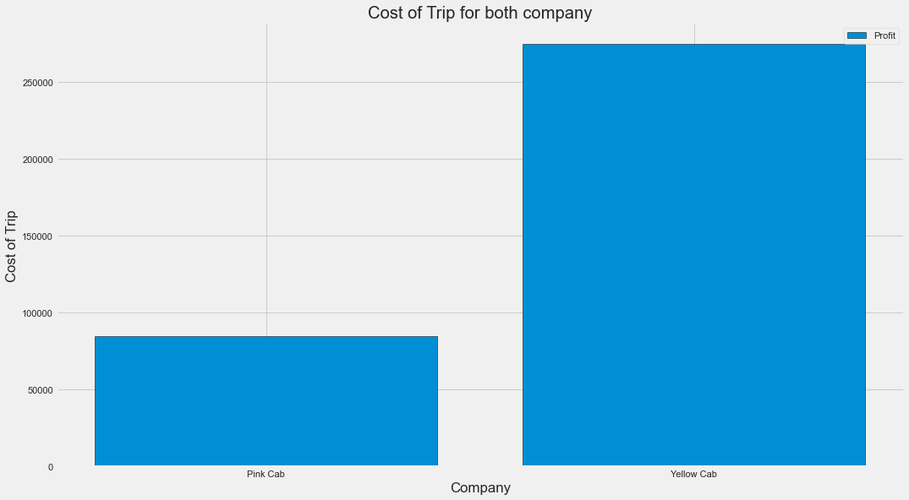
Travel Frequency for cost of trip:
Yellow Cab has higher cost of trip compared to
Pink Cab .

Slide 12
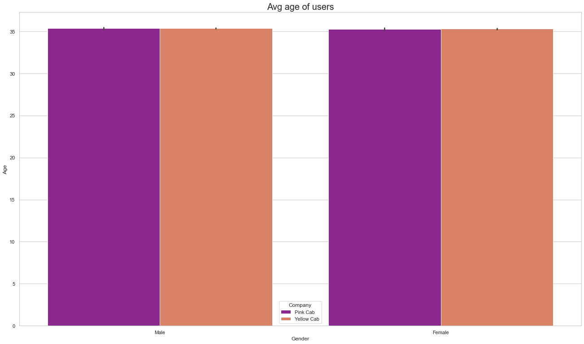
Average Age per users:
From the graph it shows 35 Average age of female and male who use cab service.

Slide 13
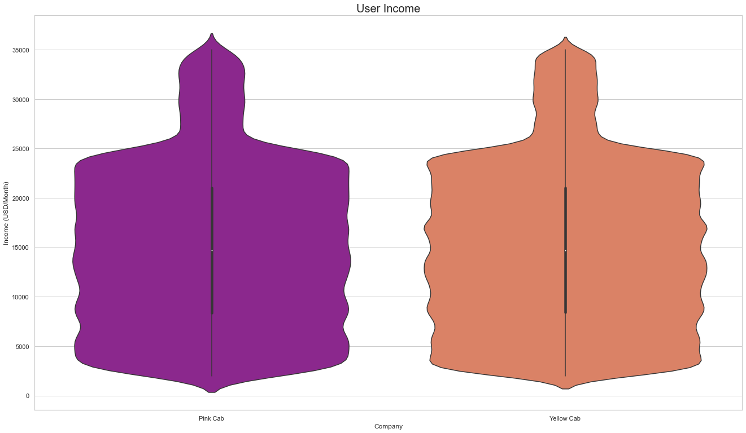
Average Income of Users:
From the graph it shows Average income is around $15000 who use cab service.

Slide 14


EDA Summary:
Rides are in the range of approximately 2 to 48 KM.
Price Charge range from 150 to 450 dollars.
The pink has 23.6% of users.
The maximum cost of Trip around 250 dollars.
Rides are in the range of approximately 2 to 48 KM.
Price Charge range from 250 to 600 dollars.
The pink has 76.4% of users.
The maximum cost of Trip around 300dollars.

Slide 15
Hypothesis Testing

Slide 16
Hypothesis 1: There is no difference gender in pink cab
Pink cab: We accept null hypothesis that there is no difference regarding gender for pink cab
Pink Cab Result:
47231 37480
P value is 0.11515305900425798
We accept null hypothesis that there is no difference regarding gender for Pink Cab

Slide 17
Hypothesis 2: There is difference gender in yellow cab
Yellow Cab : We accept alternative hypothesis that there is a difference regarding gender for yellow cab
Yellow cab Result:
158681 116000
P value is 6.060473042494144e-25
We accept alternative hypothesis that there is a difference regarding gender for Yellow Cab

Slide 18
Hypothesis 3: There is no difference regarding age for pink cab
Pink cab: We accept null hypothesis that there is no difference regarding age for Pink Cab
Pink Cab:
75629 9894
P value is 0.6363803611221691
We accept null hypothesis that there is no difference regarding age for Pink Cab

Slide 19
Hypothesis 4:There is difference regarding age for yellow Cab
Yellow Cab: We accept alternative hypothesis that there is a difference regarding age for Yellow Cab
Yellow cab:
245687 31624
P value is 1.0156079682838574e-07
We accept alternative hypothesis that there is a difference regarding age for Yellow Cab

Slide 20
Hypothesis 5: There is no difference in payment mode for Pink Cab
Pink Cab: We accept null hypothesis that there is no difference in payment mode for Pink Cab
Pink Cab:
P value is 0.7900465828793288
We accept null hypothesis that there is no difference in payment mode for Pink Cab

Slide 21
Hypothesis 6: There is no difference in payment mode for yellow Cab
Yellow Cab: We accept null hypothesis that there is no difference in payment mode for Yellow cab
Yellow Cab Result:
P value is 0.2933060638298729
We accept null hypothesis that there is no difference in payment mode for Yellow Cab

Slide 22
Thank You

