Slide 1
CAPSTORE PROJECT
LOGIN & LOGOUT SESSION
Presented By:
B. Anitha Rani
Employee Id:190110

Slide 2
INTRODUCTION
Capstore is a web based e-commerce website that allows users to buy or sell products.
It allows users to sell their products, they need to register on to the website.
User will login into the system, session will be established and can logout

Slide 3
Requirements:
Spring Tool Suite (STS) - for Spring Boot
Oracle SQL Developer - for Database
Visual Studio Code - for Angular

Slide 4
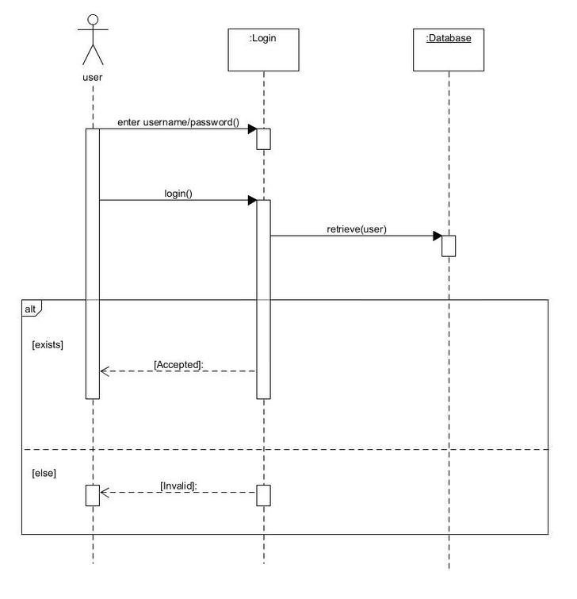
Login Session

Slide 5
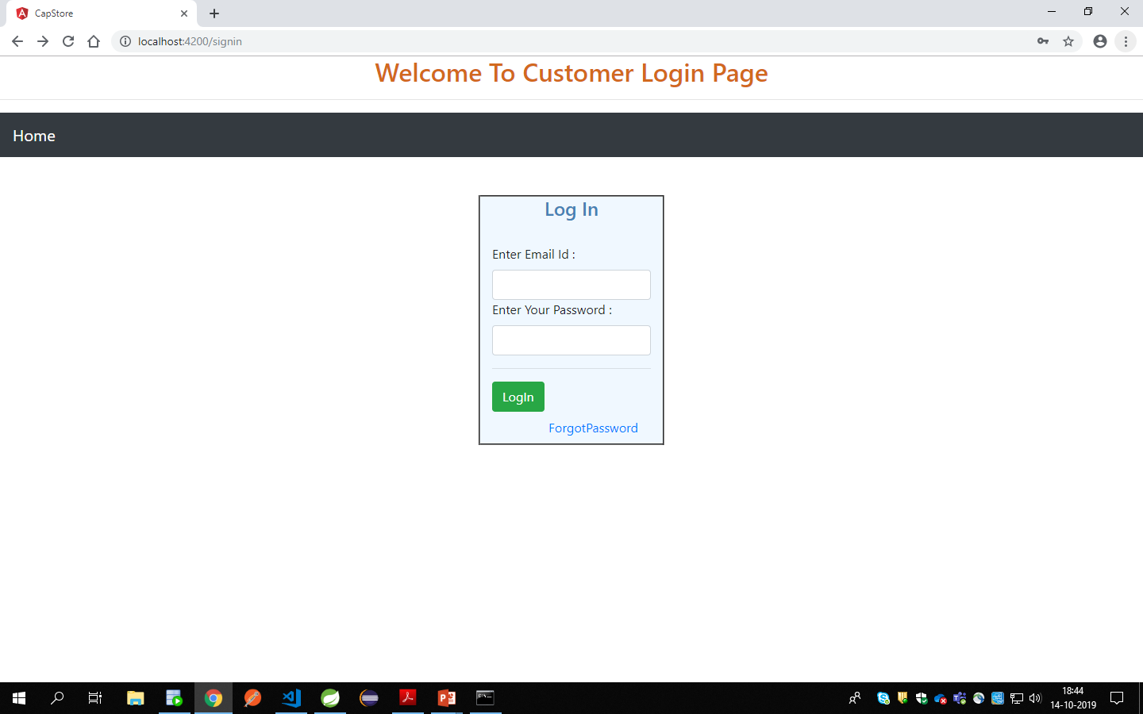

Slide 6
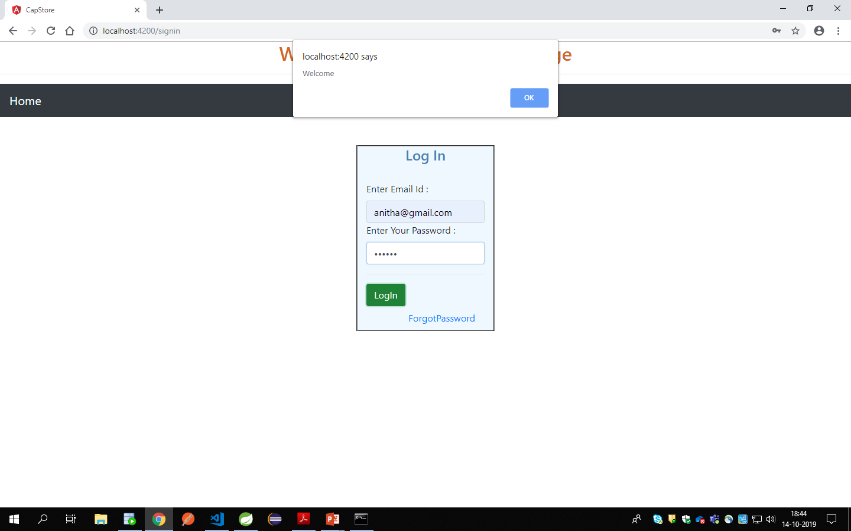

Slide 7
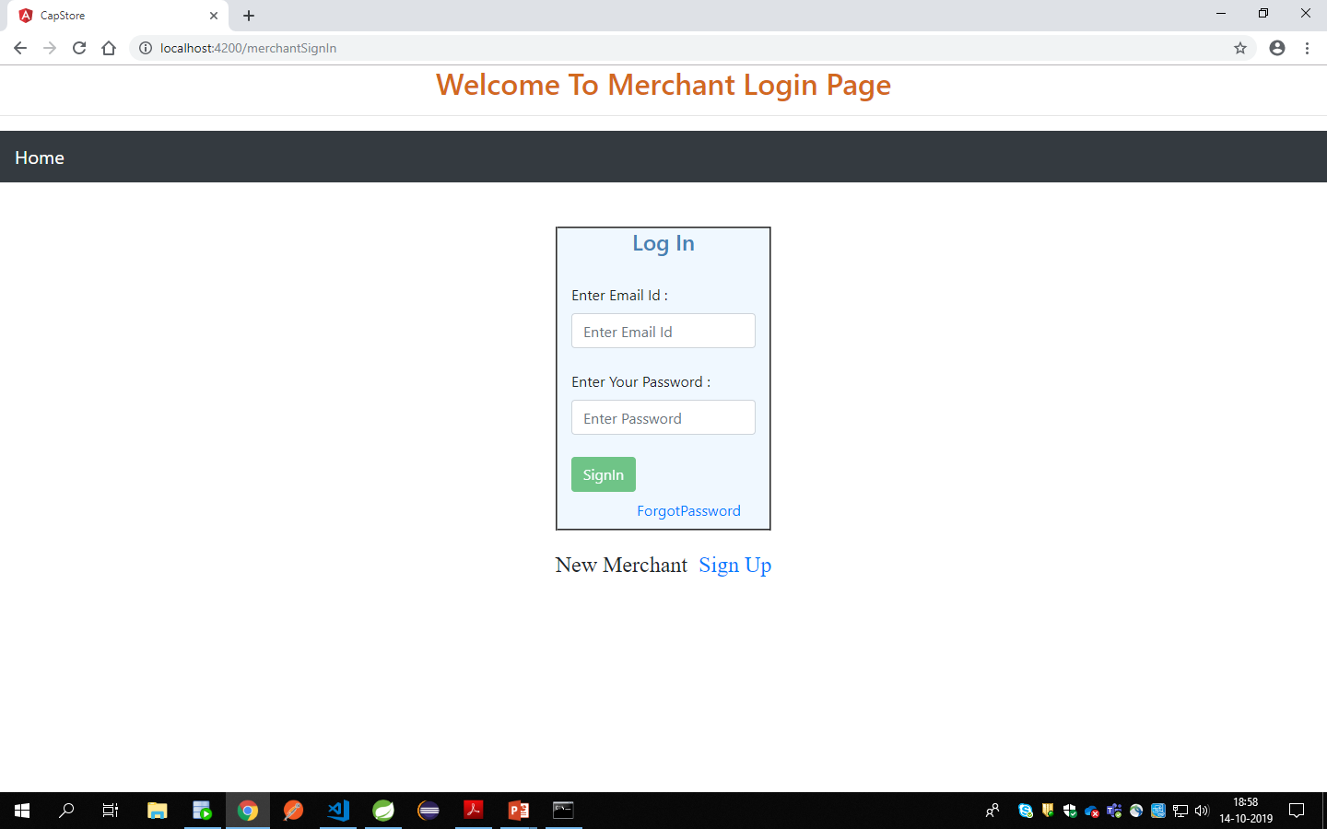

Slide 8
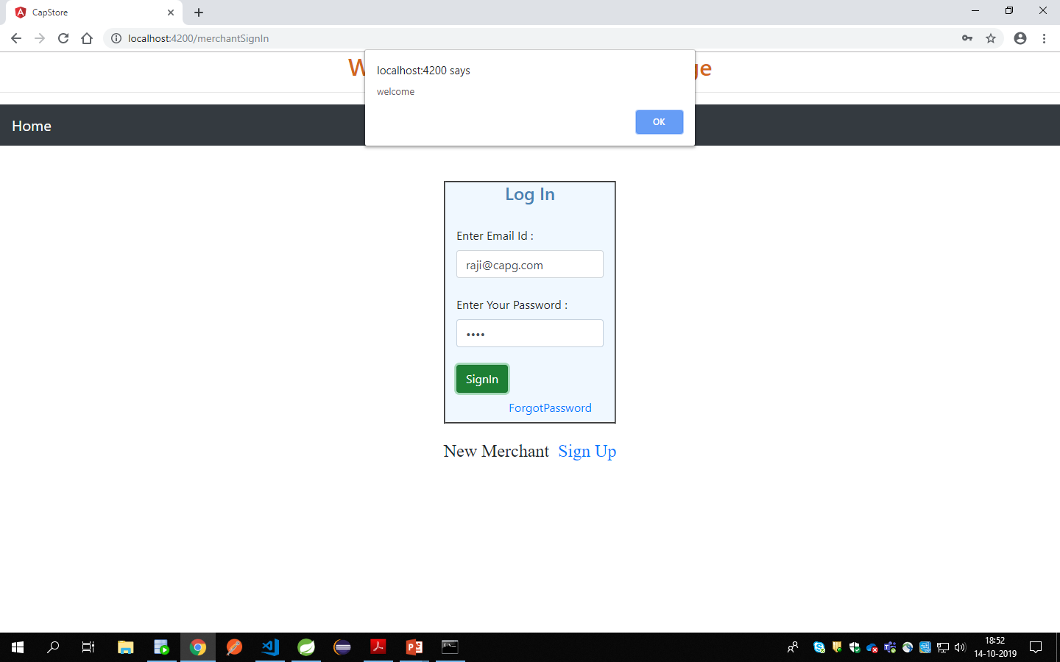

Slide 9


