Slide 1
CSS Simplilearn

Slide 2
Introduction to css
CSS stands for Cascading Style Sheet.
CSS is used to design HTML tags.
CSS is a widely used language on the web.
HTML, CSS and JavaScript are used for web designing. It helps the web designers to apply style on HTML tags.
CSS stands for Cascading Style Sheets. It is a style sheet language which is used to describe the look and formatting of a document written in markup language. It provides an additional feature to HTML. It is generally used with HTML to change the style of web pages and user interfaces. It can also be used with any kind of XML documents including plain XML, SVG and XUL.
CSS is used along with HTML and JavaScript in most websites to create user interfaces for web applications and user interfaces for many mobile applications.

Slide 3
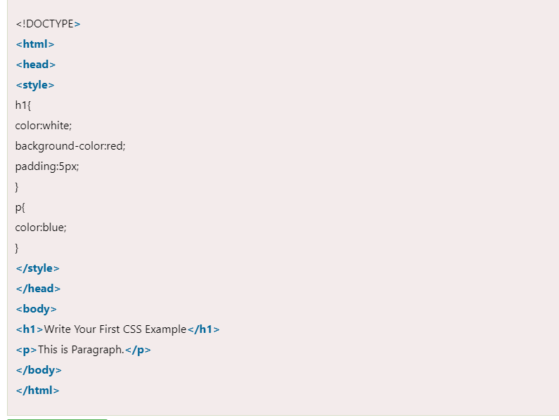
Css example

Slide 4
Why use css
Solves a big problem
Before CSS, tags like font, color, background style, element alignments, border and size had to be repeated on every web page. This was a very long process. For example: If you are developing a large website where fonts and color information are added on every single page, it will be become a long and expensive process. CSS was created to solve this problem. It was a W3C recommendation.
Saves a lot of time
CSS style definitions are saved in external CSS files so it is possible to change the entire website by changing just one file.
3) Provide more attributes
CSS provides more detailed attributes than plain HTML to define the look and feel of the website.

Slide 5
Css selector
CSS selectors are used to select the content you want to style. Selectors are the part of CSS rule set. CSS selectors select HTML elements according to its id, class, type, attribute etc.
There are several different types of selectors in CSS.
CSS Element Selector
CSS Id Selector
CSS Class Selector
CSS Universal Selector
CSS Group Selector

Slide 6
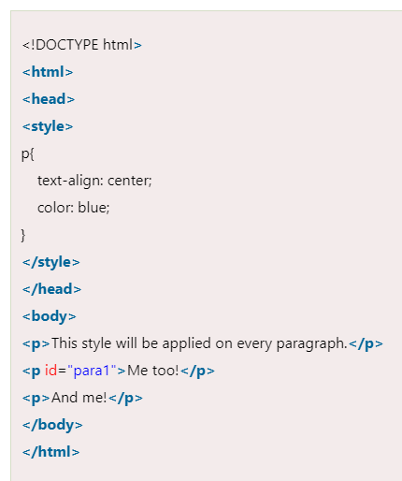
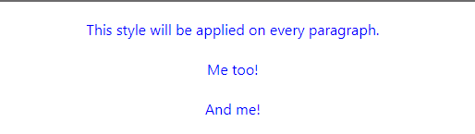
Css element selector

Slide 7
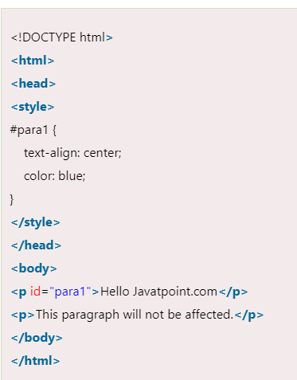
Css id selector
The id selector selects the id attribute of an HTML element to select a specific element. An id is always unique within the page so it is chosen to select a single, unique element.
It is written with the hash character (#), followed by the id of the element.
Lets take an example with the id "para1".
Hello Javatpoint.com

Slide 8
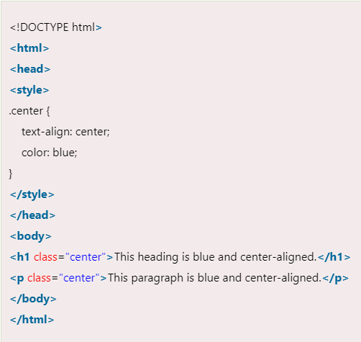

Css class selector
The class selector selects HTML elements with a specific class attribute. It is used with a period character . (full stop symbol) followed by the class name.

Slide 9
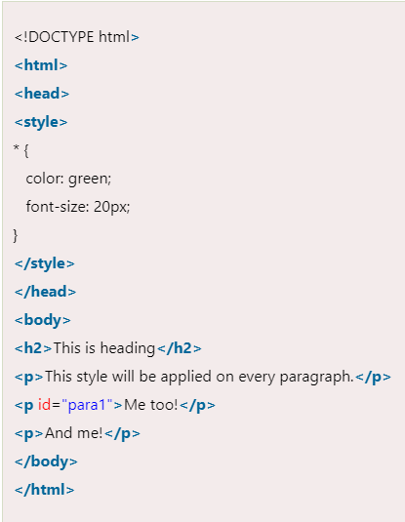
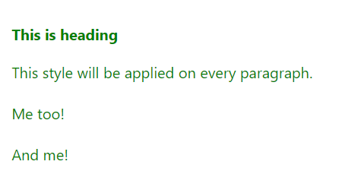
Css universal selector
The universal selector is used as a wildcard character. It selects all the elements on the pages.

Slide 10
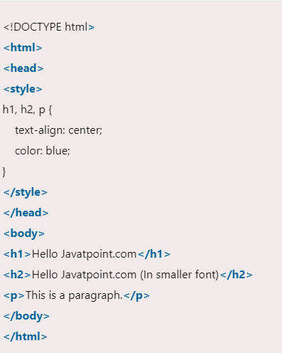
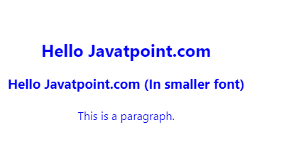
Css group selector
The grouping selector is used to select all the elements with the same style definitions.
Grouping selector is used to minimize the code. Commas are used to separate each selector in grouping.
Let's see the CSS code without group selector.

Slide 11
How to add css
CSS is added to HTML pages to format the document according to information in the style sheet. There are three ways to insert CSS in HTML documents.
Inline CSS
Internal CSS
External CSS
Inline CSS is used to apply CSS on a single line or element.
Internal CSS is used to apply CSS on a single document or page. It can affect all the elements of the page. It is written inside the style tag within head section of html.
External CSS is used to apply CSS on multiple pages or all pages. Here, we write all the CSS code in a css file. Its extension must be .css for example style.css.

Slide 12
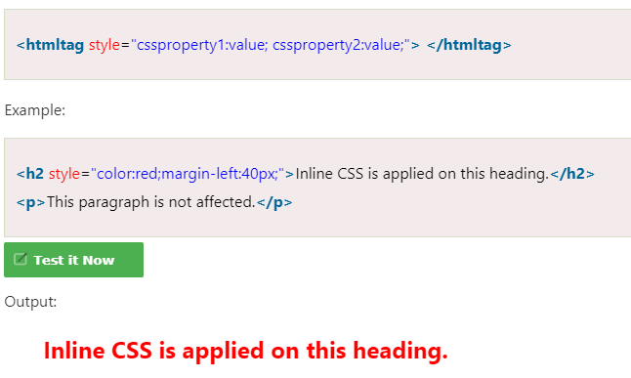
Inline css
We can apply CSS in a single element by inline CSS technique.
The inline CSS is also a method to insert style sheets in HTML document. This method mitigates some advantages of style sheets so it is advised to use this method sparingly.
If you want to use inline CSS, you should use the style attribute to the relevant tag.

Slide 13
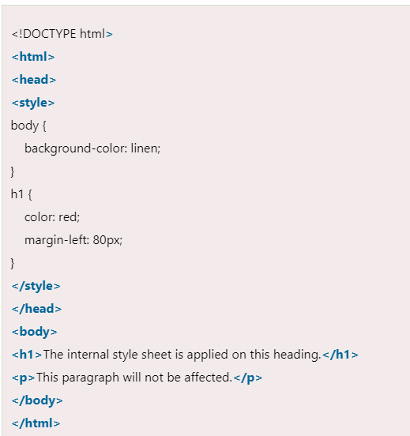
Internal css
The internal style sheet is used to add a unique style for a single document. It is defined in <head> section of the HTML page inside the <style> tag.

Slide 14
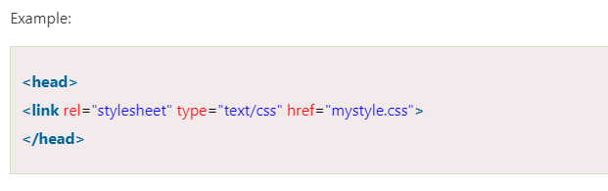
External css
The external style sheet is generally used when you want to make changes on multiple pages. It is ideal for this condition because it facilitates you to change the look of the entire web site by changing just one file.
It uses the <link> tag on every pages and the <link> tag should be put inside the head section.

Slide 15
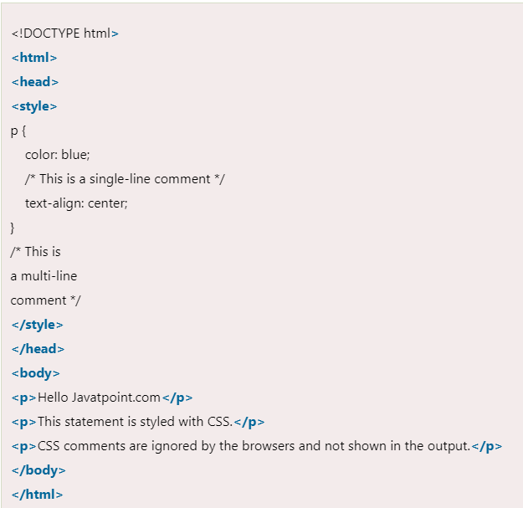
Css comments
CSS comments are generally written to explain your code. It is very helpful for the users who reads your code so that they can easily understand the code.
Comments are ignored by browsers.
Comments are single or multiple lines statement and written within /*............*/ .

Slide 16
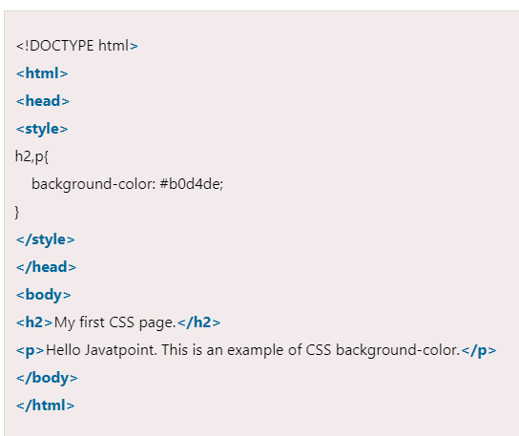
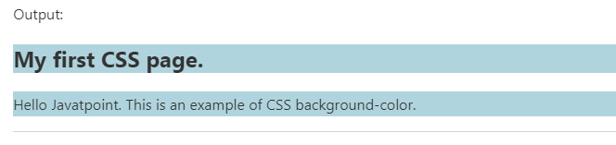
Css background color
The background-color property is used to specify the background color of the element.
You can set the background color like this:

Slide 17
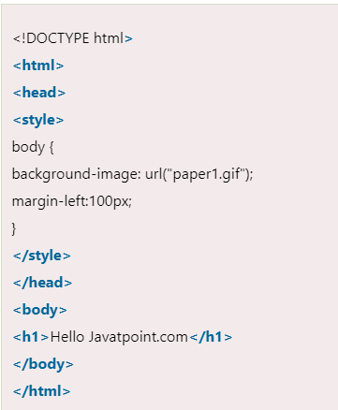
Css background image
The background-image property is used to set an image as a background of an element. By default the image covers the entire element. You can set the background image for a page like this.
Note: The background image should be chosen according to text color. The bad combination of text and background image may be a cause of poor designed and not readable webpage.

Slide 18
css border
The CSS border is a shorthand property used to set the border on an element.
The CSS border properties are use to specify the style, color and size of the border of an element. The CSS border properties are given below
border-style
border-color
border-width
border-radius

Slide 19
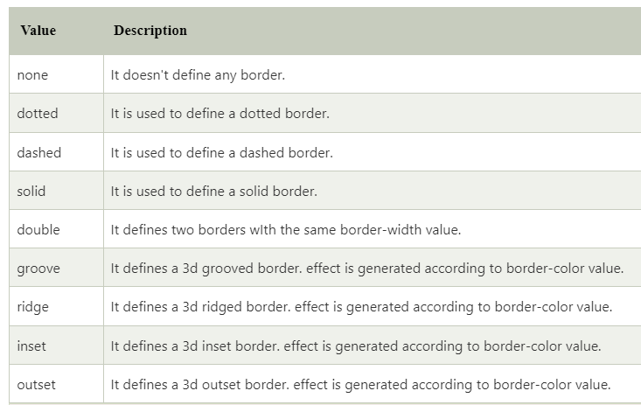
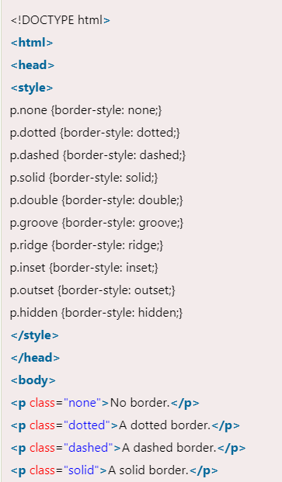
Css border style
The Border style property is used to specify the border type which you want to display on the web page.
There are some border style values which are used with border-style property to define a border.

Slide 20
Css comments
CSS comments are generally written to explain your code. It is very helpful for the users who reads your code so that they can easily understand the code.
Comments are ignored by browsers.
Comments are single or multiple lines statement and written within /*............*/ .

Slide 21
Css font
CSS Font property is used to control the look of texts. By the use of CSS font property you can change the text size, color, style and more. You have already studied how to make text bold or underlined. Here, you will also know how to resize your font using percentage.
These are some important font attributes:
CSS Font color: This property is used to change the color of the text. (standalone attribute)
CSS Font family: This property is used to change the face of the font.
CSS Font size: This property is used to increase or decrease the size of the font.
CSS Font style: This property is used to make the font bold, italic or oblique.
CSS Font variant: This property creates a small-caps effect.
CSS Font weight: This property is used to increase or decrease the boldness and lightness of the font.

Slide 22
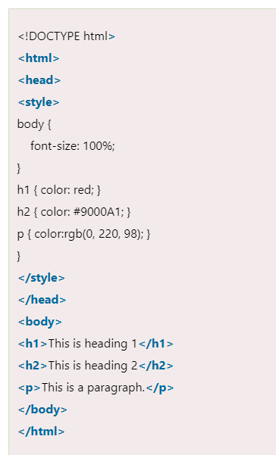
Css font color
CSS font color is a standalone attribute in CSS although it seems that it is a part of CSS fonts. It is used to change the color of the text.
There are three different formats to define a color:
By a color name
By hexadecimal value
By RGB

Slide 23
Css font family
CSS font family can be divided in two types:
Generic family: It includes Serif, Sans-serif, and Monospace.
Font family: It specifies the font family name like Arial, New Times Roman etc.
Serif: Serif fonts include small lines at the end of characters. Example of serif: Times new roman, Georgia etc.
Sans-serif: A sans-serif font doesn't include the small lines at the end of characters. Example of Sans-serif: Arial, Verdana etc.

Slide 24
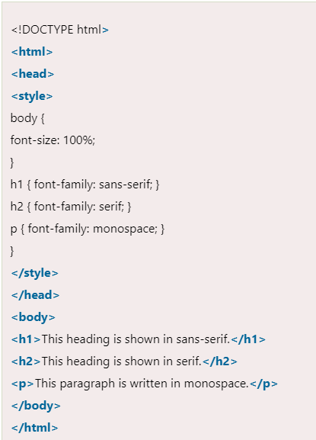
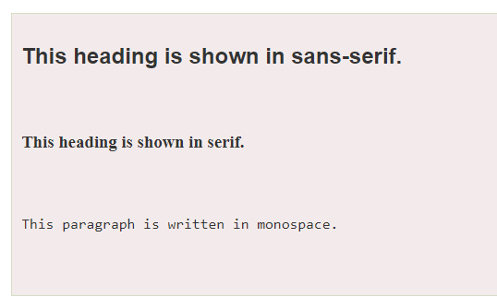
Css font family

Slide 25
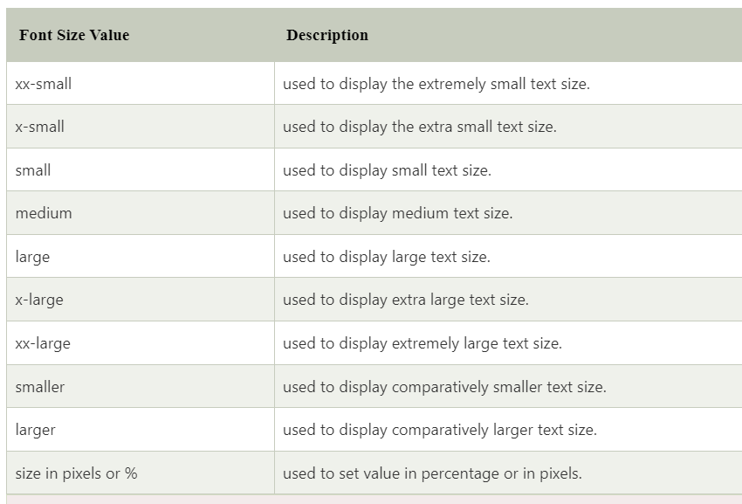
Css font size

Slide 26
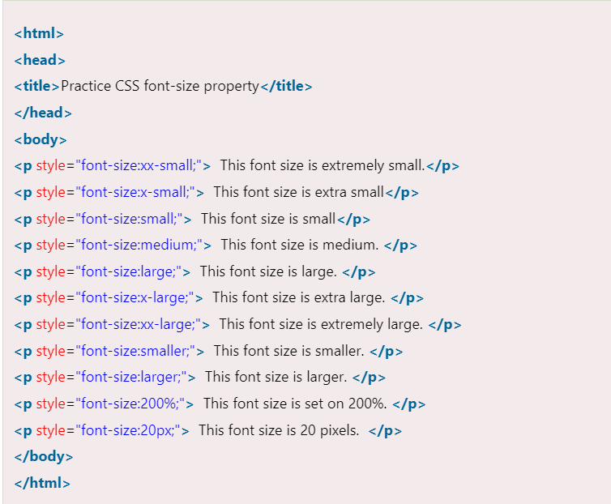
Css font size

Slide 27
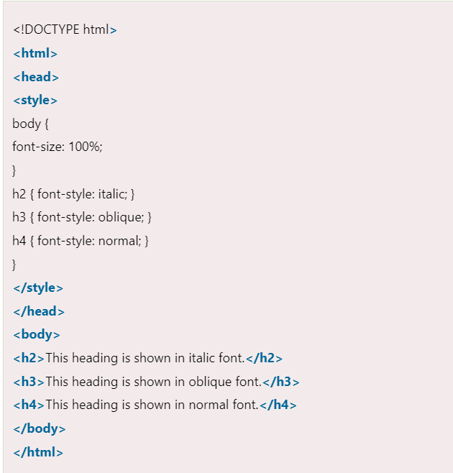
Css font style
CSS Font style property defines what type of font you want to display. It may be italic, oblique, or normal.

Slide 28
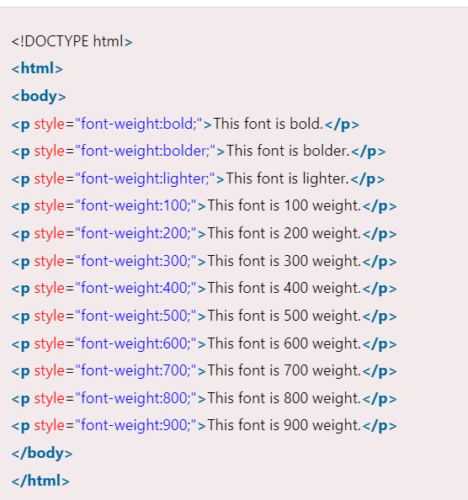
Css font weight
CSS font weight property defines the weight of the font and specify that how bold a font is. The possible values of font weight may be normal, bold, bolder, lighter or number (100, 200..... upto 900).

Slide 29
Css colors
The color property in CSS is used to set the color of HTML elements. Typically, this property is used to set the background color or the font color of an element.
In CSS, we use color values for specifying the color. We can also use this property for the border-color and other decorative effects.
We can define the color of an element by using the following ways:
RGB format.
RGBA format.
Hexadecimal notation.
HSL.
HSLA.
Built-in color.

Slide 30
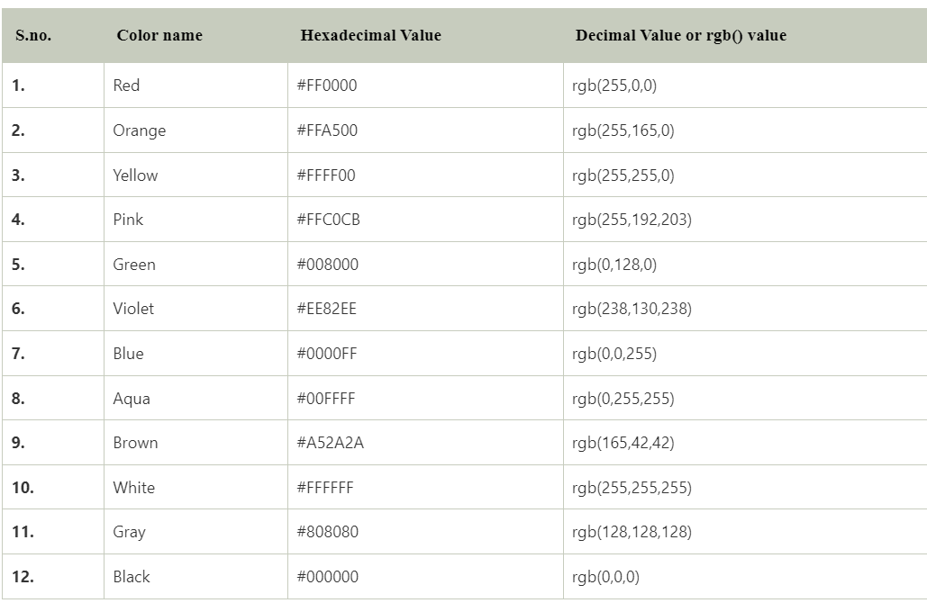
Css colour code

Slide 31
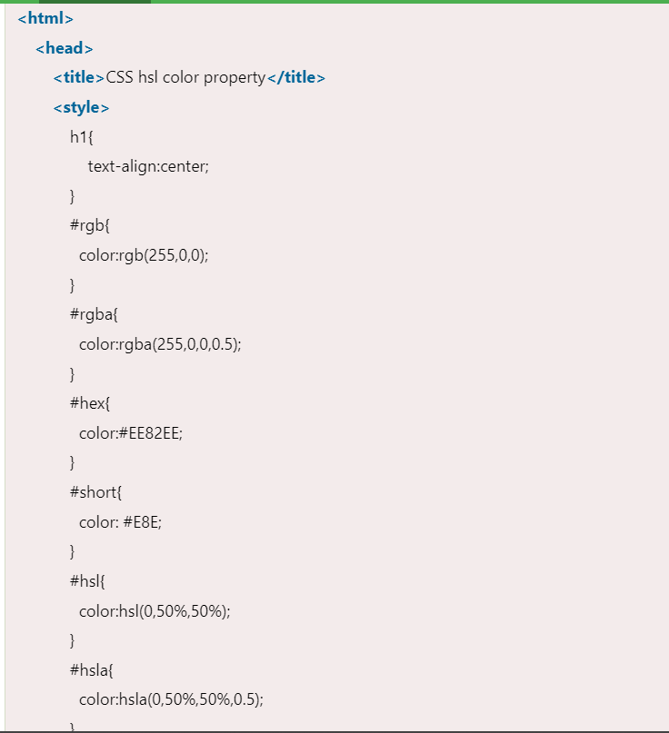
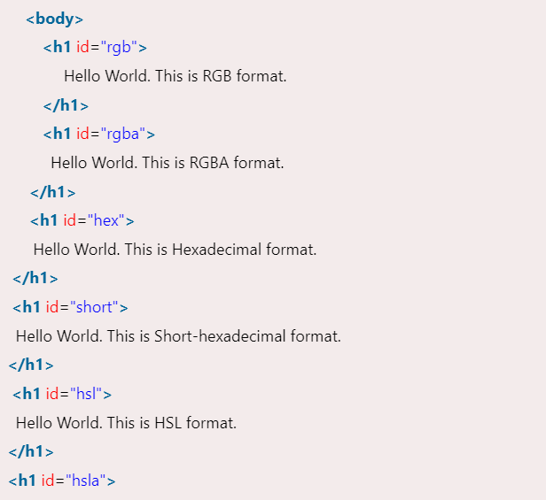
Css color code

Slide 32
Css hover
The :hover selector is for selecting the elements when we move the mouse on them. It is not only limited to the links. We can use it on almost every HTML element. To style the link to unvisited pages, we can use the :link selector. To style the link for visited pages, we can use the :visited selector and to style the active links we can use the :active selector.
It is introduced in CSS1. The hover can be used to highlight the web pages as per the preference of users in an effective web-designing program.
The hover feature includes the following effects:
Change the color of the background and font.
Modify the opacity of the image.
Text embedding.
Create image rollover effects.
Swapping of images.

Slide 33
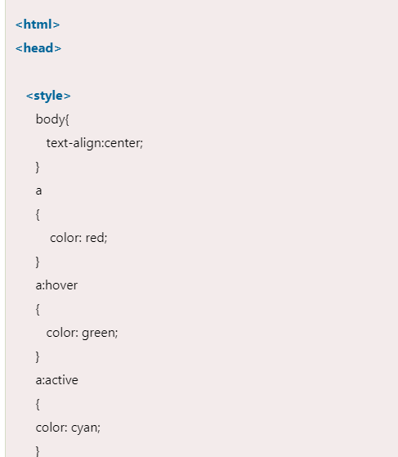
Css hover continued

Slide 34
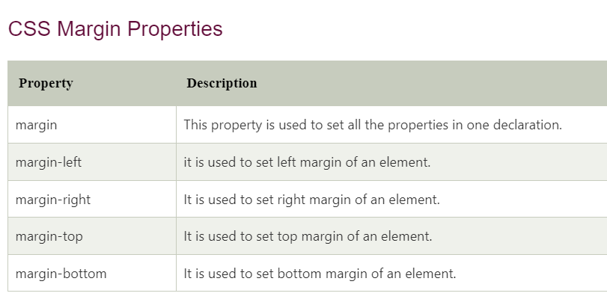
Css margin
CSS Margin property is used to define the space around elements. It is completely transparent and doesn't have any background color. It clears an area around the element.
Top, bottom, left and right margin can be changed independently using separate properties. You can also change all properties at once by using shorthand margin property.

Slide 35
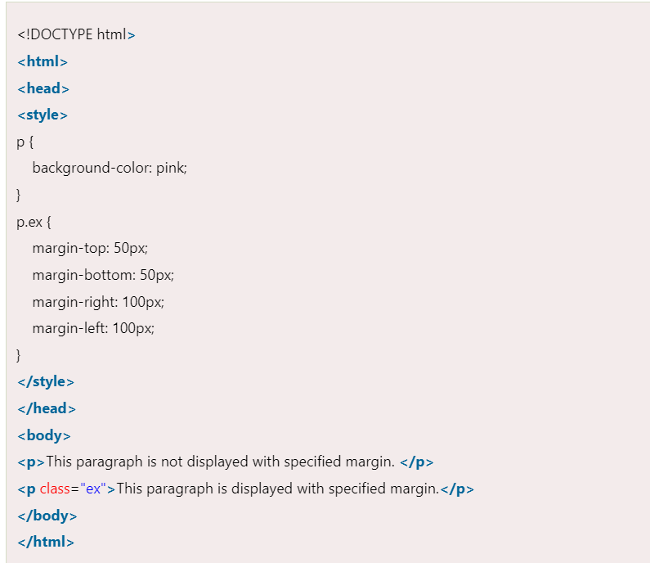
Css margin example

Slide 36
Css margin shorthand property
CSS shorthand property is used to shorten the code. It specifies all the margin properties in one property.
There are four types to specify the margin property. You can use one of them.
margin: 50px 100px 150px 200px;
margin: 50px 100px 150px;
margin: 50px 100px;
margin 50px;

Slide 37
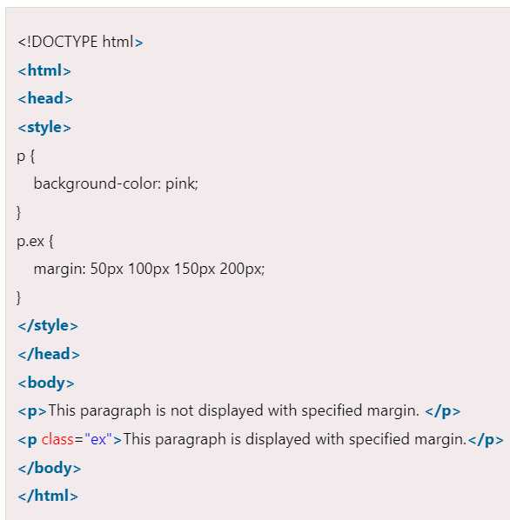
Css margin :50px 100px150px 200px
top margin value is 50px
right margin value is 100px
bottom margin value is 150px
left margin value is 200px

Slide 38
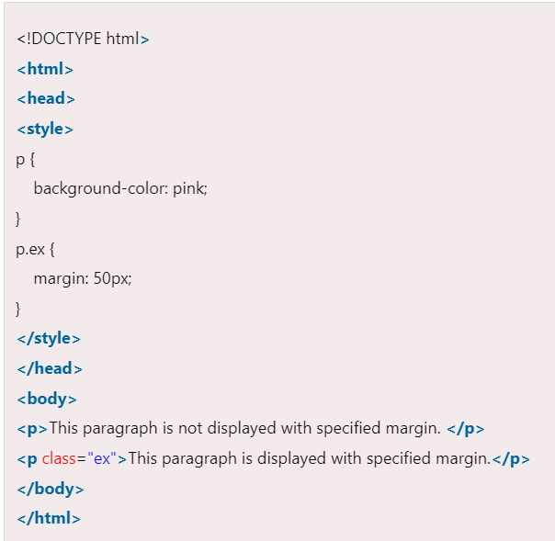
Css margin 50px
It identifies that:
top right bottom and left margin values are 50px

Slide 39
Css opacity
The CSS opacity property is used to specify the transparency of an element. In simple word, you can say that it specifies the clarity of the image.
In technical terms, Opacity is defined as degree in which light is allowed to travel through an object.
How to apply CSS opacity setting
Opacity setting is applied uniformly across the entire object and the opacity value is defined in term of digital value less than 1. The lesser opacity value displays the greater opacity. Opacity is not inherited.
CSS Opacity Example: transparent image
Let's see a simple CSS opacity example of image transparency.

Slide 40
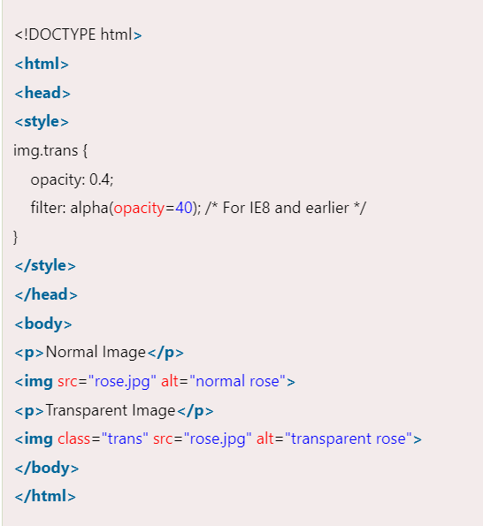
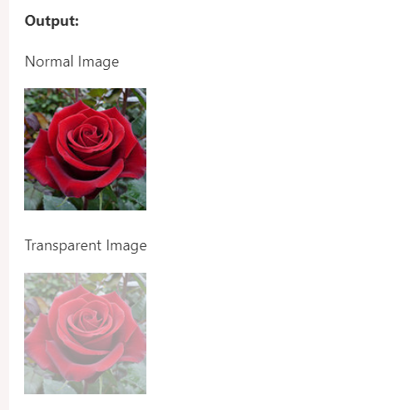
Css opacity

Slide 41
Css filter
CSS filters are used to set visual effects to text, images, and other aspects of a webpage. The CSS filter property allows us to access the effects such as color or blur, shifting on the rendering of an element before the element gets displayed.
The syntax of CSS filter property is given below.
Syntax
filter: none | invert() | drop-shadow() | brightness() | saturate() | blur() | hue-rotate() | contrast() | opacity() | grayscale() | sepia() | url();

Slide 42
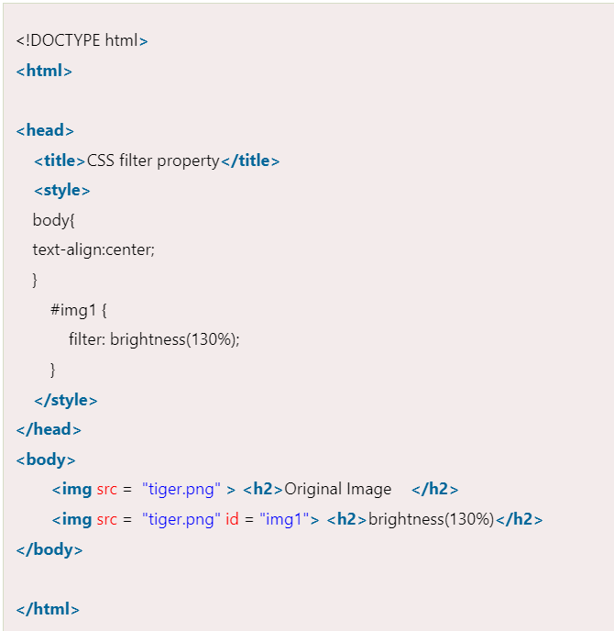
Brightness()
As its name implies, it is used to set the brightness of an element. If the brightness is 0%, then it represents completely black, whereas 100% brightness represents the original one. It can also accept values above 100% that provide brighter results.

Slide 43
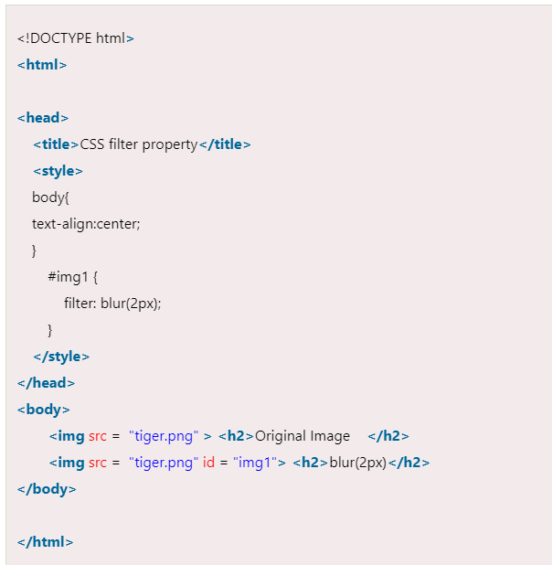
blur
It is used to apply the blur effect to the element. If the blur value is not specified, then the value 0 is used as a default value. The parameter in blur() property does not accept the percentage values. A larger value of it creates more blur.

Slide 44
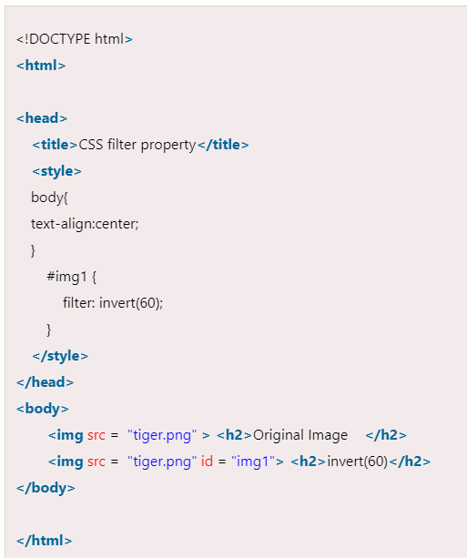
invert
It is used to invert the samples in the input image. Its 100% value represents completely inverted, and 0% values leave the unchanged input. Negative values are not allowed in it.

Slide 45
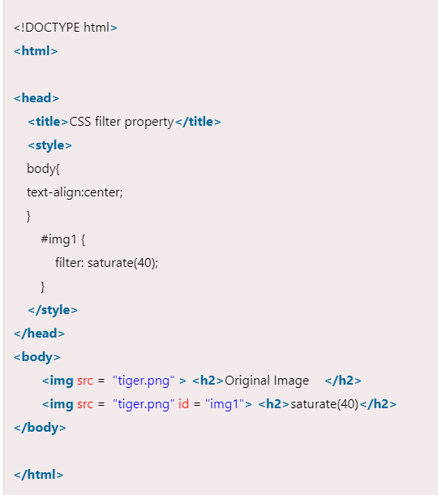
saturate
It sets the saturation of an element. The 0% saturation represents the completely unsaturated element, whereas the 100% saturation represents the original one. The values greater than 100% are allowed that provides super-saturated results. We cannot use negative values with this property.

Slide 46
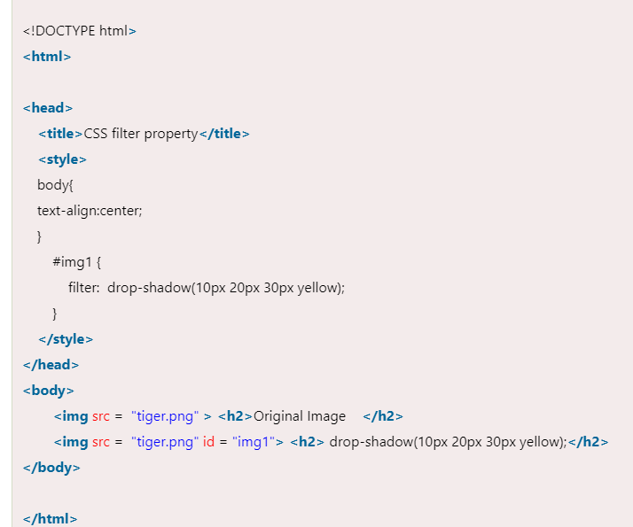
Drop-shadow
It applies the drop-shadow effect to the input image. The values it accepts are h-shadow, v-shadow, blur, spread, and color.

Slide 47

contrast
It adjusts the contrast of the input. Its 0% value will create a completely black image, whereas the 100% values leave the unchanged input, i.e., represents the original one. Values greater than 100% are allowed that provides results with less contrast.

