Slide 1

DR.BABASAHEB AMBEDKAR TECHNOLOGICAL UNIVERSITY, LONERE-RAIGAD
A
PRESENTATION
ON
“UNDERGROUND CABLE FAULT DISTANCE CONVEYED OVER IOT”
PRESENTED BY,
Mr. Anurag M. Harshe (20140214)
Mr. Ashwaghosh B. Kamble (20140219)
Mr. Vishal B. Koktare (20140223)
Mr. Mahesh S. Tribhuvan (20140255)
Mr. Anitya Umare (20140256)

Slide 2
INTRODUCTION
WHAT IS FAULT ??
In an electric power system, a fault or fault current is any abnormal electric current.
In three-phase systems, a fault may involve one or more phases and ground, or may occur only between phases. In a "ground fault" or "earth fault", current flows into the earth.
TYPES OF FAULT??
SYMMETRIC
ASSYMETRIC

Slide 3
CAUSES OF FAULTS
Mechanical failures
Moisture in the insulation
Electrical puncture
Heating of the Cable
Corrosion of sheath
OBJECTIVE OF THIS PROJECT
1.To detect fault location in underground cable system .
2.To restore the faulty condition to normal working condition within shorter time duration.
3.Using Internet Of Things (IOT) this method becomes more advanced.

Slide 4
NEED OF MODERN TECHNIQUE
Today quite sophisticated methods and aids are available.
Careful application of faults and cable systems can ensure satisfactory results in accurately locating cable breakdowns.
The modern method is to establish an approximate fault locality and then to accurately confirm the fault position and cause of fault is analysed.
In this Project, the objective is to determine the distance of underground cable fault from base station in kilometers.
If there is a short circuit (Line to Ground), the voltage across series resistors changes accordingly.
The fault occurring at a particular distance and the respective phase is displayed on a LCD interfaced to the microcontroller.

Slide 5
UNDERGROUND CABLE FAULT DETECTION MODEL
The model is built as a prototype of a cable, which is having a fixed amount of resistance for all 3 of its phases.
These resistors are arranged in series connection to each other and forming the 3 different lines.
9 different DPST switches are used to create short circuit from lined to ground.
3 LED’s are used to give the indication for faulty & emergency condition for particular phase using specific colour.
The part which is being short circuited have a specific length designated which is ultimately shown on the LCD display.

Slide 6
COMPONENTS
AC Supply – 230V AC
Transformer – 230/12 V AC
Rectifier – 12V DC
Regulator – 5V DC
Display – 5V DC
Arduino – 5-10V DC
Fault Switches
Wi-Fi Module

Slide 7
OPERATING PRINCIPLE
Ohm’s Law
The voltage would vary depending upon the length of fault i.e. Resistance.
Voltage Drop of resistor connected to Arduino.
Resistors represent distance in KM
Arduino does the necessary calculations.
Distance is displayed on the LCD display and send to user via Internet.

Slide 8
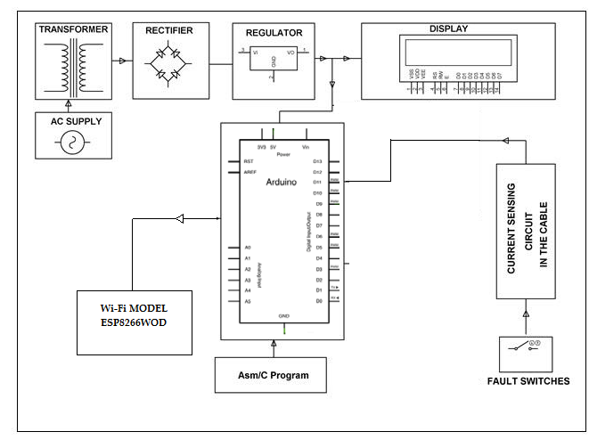
Block Diagram

Slide 9
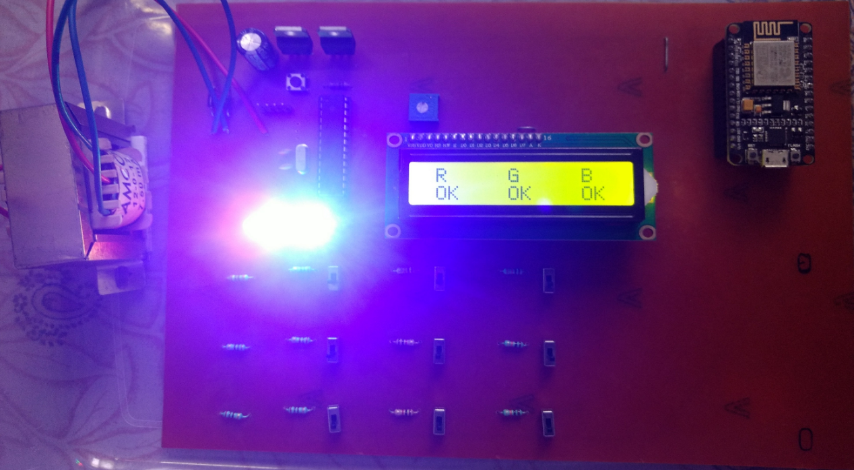
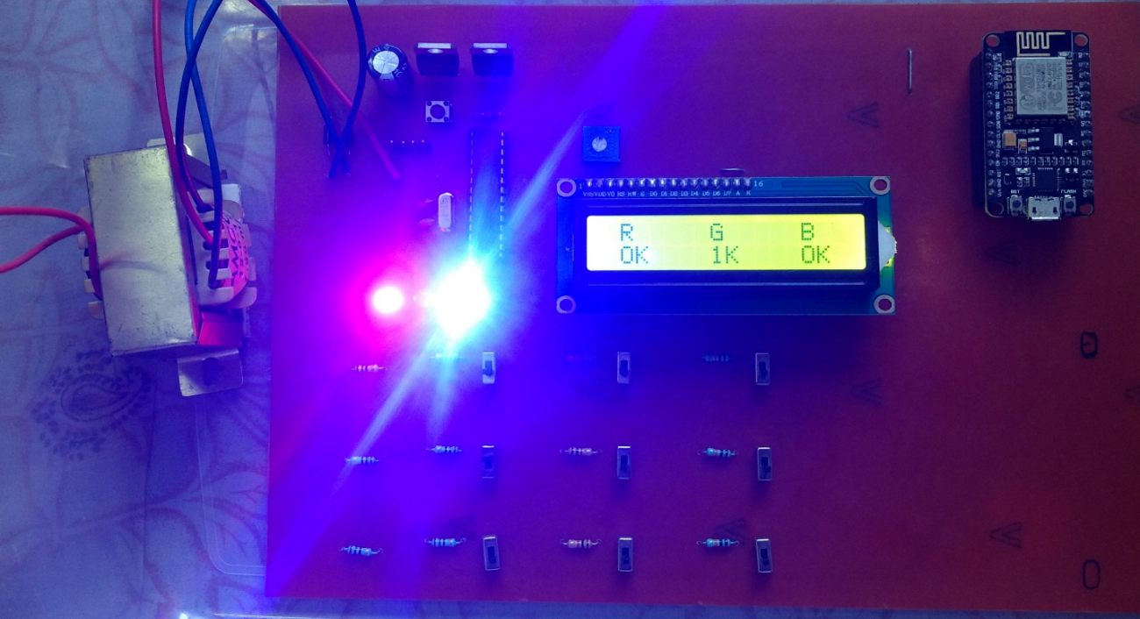
OPERATION OF CIRCUIT
Pre-Fault Condition Working
Post-Fault Condition Working

Slide 10
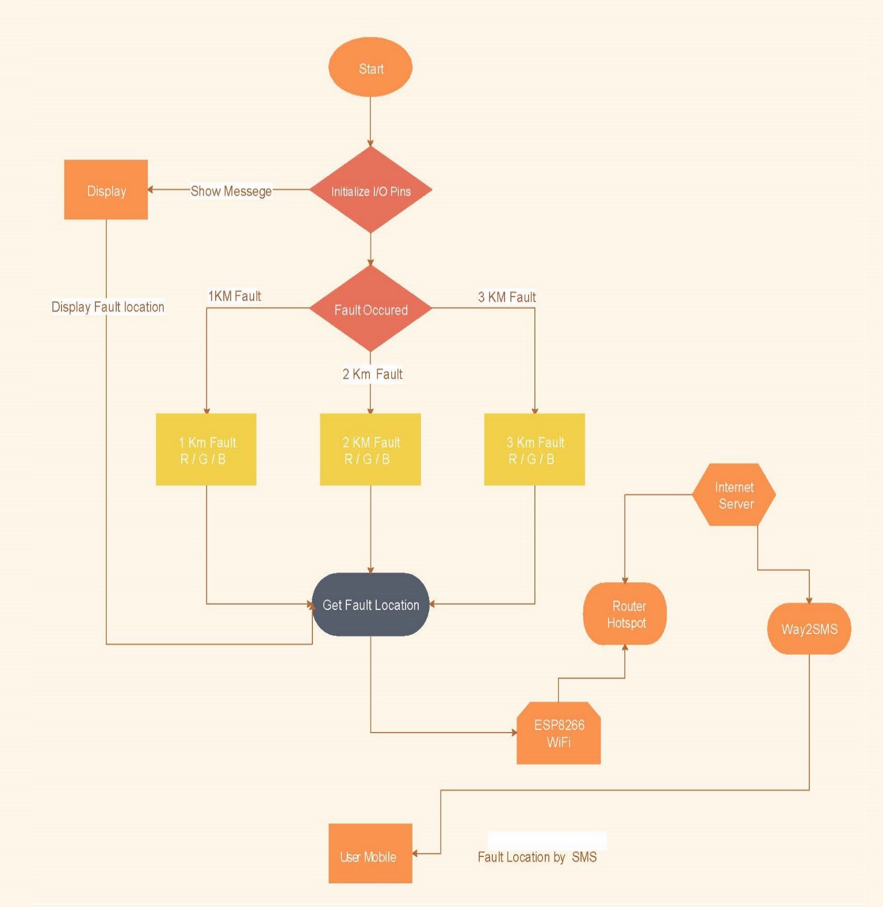
IFTTT

Slide 11
Programming
Algorithm for Arduino
Digital value read from r/g/b phase if ( ( rphasevalue >= 1000 ) | Display on lcd lcd.print("OK"); | Action of LED digitalWrite(rled, HIGH);
rphase>=1000 | OK | HIGH
700>=rphase>=400 | 1K | LOW
250>=rphase>=70 | 2K | LOW
50>=rphase=10 | 3K | LOW

Slide 12
Algorithm for ESP 8266 WiFi Model
Distance in KM int d = atoi(t); | Message displayed on Android Serial.print("All Ok");
If d==0 | All OK
If d==1 | Fault at 1KM Red phase
If d==2 | Fault at 2KM Red phase
If d==3 | Fault at 3KM Red phase
If d==4 | Fault at 1KM Green phase
If d==5 | Fault at 2KM Green phase
If d==6 | Fault at 3KM Green phase
If d==7 | Fault at 1KM Blue phase
If d==8 | Fault at 2KM Blue phase
If d==9 | Fault at 3KM Blue phase
Else | Fault at two or more phases

Slide 13
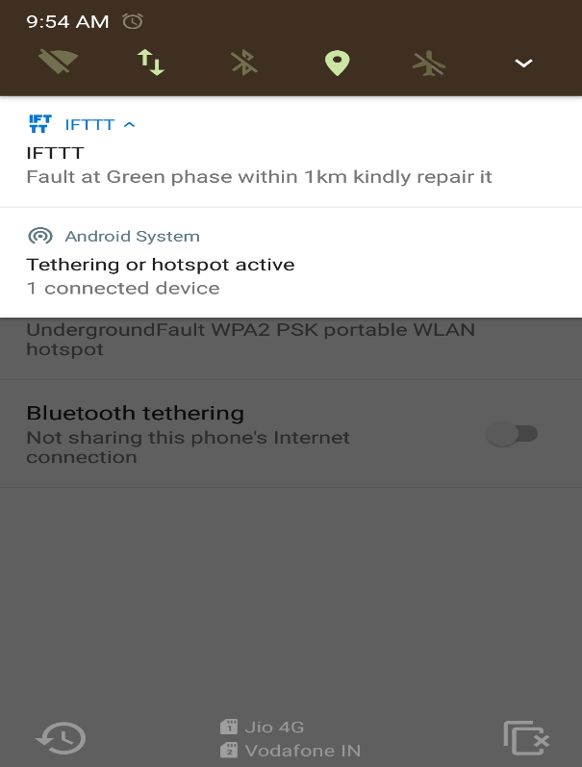
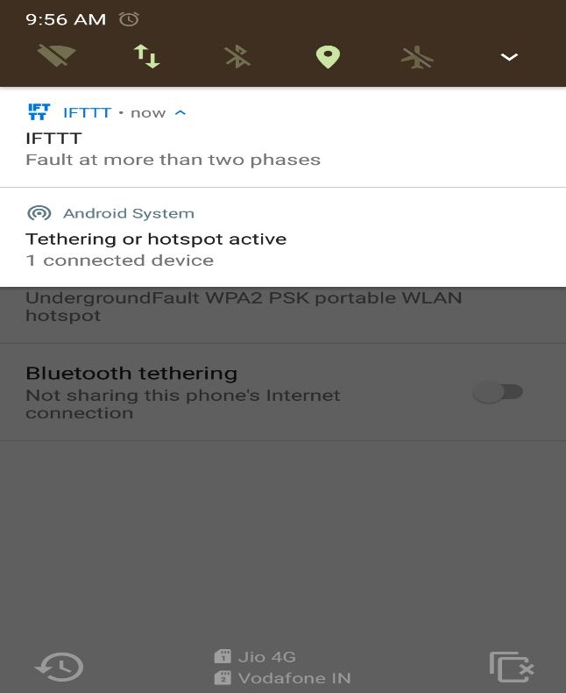
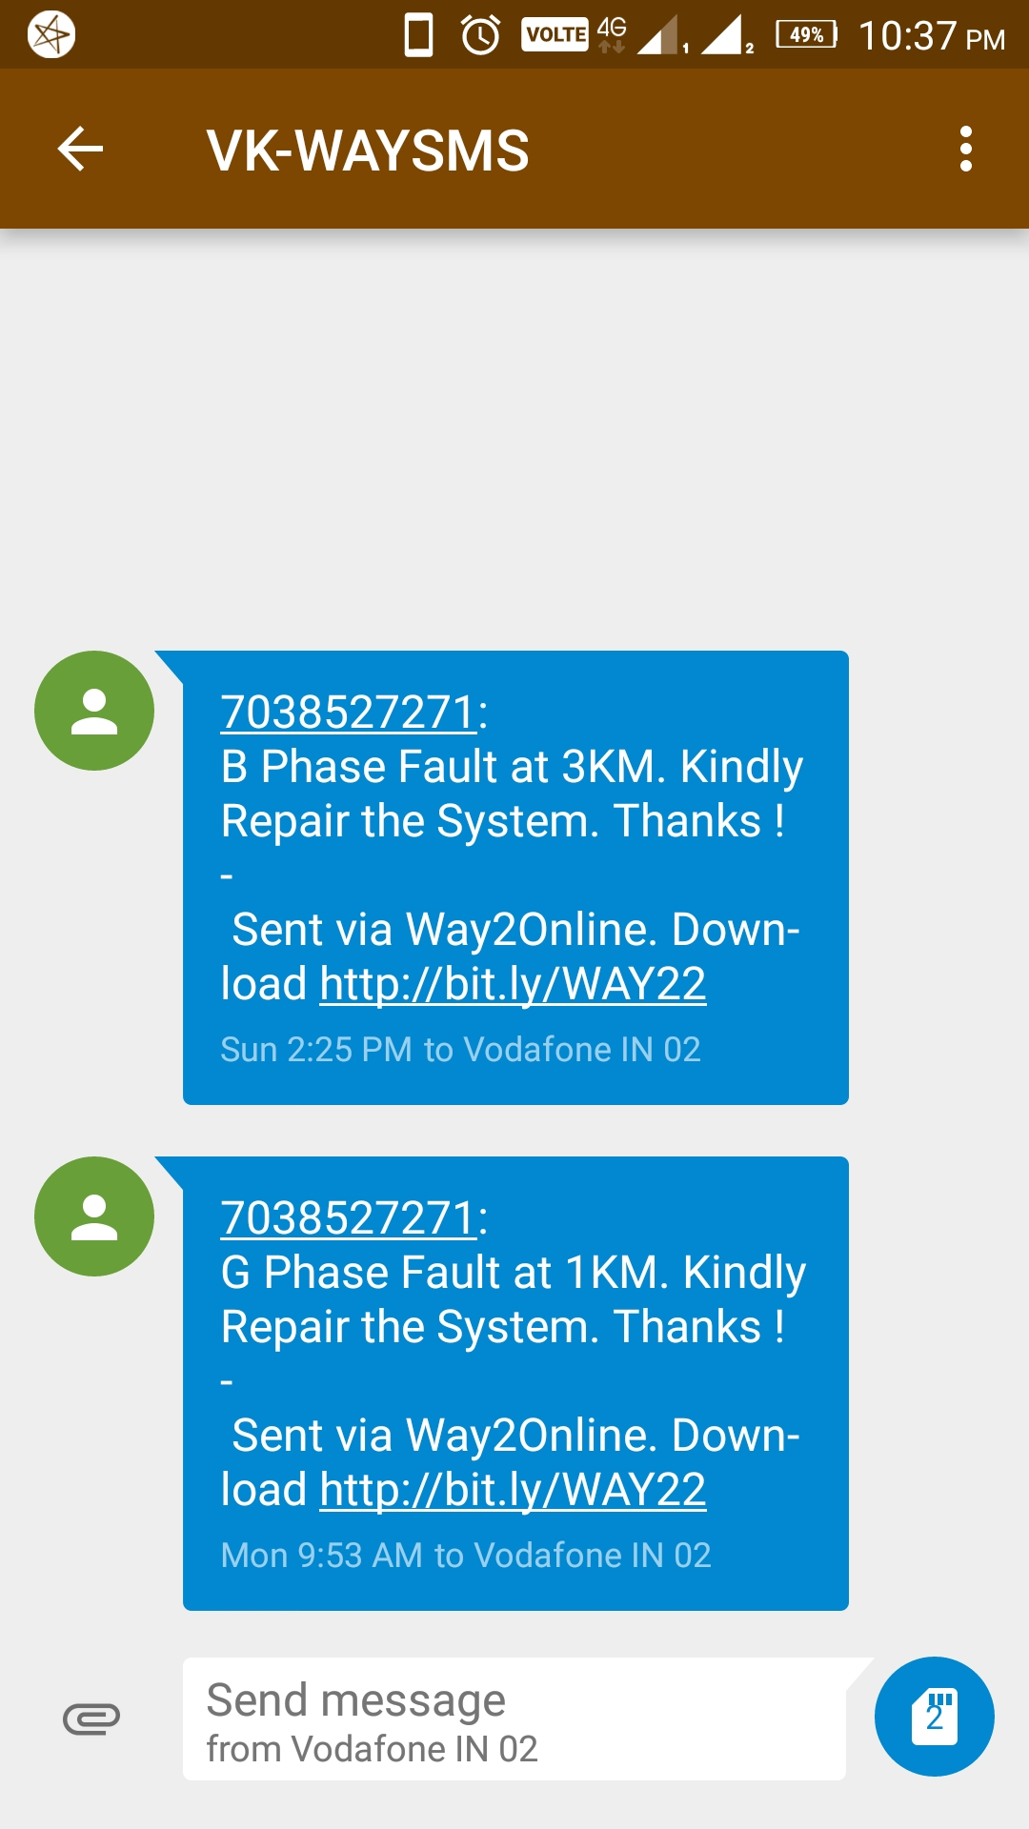
Mobile user get notification when fault occur in system via IFTTT

Slide 14
Applications
It can be used in Urban areas and where overhead lines are not suitable.
Commercial sectors

Slide 15
Advantages
Disadvantages
Compact and reliable
Less operating time
Reduce tracing expenses
Modern technique with IOT
It does not provide exact fault location
Programming of circuit becomes complex
Not able to provide information about health of cable insulation
Requires external protective circuitry

Slide 16


Slide 17


Slide 18


