Slide 1

Exploratory Data Analysis
G2M insight for Cab Investment firm
21/07/2023

Slide 2

Problem Statement
XYZ is a private firm in US. Due to remarkable growth in the Cab Industry in last few years and multiple key players in the market, it is planning for an investment in Cab industry and as per their Go-to-Market(G2M) strategy they want to understand the market before taking final decision between the Yellow Cab and Pink Cab.

Slide 3
Approach
To determine the more favorable investment opportunity for XYZ, we will attempt to address the following inquiries:
Which company has travelled more and what’s the price per KM travelled?
Which cities use cabs the most?
Which company has the more percentage of men and women customers?
Who uses the cabs mostly in cites? (Gender based)
Which is the most preferable payment method in different cities?
Profitability of each company

Slide 4
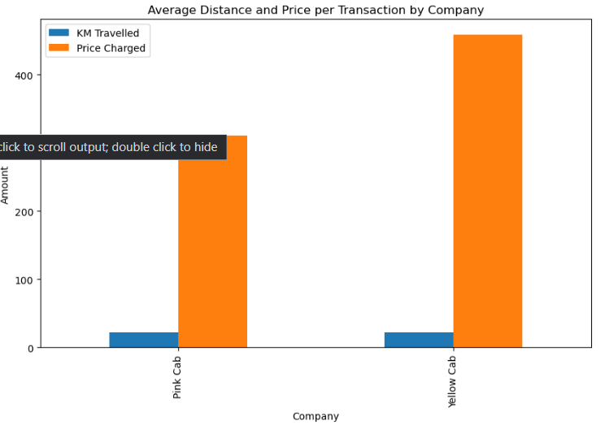
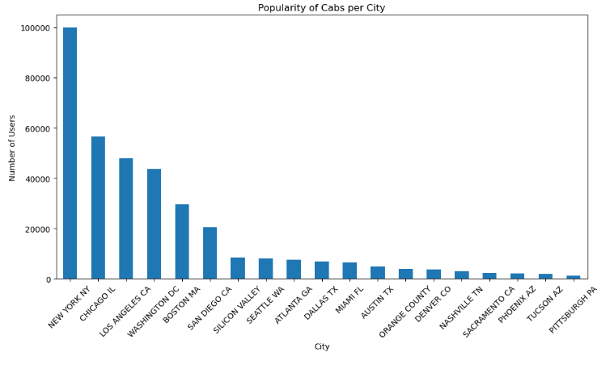
Approach
NewYork has the most number of cab users than the other cities.
The average distance by both company is almost same (approx 22.9 KM) but the price charged by the pink cab company ( approx 320) is very less than the yellow cab company(~460)

Slide 5
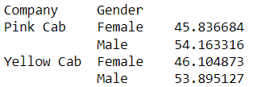
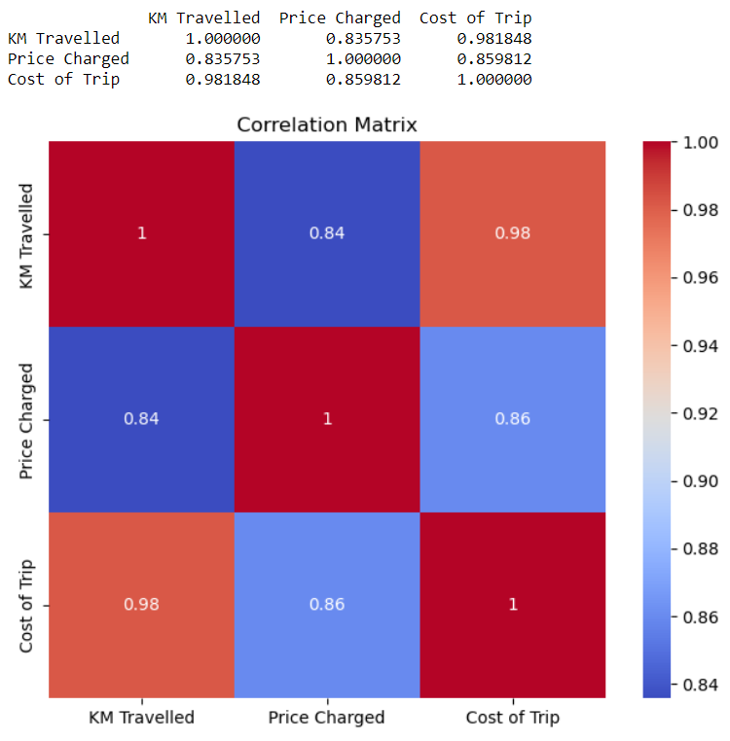
Approach
The above stats show the percentage of male and female customers in the yellow cab and the pink cab companies

Slide 6
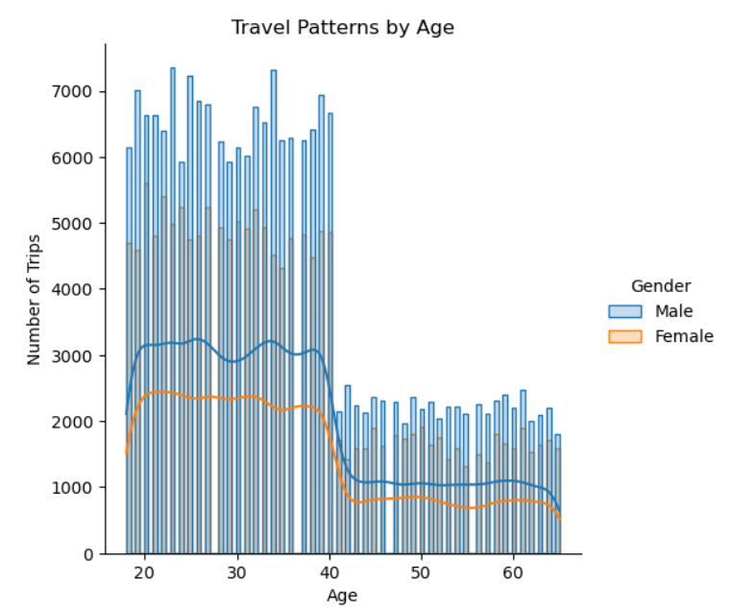
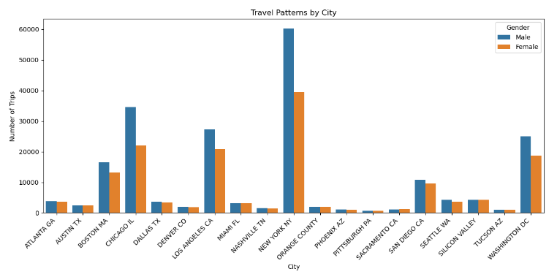
Approach
Travel patterns by age and the city that shows who uses the cabs most in a gender based manner

Slide 7
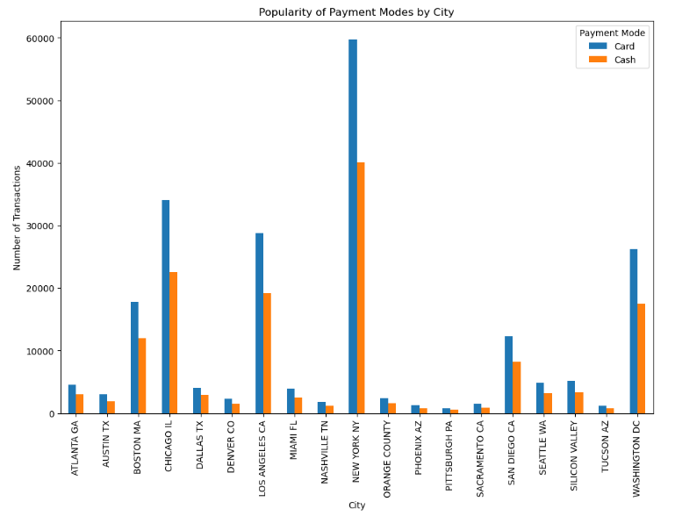
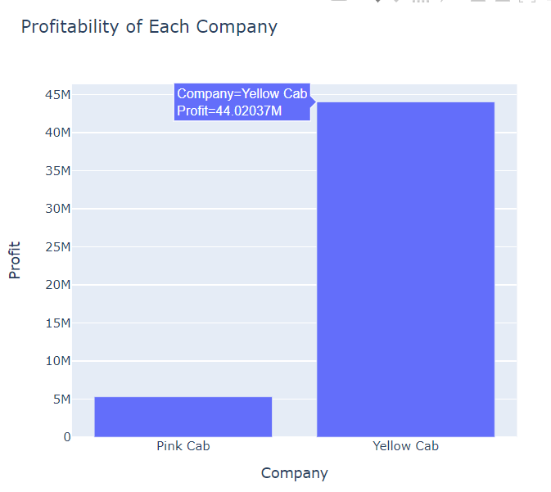
Approach
We can conclude that the Yellow cab is better than the pink cab

Slide 8
Thank You

