Slide 1


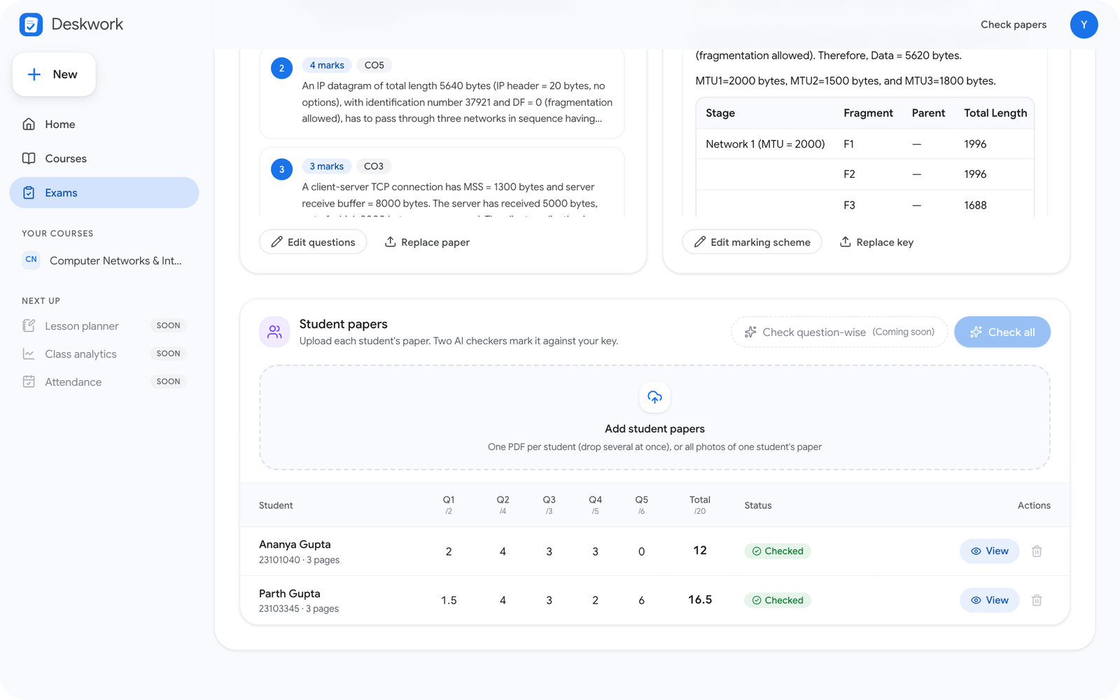
Jaypee Institute of Information Technology, Noida
Department of Computer Science & Engineering and IT
B.TECH MAJOR PROJECT
Deskwork
An AI workspace for teachers to set papers and check answer sheets from their own course material
SUBMITTED BY
Yug Jindal
23103328
Anish Das
23103322
Yashita Gogia
23103305
Anjaneya Sharma
23103301

Slide 2



The problem, and what Deskwork does
Today
With Deskwork
Hours checking handwritten papers, one by one
Assignments and papers written from scratch
Tired eyes miss slips, marks drift
Generic AI chat does not know your slides
Upload course slides once
Generate assignments, solutions and papers with answer keys
Two AI checkers mark each scanned paper against your key
Disagreements flagged, teacher has the final say
Marks to Excel in one click
Deskwork
2 / 9

Slide 3
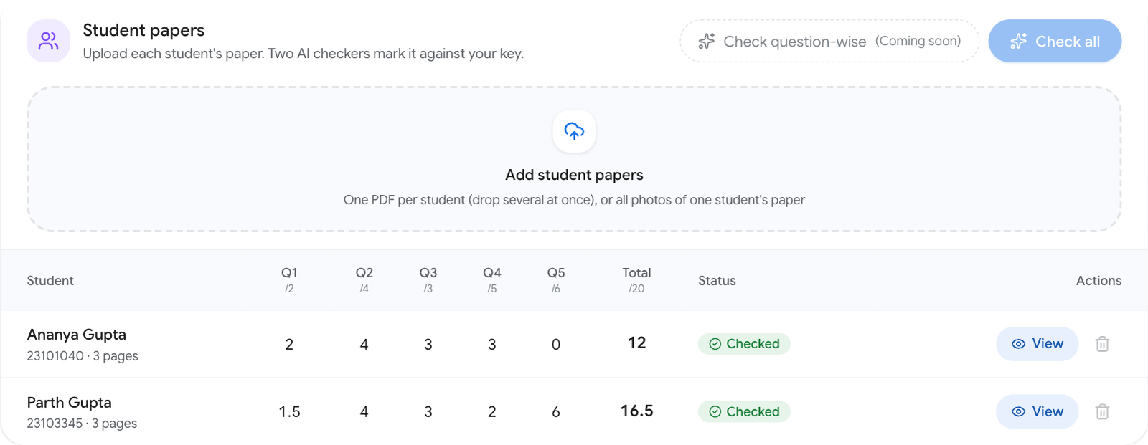
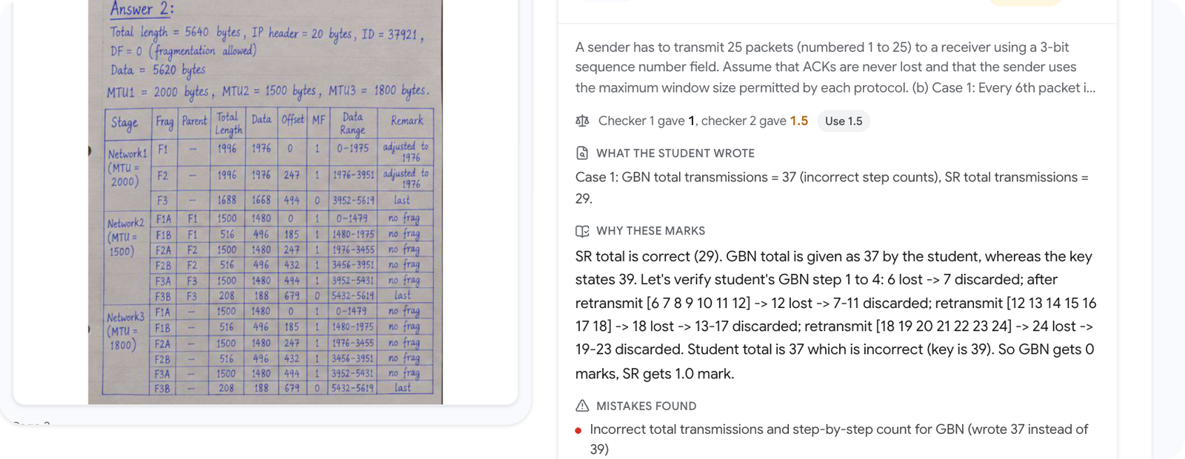
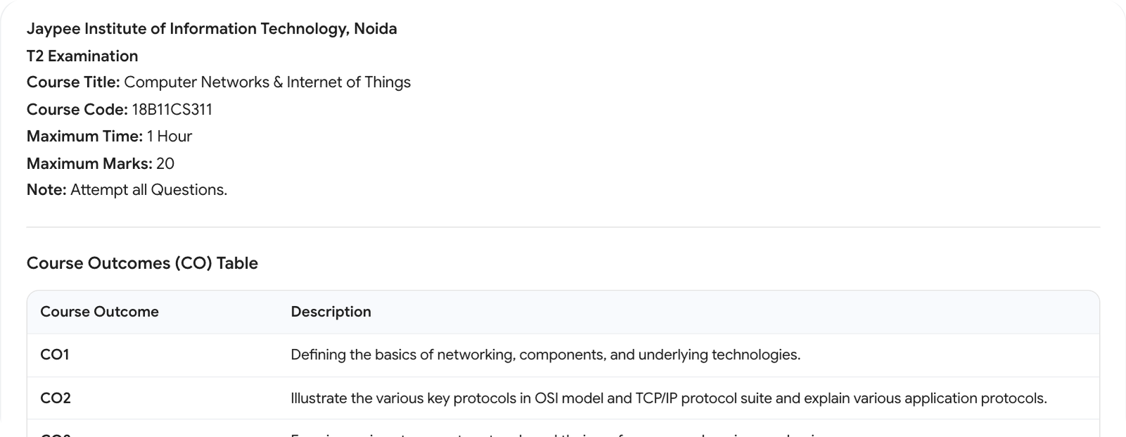
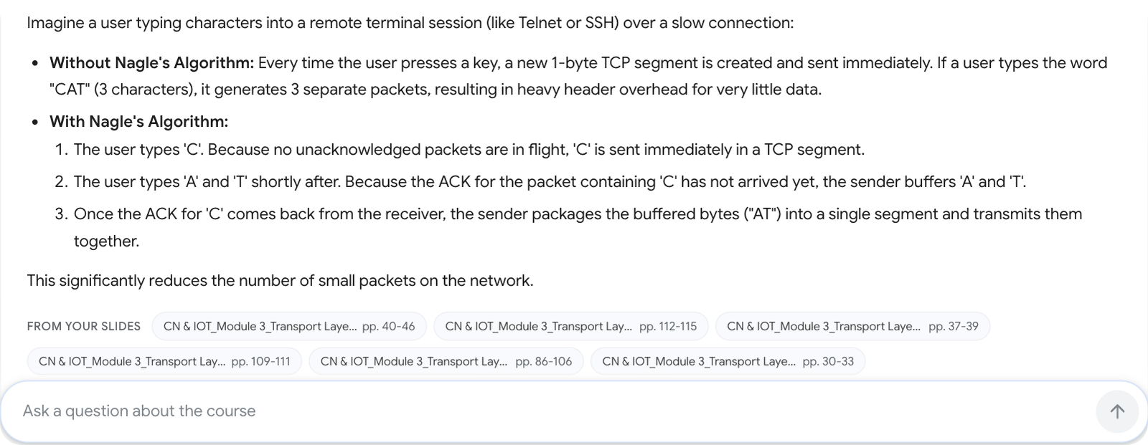
Deskwork in action
Real CN & IoT slides and real handwritten answer sheets
Every paper checked, marks per question
Both checkers' marks, with the reason
Question paper written from the slides
Answers cite the slide pages used
Deskwork
3 / 9

Slide 4



How it works
System
Supabase: Google sign-in, Postgres, files
Web app
Next.js
Backend
FastAPI
Gemini API: reading, grading, writing
ChromaDB: slide search, local
Generate
Slides
PDF, PPTX
Text chunks
gemini-
embedding-2
ChromaDB
search
Assignment,
solutions, paper
Check
Paper and
answer key
Student scan
(page images)
Two Gemini
checkers
Flag
disagreements
Teacher review,
Excel
Deskwork
4 / 9

Slide 5





Tech stack
Next.js 16, React 19
FastAPI, Python 3.12
Supabase
Web app, Tailwind, Motion
API, grading, PDF and PPTX reading
Google sign-in, Postgres, file storage
Gemini 3.5 + 3.1 Flash-Lite
Embeddings + ChromaDB
Pytest + Playwright
Reads scans, marks, writes papers
gemini-embedding-2, slide search (RAG)
Unit, end-to-end and browser tests
Deskwork
5 / 9

Slide 6



Impact
2
1
16.5/20
35/35
AI checkers on every answer
slide upload, used by every chatbot
real booklet checked, slips caught
end-to-end checks on real material
Less time on repetitive checking and paper setting
Consistent marks, each with its reason shown
Everything built from the teacher's own slides
Deskwork
6 / 9

Slide 7




References
Design
Docs
Material Design 3, m3.material.io
Google Meet and Workspace UI (layout, pill navigation)
Google Sans typeface, fonts.google.com
Lucide icons, lucide.dev
Gemini API: structured output, embeddings, ai.google.dev
Supabase: Auth, Postgres, Storage, supabase.com/docs
ChromaDB, docs.trychroma.com
Next.js, nextjs.org/docs; FastAPI, fastapi.tiangolo.com
Research
Products studied
arXiv 2604.22774: models silently fix student slips when transcribing
arXiv 2603.13083: confidence alone is no safe flag
PNAS Nexus 2026: teachers over-trust AI grades
Gradescope (grading by question)
MagicSchool (teacher content tools)
Deskwork
7 / 9

Slide 8




Future scope
What we will add by the final evaluation
Check question-wise
Class analytics
Mark one question for the whole class at once
Per-question scores and weak topics
Lesson planner
Question bank
Lecture plans drafted from the course slides
Reuse questions across papers and exams
Deskwork
8 / 9

Slide 9
Thank you

