Slide 1

MP Neuron & Perceptron

Slide 2

MP Neuron & Perceptron
Courtesy :: NPTel lecture series from IIT Madras – Mitesh Kapra,
Coursera : Andrew NG, Deep Learning
fast.ai, Dive into Deep Learning

Slide 3
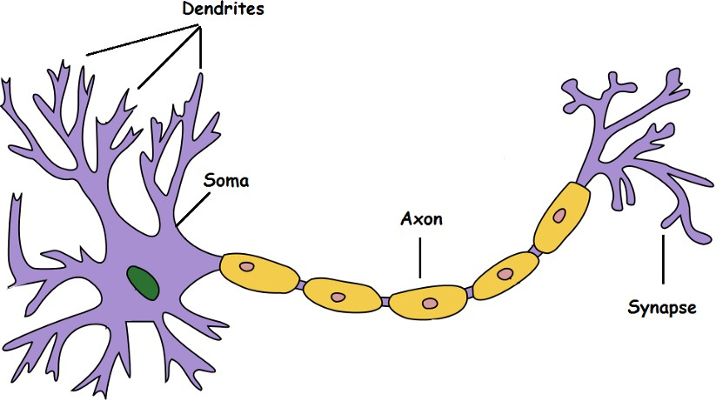
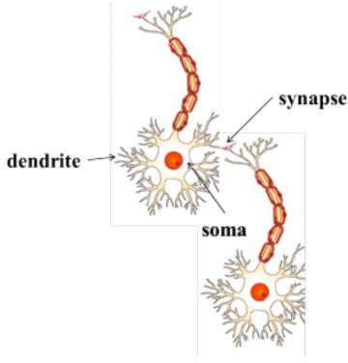
Takes an input, processes it, throws out an output.
Dendrite: Receives signals from other neurons
Soma: Processes the information
Axon: Transmits the output of this neuron
Synapse: Point of connection to other neurons
Biological Neuron
Courtesy: Towardsdatascience.com

Slide 4
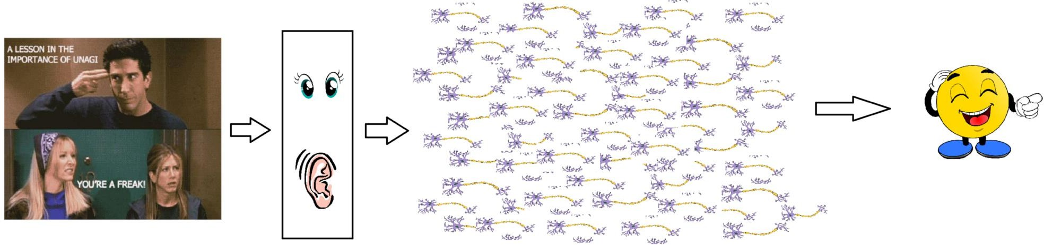
Biological Neuron
Our sense organs interact with the outer world and send the visual and sound information to the neurons
Each neuron gets fired/activated only when its respective criteria is met
. Let's say you are watching a video clip. Now the information your brain receives is taken in by the “laugh or not” set of neurons that will help you make a decision on whether to laugh or not.
There is a massively parallel interconnected network of 10¹¹ neurons (100 billion) in our brain and their connections are not simple
Courtesy: Towardsdatascience.com

Slide 5
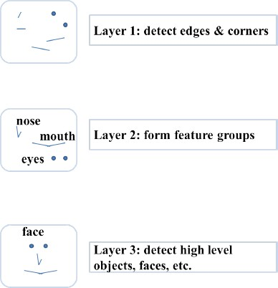
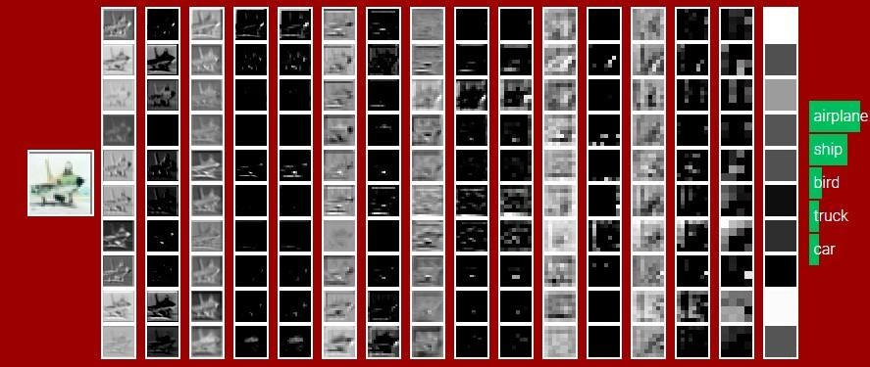
Neurons are arranged in a hierarchical fashion
Neurons are arranged in a hierarchical fashion and each layer has its own role and responsibility.
To detect a face, the brain could be relying on the entire network
and not on a single layer.
Courtesy :Sample illustration of hierarchical
processing. Credits: Mitesh M. Khapra’s lecture slides

Slide 6
The very first step towards the perceptron we use today was taken in 1943 by McCulloch and Pitts, by mimicking the functionality of a biological neuron.

Slide 7
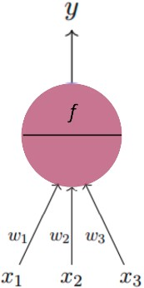
Artificial Neuron
The fundamental Building block of Deep Learning
The fundamental unit of deep neural networks is is called an artificial neuron/perceptron
g
Courtesy :: Mitesh M. Khapra’s lecture slides

Slide 8
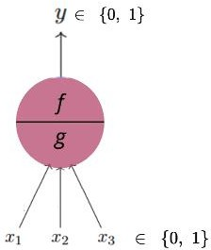
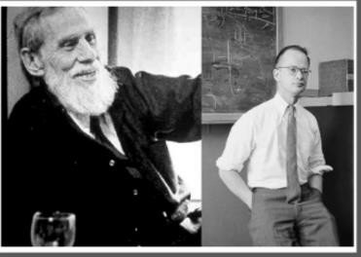
Artificial Neuron
“threshold logic” to mimic the thought process
The fundamental Building block of Deep Learning
McCulloch-Pitts Neuron
The first computational model of a neuron was proposed by
Artificial Neural Networks
Warren MuCulloch (neuroscientist) and Walter Pitts (logician) in 1943
It may be divided into 2 parts. The first part, g takes an input, performs an aggregation and based on the aggregated value the second part, f makes a decision.
Lets suppose that I want to predict my own decision, whether to watch a random football game or not on TV?.
The inputs are all boolean i.e., {0,1} and my output variable is also boolean {0:
Will watch it, 1: Won’t watch it}.
So, x1 could be isPremierLeagueOn (I like Premier League more)
x2 could be isItAFriendlyGame (I tend to care less about the friendlies)
x3 could be isNotHome (Can’t watch it when I’m running errands. Can I?)
x4 could be isManUnitedPlaying (I am a big Man United fan. GGMU!) and so
on.

Slide 9
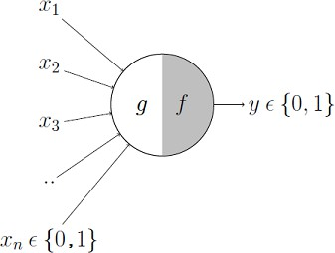
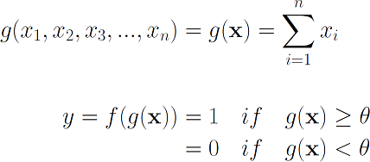
Excitatory or inhibitory inputs.
These inputs can either be excitatory or inhibitory.
Inhibitory inputs are those that have maximum effect on the
decision making irrespective of other inputs
i.e., if x3 is 1 (not home) then my output will always be 0 i.e., the neuron will never fire, so x3 is an inhibitory input
Excitatory inputs are NOT the ones that will make the neuron fire on their own but they might fire it when combined together

Slide 10

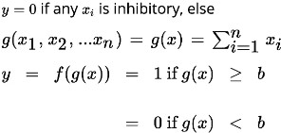
The mathematical Model- McCulloch-Pitts Neuron (MP Neuron)
These inputs can either be excitatory or inhibitory

Slide 11
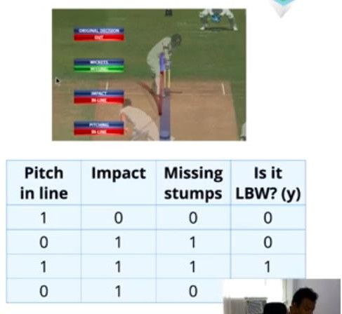
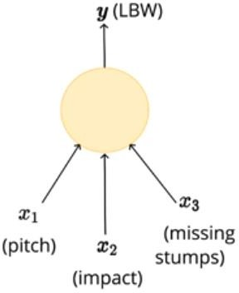
What task can be done with MP Neuron?
Courtesy :: Mitesh M. Khapra’s lecture slides

Slide 12
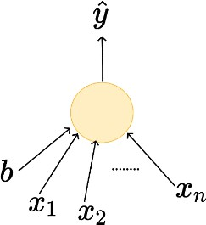
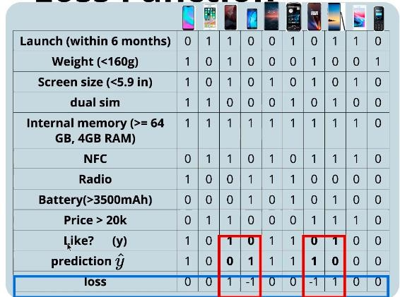




We aim at minimizing the loss function
Loss Function
Courtesy :: Mitesh M. Khapra’s lecture slides

Slide 13
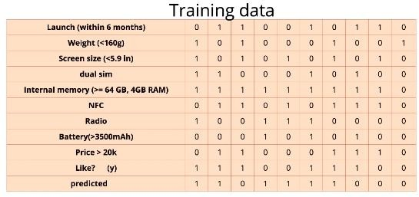
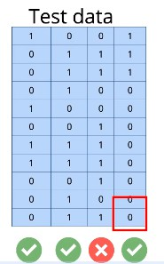


Learning
MODEL
Predictions

Slide 14
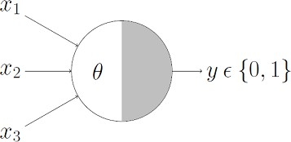
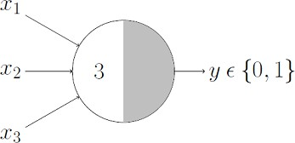
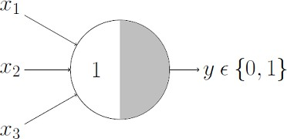
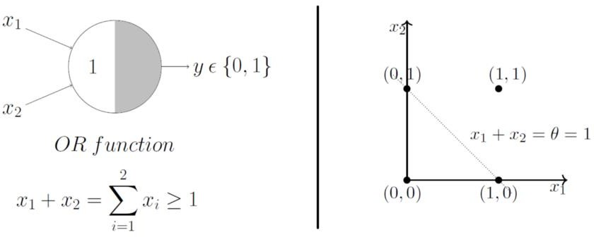
Boolean Functions Using M-P Neuron
OR Function
AND Function
sum ≥ theta, the neuron will fire
otherwise, it won’t.
An AND function neuron would only fire when ALL the inputs are ON
neuron would fire if ANY of the inputs is ON i.e., g(x) ≥ 1 here.
i.e., g(x) ≥ 3 here.
Geometric Interpretation OR function
x1 + x2 =1 to graphically show that all those inputs whose output when passed through the OR function M-P neuron lie ON or ABOVE that line and all the input points that lie BELOW that line are going to output 0.
The M-P neuron just learnt a linear decision boundary!

Slide 15
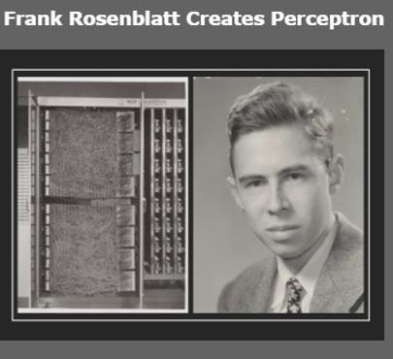
Limitations Of M-P Neuron
What about non-boolean (say, real) inputs?
Do we always need to hand code the threshold?
Are all inputs equal?
What if we want to assign more importance to some inputs?
What about functions which are not linearly separable?
Say the XOR function.
Frank Rosenblatt
Overcoming the limitations of the M-P neuron, Frank Rosenblatt, an American psychologist, proposed the classical perception model, the mighty artificial neuron, in 1958. It is more generalized computational model than the McCulloch-Pitts neuron where weights and thresholds can be learnt over time

Slide 16
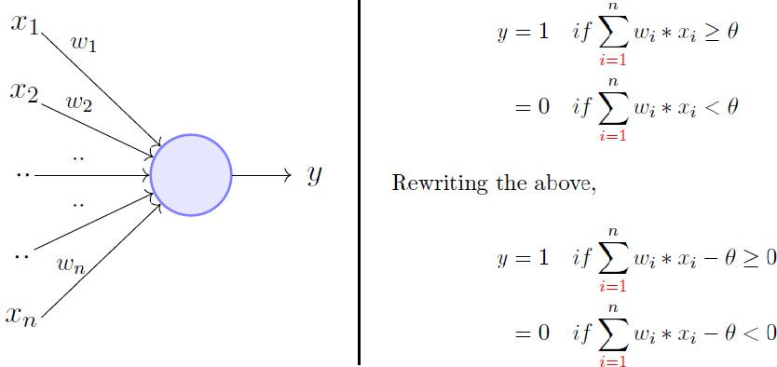
The perceptron model
The perceptron Model:
is very similar to an M-P neuron but we take a weighted sum of the inputs and set the output as one only when the sum is more than an arbitrary threshold (theta).
It overcomes some of the limitations of the M-P neuron by
introducing
the concept of numerical weights (a measure of importance) for inputs,
a mechanism for learning those weights.
Inputs are no longer limited to boolean values like in the case
of an M-P neuron,
it supports real inputs as well which makes it more useful and generalized.
However, according to the convention, instead of hand coding the thresholding parameter theta, we add it as one of the inputs, with the weight -theta like shown in next slide, which makes it learnable

Slide 17
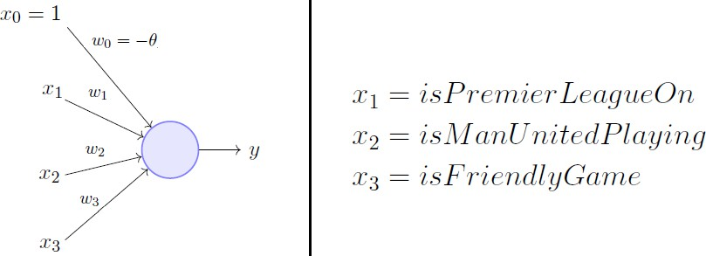
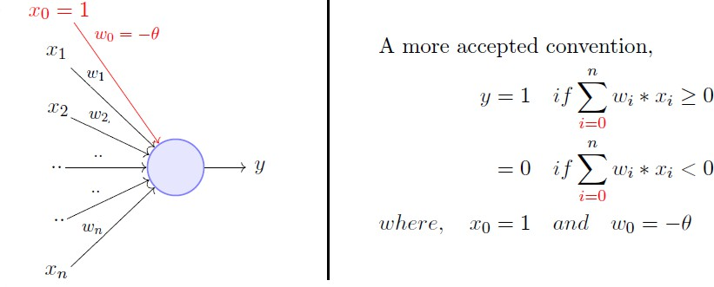
Theta add as one of the inputs- theta(θ) is b i a s
theta, is treated as bias, with the weight -theta like shown above, which makes it learn-able
Here, theta(θ) is called the bias because it represents the prior (prejudice).
A football freak may have a very low threshold and may
watch any football game irrespective of the league, club or
importance of the game [theta = 0].
The weights and the bias will depend on the data (my viewing history in football watching).
On the other hand, a selective viewer may only watch a
football game that is a premier league game, featuring Man United game and is not friendly [theta = 2].

Slide 18
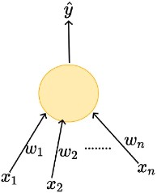
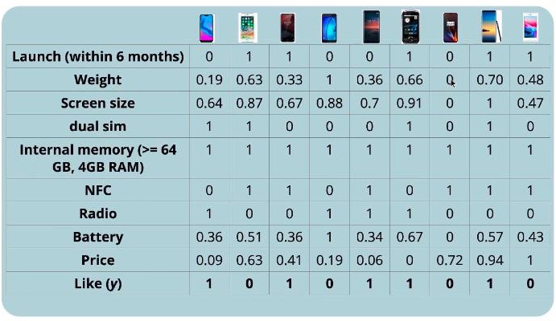

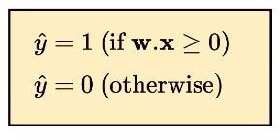
Perceptron- Frank Rosenblatt
W0=b
X0=1
Real Inputs
Boolean outputs
Weight assigned for each input
Linear
Courtesy :: Mitesh M. Khapra’s lecture slides

Slide 19
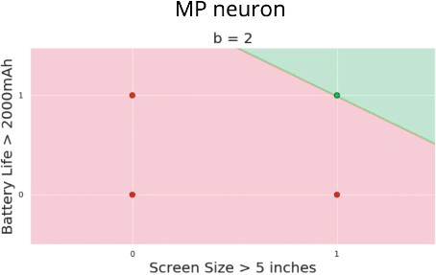
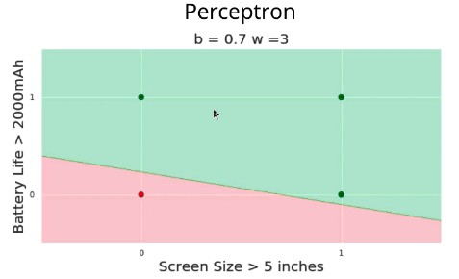




Geometric Interpretation
Flexible Slope
Fixed Slope
Notes:
Slope:
m=−w1/w2=−1/3 (shallow slope)
Intercept:
c=b/w2=0.7/3 ≈ 0.233
🔹 Flexibility:
The slope is now -1/3, not -1 — the line is much flatter.
Both slope and intercept depend on the learned weights and bias.
This tilting ability allows the perceptron to separate classes in ways the MP neuron cannot.

Slide 20
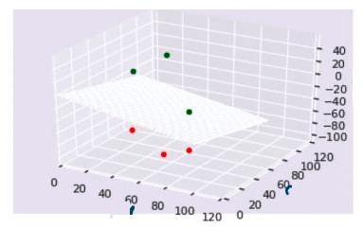
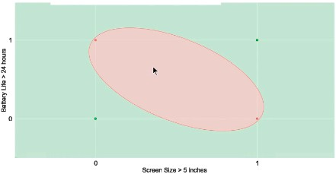
More dimensions

Slide 21
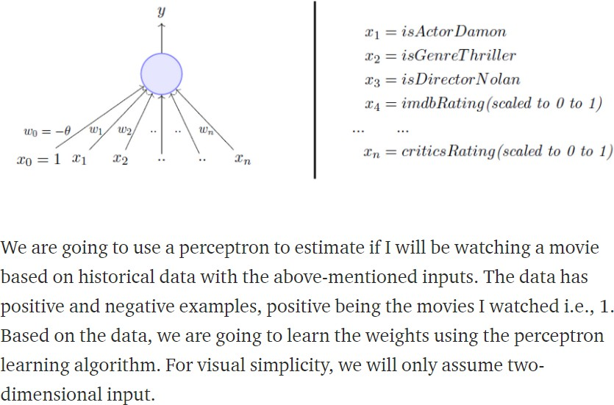
Perceptron Learning Algorithm- setting up the problem

Slide 22

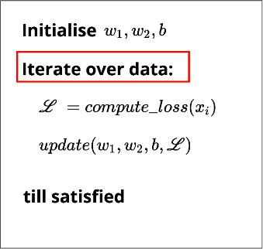
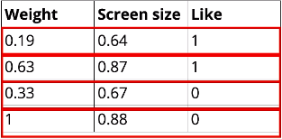
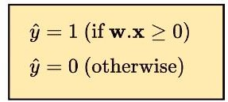
Our goal is to find the w vector that can perfectly classify
positive inputs and negative inputs in our data

Slide 23
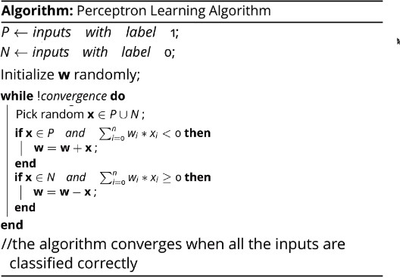
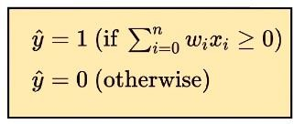
Perceptron Learning Algorithm
P- positive examples N – Negative examples
𝑊₁
𝑊₂
𝑊₃
𝑊₀
𝑥₁
𝑥₂
𝑥₃
𝑏
𝒘 =
𝒙 =

Slide 24
Perceptron Learning Algorithm
(P U N) both positive and negative examples
𝑊₁
𝑊₂
𝑊₃
𝑊₀
𝑥₁
𝑥₂
𝑥₃
𝑏
𝒘 =
𝒙 =
Case 1: When x belongs to P and its dot product w.x < 0
Case 2: When x belongs to N and its dot product w.x ≥ 0

Slide 25
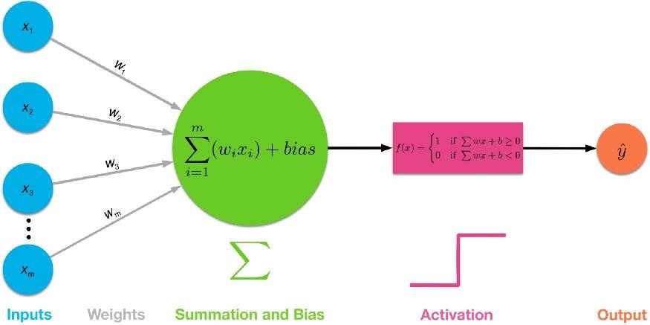
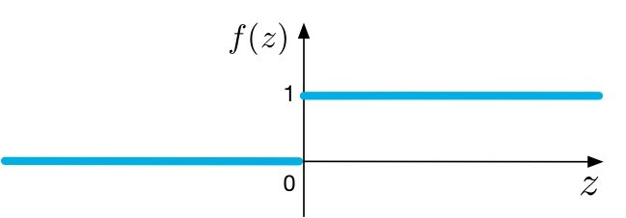
Procedures of a Single-layer
Perceptron Network
Step -Activation Function
Courtesy: towardsdatascience.com

Slide 26
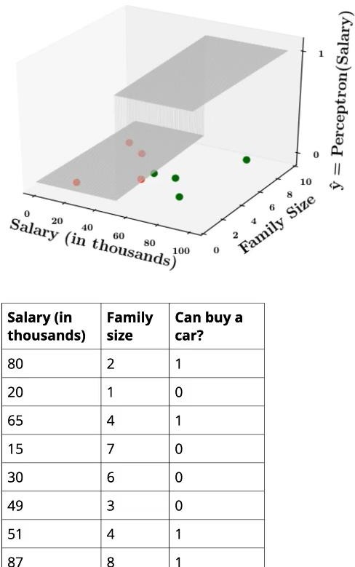
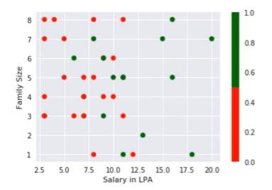
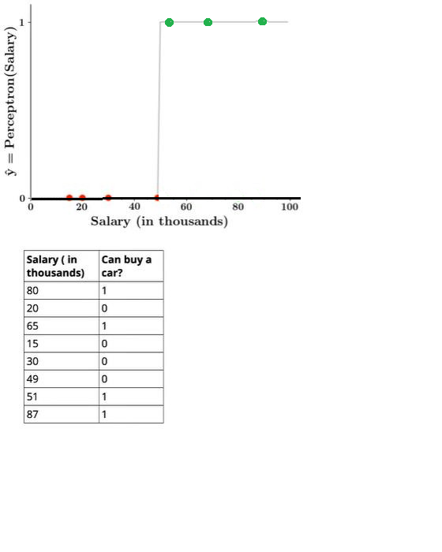
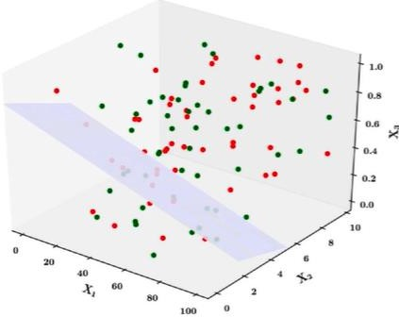
Limitations of Perceptron
1D
How about these? Non linearly separable data?
2D

Slide 27
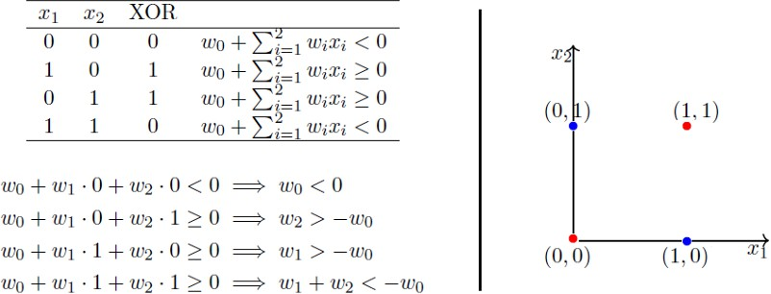
XOR Function — Can’t Do!- Non Linearly separated data
Notice that the fourth equation contradicts the second and the third equation. Point is, there are
no perceptron solutions for non-linearly separated data. So the key take away is that a single perceptron cannot learn to separate the data that are non-linear in nature.

