Slide 1
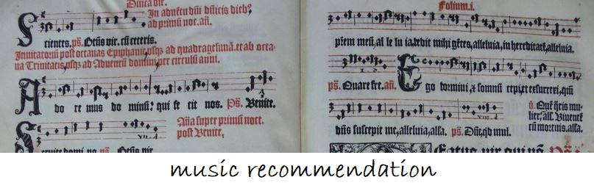
Group Work by Preby and Anja

Slide 2

Intro
Web Scraping
Spotify
KMeans model
Input-Output-Function

Slide 3
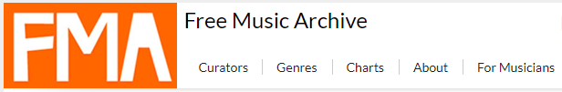

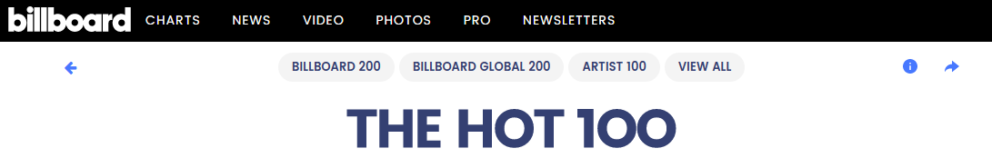
1. Web Scraping
        round 84.000 songs
        round 1.400 songs

Slide 4

1. Web Scraping
Struggle parts (mulit page scraping)
    find the right CSS Selector – page parsed function
    firefox
        song
        artist
        genre
    chrome
        song
        artist
        genre

Slide 5


2. Spotify
1.
      succesful to csv-file
2.

Slide 6

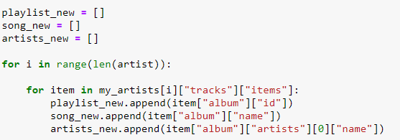

2. Spotify
Struggle parts

Slide 7
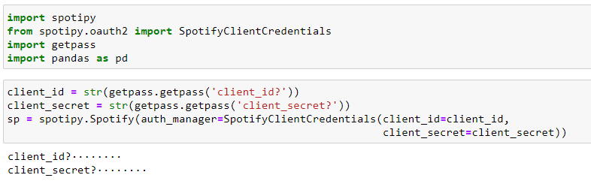

2. Spotify
Struggle parts
after that: keyboard out of work -> fix it: restart the laptop

Slide 8
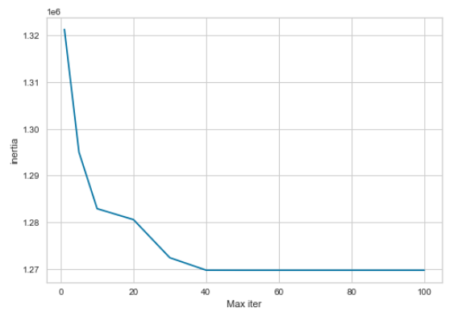
3. KMeans model
calculate the number of cluster
take the file from Kaggle
cluster: 30

Slide 9

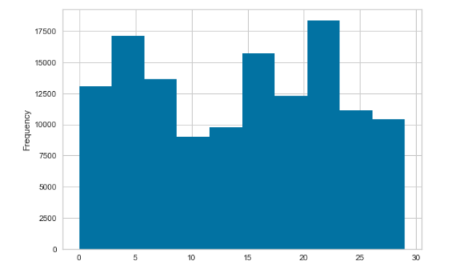
3. KMeans model
train the model

Slide 10
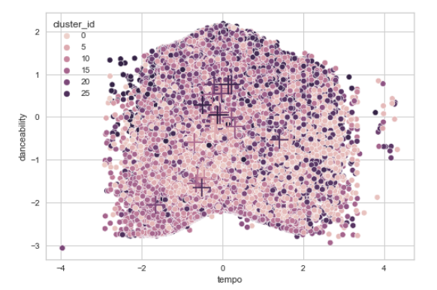
3. KMeans model
plot the clusters

Slide 11
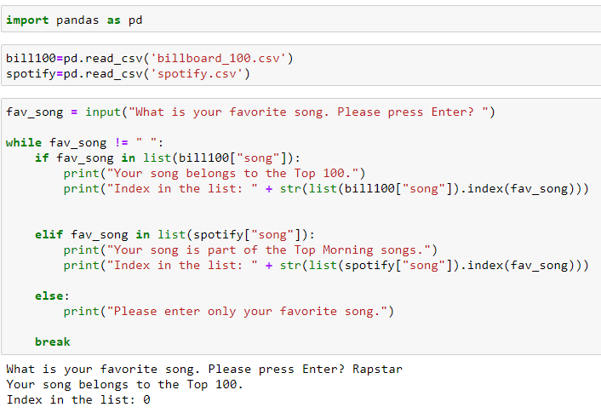
4. Input-Output-Function

Slide 12
Thank you.

