Slide 1


Book into movie
Gives the New York Times Bestseller list for books (fiction/non-fiction) a hint for those books that will be made into movies?
Final Bootcamp Project – Anja Fechner

Slide 2
Overview
Assignment and practical test
Dataset
Evaluation
Result
Decision
Final Bootcamp Project – Anja Fechner

Slide 3


The Assignment
Lucy
Influencer
favourite authors
recommendations
  friends
  follower
new category: books for movies
  win new follower
She asks for help to identifiy possible books.
Final Bootcamp Project – Anja Fechner

Slide 4


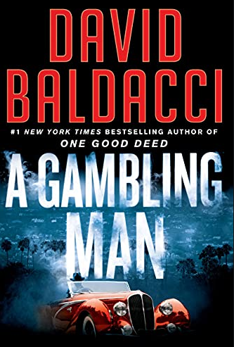
Practical test
1
2
3
free available additional information
Price
$ 12.64
4,5
47.613
$ 11,67
4,5
5.977
$ 12,95
4,5
6.561
Rating
Reviews
Final Bootcamp Project – Anja Fechner

Slide 5






Dataset (sources)
New York Times Bestseller list for books
movies based on books
additional information about the books
Final Bootcamp Project – Anja Fechner

Slide 6
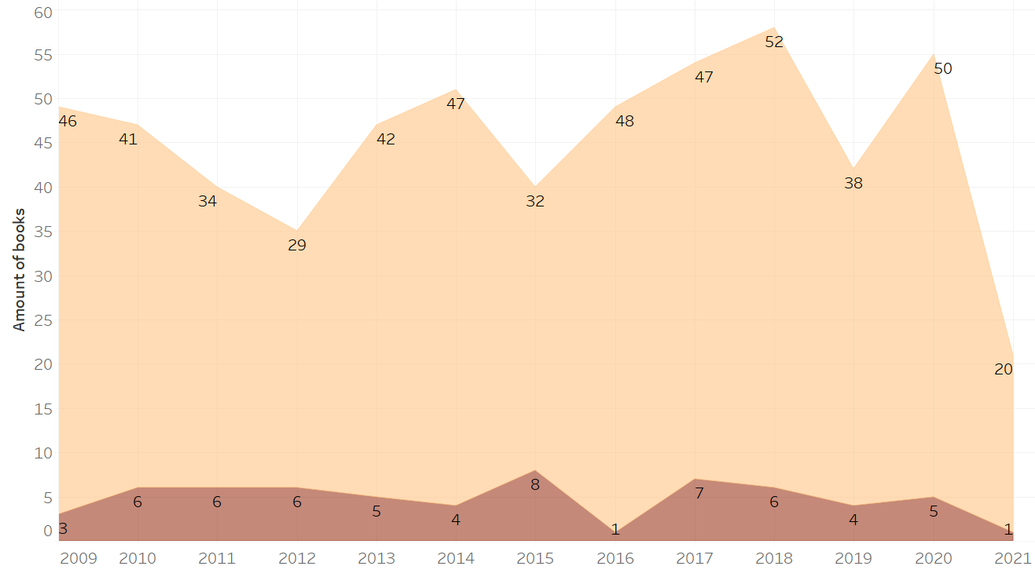
Evaluation
1st place books
amounts of movies
Final Bootcamp Project – Anja Fechner

Slide 7
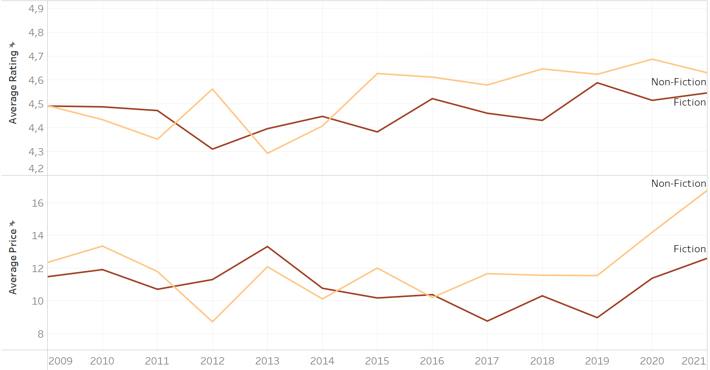
Evaluation (all books)
Final Bootcamp Project – Anja Fechner

Slide 8


Result
Final Bootcamp Project – Anja Fechner

Slide 9
Decision
Random Forest model
Log. Regression
+
Random Forest model
R²
0,14
0,15
Final Bootcamp Project – Anja Fechner

Slide 10
End
Thank you.
Any questions?
Final Bootcamp Project – Anja Fechner

