Slide 1
HEALTH INSURANCE LEAD PREDICTION
Anja H

Slide 2
DATA OVERVIEW
Observations | Variables | Duplicate rows | Missing cells
50 882 | 14 | 0 | 52 193
Variable name | ID | City_code | Region_code | Acommodation_type | Reco_Insurance_Type
type | numeric | categorical | numeric | categorical | categorical
Value set | 1 - 50882 | C1 – C36 | 1 - 6107 | Owned/rented | Individual/joint
Missing rows | 0 | 0 | 0 | 0 | 0

Slide 3
DATA OVERVIEW
Variable name | Upper_age | Lower_age | Is_spouse | Health_Indicator | Holding_Policy_Duration
type | numeric | categorical | boolean | categorical | numerical
Value set | 18-75 | 16-75 | F/T | x1-x9 | 1 – 14+
Missing rows | 0 | 0 | 0 | 11 697 | 20 251
Variable name | Holding_policy_Type | Reco_Policy_Cat | Reco_policy_Premium | Response
type | categorical | numerical | numeric | boolean
Value set | 1, 2, 3, 4 | 1- 22 | 2560 – 42316,8 | Yes/No
Missing rows | 20 251 | 0 | 0 | 0

Slide 4
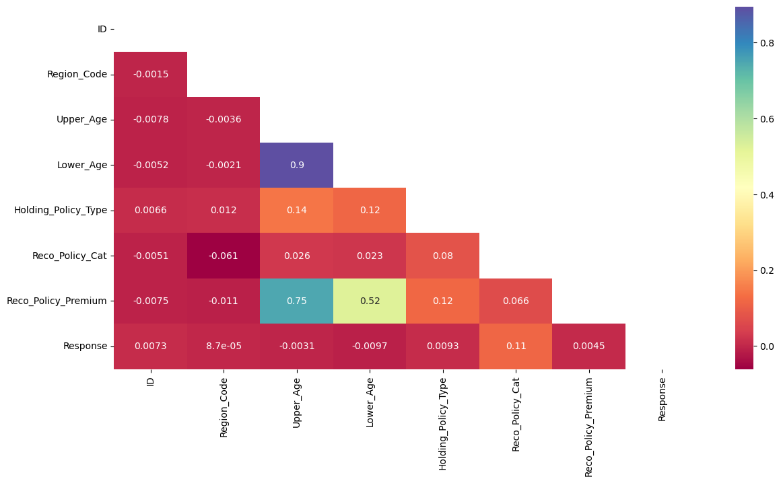
DATA OVERVIEW

Slide 5
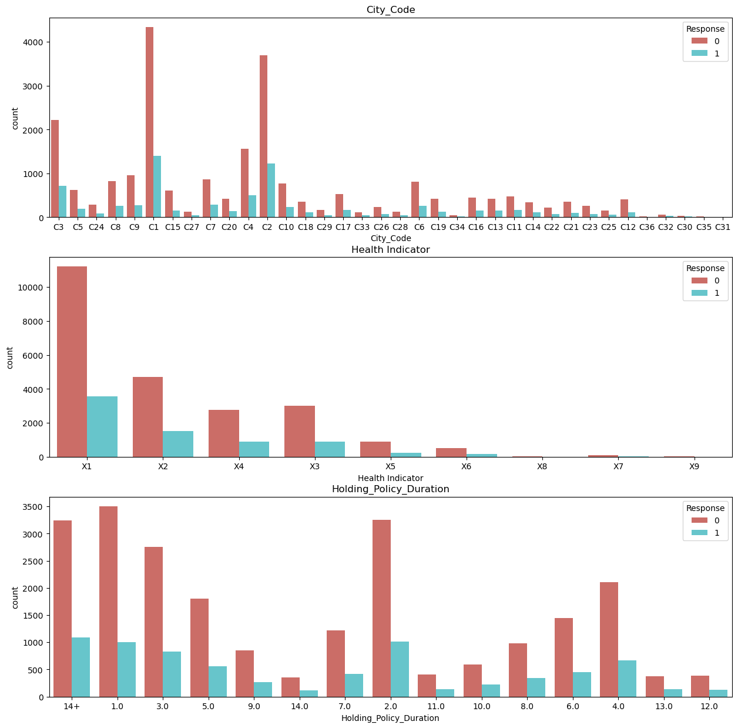
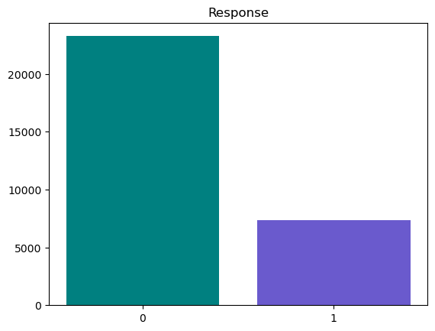
DATA OVERVIEW

Slide 6
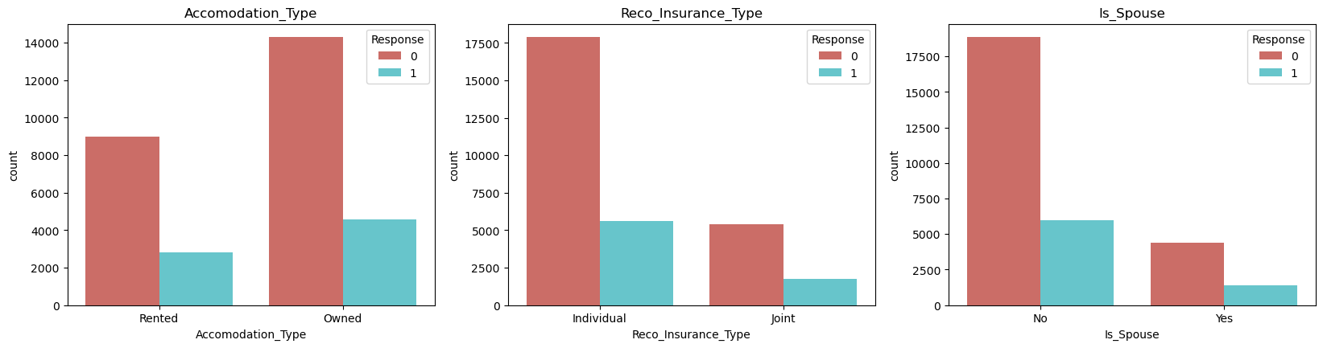
DATA OVERVIEW

Slide 7
CHOSEN MODELS
Decision tree
Random forest
Logistic regression

