Slide 1
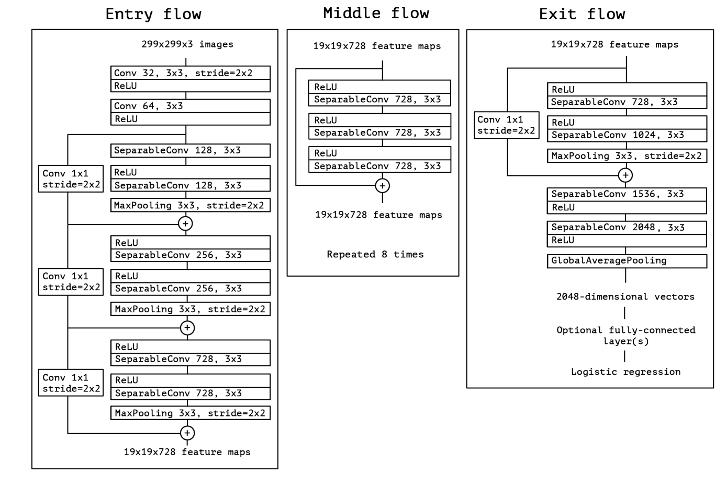
XceptionNet implementation
Architecture as in F. Chollet, "Xception: Deep Learning with Depthwise Separable Convolutions,"
Training parameters:
  Starting lr: 0.0001
  Batch size: 32
  Epochs: 30
  Loss function: Cross Entropy Loss
  Optimizer: AdamW (default values
  for the moments)
  Step Lr schedule: ᵞ=0.94, step_size=2
  He Weight initialization
Train dataset: DeepFake

Slide 2
Results
Method | AUC | AC | Loss
FaceSwap | 0.4427 | 0.5522 | 7.95E-09
Face2Face | 0.6946 | 0.5264 | 3.97E-08
DeepFake | 0.9977 | 0.9894 | 9.93E-09
InsightFace | 0.6767 | 0.5057 | 8.83E-09
NeuralTextures | 0.7576 | 0.6162 | 3.97E-08
FaceShifter | 0.5866 | 0.5041 | 1.19E-07

Slide 3
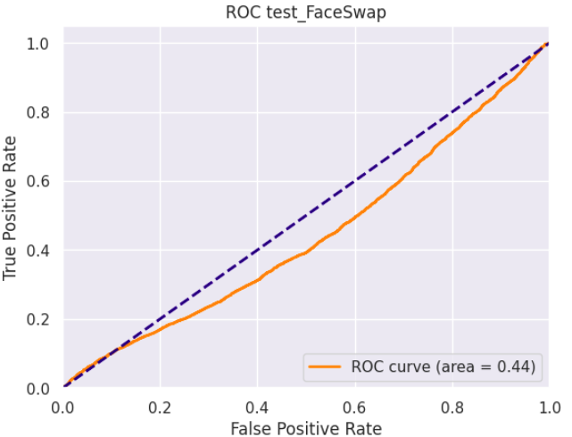
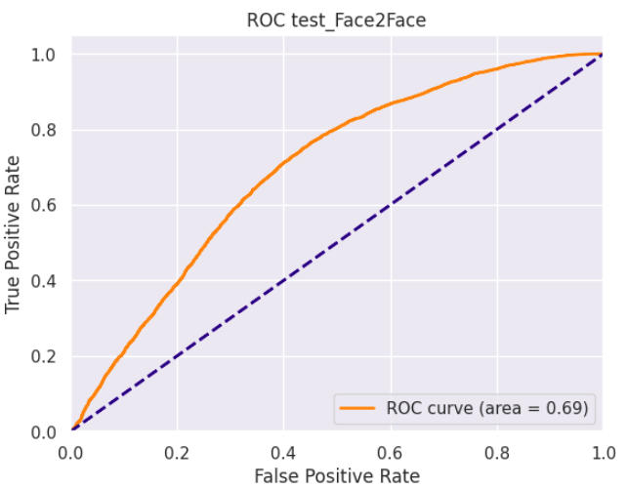
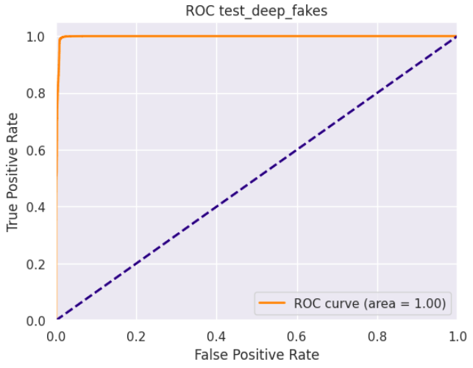
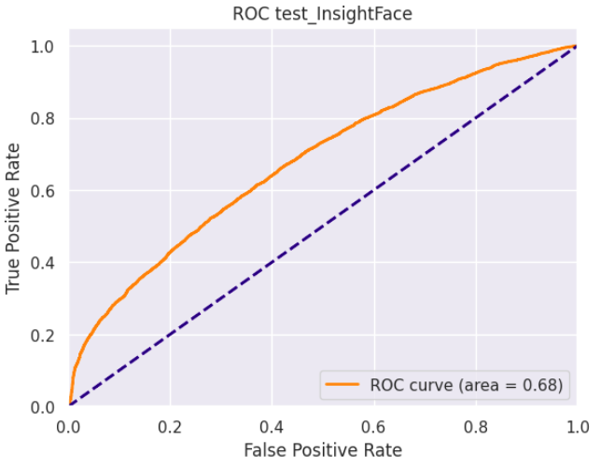
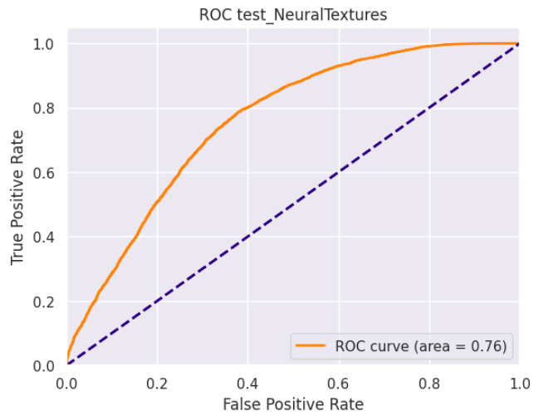

Slide 4
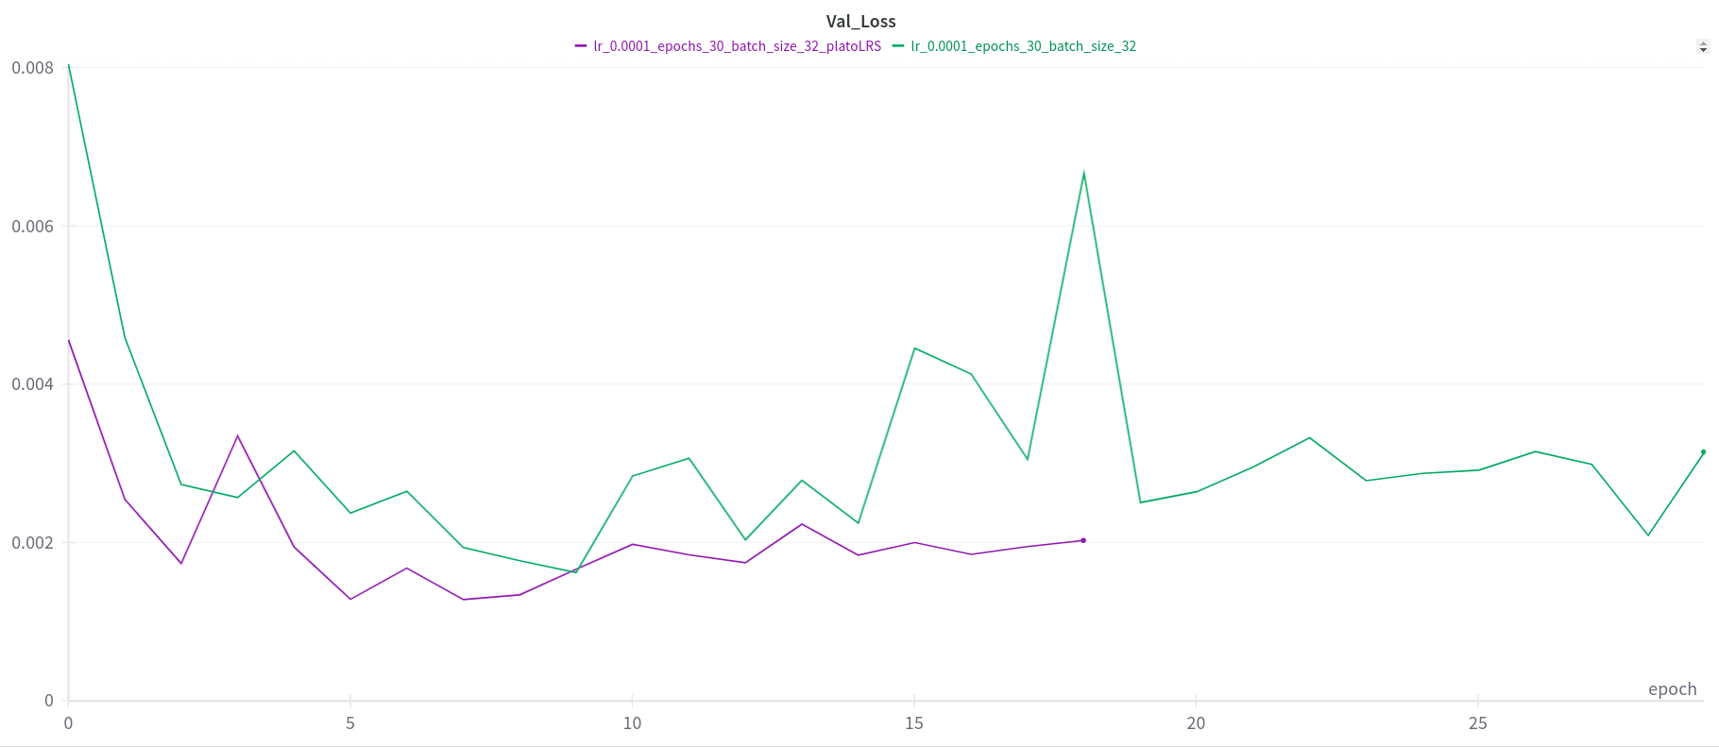
To try
Tried learning schedule: Reduce LR on Plateau (purple)
Training with more epochs
Different learning rates (0.0002)
Results uncertainty estimation?
Reproducibility!

