Slide 1
CS162 Operating Systems and Systems Programming Lecture 12 Scheduling Core Concepts and Classic Policies
Professor Natacha Crooks
https://cs162.org/
Slides based on prior slide decks from David Culler, Ion Stoica, John Kubiatowicz, Alison Norman and Lorenzo Alvisi

Slide 2
Recall: STCF
Schedule jobs in order of shortest completion time
Requires knowledge of job completion time
Subject to Starvation
Dynamically adapt priorities
Approximate duration of CPU burst; encode it in priorities

Slide 3
Recall: Multi Level Feedback Queue
Rule 1
If Priority(A) > Priority(B), A runs (B doesn’t).
Rule 2
If Priority(A) = Priority(B), A & B run RR using quantum of queue.
Rule 3
A new job is placed in the topmost queue.
Rule 4
If a job uses up its time allotment at a given level (regardless of how many times it has given up the CPU), its priority is reduced.
Rule 5
After some time period S, move all the jobs in the system to the topmost queue.

Slide 4
Recall: Multi Level Feedback Queue
Rule 1
If Priority(A) > Priority(B), A runs (B doesn’t).
Rule 2
If Priority(A) = Priority(B), A & B run RR using quantum of queue.
Rule 3
A new job is placed in the topmost queue.
Rule 4
If a job uses up its time allotment at a given level (regardless of how many times it has given up the CPU), its priority is reduced.
Rule 5
After some time period S, move all the jobs in the system to the topmost queue.

Slide 5
Recall: Learning behaviour
P₁
Computes for 1 ms. Uses disk for 10 ms
P₂
Computes for 50 ms.
q= 2 ms
P₁
q= 10 ms
P₂
q= 100 ms
Schedule
P₁
P₁
P₂
P₁
P₂

Slide 6
Many many different variants of MLQF
Change how prevent starvation
Change constants
Change scheduling policies within each queue
Most modern schedulers are variants of MLQF queues

Slide 7
What’s important?
IO-bound jobs have high priorities.
Get scheduled quickly. Run for short quantas.
Compute-bound jobs have low priority. Run with low time quantas. Run when IO bound jobs blocked on IO.
To prevent starvation, all jobs get a chance to run in a given period S.
No job says in the lower queue for ever. Account for changes in workload.

Slide 8
Goals for Today
What did “older” Linux schedulers do?
Introducing the concept of proportional fair sharing and CFS
Understanding deadlocks more formally

Slide 9
Recall: History of Schedulers in Linux
O(n) scheduler
Linux 2.4 to Linux 2.6
O(1) scheduler
Linux 2.6 to 2.6.22
CFS scheduler
Linux 2.6.23 onwards

Slide 10
Case Study: Linux O(n) Scheduler
At every context switch:
Scan full list of processes in the ready queue
Compute relevant priorities
Select the best process to run
Scalability issues:
Context switch cost increases as number of processes increase
Single queue even in multicore systems

Slide 11
Case Study: Linux O(1) Scheduler
Kernel/Realtime Tasks
User Tasks
0
100
139
Next process to run is chosen in constant time
Priority-based scheduler with 140 different priorities
Real-time/kernel tasks assigned priorities 0 to 99 (0 is highest priority)
User tasks (interactive/batch) assigned priorities 100 to 139 (100 is highest priority)

Slide 12
Case Study: O(1) Scheduler – User tasks
Per priority-level, each CPU has two ready queues
An active queue, for processes which have not used up their time quanta
An expired queue, for processes who have
Timeslices/priorities/interactivity credits all computed when jobs finishes timeslice
Timeslice depends on priority

Slide 13
User tasks – Priority Adjustment
User-task priority adjusted ±5 based on heuristics
p->sleep_avg = sleep_time – run_time
Higher sleep_avg ⇒ more I/O bound the task, more reward (and vice versa)
Interactive Credit
Earned when a task sleeps for a “long” time
Spend when a task runs for a “long” time
IC is used to provide hysteresis to avoid changing interactivity for temporary changes in behavior
However, “interactive tasks” get special dispensation
To try to maintain interactivity
Placed back into active queue, unless some other task has been starved for too long…

Slide 14
O(1) Scheduler – Real tasks
Real-Time Tasks always preempt non-RT tasks
No dynamic adjustment of priorities
Scheduling schemes:
SCHED_FIFO: preempts other tasks, no timeslice limit
SCHED_RR: preempts normal tasks, RR scheduling amongst tasks of same priority

Slide 15
An aside: Real-Time Scheduling
Goal
Predictability of Performance!
We need to predict with confidence worst case response times for systems!
Real-time is about enforcing predictability,
and does not equal fast computing.

Slide 16
Introducing the Completely Fair Scheduler
Key idea: Proportional Fair Sharing
Give each job a share of the CPU according to its priority

Slide 17
Proportional Fair Sharing
Share the CPU proportionally
Give each job a share of the CPU according to its priority
Low-priority jobs get to run less often
But all jobs can at least make progress
(no starvation)

Slide 18
Early Example: Lottery Scheduling
Give each job some number of lottery tickets
On each time slice, randomly pick a winning ticket
Each job gets at least one ticket
On average, CPU time is proportional to number of tickets given to each job

Slide 19
How to assign tickets?
Give Job A 50% of CPU, Job B 25%, Job C 10%
How can we use tickets to allow IO/interactive tasks to run quickly?
Assign tasks more tickets!
Can lottery scheduling lead to starvation?
a) Yes b) No
Can lottery scheduling lead to priority inversion?

Slide 20
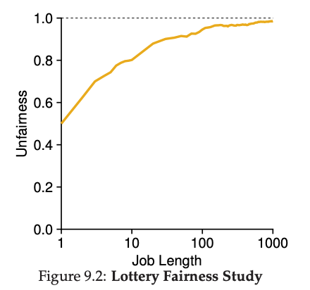
Temporary Unfairness
Lose control over which job gets scheduled next.
Can suffer temporary bouts of unfairness
Given two jobs A and B of same run time
(#Qs) that are each supposed to receive 50%,
U = finish time of first / finish time of last
As a function of run time

Slide 21
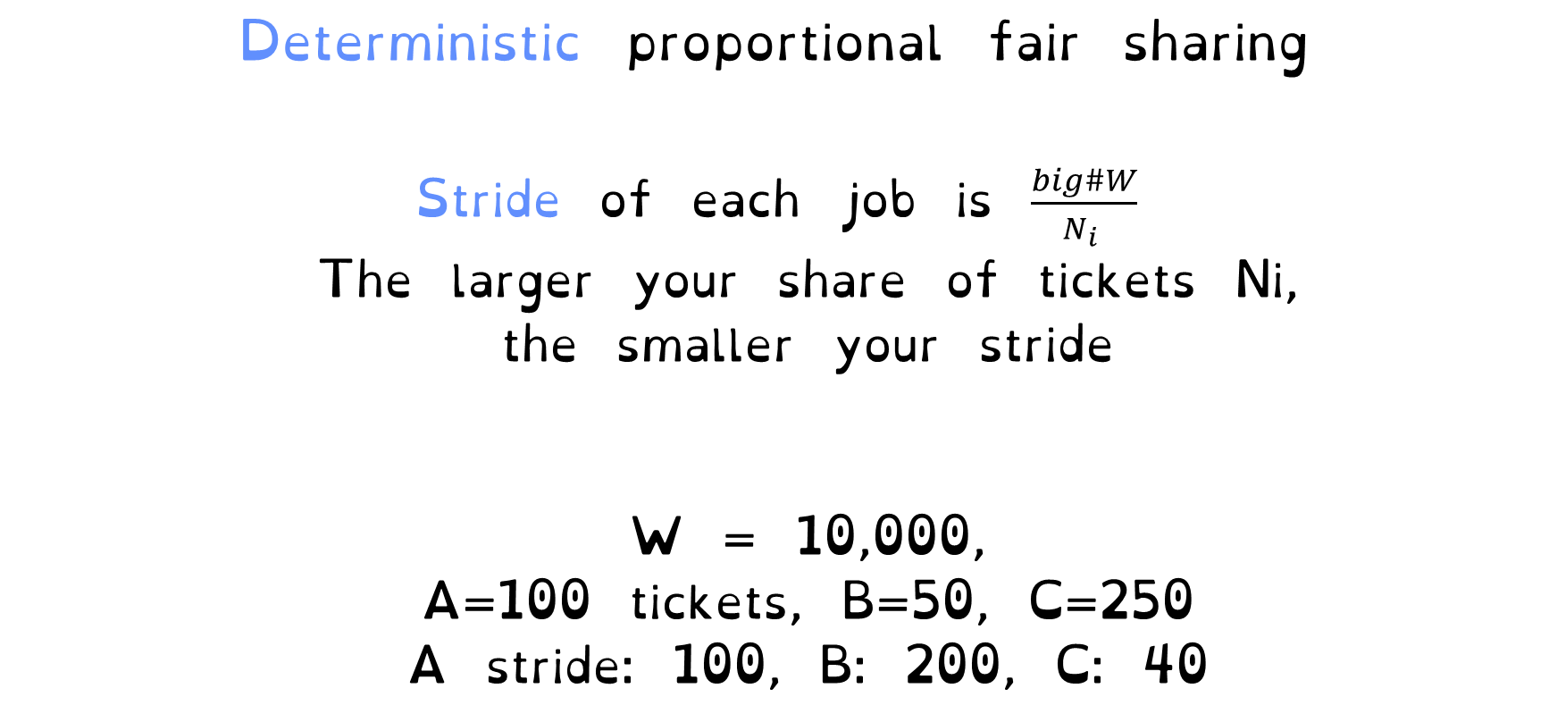
Stride Scheduling
Deterministic proportional fair sharing
Stride of each job is $\frac{big\#W}{N_{i} }$
The larger your share of tickets Ni,
the smaller your stride
W = 10,000,
A=100 tickets, B=50, C=250
A stride: 100, B: 200, C: 40

Slide 22
Stride Scheduling
Each job as a pass counter.
Scheduler picks a job with lowest pass, runs it,
add its stride to its pass
Low-stride jobs (lots of tickets) run more often

Slide 23
Stride Scheduling
W = 10,000,
A=200 tickets, B=100 tickets, C=50 tickets
Strides:
50
100
200
Schedule
50
100
100
150
200
200
200
Ready Queue
50
100
100
150
200
200
200
250
100
200
200
200
200
200
250
300
200

Slide 24
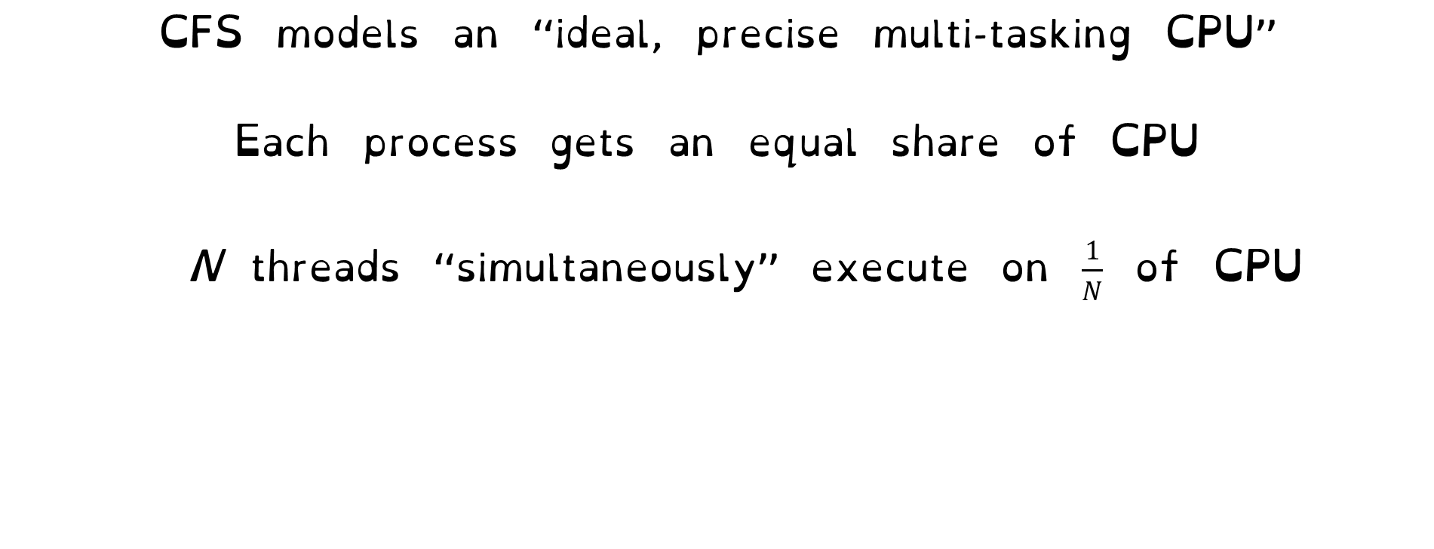


Linux Completely Fair Scheduler (CFS)
CFS models an “ideal, precise multi-tasking CPU”
Each process gets an equal share of CPU
N threads “simultaneously” execute on $\frac{1}{N}$ of CPU
Model: “Perfectly” subdivided CPU:
Each thread gets $\frac{1}{N}$ of the cycles
Optimise a global metric, not a local decision
$$\frac{1}{N}$$
T₁
T₂
T₃
CPU Time

Slide 25
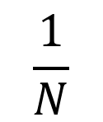
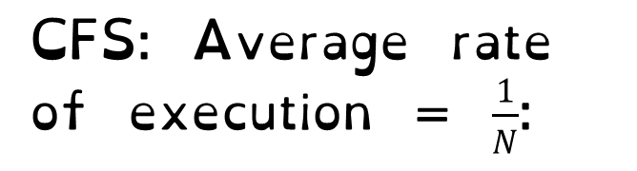
Linux Completely Fair Scheduler (CFS)
Basic Idea
Track CPU time per thread
CFS: Average rate of execution = $\frac{1}{N}$:
Scheduling Decision
“Repair” illusion of complete fairness
Choose thread with minimum CPU time
T₁
$$\frac{1}{N}$$
T₃
CPU Time
T₂

Slide 26
Linux Completely Fair Scheduler (CFS)
Fair by construction
Scheduling Cost is O(log n)
Threads are stored in a Red-Black tree.
Easy to capture interactivity
Sleeping threads don’t advance their CPU time, so automatically get a boost when wake up again

Slide 27
Linux CFS: Responsiveness
Low response time & Starvation-freedom
Make sure that everyone gets to run in a given period of time
Constraint 1: Target Latency
Period of time over which every process
gets service
Quanta = Target_Latency / n

Slide 28
Linux CFS: Latency
Constraint 1: Target Latency
Quanta = Target_Latency / n
Target Latency: 20 ms, 4 Processes
Each process gets 5ms time slice
Target Latency: 20 ms, 200 Processes
Each process gets 0.1ms time slice

Slide 29
Linux CFS: Throughput
Goal: Throughput
Avoid excessive overhead
Constraint 2: Minimum Granularity
Minimum length of any time slice
Target Latency 20 ms,
Minimum Granularity 1 ms, 200 processes
Each process gets 1 ms time slice

Slide 30
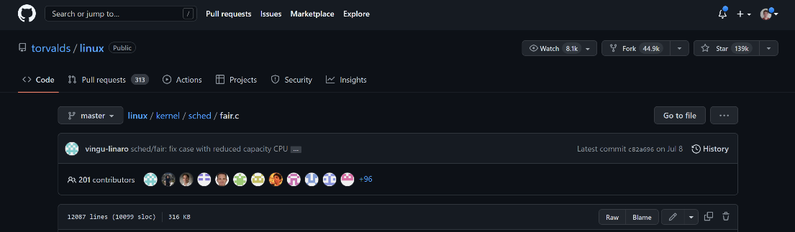
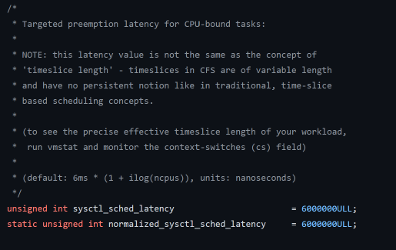
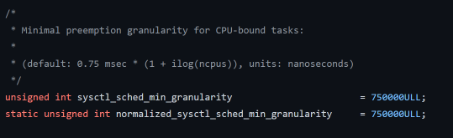
Constraints in the Wild (Linux Kernel)

Slide 31
Priorities in Unix
nice values range from -20 to 19
Negative values are “not nice”
If you wanted to let your friends get more time, you would nice up your job
Easy to implement for O(1) scheduler, how does it work for CFS?
We want to implement proportional fair sharing

Slide 32
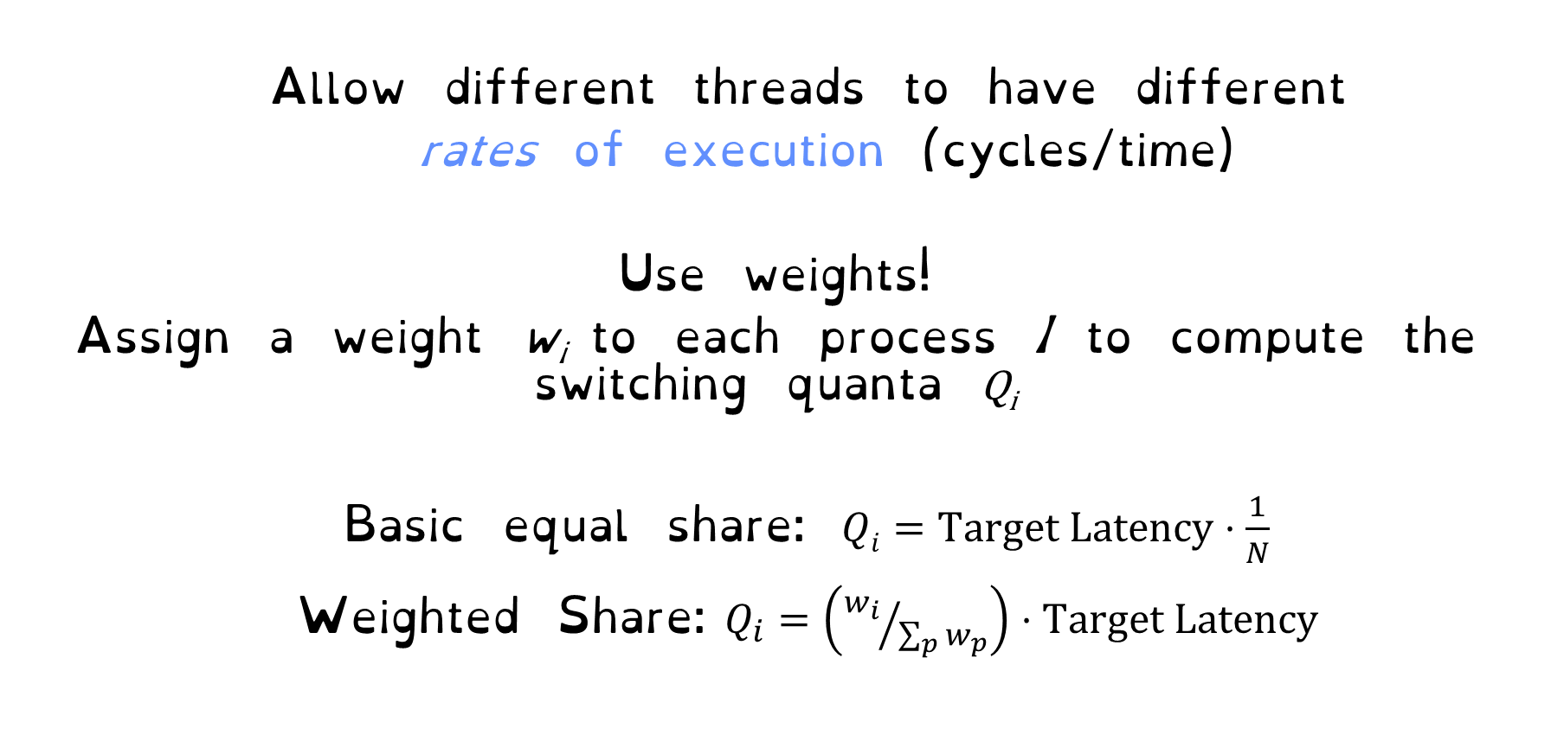
Linux CFS: Proportional Shares
Allow different threads to have different
rates of execution (cycles/time)
Use weights!
Assign a weight w_{i} to each process I to compute the switching quanta Q_{i}
Basic equal share: $Qi=Target Latency⋅\frac{1}{N}$
Weighted Share:$Q_{i}=\left({w_{i}}/{\sum_{p}{w_{p}}}\right)⋅Target Latency$

Slide 33
Linux CFS: Proportional Shares
Reuse nice value to reflect share, rather than priority
CFS uses nice values to scale weights exponentially
Weight=1024/(1.25)^{nice}

Slide 34
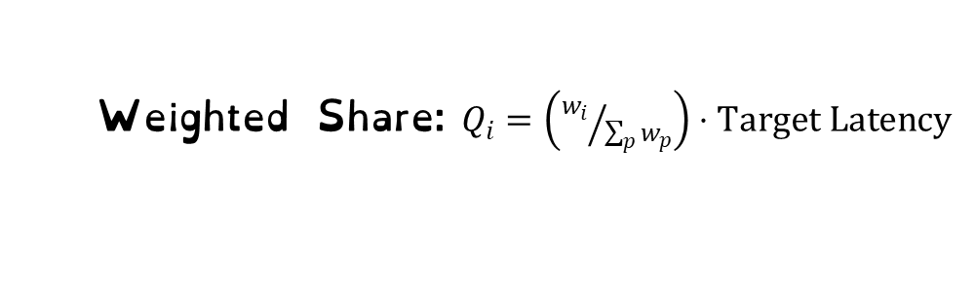
Linux CFS: Proportional Shares
Target Latency = 20ms
Minimum Granularity = 1ms
Two CPU-Bound Threads
Thread A has weight 1
Thread B has weight 4
What should the time slice of A and B be?
Weighted Share:$Q_{i}=\left({w_{i}}/{\sum_{p}{w_{p}}}\right)⋅Target Latency$
A = (1/5) * 20 = 4
B = (4/5) * 20 = 16

Slide 35
Linux CFS: Proportional Shares
Target Latency = 20ms
Minimum Granularity = 1ms
A timeslice = 4ms
B timeslice = 16 ms
Recall: Run the thread with the lowest amount of CPU use
A
B
0
0

Slide 36
Linux CFS: Proportional Shares
Target Latency = 20ms
Minimum Granularity = 1ms
A timeslice = 4ms
B timeslice = 16 ms
Recall: Run the thread with the lowest amount of CPU use
A
B
4
16
A
B

Slide 37
Linux CFS: Proportional Shares
Target Latency = 20ms
Minimum Granularity = 1ms
A timeslice = 4ms
B timeslice = 16 ms
Recall: Run the thread with the lowest amount of CPU use
A
B
8
16
A
B
A

Slide 38
Linux CFS: Proportional Shares
Target Latency = 20ms
Minimum Granularity = 1ms
A timeslice = 4ms
B timeslice = 16 ms
Recall: Run the thread with the lowest amount of CPU use
A
B
16
16
A
B
A
A
A

Slide 39
Linux CFS: Proportional Shares
Target Latency = 20ms
Minimum Granularity = 1ms
A timeslice = 4ms
B timeslice = 16 ms
A and B got 50% of the CPU. Something went wrong!
Recall: Run the thread with the lowest amount of CPU use
A
B
16
16
A
B
A
A
A

Slide 40

Virtual Runtime
Must track a thread's virtual runtime
rather than its true physical runtime
Higher weight: Virtual runtime increases more slowly
Lower weight: Virtual runtime increases more quickly
Virtual Runtime = Virtual Runtime + $\left(1/{w_{i}}\right)$ Physical Runtime

Slide 41
Linux CFS: Proportional Shares
Target Latency = 20ms
Minimum Granularity = 1ms
A timeslice = 4ms
B timeslice = 16 ms
Recall: Run the thread with the lowest amount of CPU use
A
B
0
0

Slide 42
Linux CFS: Proportional Shares
Target Latency = 20ms
Minimum Granularity = 1ms
A timeslice = 4ms
B timeslice = 16 ms
Virtual Runtime = 0 + Physical Runtime / Weight = 0 + 4/1
A
B
4
0
A

Slide 43
Linux CFS: Proportional Shares
Target Latency = 20ms
Minimum Granularity = 1ms
A timeslice = 4ms
B timeslice = 16 ms
Virtual Runtime = 0 + Physical Runtime / Weight = 0 + 16/4 = 4
A
B
4
4
A
B

Slide 44
Linux CFS: Proportional Shares
Target Latency = 20ms
Minimum Granularity = 1ms
A timeslice = 4ms
B timeslice = 16 ms
Virtual Runtime = 4 + Physical Runtime / Weight = 4 + 4/1 = 8
A
B
8
4
A
B
A

Slide 45
Linux CFS: Proportional Shares
Target Latency = 20ms
Minimum Granularity = 1ms
A timeslice = 4ms
B timeslice = 16 ms
Virtual Runtime = 4 + Physical Runtime / Weight = 4 + 16/4 = 8
A
B
8
8
A
B
A
B

Slide 46
Linux CFS: Proportional Shares
A “Physical” CPU utilization: 4 + 4 = 8
B “Physical” CPU utilization: 16 + 16 = 32
But equal virtual runtime!
CFS shares vruntime equally
A
B
8
8
A
B
A
B

Slide 47
Linux CFS: Proportional Shares
Physical
CPU Time
Virtual
CPU Time
16 (w_{B}=4)
B
B
A
4 (w_{A}=1)
A

Slide 48
Summary: Schedulers in Linux
O(n) scheduler
Linux 2.4 to Linux 2.6
O(1) scheduler
Linux 2.6 to 2.6.22
CFS scheduler
Linux 2.6.23 onwards
Did not scale with large number of processes
Heuristics too complex
Proportional Fair Sharing. Throughput and Latency constraints
Gives all processes 1/N *virtual time * on CPU

