Slide 1
CS162 Operating Systems and Systems Programming Lecture 19 File Systems
Professor Natacha Crooks
https://cs162.org/
Slides based on prior slide decks from David Culler, Ion Stoica, John Kubiatowicz, Alison Norman and Lorenzo Alvisi

Slide 2
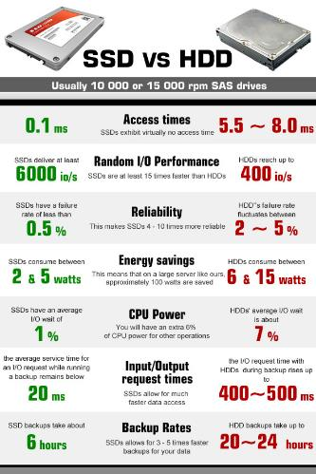
Recall: HDD vs. SSD Comparison
HDD | SDD
Require seek + rotation | No seeks
Not parallel (one head) | Parallel
Brittle (moving parts) | No moving parts
Random reads take 10s milliseconds | Random reads take 10s microseconds
Slow (Mechanical) | Wears out
Cheap/large storage | Expensive/smaller storage

Slide 3
Recall: I/O and Storage Layers
High Level I/O
Streams
Low Level I/O
File Descriptors
Syscall
open(), read(), write(), close(), …
Open File Descriptions
File System
Files/Directories/Indexes
I/O Driver
Commands and Data Transfers
Disks, Flash, Controllers, DMA

Slide 4
From Storage to File Systems
I/O API and
syscalls
Variable-Size Buffer
Memory Address
Logical Index, Typically 4 KB
File System
Block
Flash Trans. Layer
Hardware Devices
Sector(s)
Sector(s)
Sector(s)
Phys. Block
Phys Index., 4KB
Physical Index,
512B or 4KB
Erasure Page
HDD
SSD

Slide 5
Building a File System
Layer of OS that transforms block interface of disks (or other block devices) into Files, Directories, etc.

Slide 6
Building a File System
Take limited hardware interface (array of blocks) and provide a more convenient/useful interface with:
Naming: Find file by name, not block numbers
Structure: Organize file names with directories
Organization: Map files to blocks
Protection: Enforce access restrictions
Reliability: Keep files intact despite crashes, failures, etc.

Slide 7
User vs. System View of a File
User’s view:
Durable Data Structures
System’s view (system call interface):
Collection of Bytes (UNIX)
Doesn’t matter to system what kind of data structures you want to store on disk!
System’s view (inside OS):
Collection of blocks (a block is a logical transfer unit, while a sector is the physical transfer unit)
Block size ≥ sector size; in UNIX, block size is 4KB

Slide 8

Translation from User to System View
File (Bytes)
File
System
What happens if user says: “give me bytes 2 – 12?”
Fetch block corresponding to those bytes
Return just the correct portion of the block
What about writing bytes 2 – 12?
Fetch block, modify relevant portion, write out block
Everything inside file system is in terms of whole-size blocks

Slide 9
Disk Management
File:
User-visible group of blocks arranged sequentially
in logical space
Directory:
User-visible index mapping names to files
Logical Block Addressing (LBA)
The disk is accessed as linear array of sectors
Every sector has integer address
Controller translates from address ⇒ physical position
Shields OS from structure of disk

Slide 10
What Does the File System Need?
Track free disk blocks
Need to know where to put newly written data
Track which blocks contain data for which files
Need to know where to read a file from
Track files in a directory
Find list of file's blocks given its name
Where do we maintain all of this?
Somewhere on disk

Slide 11

Recall: FD & File Descriptors
O: STDIN
Mode
Flags
Offset
Phys
1: STDOUT
U
R
200
2: STDERR
U
RW
200
3
4
Per-Process File Descriptor Table
Global Open File Description Table
Global Open File Description Table

Slide 12
Critical Factors in File System Design
(Hard) Disks Performance !!!
Open before Read/Write
Size is determined as they are used !!!
Organized into directories
Need to carefully allocate / free blocks

Slide 13
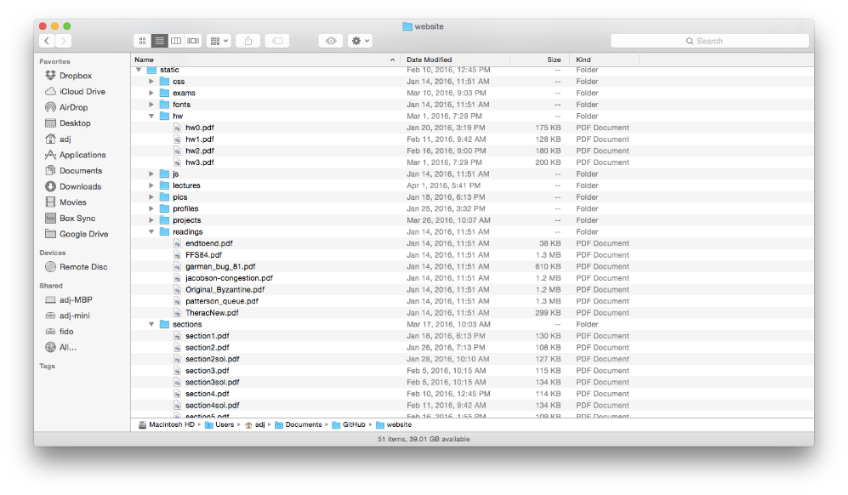
Files & Directories

Slide 14
Files & Directories

Slide 15
Manipulating directories
System calls to access directories
open / creat / readdir traverse the structure
mkdir / rmdir add/remove entries
link / unlink (rm)
libc support
DIR * opendir (const char *dirname)
struct dirent * readdir (DIR *dirstream)
int readdir_r (DIR *dirstream, struct dirent *entry, struct dirent **result)
/usr
/usr/lib
/usr/lib4.3
/usr/lib4.3/foo

Slide 16
Components of a File System
Superblock object: information about file system
Free bitmaps: what is allocated/not allocated
Inode object: represents a specific file
Dentry object: directory entry, single component of a path
File object: open file associated with a process.
Blocks: How files are stored on disk

Slide 17
Components of a File System
open(/laptop/Natacha/cs162/foo.txt)
File path
Directory
Structure
File
Header
Structure
One Block = multiple sectors
Ex: 512 sector, 4K block
File number
“inumber”
Data blocks
Inode
…

Slide 18
The (In)famous Inode
O: STDIN
Mode
Flags
Offset
Phys
R
Inode Number
1: STDOUT
U
200
U
RW
200
Inode Number
2: STDERR
3
4
Per-Process File Descriptor Table
Global Open File Description Table
Global Open File Description Table

Slide 19
How to get the Inode number?
Look up in directory structure
Directory is a specialised file containing
<file_name : inode number> mappings
File number could be a file or another directory
Each <file_name : inode> mapping is called a directory entry

Slide 20
How to read a file from disk
Let’s read file /foo/bar.txt (Time goes downwards)

Slide 21
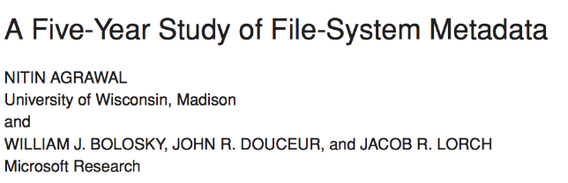
Characteristics of Files
Published in FAST 2007

Slide 22
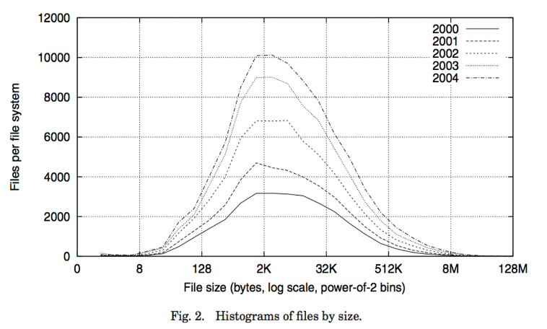
Observation #1: Most Files Are Small

Slide 23
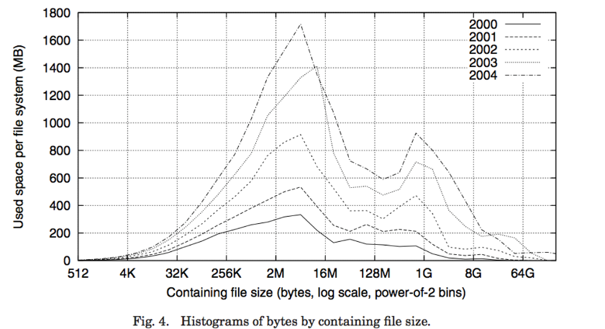
Observation #2: Most Bytes are in Large Files

Slide 24
The key to it all: the Inode
File Number is index into set of inode arrays
Index structure is an array of inodes
Each inode corresponds to a file and contains its metadata
Inode maintains a multi-level tree structure to find storage blocks for files
Original inode format appeared in BSD 4.1
Berkeley Standard Distribution Unix!

Slide 25
Inode Structure

Slide 26
File Attributes
User
Group
9 basic access control bits
- UGO x RWX
SetUID bit
- execute at owner permissions rather than user
SetGID bit
- execute at group’s permissions

Slide 27

Direct Pointers
Direct pointers
4kB blocks ⇒ sufficient for files up to 48KB

Slide 28
Indirect Pointers
Indirect pointers point to a disk block containing only pointers
48 KB
+4 MB
+4 GB
+4 TB

Slide 29
Indirect Pointers
Assume 4KB blocks
What is the maximum size of a file with only direct pointers?
12 * 4 KB = 48 KB
What is the maximum size of a file with one indirect pointer?
12 * 4 KB + 1024 * 4KB = 4.1MB
What is the maximum size of a file with double indirect pointers?
12 * 4KB + 1024 * 4KB + 1024 * 1024 * 4KB = 4.6 GB

Slide 30
Inodes form an on-disk index
Sample file in multilevel indexed format:
12 direct ptrs, 4K blocks
How many accesses for block #23? (assume file header accessed on open)?
Two: One for indirect block, one for data
How about block #5?
One: One for data
Block #340?
Three: double indirect block, indirect block, and data

Slide 31
Creating new files
Inodes are (logically) stored in an inode table
File system stores a bitmap of free inodes and free blocks
On creating a new file,
Check which inode is free/where that inode is stored
Check which data blocks are free

Slide 32
Putting it together
/cs162/natacha.txt (60KB)
/cs162/natasha.txt (4KB)
Each block is 4KB
Inode is 256 Bytes

Slide 33
Putting it together
/cs162/natacha.txt (60KB)
/cs162/natasha.txt (4KB)
Sblock

Slide 34
Putting it together
/cs162/natacha.txt (60KB)
/cs162/natasha.txt (4KB)
Sblock
Inode bitmap
Block bitmap

Slide 35
Putting it together
/cs162/natacha.txt (60KB)
/cs162/natasha.txt (4KB)
Sblock
Inode bitmap
Block bitmap
Inodes 0 to 15
Inodes 16 to 31
Inodes 32 to 47
Inodes 48 to 63
Inodes 64 to 79

Slide 36
Putting it together
/cs162/natacha.txt (60KB)
/cs162/natasha.txt (4KB)
Sblock
Inode bitmap
Block bitmap
Inodes 0 to 15
Inodes 16 to 31
Inodes 32 to 47
Inodes 48 to 63
Inodes 64 to 79

Slide 37
Putting it together
/
Allocate inode 0
Create data block
Sblock
Inode bitmap
Block bitmap
Inodes 0 to 15
Inodes 16 to 31
Inodes 32 to 47
Inodes 48 to 63
Inodes 64 to 79

Slide 38
Putting it together
/
Allocate inode 0
Create data block
Sblock
1000
1000
0000
Inodes 0 to 15
Inodes 16 to 31
Inodes 32 to 47
Inodes 48 to 63
Inodes 64 to 79
<.,0>

Slide 39
Putting it together
/cs162
Allocate inode 1
Update direntry for /
Create data block
Sblock
1000
1000
0000
Inodes 0 to 15
Inodes 16 to 31
Inodes 32 to 47
Inodes 48 to 63
Inodes 64 to 79
<..,-1>

Slide 40
Putting it together
/cs162
Allocate inode 1
Update direntry for /
Create data block
Sblock
1100
1100
0000
Inodes 0 to 15
Inodes 16 to 31
Inodes 32 to 47
Inodes 48 to 63
Inodes 64 to 79
<..,-1>
<cs162,1>
<..,0>

Slide 41
Putting it together
/cs162/natacha.txt (60KB)
Allocate inode 3
Update direntry
Create indirect block
Create datablocks
Sblock
1101
1111
1111
Inodes 0 to 15
Inodes 16 to 31
Inodes 32 to 47
Inodes 48 to 63
Inodes 64 to 79
<..,-1>
<cs162,1>
<..,0>
<nat..,3>
Indirect block
Data block
Data block
Data block
Data block
Data block
…

Slide 42
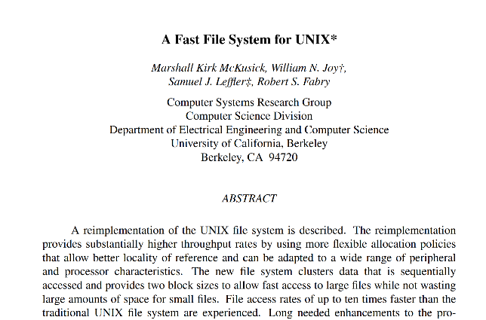
Unix File System (Berkeley FFS)
Introducing Disk Awareness

Slide 43
Recall: Critical Factors in File System Design
(Hard) Disk Performance !!!
Maximize sequential access, minimize seeks
Open before Read/Write
Can perform protection checks and look up where the actual file resource are, in advance
Size is determined as they are used !!!
Can write (or read zeros) to expand the file
Start small and grow, need to make room
Organized into directories
What data structure (on disk) for that?
Need to carefully allocate / free blocks
Such that access remains efficient

Slide 44
Recall: Magnetic Disks
Track
Sector
Cylinders: all the tracks under the head at a given point on all surfaces
Read/write data is a three-stage process:
Seek time: position the head/arm over the proper track
Rotational latency: wait for desired sector to rotate under r/w head
Transfer time: transfer a block of bits (sector) under r/w head
Head
Cylinder
Platter

Slide 45
Fast File System (BSD 4.2, 1984)
Same inode structure as in BSD 4.1
same file header and triply indirect blocks like we just studied
Some changes to block sizes from 1024⇒4096 bytes for performance
Optimization for Performance and Reliability:
Distribute inodes among different tracks to be closer to data
Uses bitmap allocation in place of freelist
Attempt to allocate files contiguously
10% reserved disk space
Skip-sector positioning (mentioned later)

Slide 46
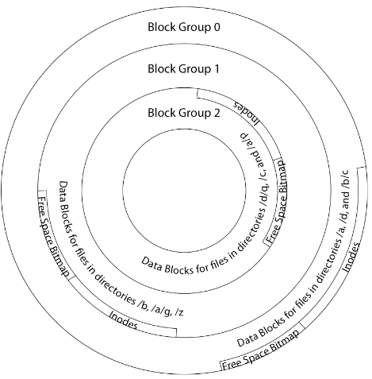
FFS Locality: Block Groups
Distribute header information (inodes) closer to the data blocks, in same “cylinder group”
File system volume divided into set of block groups
Data blocks, metadata, and free space interleaved within block group
Put directory and its files in common block group

Slide 47
FFS Locality: Block Groups
First-Free allocation of new file blocks
To expand file, first try successive blocks in bitmap, then choose new range of blocks
Few little holes at start, big sequential runs at end of group
Avoids fragmentation
Sequential layout for big files
Important: keep 10% or more free!
Reserve space in the Block Group

Slide 48
Attack of the Rotational Delay
Missing blocks due to rotational delay
Issue: Read one block, do processing, and read next block. In meantime, disk has continued turning: missed next block! Need 1 revolution/block!

Slide 49
Attack of the Rotational Delay
Solution 1: Skip sector positioning (“interleaving”)
Place the blocks from one file on every other block of a track: give time for processing to overlap rotation
Can be done by OS or in modern drives by the disk controller
Solution 2: Read ahead: read next block right after first, even if application hasn’t asked for it yet
This can be done either by OS (read ahead)
By disk itself (track buffers) - many disk controllers have internal RAM that allows them to read a complete track

Slide 50
UNIX 4.2 BSD FFS
Pros
Efficient storage for both small and large files
Locality for both small and large files
Locality for metadata and data
No defragmentation necessary!
Cons
Inefficient for tiny files (a 1 byte file requires both an inode and a data block)
Inefficient encoding when file is mostly contiguous on disk
Need to reserve 10-20% of free space to prevent fragmentation

Slide 51
What about other file systems?
FAT:
File Allocation Table
(MS-DOS,1977)
Windows NTFS

Slide 52
FAT (File Allocation Table)
Assume (for now) we have a way to translate a path to a “file number”
i.e., a directory structure
Disk Storage is a collection of Blocks
Just hold file data
(offset o = < B, x >)
Example: file_read 31, < 2, x >
Index into FAT with file number
Follow linked list to block
Read the block from disk into memory
FAT
Disk Blocks
0:
0:
File number
31:
File 31, Block 0
File 31, Block 1
File 31, Block 2
File 31, Block 2
N-1:
N-1:
memory

Slide 53
FAT (File Allocation Table)
File is a collection of disk blocks
FAT is linked list 1-1 with blocks
File number is index of root of block list for the file
File offset: block number and offset within block
Follow list to get block number
Unused blocks marked free
Could require scan to find
Or, could use a free list
FAT
Disk Blocks
0:
0:
File number
31:
File 31, Block 0
File 31, Block 1
free
File 31, Block 2
N-1:
N-1:
memory

Slide 54
FAT (File Allocation Table)
file_write(31, < 3, y >)
Grab free block
Linking them into file
FAT
Disk Blocks
0:
0:
File number
31:
File 31, Block 0
File 31, Block 1
File 31, Block 3
free
File 31, Block 2
N-1:
N-1:
memory

Slide 55
FAT (File Allocation Table)
FAT
Disk Blocks
Where is FAT stored?
On disk
How to format a disk?
Zero the blocks, mark FAT entries “free”
How to quick format a disk?
Mark FAT entries “free”
Simple: can implement in device firmware
0:
0:
File #1
31:
File 31, Block 0
File 31, Block 1
File 31, Block 3
free
File #2
File 31, Block 2
N-1:
N-1:
memory

Slide 56
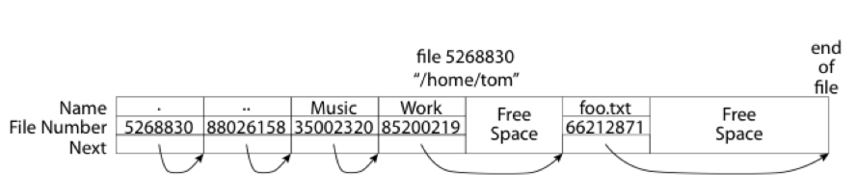
FAT: Directories
A directory is a file containing <file_name: file_number> mappings
In FAT: file attributes are kept in directory (!!!)
Not directly associated with the file itself
Each directory a linked list of entries
Requires linear search of directory to find particular entry
Where do you find root directory (“/”)?
At well-defined place on disk
For FAT, this is at block 2 (there are no blocks 0 or 1)

Slide 57
FAT Discussion
FAT
Disk Blocks
Suppose you start with the file number:
Time to find block?
Block layout for file?
Sequential access?
Random access?
Fragmentation?
Small files?
Big files?
0:
0:
File #1
31:
File 31, Block 0
File 31, Block 1
File 31, Block 3
free
File #2
File 31, Block 2
N-1:
N-1:
memory

