Slide 1
CS162 Operating Systems and Systems Programming Lecture 2 Protection: Processes and Kernels
Professor Natacha Crooks
https://cs162.org/
Slides based on prior slide decks from David Culler, Ion Stoica, John Kubiatowicz, Alison Norman and Lorenzo Alvisi

Slide 2

Admistratrivia
This Photo by Unknown Author is licensed under CC BY-SA-NC

Slide 3
Homework and Early Drop Deadline
HW0 Due 31/8
Should be working on Homework 0 already!
cs162-xx account, Github accountVagrant and VirtualBox – VM environment for the course
Consistent, managed environment on your machine
Get familiar with all the cs162 tools, submit to autograder via git

Slide 4
Homework and Early Drop Deadline
HW0 Due 1/9 (Same Day as Early Drop Deadline)
Should be working on Homework 0 already!
Get familiar with all the cs162 tools, submit to autograder via git
HW1 will be released on 2/9

Slide 5
Projects are looming
Group Formation Form (Link on EdStem) is due 2/9.
There is a teammate search functionality on EdStem.
Discussions are starting! First 2 optional but mandatory afterwards
Project 0 will be released on 9/4

Slide 6
Recall: Operating System
An operating system implements a virtual machine for the application whose interface is more convenient than the raw hardware interface (convenient = security, reliability, portability)
Application 1
Application 2
Application 3
Operating System
Hardware

Slide 7



Recall: Three main hats
Referee
Manage protection, isolation, and sharing of resources
Illusionist
Provide clean, easy-to-use abstractions of physical resources
Glue
Provides a set of common services

Slide 8
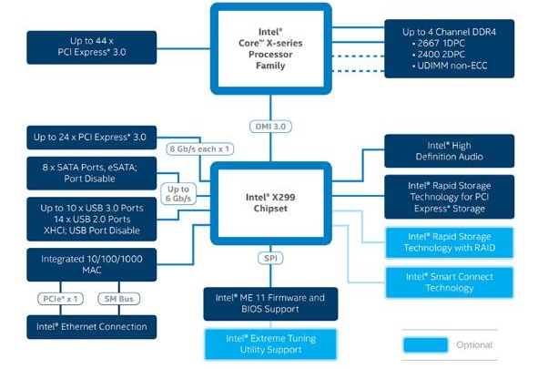
Recall: HW Complex
Memory Channels
(High BW DRAM)
Really High Speed I/O (e.g. graphics)
Direct Media Interface (3.93 GBytes/sec)
High-Speed I/O devices (PCI Exp)
HD Audio
Disks (8 x SATA)
PCI/e Drives
Slower I/O (USB)
RAID 0/1/5/10
Integrated Ethernet
Smart Connect (autoupdate)
Intel Skylake-X I/O Configuration

Slide 9
Recall: Increasing Software Complexity

Slide 10
Topic Breakdown
Process Abstraction and API
Threads and Concurrency
Virtualizing the CPU
Scheduling
Virtual Memory
Virtualizing Memory
Paging
IO devices
Persistence
File Systems
Challenges with distribution
Distributed Systems
Data Processing & Storage

Slide 11
Mechanisms vs Policy
Mechanism
Low-level methods or protocols that implement a needed piece of functionality
Policy
Algorithms for making decisions within the OS.
Use the mechanism.
A Brake Pedal!
“I break when I see a stop sign”

Slide 12
Goals for Today
What are the requirements of a good VM abstraction?
What is a process?
How does the kernel use processes to enforce protection?
When does one switch from kernel to user mode and back?

Slide 13
Goal 1: Requirements for Virtualization

Slide 14

The OS will protect you
Protection is necessary to preserve the virtualization abstraction
Protect applications from other application’s code
(reliability, security, privacy)
Protect OS from the application
Protect applications against inequitable resource utilisation
(memory, CPU time)
OS

Slide 15
Goal 2: What is a Process?

Slide 16
A process (simplified)
A process is an instance of a running program
CPU
Memory
(address space)
Registers
IO information
Store code, data, stack, heap
Program Counter, Stack Pointer
Regular registers
Open files (and others)

Slide 17

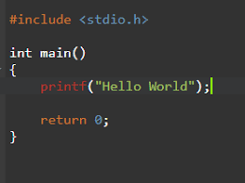
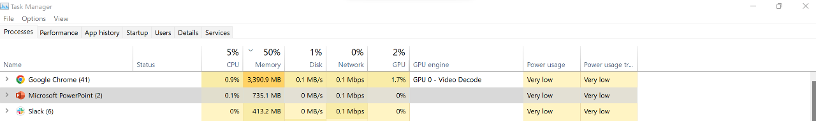
From program to process
Executable image, instructions and data
./helloworld
crooks@laptop> ./helloworld
crooks@laptop> ./helloworld
Physical Memory
Code
Data
Heap
Stack
Code
Data
Heap
Stack

Slide 18
Process Life Cycle
A process can be in one of several states:
(real OSes have additional variants)
Descheduled
Dying
Running
Ready
Scheduled
Request I/O
Finish I/O
Blocked

Slide 19
Process Management by the OS
Process Control Block (or process descriptor)
in OS stores necessary metadata
PC
Stack Ptr
Registers
PID
UID
List of open files
Process State
…

Slide 20
Three “Prongs” for the Class
Understanding OS principles
System Programming
Map Concepts to Real Code

Slide 21
Processes in the wild (well, in the kernel)
enum procstate { UNUSED, EMBRYO, SLEEPING, RUNNABLE, RUNNING, ZOMBIE };
// Per-process state
struct proc {
uint sz; // Size of process memory (bytes)
pde_t* pgdir; // Page table
char *kstack; // Bottom of kernel stack for this process
enum procstate state; // Process state
int pid; // Process ID
struct proc *parent; // Parent process
struct trapframe *tf; // Trap frame for current syscall
struct context *context; // swtch() here to run process
void *chan; // If non-zero, sleeping on chan
int killed; // If non-zero, have been killed
struct file *ofile[NOFILE]; // Open files
struct inode *cwd; // Current directory
char name[16]; // Process name (debugging)
};
In Linux: task_struct defined in <linux/sched.h>
Xv6 Kernel (proc.h)

Slide 22
Processes in Pintos
struct process {
/* Owned by process.c. */
uint32_t* pagedir; /* Page directory. */
char process_name[16]; /* Name of the main thread */
struct thread* main_thread; /* Pointer to main thread */
/* All the fun data structures you’re going to add */
};
Pintos (userprog/process.h)

Slide 23
Many Processes
Process List stores all processes
struct {
struct spinlock lock;
struct proc proc[NPROC];
} ptable;
Xv6 Kernel (proc.c)
Run Queues
Lists all PCBs in READY state
Wait Queues
Lists all PCBs in BLOCKED state

Slide 24
The Illusionist and the Referee are Back
Illusionist
Give every process the illusion of running on a private CPU
Give every process the illusion of running on private memory
Referee
Manage resources to allocate to each process
Isolate process from all other processes and protect OS

Slide 25

Operating System Kernel
Lowest level of OS running on system.
Kernel is trusted with full access to all hardware capabilities
All other software (OS or applications) is considered untrusted
Applications
Untrusted
Rest of OS
Trusted
Operating System Kernel
Untrusted
Hardware

Slide 26
The Process, Refined
A executing program with restricted rights
Process
Process
Process
OS
OS
OS
Hardware
Hardware
Hardware
Enforcing mechanism must not hinder functionality or hurt performance

Slide 27

User vs Kernel: Dr Jekyll and Mr Hyde
Application/User Code (Untrusted)
Run all the processor with all potentially dangerous operations disabled
Kernel Code (Trusted)
Runs directly on processor with unlimited rights
Performs any hardware operations
But run on the same machine!

Slide 28
How can the kernel enforce restricted rights?
1) While preserving functionality
2) While preserving performance
3) While preserving control

Slide 29
Attempt 1: Simulation

Slide 30
Recall: CPU Instruction Cycle (from CS61c)
Memory
Processor
next
PC:
Instruction fetch
instruction
Decode
decode
Registers
Execute
ALU
data

Slide 31

Attempt 1: Simulation
Process
Have the Kernel interpret and check every instruction!
OS
Hardware
Potential Issues:
Extremely slow! Would have to cycle through all operations, switch into the kernel, etc.
Unnecessary. Most operations are perfectly safe!

Slide 32
Attempt 2: Dual Mode Operation
Hardware to the rescue!
Use a bit to enable two modes of execution
In User Mode
Processor checks each instruction before executing it
Executes a limited (safe) set of instructions
In Kernel Mode
OS executes with protection checks off
Can execute any instructions

Slide 33
Hardware must support
Privileged Instructions
Unsafe instructions cannot be executed in user mode
2) Memory Isolation
Memory accesses outside a process’s address space prohibited
3) Interrupts
Ensure kernel can regain control from running process
4) Safe Transfers
Correctly transfer control from user-mode to kernel-mode and back

Slide 34
Req 1/4: Privileged Instructions
Cannot change privilege level (set mode bit)
Cannot change address space
Cannot disable interrupts
Cannot perform IO operations
Cannot halt the processor

Slide 35
How can an application do anything useful …
Asks for permission to access kernel mode!
System calls Transition from user to kernel mode only at specific locations specified by the OS
Exceptions User mode code attempts to execute a privileged exception. Generates a processor exception which passes control to kernel at specific locations
More on safe control transfers later

Slide 36
Hardware must support
Privileged Instructions
Unsafe instructions cannot be executed in user mode
2) Memory Isolation
Memory accesses outside a process’s address space prohibited
3) Interrupts
Ensure kernel can regain control from running process
4) Safe Transfers
Correctly transfer control from user-mode to kernel-mode and back

Slide 37
Req 2/4: Memory Protection
OS and applications both resident in memory
Application should not read/write kernel memory
(or other apps memory)

Slide 38
A Bug’s Tail
The character could leave the game area and start overwriting other running programs and kernel memory.
One of the worst bugs I ever had to deal with was in this game. Once the game player made it to the Colony, every so often the system would crash and burn at totally random times. You might be playing for ten minutes when it happened or ten hours, but it would just die in a totally random way
There was a slow-moving slug like creature that knew how to follow the game player’s trail. When it came across another creature, rather than bouncing off and risk losing the trail, I made it so that it would destroy the other creature and stay on target to find you. This worked great, except that on some rare occasions, this slug could do to a wall what it did to the other creatures. That is, it could delete it. This meant that the virtual door was now open for this creature to explore the rest of the RAM on the Macintosh, deleting and modifying it as it went along. Of course, it was just a matter of time before it found some juicy code. In other words, the bug was a REAL bug.

Slide 39

Super Mario Land 2
Mario could exit a level and explore the entire memory of the system

Slide 40
Attempt 1: Isolation
Hardware to the rescue! (Again)
Base and Bound registers
Code
Data
Heap
Stack
Code
Data
Heap
Stack
Base
Base
Bound
Bound
Address Space
Process 1
Address Space
Process 2

Slide 41
Attempt 1: Isolation
Hardware to the rescue! (Again)
Base and Bound registers
Memory Reference
CPU
OK?
Yes
Continue
No
Generate Exception

Slide 42
Attempt 1: Isolation
Kernel Mode executes without
Base and Bound registers
What can the Kernel see?
Kernel memory only
Kernel memory + application memory of app that “invoked” kernel c) Everything

Slide 43
Limitations of Isolation
Expandable memory
Static memory allocation
2) Memory Sharing
Cannot share memory between processes
3) Non-Relative Memory Addresses
Location of code & data determined at runtime
4) Fragmentation
Cannot relocate/move programs. Leads to fragmentation

Slide 44
Attempt 2: Virtualization
Virtual address space
Set of memory addresses that process can “touch”
Physical address space
Set of memory addresses supported by hardware

Slide 45
Attempt 2: Virtualization
Map from virtual addresses to physical addresses through address translation
Pid,
Virtual Memory Address
Physical Memory Address

Slide 46
Attempt 2: Virtualization
Continues to provide isolation
Physical Memory for P1
Process 1,
Virtual Memory Address
Process 2,
Virtual Memory Address
Physical Memory for P2

Slide 47
Benefits of Virtualization
Expandable memory
Whole space of virtual address space! Even physical address not resident in memory
2) Memory Sharing
Same virtual address can map to same physical address
3) Relative Memory Addresses
Every process’s memory always starts at 0
4) Fragmentation
Can dynamically change mapping of virtual to physical addresses

Slide 48
What does this program do? (CS61C)
#include <stdio.h>
#include <stdlib.h>
#include <unistd.h>
int main(int argc, char *argv[]){
int *p = malloc(sizeof(int));
printf("(%d) p: %p\n", getpid(), p);
*p = 0;
while (1) {
*p = *p + 1;
printf("(%d) p: %d\n", getpid(), *p);
}
return 0;
}
crooks@laptop> gcc –o memory memory.c -Wall
crooks@laptop> ./memory
(120) p: 0x200000
(120) p: 1
(120) p: 2
(120) p: 3
(120) p: 4
crooks@laptop> ./memory & ./memory
(120) p: 0x200000
(254) p: 0x200000
Are these virtual or physical addresses?
Virtual memory provides each process with illusion of own complete (and infinite) memory

Slide 49
Virtual Memory is Hard!
Process Abstraction and API
Threads and Concurrency
Virtualizing the CPU
Scheduling
Virtual Memory
Virtualizing Memory
Paging
IO devices
Persistence
File Systems
Challenges with distribution
Distributed Systems
Data Processing & Storage

Slide 50
Hardware must support
Privileged Instructions
Unsafe instructions cannot be executed in user mode
2) Memory Isolation
Memory accesses outside a process’s address space prohibited
3) Interrupts
Ensure kernel can regain control from running process
4) Safe Transfers
Correctly transfer control from user-mode to kernel-mode and back

Slide 51
Req 3/4: Interrupts
Kernel must be able to regain control of the processor
Hardware to the rescue! (Again x 2)
Hardware Interrupts
Set to interrupt processor after a specified delay or specified event and transfer control to (specific locations) in Kernel.
Resetting timer is a privileged operation

Slide 52
Hardware must support
Privileged Instructions
Unsafe instructions cannot be executed in user mode
2) Memory Isolation
Memory accesses outside a process’s address space prohibited
3) Interrupts
Ensure kernel can regain control from running process
4) Safe Transfers
Correctly transfer control from user-mode to kernel-mode and back

Slide 53
Req 4/4: Safe Control Transfer
How do safely/correctly transition from executing user process to executing the kernel?
System Calls
2) Exceptions
3) Interrupts
Asynchronous
Can be maskable or non-maskable
Synchronous Events (trapping)

Slide 54
Safe Control Transfer: System Calls
User program requests OS service
Transfers to kernel at well-defined location
Synchronous/non-maskable
Read input/write to screen, to files, create new processes, send network packets, get time, etc.
How many system calls in Linux 3.0 ?
a) 15 b) 336 c) 1021 d) 21121
https://man7.org/linux/man-pages/man2/syscalls.2.html

Slide 55
System Calls are the “Narrow Waste”
Simple and powerful interface allows separation of concern
Eases innovation in user space and HW
Word Processing
Compilers
Web Browsers
Email
Databases
Web Servers
Application / Service
Portable OS Library
OS
User
System Call
Interface
System
Portable OS Kernel
Software
Platform support, Device Drivers
Hardware
x86
PowerPC
ARM
PCI
Ethernet (1Gbs/10Gbs)
802.11 a/g/n/ac
SCSI
Graphics
Thunderbolt

Slide 56
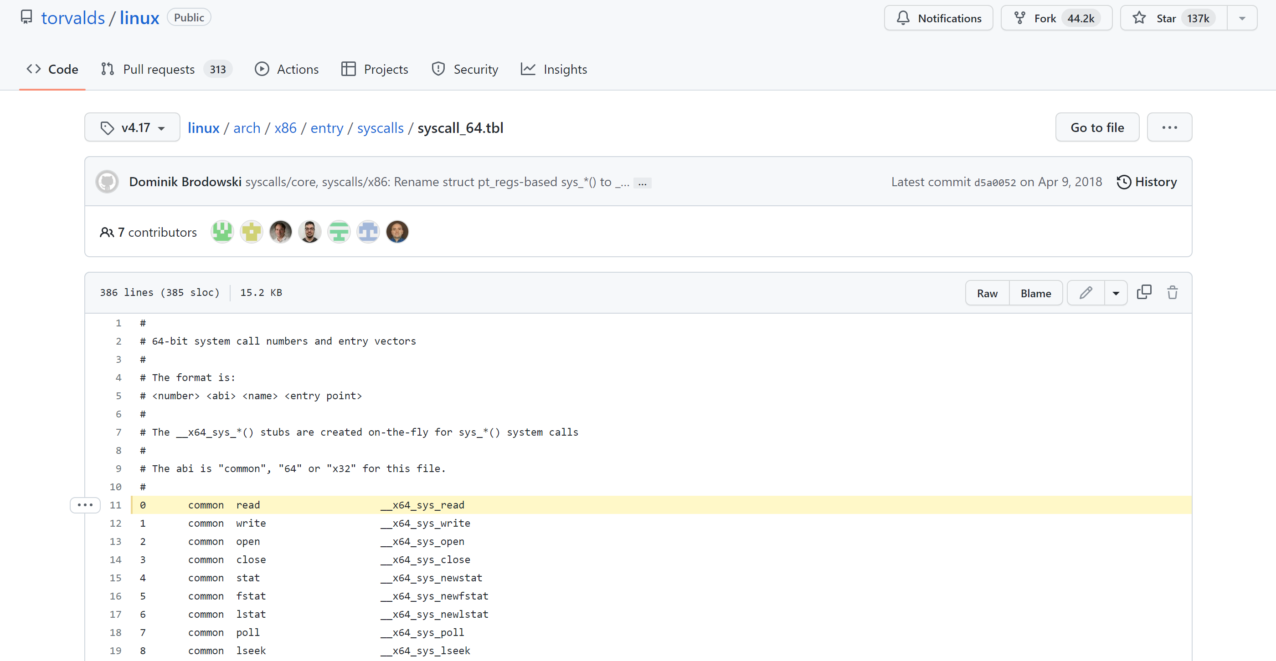
System Calls in the Wild (In Linux)

Slide 57
Safe Control Transfer: Exceptions
Any unexpected condition caused by user program behaviour
Stop executing process and enter kernel at specific exception handler
Synchronous and non-maskable
Process missteps (division by zero, writing read-only memory)
Attempts to execute a privileged instruction in user mode
Debugger breakpoints!

Slide 58
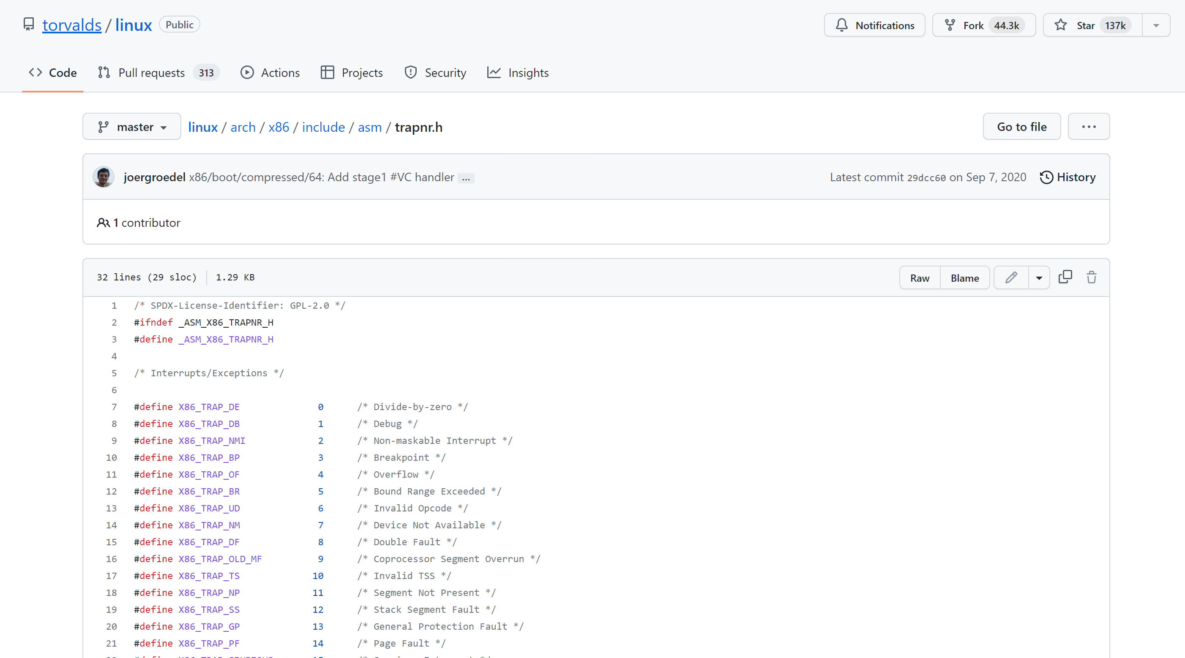
Exceptions in the Wild (In Linux)

Slide 59
Safe Control Transfer: Interrupts
Asynchronous signal to the processor that some external event has occurred and may require attention
When process interrupt, stop current process and enter kernel at designated interrupt handler
Timer Interrupts, IO Interrupts, Interprocessor Interrupts

Slide 60
Safe Control Transfer: Kernel->User
New Process Creation
Kernel instantiates datastructures, sets registers, switches to user mode
Resume after an exception/interrupt/syscall
Resume execution by restoring PC, registers, and unsetting mode
Switching to a different process
Save old process state. Load new process state (restore PC, registers). Unset mode.

Slide 61
Summary: Goals for today
What are the requirements of a good VM abstraction?
What is a process?
How does the kernel use processes to enforce protection?
When does one switch from kernel to user mode and back?

Slide 62
Summary: Goals for today
What are the requirements of a good VM abstraction?
What is a process?
How does the kernel use processes to enforce protection?
When does one switch from kernel to user mode and back?
Protection while preserving functionality and performance
Program execution with restricted rights
Dual-Mode operation: privileged instructions, memory protection, control, interrupts, safe control transfer
System Calls, Interrupts, Exceptions

