Slide 1
CS162 Operating Systems and Systems Programming Lecture 20 File Systems
Professor Natacha Crooks
https://cs162.org/
Slides based on prior slide decks from David Culler, Ion Stoica, John Kubiatowicz, Alison Norman and Lorenzo Alvisi

Slide 2
Recall: Inodes in Unix
File Number is index into set of inode arrays
Index structure is an array of inodes
Each inode corresponds to a file and contains its metadata
Inode maintains a multi-level tree structure to find storage blocks for files
Original inode format appeared in BSD 4.1
Berkeley Standard Distribution Unix!

Slide 3
Recall: Inode Structure

Slide 4
Recall: Critical Factors in File System Design
(Hard) Disk Performance !!!
Maximize sequential access, minimize seeks
Open before Read/Write
Can perform protection checks and look up where the actual file resource are, in advance
Size is determined as they are used !!!
Can write (or read zeros) to expand the file
Start small and grow, need to make room
Organized into directories
What data structure (on disk) for that?
Need to carefully allocate / free blocks
Such that access remains efficient

Slide 5
Recall: Magnetic Disks
Track
Sector
Cylinders: all the tracks under the head at a given point on all surfaces
Read/write data is a three-stage process:
Seek time: position the head/arm over the proper track
Rotational latency: wait for desired sector to rotate under r/w head
Transfer time: transfer a block of bits (sector) under r/w head
Head
Cylinder
Platter

Slide 6
Fast File System (BSD 4.2, 1984)
Same inode structure as in BSD 4.1
same file header and triply indirect blocks like we just studied
Some changes to block sizes from 1024⇒4096 bytes for performance
Optimization for Performance and Reliability:
Distribute inodes among different tracks to be closer to data
Uses bitmap allocation in place of freelist
Attempt to allocate files contiguously
10% reserved disk space
Skip-sector positioning (mentioned later)

Slide 7
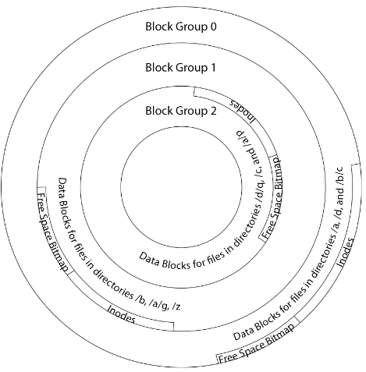
FFS Locality: Block Groups
Distribute header information (inodes) closer to the data blocks, in same “cylinder group”
File system volume divided into set of block groups
Data blocks, metadata, and free space interleaved within block group
Put directory and its files in common block group

Slide 8
FFS Locality: Block Groups
First-Free allocation of new file blocks
To expand file, first try successive blocks in bitmap, then choose new range of blocks
Few little holes at start, big sequential runs at end of group
Avoids fragmentation
Sequential layout for big files
Important: keep 10% or more free!
Reserve space in the Block Group

Slide 9
Attack of the Rotational Delay
Missing blocks due to rotational delay
Issue: Read one block, do processing, and read next block. In meantime, disk has continued turning: missed next block! Need 1 revolution/block!

Slide 10
Attack of the Rotational Delay
Solution 1: Skip sector positioning (“interleaving”)
Place the blocks from one file on every other block of a track: give time for processing to overlap rotation
Can be done by OS or in modern drives by the disk controller
Solution 2: Read ahead: read next block right after first, even if application hasn’t asked for it yet
This can be done either by OS (read ahead)
By disk itself (track buffers) - many disk controllers have internal RAM that allows them to read a complete track

Slide 11
UNIX 4.2 BSD FFS
Pros
Efficient storage for both small and large files
Locality for both small and large files
Locality for metadata and data
No defragmentation necessary!
Cons
Inefficient for tiny files (a 1 byte file requires both an inode and a data block)
Inefficient encoding when file is mostly contiguous on disk
Need to reserve 10-20% of free space to prevent fragmentation

Slide 12
What about other file systems?
FAT:
File Allocation Table
(MS-DOS,1977)
Windows NTFS

Slide 13
FAT (File Allocation Table)
Example:
file_read 31, < 2, x >
Index into FAT with file number
Follow linked list to block
Read the block from disk into memory
FAT
Disk Blocks
0:
0:
File number
31:
File 31, Block 0
File 31, Block 1
File 31, Block 2
File 31, Block 2
N-1:
N-1:
memory

Slide 14
FAT (File Allocation Table)
File is a collection of disk blocks
FAT is linked list 1-1 with blocks
File number is index of root of block list for the file
File offset: block number and offset within block
Follow list to get block number
Unused blocks marked free
Could require scan to find
Or, could use a free list
FAT
Disk Blocks
0:
0:
File number
31:
File 31, Block 0
File 31, Block 1
free
File 31, Block 2
N-1:
N-1:
memory

Slide 15
FAT (File Allocation Table)
file_write(31, < 3, y >)
Grab free block
Linking them into file
FAT
Disk Blocks
0:
0:
File number
31:
File 31, Block 0
File 31, Block 1
File 31, Block 3
free
File 31, Block 2
N-1:
N-1:
memory

Slide 16
FAT (File Allocation Table)
FAT
Disk Blocks
Where is FAT stored?
On disk
How to format a disk?
Zero the blocks, mark FAT entries “free”
How to quick format a disk?
Mark FAT entries “free”
Simple: can implement in device firmware
0:
0:
File #1
31:
File 31, Block 0
File 31, Block 1
File 31, Block 3
free
File #2
File 31, Block 2
N-1:
N-1:
memory

Slide 17
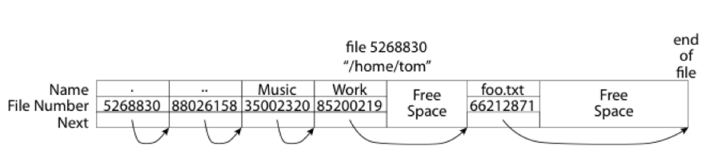
FAT: Directories
A directory is a file containing <file_name: file_number> mappings
In FAT: file attributes are kept in directory (!!!)
Not directly associated with the file itself
Each directory a linked list of entries
Requires linear search of directory to find particular entry
Where do you find root directory (“/”)?
At well-defined place on disk
For FAT, this is at block 2 (there are no blocks 0 or 1)

Slide 18
FAT Discussion
FAT
Disk Blocks
Suppose you start with the file number:
Time to find block?
Block layout for file?
Sequential access?
Random access?
Fragmentation?
Small files?
Big files?
0:
0:
File #1
31:
File 31, Block 0
File 31, Block 1
File 31, Block 3
free
File #2
File 31, Block 2
N-1:
N-1:
memory

Slide 19
Windows NTFS

Slide 20
New Technology File System (NTFS)
Default on modern Windows systems
Variable length extents
Master File Table
Everything (almost) is a sequence of <attribute:value>
Each entry in MFT contains metadata and:
File’s data directly (for small files)
A list of extents (start block, size) for file’s data
For big files: pointers to other MFT entries with more extent lists

Slide 21
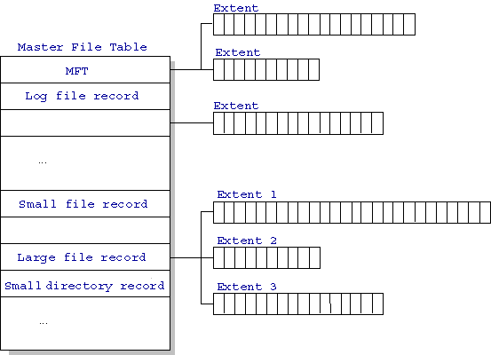
NTFS
http://ntfs.com/ntfs-mft.htm

Slide 22
NTFS Small File: Data stored with Metadata
Create time, modify time, access time,
Owner id, security specifier, flags (RO, hidden, sys)
data attribute
Attribute list

Slide 23
NTFS Medium File: Extents for File Data

Slide 24
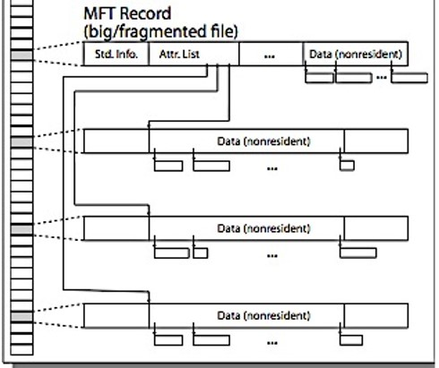
NTFS Large File: Pointers to Other MFT

Slide 25
NTFS Directories
Directories implemented as B-Trees
File's number identifies its entry in MFT
MFT entry always has a file name attribute
Human readable name, file number of parent dir
Hard link? Multiple file name attributes in MFT entry

Slide 26
Buffer Cache
Kernel must copy disk blocks to main memory to access their contents and write them back if modified
Key Idea: Exploit locality by caching disk data in memory
Name translations: Mapping from paths→inodes
Disk blocks: Mapping from block address→disk content
Buffer Cache: Memory used to cache kernel resources, including disk blocks and name translations
Can contain “dirty” blocks (with modifications not on disk)

Slide 27

File System Buffer Cache
Data blocks
Disk
Reading
OS implements a cache of disk blocks for efficient access to data, directories, inodes, freemap
PCB
iNodes
file desc
Writing
Dir Data blocks
Free bitmap
Memory
Blocks
State
free
free

Slide 28
File System Buffer Cache: open
Data blocks
Disk
Reading
Directory lookup repeat as needed:
load block of directory
search for map
PCB
iNodes
file desc
Writing
Dir Data blocks
Free bitmap
Memory
Blocks
State
free
free
rd
dir

Slide 29
File System Buffer Cache: open
Data blocks
Disk
Reading
PCB
Directory lookup repeat as needed:
load block of directory
search for map
Create reference via open file descriptor
iNodes
file desc
Writing
Dir Data blocks
<name>:inumber
Free bitmap
Memory
Blocks
State
free
dir
inode
rd

Slide 30
File System Buffer Cache: Read?
Data blocks
Disk
Read Process
From inode, traverse index structure to find data block
load data block
copy all or part to read data buffer
Reading
PCB
iNodes
file desc
Writing
Dir Data blocks
<name>:inumber
Free bitmap
Memory
Blocks
State
free
dir
inode

Slide 31
File System Buffer Cache: Write?
Data blocks
Disk
Process similar to read, but may allocate new blocks (update free map), blocks need to be written back to disk; inode?
Reading
PCB
iNodes
file desc
Writing
Dir Data blocks
<name>:inumber
Free bitmap
Memory
Blocks
State
free
dir
inode

Slide 32
File System Buffer Cache: Eviction?
Data blocks
Disk
Reading
PCB
Blocks being written back to disc go through a transient state
iNodes
file desc
Writing
Dir Data blocks
<name>:inumber
Free bitmap
Memory
Blocks
State
free
dir
dirty
inode

Slide 33
File System Caching
Replacement policy? LRU
Can afford overhead full LRU implementation
Advantages:
Works very well for name translation
Works well in general as long as memory is big enough to accommodate a host’s working set of files.
Disadvantages:
Fails when some application scans through file system, thereby flushing the cache with data used only once
Example: find . –exec grep foo {} \;
Other Replacement Policies?
Some systems allow applications to request other policies
Example, ‘Use Once’:
File system can discard blocks as soon as they are used

Slide 34
File System Caching (con’t)
Cache Size: How much memory should the OS allocate to the buffer cache vs virtual memory?
Too much memory to the file system cache ⇒ won’t be able to run many applications
Too little memory to file system cache ⇒ many applications may run slowly (disk caching not effective)
Solution: adjust boundary dynamically so that the disk access rates for paging and file access are balanced

Slide 35
File System Prefetching
Read Ahead Prefetching: fetch sequential blocks early
Key Idea: exploit fact that most common file access is sequential by prefetching subsequent disk blocks ahead of current read request
Elevator algorithm can efficiently interleave prefetches from concurrent applications
How much to prefetch?
Too much prefetching imposes delays on requests by other applications
Too little prefetching causes many seeks (and rotational delays) among concurrent file requests

Slide 36
Delayed Writes
Buffer cache is a writeback cache
write() copies data from user space to kernel buffer cache
Quick return to user space
read() is fulfilled by the cache, so reads see the results of writes
Even if the data has not reached disk
When does data from a write syscall finally reach disk?
When the buffer cache is full (e.g., we need to evict something)
When the buffer cache is flushed periodically (in case we crash)

Slide 37
Delayed Writes (Advantages)
Performance advantage: return to user quickly without writing to disk!
Disk scheduler can efficiently order lots of requests
Elevator Algorithm can rearrange writes to avoid random seeks
Delay block allocation:
May be able to allocate multiple blocks at same time for file, keep them contiguous
Some files never actually make it all the way to disk
Many short-lived files!

Slide 38
Buffer Caching vs. Demand Paging
Replacement Policy?
Demand Paging: LRU is infeasible; use approximation (like NRU/Clock)
Buffer Cache: LRU is OK
Eviction Policy?
Demand Paging: evict not-recently-used pages when memory is close to full
Buffer Cache: write back dirty blocks periodically, even if used recently
Why? To minimize data loss in case of a crash

Slide 39
Dealing with Persistent State
Buffer Cache: write back dirty blocks periodically, even if used recently
Why? To minimize data loss in case of a crash
Linux does periodic flush every 30 seconds
Not foolproof! Can still crash with dirty blocks in the cache
What if the dirty block was for a directory?
Lose pointer to file’s inode (leak space)
File system now in inconsistent state

Slide 40

Boom!

Slide 41
Important “ilities”
Availability
The probability that the system can accept and process requests
Durability
The ability of a system to recover data despite faults
Reliability
The ability of a system or component to perform its required functions under stated conditions for a specified period of time (IEEE definition)

Slide 42
File System Reliability
What can happen if disk loses power or software crashes?
Some operations in progress may complete
Some operations in progress may be lost
Overwrite of a block may only partially complete
File system needs durability (as a minimum!)
Data previously stored can be retrieved (maybe after some recovery step), regardless of failure
But durability is not quite enough…!

Slide 43
Storage Reliability Problem
Single logical file operation can involve updates to multiple physical disk blocks
inode, indirect block, data block, bitmap, …
With sector remapping, single update to physical disk block can require multiple (even lower level) updates to sectors
At a physical level, operations complete one at a time
Want concurrent operations for performance
How do we guarantee consistency regardless of when crash occurs?

Slide 44
Threats to Reliability
Interrupted Operation
Crash or power failure in the middle of a series of related updates may leave stored data in an inconsistent state
Example: transfer funds from one bank account to another
What if transfer is interrupted after withdrawal and before deposit?
Loss of stored data
Failure of non-volatile storage media may cause previously stored data to disappear or be corrupted

Slide 45
Two Reliability Approaches
Versioning and Copy-on-Write
Careful Ordering and Recovery
FAT & FFS + (fsck)
Each step builds structure,
Data block ⇐ inode ⇐ free ⇐ directory
Last step links it in to rest of FS
Recover scans structure looking for incomplete actions
ZFS, …
Version files at some granularity
Create new structure linking back to unchanged parts of old
Last step is to declare that the new version is ready

Slide 46
Reliability Approach #1: Careful Ordering
Sequence operations in a specific order
Careful design to allow sequence to be interrupted safely
Post-crash recovery
Read data structures to see if there were any operations in progress
Clean up/finish as needed
Approach taken by
FAT and FFS (fsck) to protect filesystem structure/metadata
Many app-level recovery schemes (e.g., Word, emacs autosaves)

Slide 47
Berkeley FFS: Create a File
Normal operation:
Allocate data block
Write data block
Allocate inode
Write inode block
Update bitmap of free blocks and inodes
Update directory with file name → inode number
Update modify time for directory
Recovery:
Scan inode table
If any unlinked files (not in any directory), delete or put in lost & found dir
Compare free block bitmap against inode trees
Scan directories for missing update/access times
Time proportional to disk size

Slide 48
Reliability Approach #2: Copy on Write File Layout
Create a new version of the file with the updated data
Reuse blocks that don’t change much of what is already in place
Seems expensive!
But Updates can be batched
Almost all disk writes can occur in parallel
Approach taken in network file server appliances
NetApp’s Write Anywhere File Layout (WAFL)
ZFS (Sun/Oracle) and OpenZFS

Slide 49
More General Reliability Solutions
Use Transactions for atomic updates
Ensure that multiple related updates are performed atomically
i.e., if a crash occurs in the middle, the state of the systems reflects either all or none of the updates
Most modern file systems use transactions internally to update filesystem structures and metadata
Many applications implement their own transactions
Provide Redundancy for media failures
Redundant representation on media (Error Correcting Codes)
Replication across media (e.g., RAID disk array)

Slide 50
Transactions
Closely related to critical sections for manipulating shared data structures
They extend concept of atomic update from memory to stable storage
Atomically update multiple persistent data structures
Many ad-hoc approaches
FFS carefully ordered the sequence of updates so that if a crash occurred while manipulating directory or inodes the disk scan on reboot would detect and recover the error (fsck)
Applications use temporary files and rename

Slide 51
Key Concept: Transaction
A transaction is an atomic sequence of reads and writes that takes the system from consistent state to another.
Recall: Code in a critical section appears atomic to other threads
Transactions extend the concept of atomic updates from memory to persistent storage
transaction
consistent state 1
consistent state 2

Slide 52
Typical Structure
Begin a transaction – get transaction id
Do a bunch of updates
If any fail along the way, roll-back
Or, if any conflicts with other transactions, roll-back
Commit the transaction

Slide 53
“Classic” Example: Transaction
BEGIN; --BEGIN TRANSACTION
UPDATE accounts SET balance = balance - 100.00 WHERE name = 'Alice';
UPDATE branches SET balance = balance - 100.00 WHERE name = (SELECT branch_name FROM accounts WHERE name = 'Alice');
UPDATE accounts SET balance = balance + 100.00 WHERE name = 'Bob';
UPDATE branches SET balance = balance + 100.00 WHERE name = (SELECT branch_name FROM accounts WHERE name = 'Bob');
COMMIT; --COMMIT WORK
Transfer $100 from Alice’s account to Bob’s account

Slide 54
Concept of a log
One simple action is atomic – write/append a basic item
Use that to seal the commitment to a whole series of actions
Commit Tran N
Start Tran N
Get 10$ from account A
Get 7$ from account B
Get 13$ from account C
Put 15$ into account X
Put 15$ into account Y

Slide 55
Transactional File Systems
Better reliability through use of log
Changes are treated as transactions
A transaction is committed once it is written to the log
Data forced to disk for reliability
Process can be accelerated with NVRAM
Although File system may not be updated immediately, data preserved in the log
Difference between “Log Structured” and “Journaled”
In a Log Structured filesystem, data stays in log form
In a Journaled filesystem, Log used for recovery

Slide 56
Journaling File Systems
Don’t modify data structures on disk directly
Write each update as transaction recorded in a log
Commonly called a journal or intention list
Also maintained on disk (allocate blocks for it when formatting)
Once changes are in the log, they can be safely applied to file system
e.g. modify inode pointers and directory mapping
Linux took original FFS-like file system (ext2) and added a journal to get ext3!
Some options: whether or not to write all data to journal or just metadata

Slide 57
Creating a File (No Journaling Yet)
Find free data block(s)
Find free inode entry
Find dirent insertion point
-----------------------------------------
Write map (i.e., mark used)
Write inode entry to point to block(s)
Write dirent to point to inode
Free space map
Data blocks
…
Inode table
Directory
entries

Slide 58
Creating a File (With Journaling)
Find free data block(s)
Find free inode entry
Find dirent insertion point
-----------------------------------------
[log] Write map (i.e., mark used)
[log] Write inode entry to point to block(s)
[log] Write dirent to point to inode
Free space map
Data blocks
…
Inode table
Directory
entries
tail
head
done
pending
start
commit
Log: in non-volatile storage (Flash or on Disk)

Slide 59
After Commit, Eventually Replay Transaction
All accesses to the file system first looks in the log
Actual on-disk data structure might be stale
Eventually, copy changes to disk and discard transaction from the log
Free space map
Data blocks
…
Inode table
Directory
entries
tail
tail
tail
tail
tail
head
done
pending
start
commit
Log: in non-volatile storage (Flash or on Disk)

Slide 60
Crash Recovery: Discard Partial Transactions
Upon recovery, scan the log
Detect transaction start with no commit
Discard log entries
Disk remains unchanged
Free space map
Data blocks
…
Inode table
Directory
entries
tail
head
done
pending
start
Log: in non-volatile storage (Flash or on Disk)

Slide 61
Crash Recovery: Keep Complete Transactions
Scan log, find start
Find matching commit
Redo it as usual
Or just let it happen later
Free space map
Data blocks
…
Inode table
Directory
entries
tail
head
done
pending
start
commit
Log: in non-volatile storage (Flash or on Disk)

Slide 62
Journaling Summary
Why go through all this trouble?
Updates atomic, even if we crash:
Update either gets fully applied or discarded
All physical operations treated as a logical unit
Isn’t this expensive?
Yes! We're now writing all data twice (once to log, once to actual data blocks in target file)
Modern filesystems journal metadata updates only
Record modifications to file system data structures
But apply updates to a file’s contents directly

