Slide 1
CS162 Operating Systems and Systems Programming Lecture 21 Reliability & Distributed Systems
Professor Natacha Crooks
https://cs162.org/
Slides based on prior slide decks from David Culler, Ion Stoica, John Kubiatowicz, Alison Norman and Lorenzo Alvisi

Slide 2
Recall: File System Ideas
File Number is index into set of inode arrays
Index structure is an array of inodes
Each inode corresponds to a file and contains its metadata
Inode maintains a multi-level tree structure to find storage blocks for files
Original inode format appeared in BSD 4.1
Berkeley Standard Distribution Unix!

Slide 3
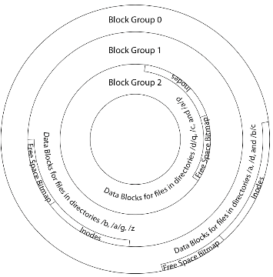
File System Buffer Cache
Data blocks
Disk
Reading
OS implements a cache of disk blocks for efficient access to data, directories, inodes, freemap
PCB
iNodes
file desc
Writing
Dir Data blocks
Free bitmap
Memory
Blocks
State
free
free

Slide 4
Recall: Dealing with Persistent State
Buffer Cache: write back dirty blocks periodically, even if used recently
Why? To minimize data loss in case of a crash
Linux does periodic flush every 30 seconds
Not foolproof! Can still crash with dirty blocks in the cache
What if the dirty block was for a directory?
Lose pointer to file’s inode (leak space)
File system now in inconsistent state

Slide 5

Recall: Boom!

Slide 6
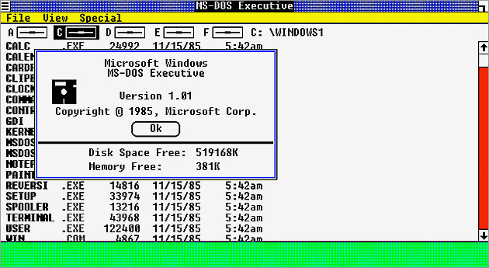
Happy Birthday Windows!
Happy 40th Birthday to Windows! Was first announced on Nov 10th 1983

Slide 7
Recall: Storage Reliability Problem
Single logical file operation can involve updates to multiple physical disk blocks
inode, indirect block, data block, bitmap, …
With sector remapping, single update to physical disk block can require multiple (even lower level) updates to sectors
At a physical level, operations complete one at a time
Want concurrent operations for performance
How do we guarantee consistency regardless of when crash occurs?

Slide 8
Two Reliability Approaches
Versioning and Copy-on-Write
Careful Ordering and Recovery
FAT & FFS + (fsck)
Each step builds structure,
Data block ⇐ inode ⇐ free ⇐ directory
Last step links it in to rest of FS
Recover scans structure looking for incomplete actions
ZFS, …
Version files at some granularity
Create new structure linking back to unchanged parts of old
Last step is to declare that the new version is ready

Slide 9
Reliability Approach #1: Careful Ordering
Sequence operations in a specific order
Careful design to allow sequence to be interrupted safely
Post-crash recovery
Read data structures to see if there were any operations in progress
Clean up/finish as needed
Approach taken by
FAT and FFS (fsck) to protect filesystem structure/metadata
Many app-level recovery schemes (e.g., Word, emacs autosaves)

Slide 10
Berkeley FFS: Create a File
Normal operation:
Allocate data block
Write data block
Allocate inode
Write inode block
Update bitmap of free blocks and inodes
Update directory with file name → inode number
Update modify time for directory
Recovery:
Scan inode table
If any unlinked files (not in any directory), delete or put in lost & found dir
Compare free block bitmap against inode trees
Scan directories for missing update/access times
Time proportional to disk size

Slide 11
Reliability Approach #2: Copy on Write File Layout
Create a new version of the file with the updated data
Reuse blocks that don’t change much of what is already in place
Seems expensive!
But Updates can be batched
Almost all disk writes can occur in parallel
Approach taken in network file server appliances
NetApp’s Write Anywhere File Layout (WAFL)
ZFS (Sun/Oracle) and OpenZFS

Slide 12
More General Reliability Solutions
Use Transactions for atomic updates
Ensure that multiple related updates are performed atomically
i.e., if a crash occurs in the middle, the state of the systems reflects either all or none of the updates
Most modern file systems use transactions internally to update filesystem structures and metadata
Many applications implement their own transactions
Provide Redundancy for media failures
Redundant representation on media (Error Correcting Codes)
Replication across media (e.g., RAID disk array)

Slide 13
Transactions
Closely related to critical sections for manipulating shared data structures
They extend concept of atomic update from memory to stable storage
Atomically update multiple persistent data structures
Many ad-hoc approaches
FFS carefully ordered the sequence of updates so that if a crash occurred while manipulating directory or inodes the disk scan on reboot would detect and recover the error (fsck)
Applications use temporary files and rename

Slide 14
Key Concept: Transaction
A transaction is an atomic sequence of reads and writes that takes the system from consistent state to another.
Recall: Code in a critical section appears atomic to other threads
Transactions extend the concept of atomic updates from memory to persistent storage
transaction
consistent state 1
consistent state 2

Slide 15
Typical Structure
Begin a transaction – get transaction id
Do a bunch of updates
If any fail along the way, roll-back
Or, if any conflicts with other transactions, roll-back
Commit the transaction

Slide 16
“Classic” Example: Transaction
BEGIN; --BEGIN TRANSACTION
UPDATE accounts SET balance = balance - 100.00 WHERE name = 'Alice';
UPDATE branches SET balance = balance - 100.00 WHERE name = (SELECT branch_name FROM accounts WHERE name = 'Alice');
UPDATE accounts SET balance = balance + 100.00 WHERE name = 'Bob';
UPDATE branches SET balance = balance + 100.00 WHERE name = (SELECT branch_name FROM accounts WHERE name = 'Bob');
COMMIT; --COMMIT WORK
Transfer $100 from Alice’s account to Bob’s account

Slide 17
Concept of a log
One simple action is atomic – write/append a basic item
Use that to seal the commitment to a whole series of actions
Commit Tran N
Start Tran N
Get 10$ from account A
Get 7$ from account B
Get 13$ from account C
Put 15$ into account X
Put 15$ into account Y

Slide 18
Write-Ahead Logging
Better reliability through use of log
Changes are treated as transactions
A transaction is committed once it is written to the log
Data forced to disk for reliability
Process can be accelerated with NVRAM
Although File system may not be updated immediately, data preserved in the log
Difference between “Log Structured” and “Journaled”
In a Log Structured filesystem, data stays in log form
In a Journaled filesystem, Log used for recovery

Slide 19
Journaling File Systems
Don’t modify data structures on disk directly
Write each update as transaction recorded in a log
Commonly called a journal or intention list
Also maintained on disk (allocate blocks for it when formatting)
Once changes are in the log, they can be safely applied to file system
e.g. modify inode pointers and directory mapping
Linux took original FFS-like file system (ext2) and added a journal to get ext3!
Some options: whether or not to write all data to journal or just metadata

Slide 20
Creating a File (No Journaling Yet)
Find free data block(s)
Find free inode entry
Find dirent insertion point
-----------------------------------------
Write map (i.e., mark used)
Write inode entry to point to block(s)
Write dirent to point to inode
Free space map
Data blocks
…
Inode table
Directory
entries

Slide 21
Creating a File (With Journaling)
Find free data block(s)
Find free inode entry
Find dirent insertion point
-----------------------------------------
[log] Write map (i.e., mark used)
[log] Write inode entry to point to block(s)
[log] Write dirent to point to inode
Free space map
Data blocks
…
Inode table
Directory
entries
tail
head
done
pending
start
commit
Log: in non-volatile storage (Flash or on Disk)

Slide 22
After Commit, Eventually Replay Transaction
All accesses to the file system first looks in the log
Actual on-disk data structure might be stale
Eventually, copy changes to disk and discard transaction from the log
Free space map
Data blocks
…
Inode table
Directory
entries
tail
tail
tail
tail
tail
head
done
pending
start
commit
Log: in non-volatile storage (Flash or on Disk)

Slide 23
Crash Recovery: Discard Partial Transactions
Upon recovery, scan the log
Detect transaction start with no commit
Discard log entries
Disk remains unchanged
Free space map
Data blocks
…
Inode table
Directory
entries
tail
head
done
pending
start
Log: in non-volatile storage (Flash or on Disk)

Slide 24
Crash Recovery: Keep Complete Transactions
Scan log, find start
Find matching commit
Redo it as usual
Or just let it happen later
Free space map
Data blocks
…
Inode table
Directory
entries
tail
head
done
pending
start
commit
Log: in non-volatile storage (Flash or on Disk)

Slide 25
Journaling Summary
Why go through all this trouble?
Updates atomic, even if we crash:
Update either gets fully applied or discarded
All physical operations treated as a logical unit
Isn’t this expensive?
Yes! We're now writing all data twice (once to log, once to actual data blocks in target file)
Modern filesystems journal metadata updates only
Record modifications to file system data structures
But apply updates to a file’s contents directly

Slide 26
Topic Breakdown
Process Abstraction and API
Threads and Concurrency
Virtualizing the CPU
Scheduling
Virtual Memory
Virtualizing Memory
Paging
IO devices
Persistence
File Systems
Challenges with distribution
Distributed Systems
Data Processing & Storage

Slide 27
What is a Distributed System?
A distributed system is one in which the failure of a computer you didn't even know existed can render your own computer unusable.
Leslie Lamport,
The Godfather of Distributed Systems

Slide 28




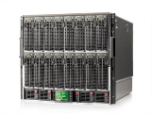
Centralised vs Distributed Systems
Considered a single computer! All computation was done on the local computer in isolation
The world is a large distributed system

Slide 29
Two types of distributed systems
Server
Client/Server Model
Peer-to-Peer Model
One or more server provides services to clients
Clients makes remote procedure calls to server
Server serves requests from clients
Each computer acts as a peer
No hierarchy or central point of coordination
All-way communication between peers through gossiping

Slide 30

Example: How do I store all my data?

Slide 31
The promise of distributed systems
Availability
Proportion of time system is in functioning condition
=> One machine goes down, use another
Fault-tolerance
System has well-defined behaviour when fault occurs
=> Store data in multiple locations
Scalability
Ability to add resources to system to support more work
Just add machines when need more storage/processing power
Transparency
The ability of the system to mask its complexity behind a simple interface

Slide 32
Transparency
Location: Can’t tell where resources are located
Migration: Resources may move without the user knowing
Replication: Can’t tell how many copies of resource exist
Concurrency: Can’t tell how many users there are
Parallelism: System may speed up large jobs by splitting them into smaller pieces
Fault Tolerance: System may hide various things that go wrong

Slide 33
The challenges of distributed systems
How do you get machines to communicate?
How do you get machines to coordinate?
How do you deal with failures?
How do you deal with security (corrupted machines)?

Slide 34
Topic roadmap
Distributed File Systems
Peer-To-Peer System: The Internet
Distributed Data Processing
Coordination
(Atomic Commit and Consensus)

Slide 35
How do machines communicate?
Protocol Exchange
C
D
C
D
E
E
B
B
A
A
Stable
Storage
Stable
Storage
A protocol is an agreement on how to communicate,
Syntax: how a communication is specified & structured
Format, order messages are sent and received
Semantics: what a communication means
Actions taken when transmitting, receiving, or when a timer expires

Slide 36
Examples of Protocols in Human Interactions
Telephone
(Pick up / open up the phone)
Listen for a dial tone / see that you have service
Dial
Should hear ringing …
Callee: “Hello?”
Caller: “Hi, it’s Natacha….” Or: “Hi, it’s me” (← what’s that about?)
Caller: “Hey, do you think … blah blah blah …” pause
Callee: “Yeah, blah blah blah …” pause
Caller: Bye
Callee: Bye
Hang up

Slide 37
Message Passing
How do you actually program a distributed application?
Interface:
Mailbox (mbox): temporary holding area for messages
Send(message,mbox)
Receive(buffer,mbox)
Send
Network
Receive

Slide 38
Question: Data Representation
An object in memory has a
machine-specific binary representation
Without shared memory, externalizing an object requires us to turn it into a sequential sequence of bytes
Serialization/Marshalling: Express an object as a sequence of bytes
Deserialization/Unmarshalling: Reconstructing the original object from its marshalled form at destination

Slide 39
Simple Data Types
uint32_t x;
Suppose I want to write a x to a file
First, open the file: FILE* f = fopen(“foo.txt”, “w”);
Then, I have two choices:
fprintf(f, “%lu”, x);
fwrite(&x, sizeof(uint32_t), 1, f);
Neither one is “wrong” but sender and receiver should be consistent!

Slide 40
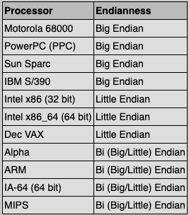
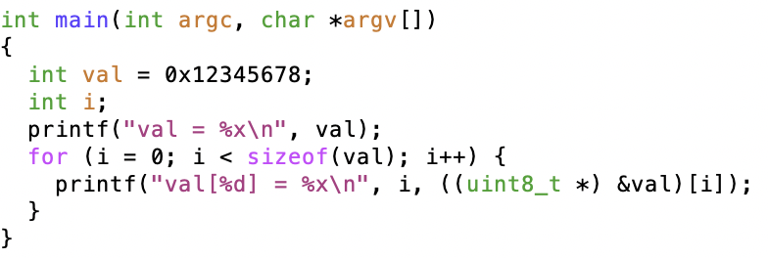
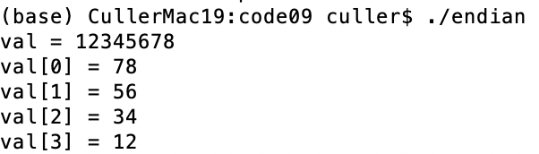
Machine Representation: Endianness
Which end of a machine-recognized object (e.g., int) does its byte-address refer to?
Big Endian: address is the most-significant bits
Little Endian: address is the least-significant bits

Slide 41
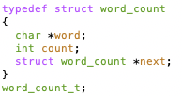
What About Richer Objects?
Consider word_count_t of Homework 0 and 1 …
Each element contains:
An int
A pointer to a string (of some length)
A pointer to the next element
fprintf_words writes these as a sequence of lines (character strings with \n) to a file stream
What if you wanted to write the whole list as a binary object (and read it back as one)?
How do you represent the string?
Does it make any sense to write the pointer?

Slide 42
Data Serialization Formats
Google Protobuffers, JSON and XML are commonly used in web applications
Lots of ad-hoc formats
{ “ faculty”:
[
{id: 1,
“name”: “Anthony”,
“lastname”: “Joseph”
},
{id: 2,
“name”: “Natacha”,
“lastname”: “Crooks”
}
]
}

Slide 43
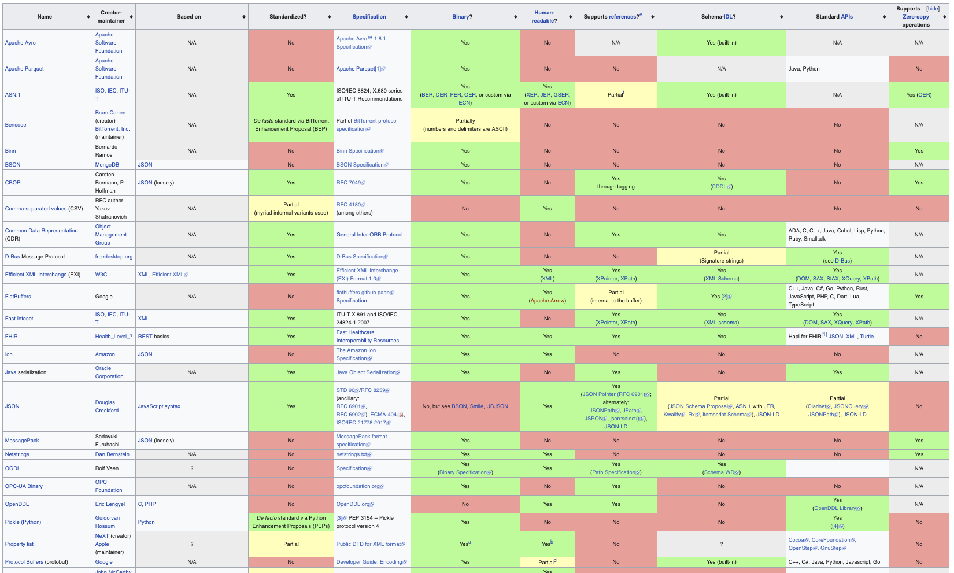
Data Serialization Formats

Slide 44
Remote Procedure Call (RPC)
Raw messaging is a bit too low-level for programming
Must wrap up information into message at source
Must decide what to do with message at destination
May need to sit and wait for multiple messages to arrive
And must deal with machine representation by hand
Another option: Remote Procedure Call (RPC)
Calls a procedure on a remote machine
Idea: Make communication look like an ordinary function call
Automate all of the complexity of translating between representations
Client calls: remoteFileSystem→Read("rutabaga");
Translated automatically into call on server: fileSys→Read("rutabaga");

Slide 45
RPC Information Flow
bundle
args
Client (caller)
r = f(v1, v2);
call
Client
Stub
send
Packet
Handler
return
receive
unbundle
ret vals
Machine A
Network
Network
Machine B
bundle
ret vals
Server (callee)
res_t f(a1, a2)
return
Server
Stub
send
Packet
Handler
Server
Stub
call
receive
unbundle
args
unbundle
args

Slide 46
RPC Implementation
Request-response message passing (under covers!)
“Stub” provides glue on client/server
Client stub is responsible for “marshalling” arguments and “unmarshalling” the return values
Server-side stub is responsible for “unmarshalling” arguments and “marshalling” the return values.
Marshalling involves (depending on system)
Converting values to a canonical form, serializing objects, copying arguments passed by reference, etc.

Slide 47
RPC Details (1/3)
Equivalence with regular procedure call
Parameters ⇔ Request Message
Result ⇔ Reply message
Name of Procedure: Passed in request message
Return Address: mbox2 (client return mail box)
Stub generator: Compiler that generates stubs
Input: interface definitions in an “interface definition language (IDL)”
Contains, among other things, types of arguments/return
Output: stub code in the appropriate source language
Code for client to pack message, send it off, wait for result, unpack result and return to caller
Code for server to unpack message, call procedure, pack results, send them off

Slide 48
RPC Details (2/3)
Cross-platform issues:
What if client/server machines are different architectures/ languages?
Convert everything to/from some canonical form
Tag every item with an indication of how it is encoded (avoids unnecessary conversions)
How does client know which mbox (destination queue) to send to?
Need to translate name of remote service into network endpoint (Remote machine, port, possibly other info)
Binding: the process of converting a user-visible name into a network endpoint
This is another word for “naming” at network level
Static: fixed at compile time
Dynamic: performed at runtime

Slide 49
RPC Details (3/3)
Dynamic Binding
Most RPC systems use dynamic binding via name service
Name service provides dynamic translation of service → mbox
Why dynamic binding?
Access control: check who is permitted to access service
Fail-over: If server fails, use a different one
What if there are multiple servers?
Could give flexibility at binding time
Choose unloaded server for each new client
Could provide same mbox (router level redirect)
Choose unloaded server for each new request
Only works if no state carried from one call to next
What if multiple clients?
Pass pointer to client-specific return mbox in request

Slide 50
Problems with RPC: Non-Atomic Failures
ifferent failure modes in dist. system than on a single machine
Consider many different types of failures
User-level bug causes address space to crash
Machine failure, kernel bug causes all processes on same machine to fail
Some machine is compromised by malicious party
Can easily result in inconsistent view of the world
Did my cached data get written back or not?
Did server do what I requested or not?
Answer? Distributed transactions/2PC

Slide 51
Problems with RPC: Performance
RPC is not performance transparent:
Cost of Procedure call « same-machine RPC « network RPC
Overheads: Marshalling, Stubs, Kernel-Crossing, Communication
Programmers must be aware that RPC is not free
Caching can help, but may make failure handling complex

