Slide 1
CS162 Operating Systems and Systems Programming Lecture 22 Distributed File Systems & Internet
Professor Natacha Crooks
https://cs162.org/
Slides based on prior slide decks from David Culler, Ion Stoica, John Kubiatowicz, Alison Norman and Lorenzo Alvisi

Slide 2
Recall: What is a Distributed System?
A distributed system is one in which the failure of a computer you didn't even know existed can render your own computer unusable.
Leslie Lamport,
The Godfather of Distributed Systems

Slide 3




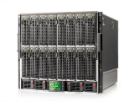
Recall: Centralised vs Distributed Systems
Considered a single computer! All computation was done on the local computer in isolation
The world is a large distributed system

Slide 4
Recall: Two types of distributed systems
Server
Client/Server Model
Peer-to-Peer Model
One or more server provides services to clients
Clients makes remote procedure calls to server
Server serves requests from clients
Each computer acts as a peer
No hierarchy or central point of coordination
All-way communication between peers through gossiping

Slide 5
Recall: The promise of distributed systems
Availability
Proportion of time system is in functioning condition
=> One machine goes down, use another
Fault-tolerance
System has well-defined behaviour when fault occurs
=> Store data in multiple locations
Scalability
Ability to add resources to system to support more work
Just add machines when need more storage/processing power
Transparency
The ability of the system to mask its complexity behind a simple interface

Slide 6
Remote Procedure Call (RPC)
Raw messaging is a bit too low-level for programming
Must wrap up information into message at source
Must decide what to do with message at destination
May need to sit and wait for multiple messages to arrive
And must deal with machine representation by hand

Slide 7
Remote Procedure Call (RPC)
Another option: Remote Procedure Call (RPC)
Calls a procedure on a remote machine
Idea: Make communication look like an ordinary function call
Automate all of the complexity of translating between representations
Client calls: remoteFileSystem→Read("rutabaga");
Translated automatically into call on server: fileSys→Read("rutabaga");

Slide 8
RPC Information Flow
bundle
args
Client (caller)
r = f(v1, v2);
call
Client
Stub
send
Packet
Handler
return
receive
unbundle
ret vals
Machine A
Network
Network
Machine B
bundle
ret vals
Server (callee)
res_t f(a1, a2)
return
Server
Stub
send
Packet
Handler
Server
Stub
call
receive
unbundle
args
unbundle
args

Slide 9
RPC Implementation
Request-response message passing (under covers!)
“Stub” provides glue on client/server
Client stub is responsible for “marshalling” arguments and “unmarshalling” the return values
Server-side stub is responsible for “unmarshalling” arguments and “marshalling” the return values.
Marshalling involves (depending on system)
Converting values to a canonical form, serializing objects, copying arguments passed by reference, etc.

Slide 10
RPC Details (1/3)
Equivalence with regular procedure call
Parameters ⇔ Request Message
Result ⇔ Reply message
Name of Procedure: Passed in request message
Return Address: mbox2 (client return mail box)
Stub generator: Compiler that generates stubs
Input: interface definitions in an “interface definition language (IDL)”
Contains, among other things, types of arguments/return
Output: stub code in the appropriate source language
Code for client to pack message, send it off, wait for result, unpack result and return to caller
Code for server to unpack message, call procedure, pack results, send them off

Slide 11
RPC Details (2/3)
Cross-platform issues:
What if client/server machines are different architectures/ languages?
Convert everything to/from some canonical form
Tag every item with an indication of how it is encoded (avoids unnecessary conversions)
How does client know which mbox (destination queue) to send to?
Need to translate name of remote service into network endpoint (Remote machine, port, possibly other info)
Binding: the process of converting a user-visible name into a network endpoint
This is another word for “naming” at network level
Static: fixed at compile time
Dynamic: performed at runtime

Slide 12
RPC Details (3/3)
Dynamic Binding
Most RPC systems use dynamic binding via name service
Name service provides dynamic translation of service → mbox
Why dynamic binding?
Access control: check who is permitted to access service
Fail-over: If server fails, use a different one
What if there are multiple servers?
Could give flexibility at binding time
Choose unloaded server for each new client
Could provide same mbox (router level redirect)
Choose unloaded server for each new request
Only works if no state carried from one call to next
What if multiple clients?
Pass pointer to client-specific return mbox in request

Slide 13
Problems with RPC: Non-Atomic Failures
Different failure modes in dist. system than on a single machine
Consider many different types of failures
User-level bug causes address space to crash
Machine failure, kernel bug causes all processes on same machine to fail
Some machine is compromised by malicious party
Can easily result in inconsistent view of the world
Did my cached data get written back or not?
Did server do what I requested or not?
Answer? Distributed transactions/2PC

Slide 14
Problems with RPC: Performance
RPC is not performance transparent:
Cost of Procedure call « same-machine RPC « network RPC
Overheads: Marshalling, Stubs, Kernel-Crossing, Communication
Programmers must be aware that RPC is not free
Caching can help, but may make failure handling complex

Slide 15

CS162 Students Vs Elon Musk

Slide 16
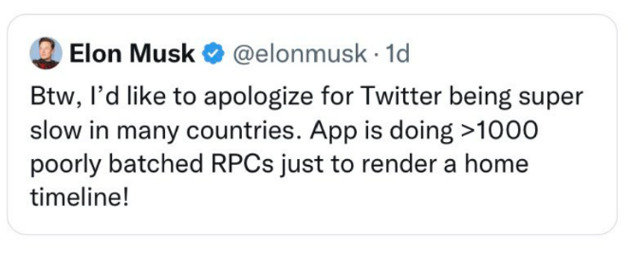
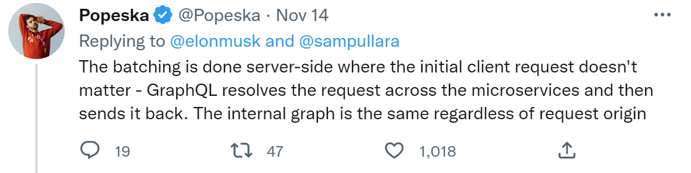
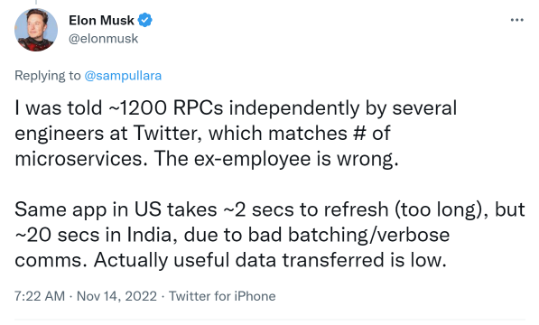
Do you believe this?

Slide 17
Topic roadmap
Distributed File Systems
Peer-To-Peer System: The Internet
Distributed Data Processing
Coordination
(Atomic Commit and Consensus)

Slide 18


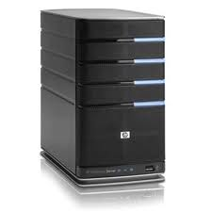
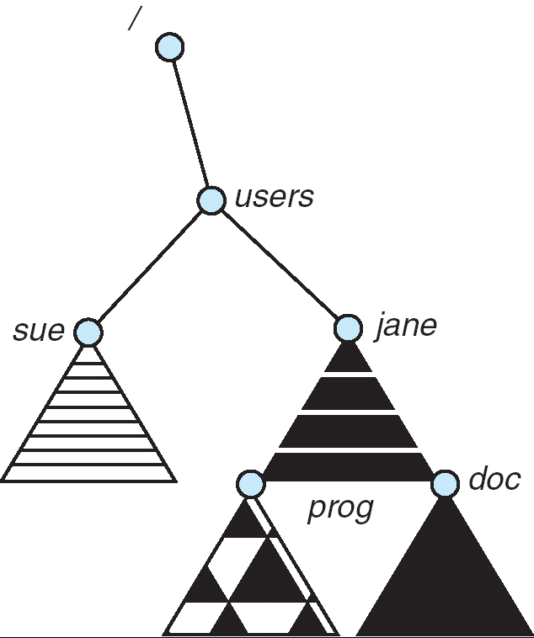
Distributed File Systems
Read File
Network
Data
Client
Server
Transparent access to files stored on a remote disk
Mount remote files into your local file system
Directory in local file system refers to remote files
e.g., /users/jane/prog/foo.c on laptop actually refers to /prog/foo.c on crooks.cs.berkeley.edu
Naming Choices:
[Hostname,localname]: Filename includes server
A global name space: Filename unique in “world”

Slide 19
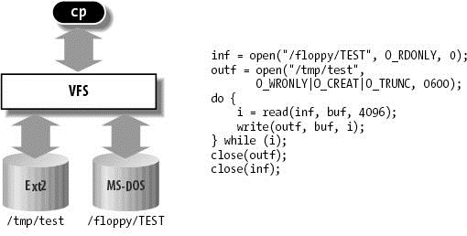
Virtual Filesystem Switch
Virtual abstraction of file system
Provides virtual superblocks, inodes, files, etc
Compatible with a variety of local and remote file systems
VFS allows the same system call interface (the API) to be used for different types of file systems
The API is to the VFS interface, rather than any specific type of file system

Slide 20
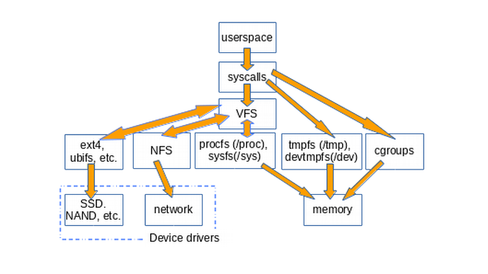
Example Linux mouting tree

Slide 21
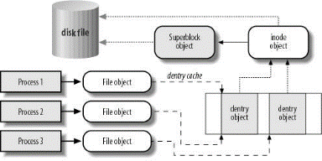
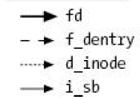
VFS Common File Model in Linux
Four primary object types for VFS:
superblock object: represents a specific mounted filesystem
inode object: represents a specific file
dentry object: represents a directory entry
file object: represents open file associated with process
May need to fit the model by faking it

Slide 22
Simple Distributed File System
Read (RPC)
Return (Data)
Client
Write (RPC)
Server
cache
ACK
Client
Remote Disk: Reads and writes forwarded to server. Use Remote Procedure Calls (RPC) to translate file system calls into remote requests
Advantage: Server provides consistent view of file system to multiple clients
Problems? Performance!
Going over network is slower than going to local memory
Lots of network traffic/not well pipelined
Server can be a bottleneck

Slide 23
Use of caching to reduce network load
read(f1)
→V1
cache
Read (RPC)
read(f1)→V1
read(f1)→V1
F1:V1
Return (Data)
read(f1)→V1
Client
cache
Write (RPC)
Server
F1:V1
Crash!
F1:V2
ACK
cache
write(f1)
→OK
F1:V2
read(f1)→V2
Client
Idea: Use caching to reduce network load
In practice: use buffer cache at source and destination
Advantage: if open/read/write/close can be done locally, don’t need to do any network traffic…fast!
Problems:
Failure:
Client caches have data not committed at server
Cache consistency! Client caches not consistent with server/each other

Slide 24
Dealing with Failures
What if server crashes? Can client wait until it comes back and just continue making requests?
Changes in server's cache but not in disk are lost
What if there is shared state across RPC's?
Client opens file, then does a seek
Server crashes
What if client wants to do another read?
Similar problem: What if client removes a file but server crashes before acknowledgement?

Slide 25
Stateless Protocol
Stateless Protocol: A protocol in which all information required to service a request is included with the request
Idempotent Operations – repeating an operation multiple times is same as executing it just once (e.g., storing to a mem addr.)
Client: timeout expires without reply, just run the operation again (safe regardless of first attempt)
Recall HTTP: Also a stateless protocol
Include cookies with request to simulate a session

Slide 26
Case Study: Network File System (NFS)
It’s an open world! Three Layers for NFS system
UNIX file-system interface: open, read, write, close calls + file descriptors
VFS layer: distinguishes local from remote files
Calls the NFS protocol procedures for remote requests
NFS service layer: bottom layer of the architecture
Implements the NFS protocol

Slide 27
NFS Continued
NFS Protocol: RPC for file operations on server
Reading/searching a directory
manipulating links and directories
accessing file attributes/reading and writing files
Write-through caching: Modified data committed to server’s disk before results are returned to the client
lose some of the advantages of caching
time to perform write() can be long
Need some mechanism for readers to eventually notice changes! (more on this later)
NSF2: Every write persisted. NSF3: open-to-close consistency

Slide 28
NFS Continued
NFS servers are stateless; each request provides all arguments require for execution
E.g. reads include information for entire operation, such as ReadAt(inumber,position), not Read(openfile)
No need to perform network open() or close() on file – each operation stands o
n its own
Idempotent: Performing requests multiple times has same effect as performing them exactly once
Example: Read and write file blocks: just re-read or re-write file block – no other side effects
Example: What about “remove”? NFS does operation twice and second time returns an advisory error

Slide 29
NFS Continued

Slide 30
NFS Continued

Slide 31
NFS Continued
Failure Model: Transparent to client system
Is this a good idea? What if you are in the middle of reading a file and server crashes?
Options (NFS Provides both):
Hang until server comes back up (next week?)
Return an error. (Of course, most applications don’t know they are talking over network)

Slide 32
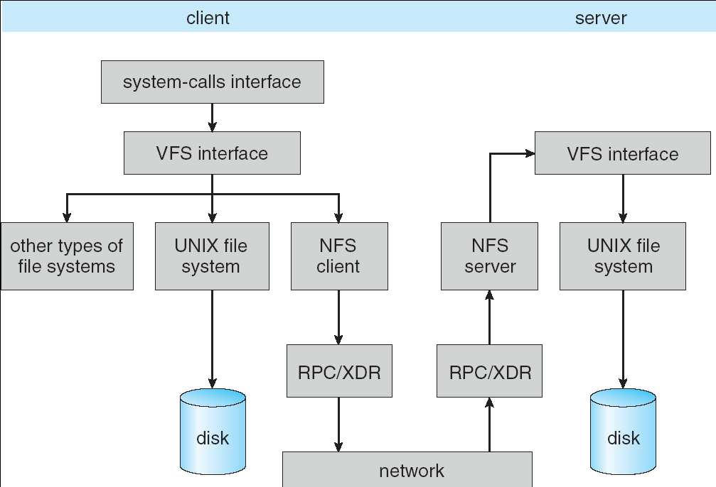
NFS Architecture

Slide 33
NFS Cache consistency
NFS protocol: weak consistency
Client polls server periodically to check for changes
Polls server if data hasn’t been checked in last 3-30 seconds (exact timeout it tunable parameter).
Thus, when file is changed on one client, server is notified, but other clients use old version of file until timeout.
What if multiple clients write to same file?
In NFS, can get either version (or parts of both)
Completely arbitrary!

Slide 34
NFS Cache consistency
F1 still ok?
F1:V2
No: (F1:V2)
cache
F1:V1
Client
cache
Write (RPC)
Server
F1:V2
ACK
cache
F1:V2
Client

Slide 35
Sequential Ordering Constraints
What sort of cache coherence might we expect?
i.e. what if one CPU changes file, and before it’s done, another CPU reads file?
Example: Start with file contents = “A”
Client 1:
Read: gets A
Write B
Read: parts of B or C
Client 2:
Read: gets A or B
Write C
Client 3:
Read: parts of B or C
Time

Slide 36
Sequential Ordering Constraints
What would we actually want?
Assume we want distributed system to behave exactly the same as if all processes are running on single system
If read finishes before write starts, get old copy
If read starts after write finishes, get new copy
Otherwise, get either new or old copy
For NFS:
If read starts more than 30 seconds after write, get new copy; otherwise, could get partial update

Slide 37
NFS Pros and Cons
NFS Pros:
Simple, Highly portable
NFS Cons:
Sometimes inconsistent!
Doesn’t scale to large # clients
Must keep checking to see if caches out of date
Server becomes bottleneck due to polling traffic

Slide 38
Case study: The Internet
The Internet is the largest distributed system that exists!
Many different applications
Email, web, P2P, etc.
Many different operating systems and devices
Many different network styles and technologies
Wireless, wired, optical
How do we organize this mess
Layering & end-to-end principle
Application
Skype
SSH
NFS
HTTP
Coaxial
cable
Fiber
optic
Packet
Radio
Transmission
Media

Slide 39
The Internet: Layers, Layers, Layers
Application
Skype
SSH
NFS
HTTP
Intermediate
layers
“Narrow Waist”
Internet Protocol
Transmission
Media
Coaxial
cable
Fiber
optic
Packet
radio
Introduce intermediate layers that provide set of abstractions for various network functionality & technologies
A new app/media implemented only once
Goal: Reliable communication channels on which to build distributed applications

Slide 40
The Internet: The hourglass
SMTP
HTTP
DNS
NTP
Applications
“Narrow waist” facilitates interoperability
Layers “abstract” away hardware so that upper layers are agnostic to lower layers
=> Sound familiar?
TCP
UDP
Transport
IP
Waist
Data Link
Ethernet
SONET
802.11
Physical
Copper
Fiber
Radio
The Hourglass Model

Slide 41
The Internet: Implications of Hourglass
Single Internet-layer module (IP):
Allows arbitrary networks to interoperate
Any network technology that supports IP can exchange packets
Allows applications to function on all networks
Applications that can run on IP can use any network
Supports simultaneous innovations above and below IP
But changing IP itself, i.e., IPv6, very involved

Slide 42
The Internet: Drawbacks of Layering
Layer N may duplicate layer N-1 functionality
E.g., error recovery to retransmit lost data
Layers may need same information
E.g., timestamps, maximum transmission unit size
Layering can hurt performance
E.g., hiding details about what is really going on
Some layers are not always cleanly separated
Inter-layer dependencies for performance reasons
Some dependencies in standards (header checksums)

Slide 43
End-To-End Argument
Hugely influential paper:
“End-to-End Arguments in System Design” by Saltzer, Reed, and Clark (‘84)
“Sacred Text” of the Internet
Endless disputes about what it means
Everyone cites it as supporting their position
Simple Message: Some types of network functionality can only be correctly implemented end-to-end
Reliability, security, etc.
Hosts cannot rely on the network help to meet requirement, so must implement it themselves

Slide 44
Example: Reliable File Transfer
Host A
Host B
Appl.
Appl.
OS
OS
OK
Solution 1: make each step reliable, and then concatenate them
Solution 2: end-to-end check and try again if necessary

Slide 45
Discussion
Solution 1 is incomplete
What happens if memory is corrupted?
Receiver has to do the check anyway!
Solution 2 is complete
Full functionality can be entirely implemented at application layer with no need for reliability from lower layers
Is there any need to implement reliability at lower layers?
Well, it could be more efficient

Slide 46
End-to-End Principle
Implementing complex functionality in the network:
- Doesn’t always reduce host implementation complexity
- Does increase network complexity
- Probably imposes delay and overhead on all applications, even if they don’t need functionality
However, implementing in network can enhance performance in some cases
e.g., very lossy link

Slide 47
Conservative Interpretation of E2E
Don’t implement a function at the lower levels of the system unless it can be completely implemented at this level
Or: Unless you can relieve the burden from hosts, don’t bother

Slide 48
Moderate Interpretation
Think twice before implementing functionality in the network
If hosts can implement functionality correctly, implement it in a lower layer only as a performance enhancement
But do so only if it does not impose burden on applications that do not require that functionality
This is the interpretation we are using

