Slide 1
CS162 Operating Systems and Systems Programming Lecture 3 Processes (Continued)
Professor Natacha Crooks
https://cs162.org/
Slides based on prior slide decks from David Culler, Ion Stoica, John Kubiatowicz, Alison Norman and Lorenzo Alvisi

Slide 2
Reminder
Drop now (by Sept 1st) or forever hold your peace
(aka stay enrolled in CS162)

Slide 3
Recall: The Process
A executing program with restricted rights
Process
Process
Process
OS
OS
OS
Hardware
Hardware
Hardware
Enforcing mechanism must not hinder functionality or hurt performance

Slide 4

Recall: Operating System Kernel
Lowest level of OS running on system.
Kernel is trusted with full access to all hardware capabilities
All other software (OS or applications) is considered untrusted
Applications
Untrusted
Rest of OS
Trusted
Operating System Kernel
Untrusted
Hardware

Slide 5
Recall: Dual Mode Operation
Use a bit to enable two modes of execution
In User Mode
Processor checks each instruction before executing it
Executes a limited (safe) set of instructions
In Kernel Mode
OS executes with protection checks off
Can execute any instructions

Slide 6

Recall: Hardware must support
Privileged Instructions
Unsafe instructions cannot be executed in user mode
2) Memory Isolation
Memory accesses outside a process’s address space prohibited
3) Interrupts
Ensure kernel can regain control from running process
4) Safe Transfers
Correctly transfer control from user-mode to kernel-mode and back

Slide 7
Virtual Memory is Hard!
Process Abstraction and API
Threads and Concurrency
Virtualizing the CPU
Scheduling
Virtual Memory
Virtualizing Memory
Paging
IO devices
Persistence
File Systems
Challenges with distribution
Distributed Systems
Data Processing & Storage

Slide 8
Goals for today
What hardware support is necessary to enable protection?
61C Review: The Stack?
How to switch from user mode to kernel mode and back?

Slide 9
Hardware must support
Privileged Instructions
Unsafe instructions cannot be executed in user mode
2) Memory Isolation
Memory accesses outside a process’s address space prohibited
3) Interrupts
Ensure kernel can regain control from running process
4) Safe Transfers
Correctly transfer control from user-mode to kernel-mode and back

Slide 10
Req 3/4: Interrupts
Kernel must be able to regain control of the processor
Hardware to the rescue! (Again x 2)
Hardware Interrupts
Set to interrupt processor after a specified delay or specified event and transfer control to (specific locations) in Kernel.
Resetting timer is a privileged operation

Slide 11
Hardware must support
Privileged Instructions
Unsafe instructions cannot be executed in user mode
2) Memory Isolation
Memory accesses outside a process’s address space prohibited
3) Interrupts
Ensure kernel can regain control from running process
4) Safe Transfers
Correctly transfer control from user-mode to kernel-mode and back

Slide 12
Req 4/4: Safe Control Transfer
How do safely/correctly transition from executing user process to executing the kernel?
System Calls
2) Exceptions
3) Interrupts
Asynchronous
Can be maskable or non-maskable
Synchronous Events (trapping)

Slide 13
Safe Control Transfer: System Calls
User program requests OS service
Transfers to kernel at well-defined location
Synchronous/non-maskable
Read input/write to screen, to files, create new processes, send network packets, get time, etc.
How many system calls in Linux 3.0 ?
a) 15 b) 336 c) 1021 d) 21121
https://man7.org/linux/man-pages/man2/syscalls.2.html

Slide 14
System Calls are the “Narrow Waste”
Simple and powerful interface allows separation of concern
Eases innovation in user space and HW
Word Processing
Compilers
Web Browsers
Email
Databases
Web Servers
Application / Service
Portable OS Library
OS
User
System Call
Interface
System
Portable OS Kernel
Software
Platform support, Device Drivers
Hardware
x86
PowerPC
ARM
PCI
Ethernet (1Gbs/10Gbs)
802.11 a/g/n/ac
SCSI
Graphics
Thunderbolt

Slide 15
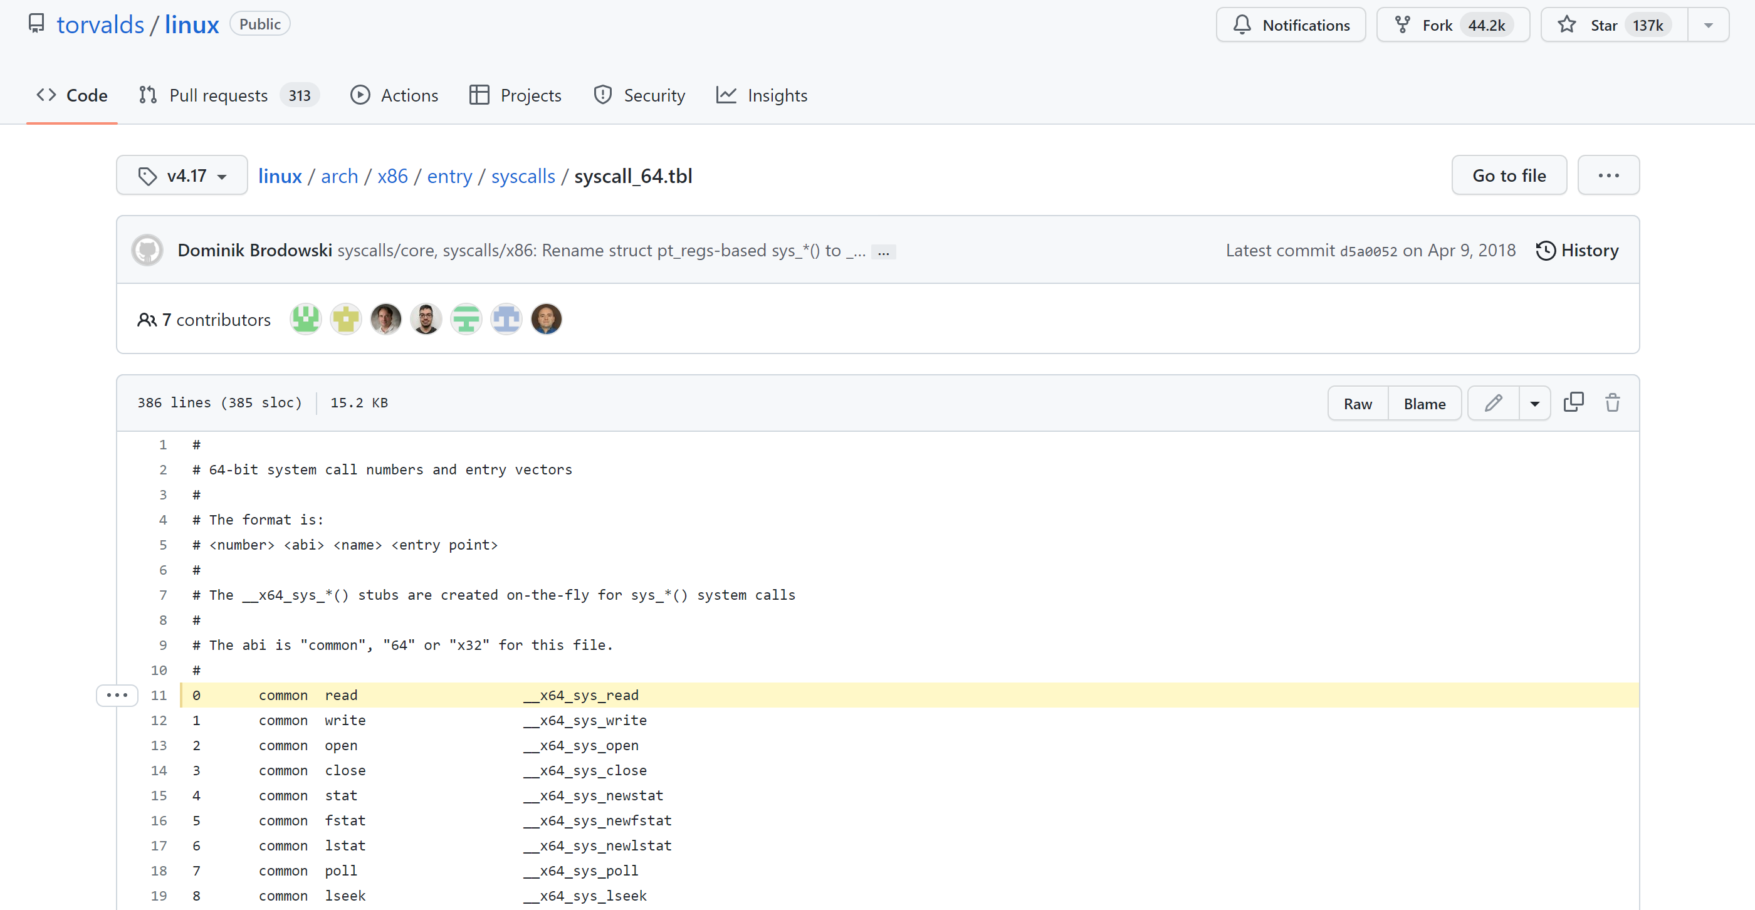
System Calls in the Wild (In Linux)

Slide 16
Safe Control Transfer: Exceptions
Any unexpected condition caused by user program behaviour
Stop executing process and enter kernel at specific exception handler
Synchronous and non-maskable
Process missteps (division by zero, writing read-only memory)
Attempts to execute a privileged instruction in user mode
Debugger breakpoints!

Slide 17
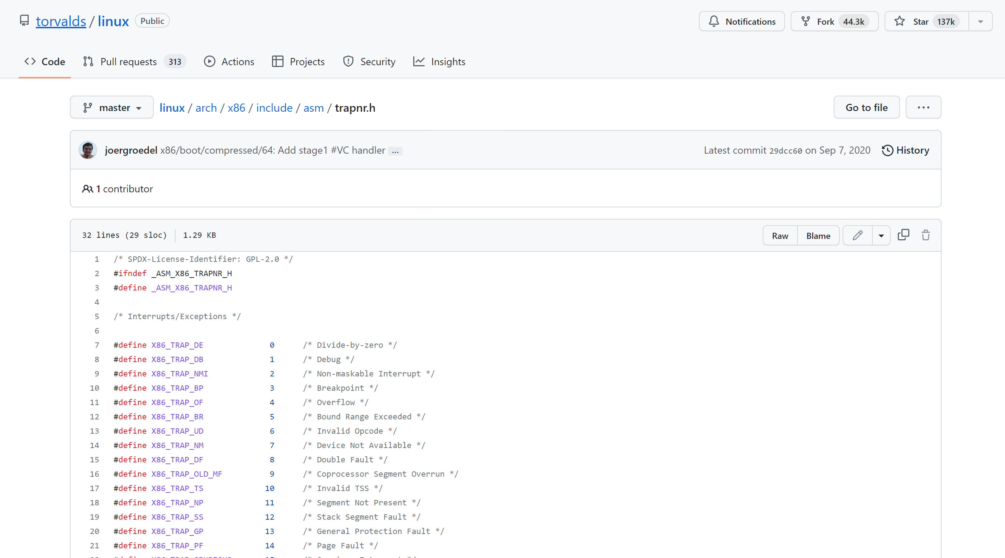
Exceptions in the Wild (In Linux)

Slide 18
Safe Control Transfer: Interrupts
Asynchronous signal to the processor that some external event has occurred and may require attention
When process interrupt, stop current process and enter kernel at designated interrupt handler
Timer Interrupts, IO Interrupts, Interprocessor Interrupts

Slide 19
Safe Control Transfer: Kernel->User
New Process Creation
Kernel instantiates datastructures, sets registers, switches to user mode
Resume after an exception/interrupt/syscall
Resume execution by restoring PC, registers, and unsetting mode
Switching to a different process
Save old process state. Load new process state (restore PC, registers). Unset mode.

Slide 20
Goals for today
61C Review: The Stack
How to switch from user mode to kernel mode and back?
For interrupts,
For exceptions,
For syscalls

Slide 21
Goal 2: The Stack is Back (Review)
Address Space Of Process
Address Space Of Process
Stack
0xFFFFFFFF
Stack Contains temporary data such as method/function parameters, return address and local variables.
Heap Dynamically allocated memory to a process during its run time.
int foo() {
int a;
Foo* foo= malloc(sizeof(foo));
}
Heap
Data
Code
0x00000000

Slide 22
Stack Terminology (Review)
Stack Frame
All the information on the stack pertaining to a function call
Frame Pointer (%ebp)
Contain base address of function's frame.
Stack Pointer (%esp)
Points to the next item on the stack.
Instruction Pointer (%eip)
Indicates the current address of the program being executed

Slide 23
The Call Stack (Review)
Frame for foo()
0xFFFFFFFF
int add(int a, int b) {
int result = a+b;
return result;
}
void foo() {
int x = add(5,10);
}
Frame for add()
0x00000000

Slide 24
The Call Stack (Review)
add:
pushl %ebp
movl %esp, %ebp
subl $16, %esp
movl 8(%ebp), %edx
movl 12(%ebp), %eax
addl %edx, %eax
movl %eax, -4(%ebp)
movl -4(%ebp), %eax
leave/ret
foo:
pushl %ebp
movl %esp, %ebp
pushl $10
pushl $5
call add
addl $8, %esp
movl %eax, -4(%ebp)
leave/ret
int add(int a, int b) {
int result = a+b;
return result;
}
void foo() {
int x = add(5,10);
}
crooks@laptop> gcc -S -m32 add.c

Slide 25
The Call Stack (Review)
void foo() {
int x = add(5,10);
}
ebp
foo:
pushl %ebp
movl %esp, %ebp
Stack Pointer (esp)
Save old frame pointer.
Set current frame pointer to stack pointer
Frame pointer is base of stack frame

Slide 26
The Call Stack (Review)
void foo() {
int x = add(5,10);
}
ebp
foo:
pushl %ebp
movl %esp, %ebp
subl $4, %esp
pushl $10
pushl $5
Stack Pointer (esp)
X=?
Stack Pointer (esp)
10
5
Stack Pointer (esp)
Create space for x
Load Function Parameters On Stack
(reverse order)

Slide 27
The Call Stack (Review)
void foo() {
int x = add(5,10);
}
ebp
foo:
pushl %ebp
movl %esp, %ebp
subl $4, %esp
pushl $10
pushl $5
call bar
X=?
Call instruction pushes EIP to stack and jumps to bar location
10
5
EIP

Slide 28
The Call Stack (Review)
int add(int a, int b) {
int result = a+b;
return result;
}
1) Save frame pointer and set to stack pointer
ebp
X=?
add:
pushl %ebp
movl %esp, %ebp
subl $16, %esp
10
5
EIP
Stack Pointer (esp)
ebp
Stack Pointer (esp)

Slide 29
The Call Stack (Review)
int add(int a, int b) {
int result = a+b;
return result;
}
ebp
X=?
add:
pushl %ebp
movl %esp, %ebp
subl $16, %esp
movl 8(%ebp), %edx
movl 12(%ebp), %eax
addl %edx, %eax
10
12 (%ebp)
5
8(%ebp)
EIP
ebp
Stack Pointer (esp)

Slide 30
The Call Stack (Review)
int add(int a, int b) {
int result = a+b;
return result;
}
ebp
Local Variables are stored in the stack frame
X=?
add:
pushl %ebp
movl %esp, %ebp
subl $16, %esp
movl 8(%ebp), %edx
movl 12(%ebp), %eax
addl %edx, %eax
movl %eax, -4(%ebp)
10
5
EIP
ebp
result

Slide 31
The Call Stack (Review)
int add(int a, int b) {
int result = a+b;
return result;
}
ebp
X=?
Move return value to eax register
add:
pushl %ebp
movl %esp, %ebp
subl $16, %esp
movl 8(%ebp), %edx
movl 12(%ebp), %eax
addl %edx, %eax
movl %eax, -4(%ebp)
movl -4(%ebp), %eax
10
5
EIP
ebp
result

Slide 32
The Call Stack (Review)
int add(int a, int b) {
int result = a+b;
return result;
}
ebp
X=?
Leave instruction restores caller’s frame (pops local variables and ebd)
Return instruction pops EIP and restores control to EIP
add:
pushl %ebp
movl %esp, %ebp
subl $16, %esp
movl 8(%ebp), %edx
movl 12(%ebp), %eax
addl %edx, %eax
movl %eax, -4(%ebp)
movl -4(%ebp), %eax
leave
ret
10
5
EIP
ebp
result

Slide 33
The Call Stack (Review)
void foo() {
int x = add(5,10);
}
Pop function parameters
ebp
X=?
foo:
pushl %ebp
movl %esp, %ebp
pushl $10
pushl $5
call add
addl $8, %esp
10
5
Stack Pointer (esp)

Slide 34
The Call Stack (Review)
void foo() {
int x = add(5,10);
}
ebp
x = ?
x = 15
foo:
pushl %ebp
movl %esp, %ebp
subl $16, %esp
pushl $10
pushl $5
call add
addl $8, %esp
movl %eax, -4(%ebp)
Stack Pointer (esp)

Slide 35
Really Really Really Big Idea
The state of a program’s execution is succinctly and completely represented by CPU register state
EIP, ESP, EBP, Eflags/PSW

Slide 36
Goal 2: User -> Kernel Mode

Slide 37
Goal 3: User -> Kernel Mode
Key Requirement:
Malicious user program (or IO device) cannot corrupt the kernel.
Interrupts, exceptions or system calls handled similarly
=> fewer code paths, fewer bugs.
Limited Entry
Cannot jump to arbitrary code in kernel
2) Atomic Switch
Switch from process stack to kernel stack
3) Transparent Execution
Restore prior state to continue program

Slide 38
Interrupt Handling Roadmap
Processor detects interrupt
Suspend user program and switch to kernel stack
Identify interrupt type and invoke appropriate interrupt handler
4) Restore user program

Slide 39

Don’t (Hardware) Interrupt Me
OS is cool
int add(int a, int b) {
int result = a+b;
return result;
}
What happens when I type “OS is cool” on my keyboard while the Add program is running?

Slide 40
1) Interrupt Detection (Hardware)
OS is cool
APIC
Device sends electric signal over interrupt request line (IRQ) to interrupt controller

Slide 41
1) Interrupt Detection (Hardware)
OS is cool
APIC
APIC converts IRQ to a vector number and sends signal to processor
Processor detects interrupt
Processor

Slide 42
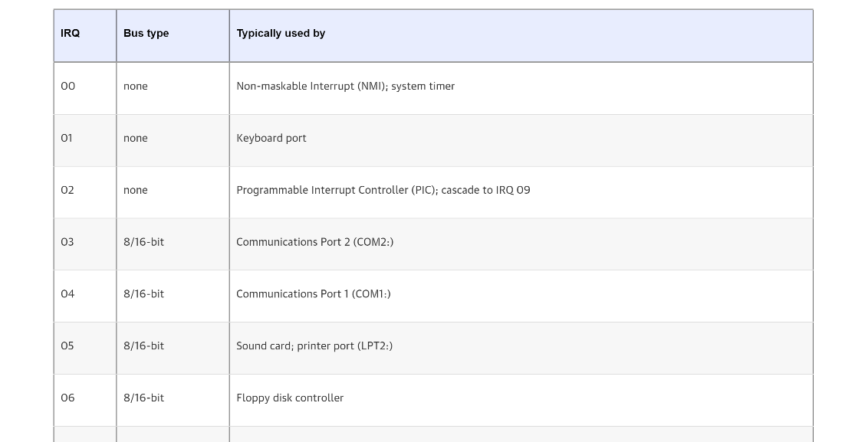
IRQs

Slide 43
2) Save Recovery State (Hardware)
Save register values (recovery state) for process recovery
int add(int a, int b) {
int result = a+b;
return result;
}
Which registers need to be saved by hardware to restore program?
Stack Pointer (esp)
Program Counter (eip)
Execution Flags / Program Status Word (Eflags)

Slide 44
3) Switching (atomically) to Kernel Stack
int add(int a, int b) {
int result = a+b;
return result;
}
Switches stack pointer to base of kernel stack
ebp
X=?
10
Pushes recovery state onto the new stack
(+ optional error code)
5
EIP
ebp
Stack Pointer
result
PSW
User Stack
Instruction Pointer
Error Code
Question 1:
Why did hardware need to save registers before switching to kernel stack?
Question 2:
Why do we need a separate kernel stack?
Integrity and privacy concerns
Must overwrite EIP/SP when switching!

Slide 45
A Tale of Two Stacks
enum procstate { UNUSED, EMBRYO, SLEEPING, RUNNABLE, RUNNING, ZOMBIE };
// Per-process state
struct proc {
uint sz; // Size of process memory (bytes)
pde_t* pgdir; // Page table
char *kstack; // Bottom of kernel stack for this process
enum procstate state; // Process state
int pid; // Process ID
struct proc *parent; // Parent process
struct trapframe *tf; // Trap frame for current syscall
struct context *context; // swtch() here to run process
void *chan; // If non-zero, sleeping on chan
int killed; // If non-zero, have been killed
struct file *ofile[NOFILE]; // Open files
struct inode *cwd; // Current directory
char name[16]; // Process name (debugging)
};
Xv6 Kernel (proc.h)

Slide 46
4) Invoke Interrupt Handler (Hardware)
Interrupt vector is an index
into Interrupt Vector Table
(or interrupt descriptor table).
32
rtc_handler
33
keyboard_handler
…
floppy_handler
127
disk_handler
Index contains appropriate
Interrupt Handler Routine
IDT Table in Linux
Control Unit sets EIP to handler
Stack Pointer
PSW
Instruction Pointer
Handler saves all remaining user registers into stack and implements necessary logic
(Transition software)
Error Code
Eax
Ebx
…
Kernel Stack

Slide 47
5) Return to Program
Pop all user registers from kernel stack (restore register state)
Invoke iret instruction to pop saved EIP, EFLAGS, and SP registers from kernel’s exception stack to relevant registers
Return to user mode
Stack Pointer
PSW
ebp
Instruction Pointer
X=?
Error Code
10
Eax
5
Ebx
EIP
…
ebp
result
Kernel Stack
User Stack

Slide 48
Concurrent Interrupts
What happens if an interrupt happens while processing an interrupt?
Hardware provides instruction to temporarily defer delivery of interrupt (disable interrupt), and re-enable them when safe (enable interrupt)
Interrupts are disabled when an interrupt handler is running
Periods during which interrupts are disabled should be very short!

Slide 49
Interrupt Summary
1) Device sends signal to APIC
2) Processor detects interrupt
3) Save Recovery State and switch to Kernel Stack
4) Jump to interrupt handler table at appropriate vector. Invoke interrupt handler
5) Restore user program

Slide 50
What about syscalls?
System calls are user functions that request services from the OS. Described as function call, with a name, parameters and return value.
Good news!
Syscalls are handled (almost) identically to interrupts.

Slide 51
What about syscalls?
32
rtc_handler
Syscalls issue a “trap” instruction (int 0x80)
Generated interrupt will trigger exception vector 128!
33
keyboard_handler
…
floppy_handler
127
disk_handler
128
syscall_handler
How does handler know which syscall to execute?
System Call number fed in to %eax register.
System call number entry into system call dispatch table,
What about parameters and return values?
Propagated through registers.
Warning: Parameters must be carefully checked.

Slide 52
What about syscalls?
Four differences:
1) Extra-layer of indirection (system call table)
2) Leverage registers for parameters/values
3) When executing iret, increment EIP by one to go to next instruction
4) Usually, interrupts not disabled

Slide 53
What about exceptions?
It’s the same!

Slide 54
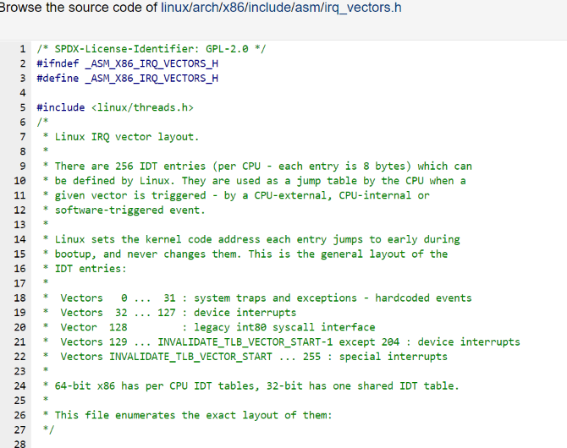
The magic of the IVT
Single, well-defined entry point in the kernel helps with security

Slide 55
Tension between performance and simplicity
Accessing IDT can be slow if not in cache.
Syscalls very common, can we make them cheaper?
Allocate a special register (machine specific register) to directly store address of system call dispatch table
Store register call in the rax register
But backwards compatibility …

Slide 56
Goals for today
(Continued) Hardware support for dual mode
61C Review: The Stack
How to switch from user mode to kernel mode and back?
Privileged Instructions, Memory Isolation, Timer Interrupts, Safe Context Switching.
Stack Pointer, Frame Pointer, Program Counter
Switch to specified location in kernel & atomic.
Interrupts, Syscalls, Exceptions handled identically. Use of the interrupt vector table

