Slide 1
CS162 Operating Systems and Systems Programming Lecture 15 Virtual Memory (2)
Professor Natacha Crooks
https://cs162.org/
Slides based on prior slide decks from David Culler, Ion Stoica, John Kubiatowicz, Alison Norman and Lorenzo Alvisi

Slide 2
Recall: Memory Management Wishlist
Memory Protection
Memory Sharing
Flexible Memory Placement
Support for Sparse Addresses
Runtime Lookup Efficiency
Compact Translation Table

Slide 3
Recall: Increasingly powerful mechanisms
No protection. Living life on the edge
Can access all memory
Base & Bound
Absolute memory addressing. Hard to relocate
Base & Bound with Relocation
Segmentation
Internal fragmentation when address space is sparse
Paging
External fragmentation as assigning variably sized chunks

Slide 4
Paging
Divide logical address space of process into fixed sized chunks called pages
View physical memory as an array of fixed-sized slots called page frames
Each page frame can contain a
single virtual-memory page
Pages should be small to minimise internal fragmentation (1K-16k)

Slide 5
How to Implement Simple Paging?
Interpret virtual address as two components
Virtual Page #
Offset
no. of bits specifies no. of pages in VA space
no. of bits specifies size of page

Slide 6
How to Implement Simple Paging?
Interpret virtual address as two components
20 bits
12 bits
2^20 pages
Page Size
2^12 = 4096 B = 4KB

Slide 7
A (Simplified) Page Table
A page table stores
virtual-to-physical address translations
One page table per process. Lives in memory.
Address stored in the in the Page Table Base Register
PTBR value saved/restored in PCB on context switch

Slide 8
How to access a byte?
Extract page number (first p bits)
Map virtual page number into a frame number
(also called physical page number) using a page table
Extract offset (last o bits)
Convert to physical memory location: access byte at offset in frame

Slide 9
A (Simplified) Page Table
Virtual Page Offset
p o
Memory
Physical Page Number (Page Frame)
Frame f
p
o
Frame f

Slide 10
Example: A Mini Page Table
Assume we have a 64 bytes (2^6) of physical memory
Assume we want pages of 4 bytes (2^2)
How long should our addresses be?
6 bits
How many offset bits should we assign?
2 bits
How many virtual pages can we have?
6 bit addresses, 2 bit for offsets, 4 bits for VPN.
2^4 = 16 pages

Slide 11
Example: A Mini Page Table
4 bits
2 bits
PMemory
VMemory
Page Table
I J K L
A B C D
0x0
A B C D
0
1
2
4
E F G H
0x4
E F G H
0x8
I J K L
…
A B C D
…
…

Slide 12
Example: A Mini Page Table
4 bits
2 bits
PMemory
VMemory
Page Table
I J K L
A B C D
0x0
A B C D
0
1
2
4
E F G H
0x4
E F G H
0x8
I J K L
…
A B C D
…
…

Slide 13
Example: A Mini Page Table
0x9 =
0010
01
PMemory
VMemory
Page Table
I J K L
A B C D
0x0
A B C D
0
1
2
4
E F G H
0x4
E F G H
0x8
I J K L
…
A B C D
…
…

Slide 14
Step 1: Extract Virtual Page Number
0x9 =
0010
01
PMemory
VMemory
Page Table
I J K L
Virtual Page Number: 0010 => 2.
Access Index 2 of Page Table
A B C D
0x0
A B C D
0
1
2
4
E F G H
0x4
E F G H
0x8
I J K L
…
A B C D
…
…

Slide 15
Step 2: Identify Physical Page Number
0x9 =
0010
01
PMemory
VMemory
Page Table
I J K L
A B C D
0x0
A B C D
0
1
2
4
E F G H
0x4
E F G H
0x8
I J K L
…
A B C D
…
…

Slide 16
Step 3: Extract Frame Offset
0x9 =
0010
01
PMemory
VMemory
Page Table
I J K L
A B C D
0x0
A B C D
0
1
2
4
E F G H
0x4
E F G H
0x8
I J K L
…
A B C D
…
…

Slide 17
Step 3: Extract Frame Offset
0x9 =
0010
01
PMemory
VMemory
Page Table
I J K L
Offset: 01 => 1.
Access Byte 1 of Frame
A B C D
0x0
A B C D
0
1
2
4
E F G H
0x4
E F G H
0x8
I J K L
…
A B C D
…
…

Slide 18
Step 3: Extract Frame Offset
0x9 =
0010
01
PMemory
VMemory
Page Table
I J K L
A B C D
0x0
A B C D
0
1
2
4
E F G H
0x4
E F G H
0x8
I J K L
…
A B C D
…
…

Slide 19
Step 4: Convert to Physical Address
0x9 =
0010
01
PMemory
VMemory
Page Table
I J K L
A B C D
0x0
A B C D
0
1
2
4
E F G H
0x4
E F G H
0x8
I J K L
Physical Page Number * Page Size
+ Offset
=
0 * 4 + 1 = 1
…
A B C D
…
…

Slide 20
What is a page table entry? (32 bits)
Page Frame Number
(Physical Page Number)
Free
(OS)
0
PS
D
A
PCD
PWT
U
W
P
P: Present (same as “valid” bit in other architectures)
W: Writeable
U: User accessible
PWT: Page write transparent: external cache write-through
PCD: Page cache disabled (page cannot be cached)
A: Accessed: page has been accessed recently
D: Dirty: page has been modified recently
PS: Page Size
31-12
11-9
8
7
6
5
4
3
2
1
0
Size of page table entry:
PFN (20 bits) + 12 bits for access control/caching
4 bytes

Slide 21
The Great Power of the PTE
Demand Paging
Keep only active pages in memory
Place others on disk and mark their PTEs invalid
Copy-on-Write
UNIX fork gives copy of parent address space to child. Use combination of page sharing + marking pages as read-only
Zero Fill On Demand
New data pages must carry no information
Mark PTEs as invalid; page fault on use gets zeroed page
Data Breakpoints
For debugger, mark instruction page as read-only. Will trigger page-fault when try to execute

Slide 22
Paging & Sharing
Processes share a page by each mapping a page of their own virtual address space to the same frame
Use protection bits for fine-sharing
PageTablePtrA
PageTablePtrB
Page Table
Page Table
Page Frame
PFN, R
0x0171
PFN, R
0x2141

Slide 23
Where is page sharing used ?
Kernel region of every process has the same page table entries
Different processes running same binary!
Do not need to duplicate code segments
Shared-memory segments between different processes

Slide 24
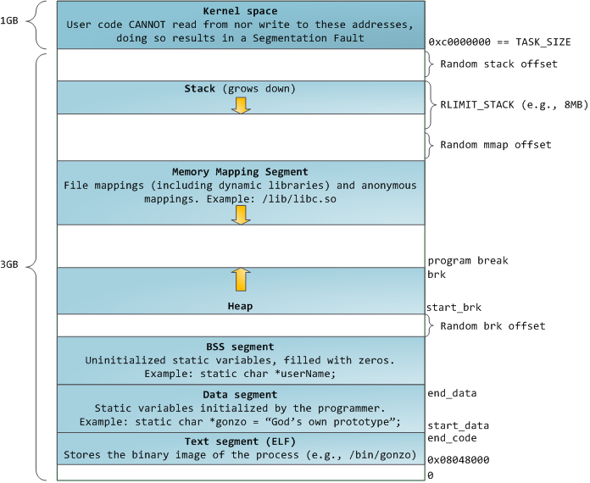
Memory Layout for Linux 32-bit

Slide 25

An aside: Meltdown
From the paper: Meltdown is a novel attack that allows overcoming memory isolation completely by providing a simple way for any user process to read the entire kernel memory of the machine it executes on, including all physical memory mapped in the kernel region. Meltdown does not exploit any software vulnerability, i.e., it works on all major operating systems.
1. raise_exception();
2. // the line below is never reached
3. access(probe_array[data * 4096]);]

Slide 26
Are we done?
How big can a page table get on x86 (32 bits)?
4KB page => 2^12
2^32/2^12 => 2^20 pages
2^20 * 4 bytes = 4 MB (approx.)
That’s a lot per process!!
How big can a page table get on x86 (64 bits)?
4KB page => 2^12
2^64/2^12 => 2^52 pages
2^20 * 8 bytes = 36 petabytes (approx.)
That’s a lot per process!!

Slide 27
Limitations of paging
Space overhead
With a 64-bit address space, size of page table can be huge
Time overhead
Accessing data now requires two memory accesses must also access page table, to find mapped frame
Internal Fragmentation
4KB pages

Slide 28

The Secret to the Whole of CS
Batching
Caching
Indirection
Specialised Hardware

Slide 29
Sparsity
Address space is sparse, i.e. has holes that are not mapped to physical memory
Most this space is taken up by page tables mapped to nothing
Process has access to full 2^64 bytes (virtually)
Physically, that would be 17,179,869,184 gigabytes

Slide 30
Paging the page table: 2-level paging
Tree of Page Tables
Outer Page #
Inner Page #
Offset
Inner Page Table
Physical Memory
Outer Page Table
Inner Page Table
…
…
…
Inner Page Table
…
PageTablePointer
…

Slide 31
V2: What is a page table entry? (32 bits)
Inner Page Table VAddress or PFN
Free
(OS)
0
PS
D
A
PCD
PWT
U
W
P
P: Present (same as “valid” bit in other architectures)
W: Writeable
U: User accessible
PWT: Page write transparent: external cache write-through
PCD: Page cache disabled (page cannot be cached)
A: Accessed: page has been accessed recently
D: Dirty: page has been modified recently
PS: Page Size
31-12
11-9
8
7
6
5
4
3
2
1
0

Slide 32
Paging the page table: 2-level paging
Tree of Page Tables
Outer Page #
Inner Page #
Offset
Number of top-level pages
Ensure that fits on a single page
Defines size of a page

Slide 33
Paging the page table: 2-level paging
Tree of Page Tables
Outer Page #
Inner Page #
Offset
10 bits
10 bits
4 KB 12 bits
Want to make sure that inner page table fits in a page!
2^12/2^2 = 2^10

Slide 34
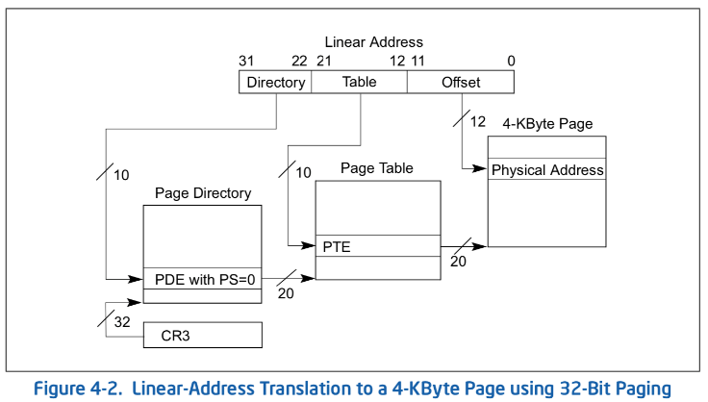
Example: x86 classic 32-bit address translation
Top-level page-table: Page Directory
Inner page-table: Page Directory Entries

Slide 35
Example Address Space View
Virtual memory view
Page Table
(level 1)
Page Tables
(level 2)
Physical memory view
1111 1111
stack
11 11101
10 11100
01 10111
00 10110
stack
1110 0000
1111 0000
1100 0000
stack
111
110 null
101 null
100
011 null
010
001 null
000
11 null
10 10000
01 01111
00 01110
heap
1000 0000
heap
0111 000
11 01101
10 01100
01 01011
00 01010
data
data
0101 000
0100 0000
11 00101
10 00100
01 00011
00 00010
code
page2 #
code
0001 0000
0000 0000
0000 0000
page1 #
offset

Slide 36
Sharing with multilevel page tables
Entire regions of the address space can be efficiently shared
Entire regions of the address space can be efficiently shared
10 bits
10 bits
12 bits
Virtual
Address:
Virtual
P1 index
Virtual
P2 index
Offset
4KB
PageTablePtr
PageTablePtr’

Slide 37
Marking entire regions as invalid!
If region of address space unused, can mark entire inner region as invalid
10 bits
10 bits
12 bits
Virtual
Address:
Virtual
P1 index
Virtual
P2 index
Offset
4KB
PageTablePtr

Slide 38
Marking entire regions as invalid!
If region of address space unused, can mark entire inner region as invalid
10 bits
10 bits
12 bits
Virtual
Address:
Virtual
P1 index
Virtual
P2 index
Offset
4KB
PageTablePtr

Slide 39
Has this helped?
Assuming 10/10/12 split:
Size of Page Table
Outer: (2^10 * 4 bytes) + Inner: 2^10 * (2^10 * 4 bytes)
Overhead of indirection! BUT Marking inner pages as invalid helps when address spaces are sparse
Downside: now have to do
two memory accesses for translation

Slide 40
Paged Segmentation
Use segments for top level. Paging within each segment.
Used in x86 (32 bit).
Code Segment, Data Segment, etc.
Virtual
Address:
Virtual
Seg #
Virtual
Page #
Offset
page #0
V,R
Base0
Limit0
V
page #1
V,R
Physical
Page #
Offset
page #2
V,R,W
Base1
Limit1
V
page #2
V,R,W
Physical Address
Base2
Limit2
V
page #3
V,R,W
Base2
Limit2
V
Base3
Limit3
N
page #4
N
Base4
Limit4
V
page #5
V,R,W
Check Permissions
Base5
Limit5
N
Base6
Limit6
N
Base7
Limit7
V
>
Access
Error
Access
Error

Slide 41
X86 64 bits has a four-level page table!
9 bits
9 bits
9 bits
9 bits
12 bits
48-bit Virtual
Address:
Virtual
P1 index
Virtual
P2 index
Virtual
P3 index
Virtual
P4 index
Offset
PageTablePtr
4096-byte pages (12 bit offset) Page tables also 4k bytes (pageable)
Physical
Address:
(40-50 bits)
Physical Page #
12bit Offset

Slide 42
Inverted Page Table
A single page table that
has an entry for each physical page of the system
Inverted Table
Each entry contains process ID + which virtual page maps to physical page
0
1
2
3
0
1
2
3
Virtual: 0x1021
NULL
Virtual: 0x0123
NULL
Physical memory much smaller than virtual memory
Size proportional to size of physical memory

Slide 43
Inverted Page Table
Don’t we have it backwards?
Add a hash table. Virtual memory can only map to specific physical frames
0010
01
Anchor Hash Table
Inverted Table
Hash(0010)
Virtual: 0x1021
NULL
Virtual: 0x09
NULL
0
1
2
3

Slide 44
Address Translation Comparison
 | Advantages | Disadvantages
Simple Segmentation | Fast context switching (segment map maintained by CPU) | External fragmentation
Paging (Single-Level) | No external fragmentation Fast and easy allocation | Large table size (~ virtual memory) Internal fragmentation
Paged Segmentation | Table size ~ # of pages in virtual memory Fast and easy allocation | Multiple memory references per page access
Multi-Level Paging
Inverted Page Table | Table size ~ # of pages in physical memory | Hash function more complex No cache locality of page table

Slide 45
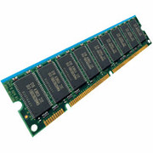
How is the Translation Accomplished?
Virtual
Addresses
Physical
Addresses
CPU
MMU
MMU must translate virtual address to physical address on every instruction fetch, load or store
What does the MMU need to do to translate an address?
Read, check, and update PTE
(set accessed bit/dirty bit on write)

Slide 46
How can we speedup translation?
MMU must make at least 2 memory reads to walk page table. Slow!
Use specialized hardware to
cache virtual-physical memory translations!
Introducing the Translation Lookaside Buffer (TLB)

Slide 47
Recall: CS61c Caching Concept
Cache: a repository for copies that can be accessed more quickly than the original
Only good if:
Frequent case frequent enough and
Infrequent case not too expensive
Important measure
Average Access time = (Hit Rate x Hit Time) + (Miss Rate x Miss Time)

Slide 48
Recall: In Machine Structures (eg. 61C) …
Caching is the key to memory system performance
Main
Memory
(DRAM)
Processor
Access time = 100ns
Main
Memory
(DRAM)
Cache
(SRAM)
Processor
1 ns
100ns

Slide 49
Recall: In Machine Structures (eg. 61C) …
Average Memory Access Time (AMAT)
= (Hit Rate x HitTime) + (Miss Rate x MissTime)
Where HitRate + MissRate = 1
HitRate = 90% => AMAT = (0.9 x 1) + (0.1 x 101)=11 ns
HitRate = 99% => AMAT = (0.99 x 1) + (0.01 x 101)=2.01 ns
MissTime_{L1} includes
HitTime_{L1}+MissPenalty_{L1} ≡ HitTime_{L1} +AMAT_{L2}

Slide 50
Why Does Caching Help? Locality!
Temporal Locality (Locality in Time):
Keep recently accessed data items closer to processor
Spatial Locality (Locality in Space):
Move contiguous blocks to the upper levels

Slide 51
Recall: Memory Hierarchy
Take advantage of the principle of locality to:
Present the illusion of having as much memory as in the cheapest technology
Provide average speed similar to that offered by the fastest technology
Recall: fast but small/expensive. Slow but large!

Slide 52
Recall: Memory Hierarchy
Address Translation needs to occur here
Page table lives here (perhaps cached)
Processor
Secondary Storage (Disk)
Core
L2 Cache
Registers
L1 Cache
Secondary Storage (SSD)
Main
Memory
(DRAM)
L3 Cache (shared)
Core
L2 Cache
Registers
L1 Cache
Speed (ns):
0.3
1
3
10-30
100
100,000 (0.1 ms)
10,000,000
(10 ms)
Size (bytes):
100Bs
10kBs
100kBs
MBs
GBs
100GBs
TBs

Slide 53
How do we make Address Translation Fast?
Cache results of recent translations !
Cache Page Table Entries using Virtual Page # as the key
Read <Phs_Addr X >
Physical
Memory
Read <V_Addr m>
Processor
(core)
pgm data
MMU
Cache(s)
Memory Bus
PTBR
page tables
V_Pg M₁ : <Phs_Frame #₁, V, … >
V_Pg M₂ : <Phs_Frame #₂, V, … >
V_Pg M_{k} : <Phs_Frame #_{k}, V, … >

Slide 54
Translation Look-Aside Buffer
Record recent Virtual Page # to Physical Frame # translation
If present, have the physical address without reading any of the page tables !!!
Caches the end-to-end result

Slide 55
Caching Applied to Address Translation
Virtual
Address
TLB
Physical
Memory
CPU
Physical
Address
Cached?
Yes
No
Save
Result
Translate
(MMU)
Does page locality exist?
Instruction accesses spend a lot of time on the same page (since accesses sequential)
Stack accesses have definite locality of reference

