Slide 1
CS162 Operating Systems and Systems Programming Lecture 23 Internet & Data Processing Systems
Professor Natacha Crooks
https://cs162.org/
Slides based on prior slide decks from David Culler, Ion Stoica, John Kubiatowicz, Alison Norman and Lorenzo Alvisi

Slide 2
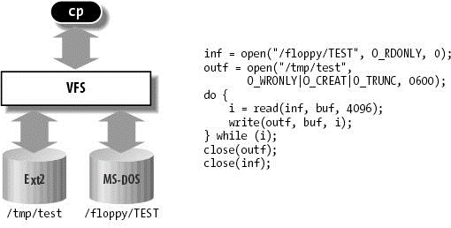
Recall: Virtual Filesystem Switch
Virtual abstraction of file system
Provides virtual superblocks, inodes, files, etc
Compatible with a variety of local and remote file systems
VFS allows the same system call interface (the API) to be used for different types of file systems
The API is to the VFS interface, rather than any specific type of file system

Slide 3
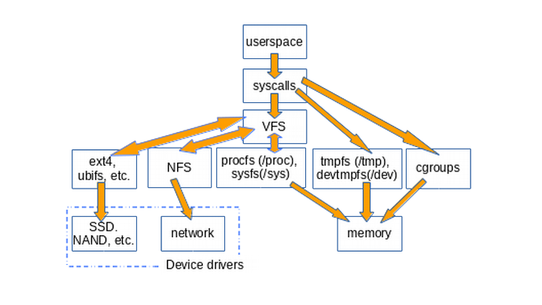
Example Linux mounting tree

Slide 4
Recall: Stateless Protocol
Stateless Protocol: A protocol in which all information required to service a request is included with the request
Idempotent Operations – repeating an operation multiple times is same as executing it just once (e.g., storing to a mem addr.)

Slide 5
Recall: Network File System (NFS)
It’s an open world! Three Layers for NFS system
UNIX file-system interface: open, read, write, close calls + file descriptors
VFS layer: distinguishes local from remote files
Calls the NFS protocol procedures for remote requests
NFS service layer: bottom layer of the architecture
Implements the NFS protocol

Slide 6
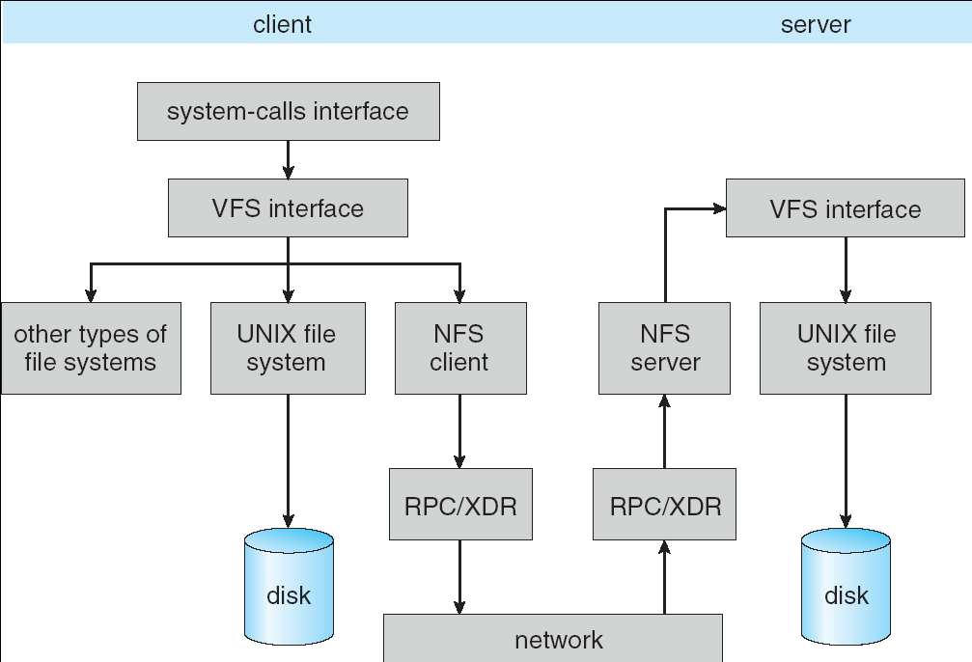
Recall: NFS Architecture

Slide 7
Topic roadmap
Distributed File Systems
Peer-To-Peer System: The Internet
Distributed Data Processing
Coordination
(Atomic Commit and Consensus)

Slide 8
Case study: The Internet
The Internet is the largest distributed system that exists!
Many different applications
Email, web, P2P, etc.
Many different operating systems and devices
Many different network styles and technologies
Wireless, wired, optical
How do we organize this mess
Layering & end-to-end principle
Application
Skype
SSH
NFS
HTTP
Coaxial
cable
Fiber
optic
Packet
Radio
Transmission
Media

Slide 9
The Internet: Layers, Layers, Layers
Application
Skype
SSH
NFS
HTTP
Intermediate
layers
“Narrow Waist”
Internet Protocol
Transmission
Media
Coaxial
cable
Fiber
optic
Packet
radio
Introduce intermediate layers that provide set of abstractions for various network functionality & technologies
A new app/media implemented only once
Goal: Reliable communication channels on which to build distributed applications

Slide 10
The Internet: The hourglass
SMTP
HTTP
DNS
NTP
Applications
“Narrow waist” facilitates interoperability
Layers “abstract” away hardware so that upper layers are agnostic to lower layers
=> Sound familiar?
TCP
UDP
Transport
IP
Waist
Data Link
Ethernet
SONET
802.11
Physical
Copper
Fiber
Radio
The Hourglass Model

Slide 11
The Internet: Implications of Hourglass
Single Internet-layer module (IP):
Allows arbitrary networks to interoperate
Any network technology that supports IP can exchange packets
Allows applications to function on all networks
Applications that can run on IP can use any network
Supports simultaneous innovations above and below IP
But changing IP itself, i.e., IPv6, very involved

Slide 12
The Internet: Drawbacks of Layering
Layer N may duplicate layer N-1 functionality
E.g., error recovery to retransmit lost data
Layers may need same information
E.g., timestamps, maximum transmission unit size
Layering can hurt performance
E.g., hiding details about what is really going on
Some layers are not always cleanly separated
Inter-layer dependencies for performance reasons
Some dependencies in standards (header checksums)

Slide 13
End-To-End Argument
Hugely influential paper:
“End-to-End Arguments in System Design” by Saltzer, Reed, and Clark (‘84)
“Sacred Text” of the Internet
Endless disputes about what it means
Everyone cites it as supporting their position
Simple Message: Some types of network functionality can only be correctly implemented end-to-end
Reliability, security, etc.
Hosts cannot rely on the network help to meet requirement, so must implement it themselves

Slide 14
Example: Reliable File Transfer
Host A
Host B
Appl.
Appl.
OS
OS
OK
Solution 1: make each step reliable, and then concatenate them
Solution 2: end-to-end check and try again if necessary

Slide 15
Discussion
Solution 1 is incomplete
What happens if memory is corrupted?
Receiver has to do the check anyway!
Solution 2 is complete
Full functionality can be entirely implemented at application layer with no need for reliability from lower layers
Is there any need to implement reliability at lower layers?
Well, it could be more efficient

Slide 16
End-to-End Principle
Implementing complex functionality in the network:
- Doesn’t always reduce host implementation complexity
- Does increase network complexity
- Probably imposes delay and overhead on all applications, even if they don’t need functionality
However, implementing in network can enhance performance in some cases
e.g., very lossy link

Slide 17
Conservative Interpretation of E2E
Don’t implement a function at the lower levels of the system unless it can be completely implemented at this level
Or: Unless you can relieve the burden from hosts, don’t bother

Slide 18
Moderate Interpretation
Think twice before implementing functionality in the network
If hosts can implement functionality correctly, implement it in a lower layer only as a performance enhancement
But do so only if it does not impose burden on applications that do not require that functionality
This is the interpretation we are using

Slide 19


Case Study: Distributed Data Processing

Slide 20
Motivation
How can I compute the number of different words in a set of files?
Option 1: Iterate over the files one by one
Option 2: Spawn one thread per file, merge at the end
Option 3: Spawn one thread per file-chunk,
merge at the end
Option 4: Spawn one thread per file-chunk on many machines, merge at the end

Slide 21
Distributed Word Count
Pros
Can scale almost infinitely. Not bound by processing power of a single machine. Many cheap machines usually cheaper than one big one
Cons
Building distributed application is really hard. Must deal with networking/RPC Must tolerate partial failures
Must deal with distributed scheduling.

Slide 22
Distributed Data Processing Goal
Come up with a model for breaking large computations into smaller tasks, then build a framework that distributes those tasks to workers in a cluster
Emphasis on simplicity! Non-experts should be able to use the framework.
Introduce MapReduce (Hadoop open-source version)

Slide 23
Motivation / History
MapReduce developed by Google; paper published in 2004
Google had large amounts of raw data:
Crawled web pages
Server logs
Search data
Needed to be able to analyze that data to construct search indices, analyze website popularity, etc.

Slide 24
Motivation / History
Large amounts of clusters of commodity machines
Commodity: an “off-the-shelf” machine, ie. hardware not custom-built for Google
Wanted to distribute workload to all these machines
Many “one-off” solutions for parallelizing workload
Hard to maintain
Hard to get right
Time-consuming to implement

Slide 25
Map/Reduce Programming Model
Map Function
map: (k1,v1) → list(k2,v2)
Takes an input key-value pair
Outputs a list of key-value pairs
Map: (k1,v1) -> (k1 + 1, v1 + 1)
Map: (k1,v1) -> (v1, k1)

Slide 26
Map/Reduce Programming Model
Reduce Function
reduce: (k2,list(v2)) → list(v2)
Takes in a key and a list of all values corresponding to that key
Produces a list of output values
reduce: (k2, list(v2) -> [sum(list(v2))]
reduce: (k2, list(v2) -> [fold(0,+,(list(v2))]

Slide 27
Revisiting Word Count
How can we implement word count
using only map and reduce?
Three steps:
convert files into pairs of (key,value)
Define a map function. Apply to all files
Shuffle! All elements with same key go to same reduce
Define a reduce function. Apply to result of the map function.

Slide 28
1000 ft view of Map Reduce
File
Map
Map
Map
Reduce
File
Map
File
Map

Slide 29
1000 ft view of Map Reduce
File
Map
Reduce
Map
Reduce
Map
File
Reduce
Map
File
Map

Slide 30
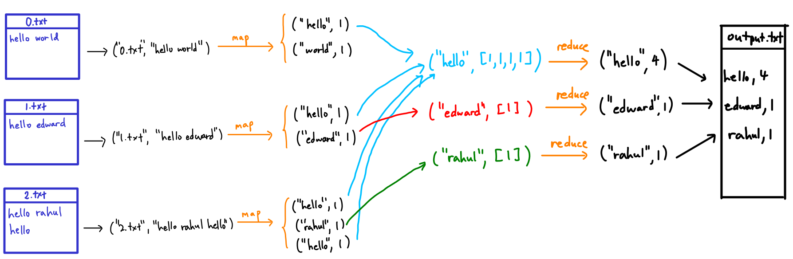
Word Count Map Reduce

Slide 31
WC. Step 1: to (Key, Value)
Transform file into: (File Name, List of words)
Map function takes (Key, List) and maps it to List (Key, Value).

Slide 32
WC. Step 2: Map Function
Map function: Associate each word with an associated count!

Slide 33
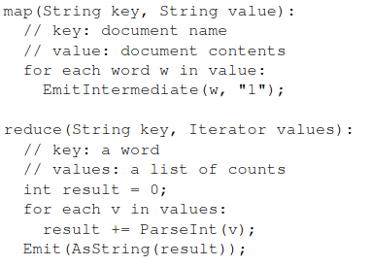
WC. Step 2: Map Function

Slide 34
WC. Step 3: Let’s do the shuffle!
Aggregate intermediate results by key
What should be the reduce function?

Slide 35
WC. Step 4: Reduce

Slide 36
WC. Step 4: Reduce

Slide 37
WC. Final Step, Generate output

Slide 38
Map Reduce System Architecture
Coord

Slide 39
Fault Tolerance
MapReduce assumes that:
Any individual machine is unlikely to crash
But large cluster of machines is likely to experience failures
MapReduce does not attempt to gracefully handle coordinator crashes.
MapReduce does handle worker failures

Slide 40
Idempotence is back!
When a worker fails, simply retry failed tasks! Since failed tasks are retried, application map and reduce functions generally should be pure, deterministic functions of their arguments.
Should not depend on the current time, randomness, resources accessed over the network, etc.
Tasks that are not pure functions can be run on MapReduce, but the results may or may not be cohesive

Slide 41
Stragglers
With many machines, probability that one is slow increases.
Cannot begin reduce phase until map phase has completed.
Spawn “duplicate/backup” tasks to reduce probability of stragglers

Slide 42
Beyond MapReduce
Not all programs can be expressed in map/reduce structure.
Hard for programmers to think of computation in this way.
Disk-based and heavy network load (with shuffle) A lot of research in the area: in-memory processing (Spark), graph-processing (PowerGraph), incremental processing (Naiad), dataflow-based (Dryad), and many, many others

