Slide 1
CS162 Operating Systems and Systems Programming Lecture 19 General IO (Continued) & File Systems
Professor Natacha Crooks.
Special Guest: Tux
https://cs162.org/
Slides based on prior slide decks from David Culler, Ion Stoica, John Kubiatowicz, Alison Norman and Lorenzo Alvisi

Slide 2
A History of Tux
Tux, the friendly penguin has been Linux logo since 1996
Why? Linus Torvalds … just really liked penguins despite being bitten by a penguin in Australia
By 2007, the zoo in Canberra where Torvalds was first nibbled by a penguin had erected a sign commemorating the episode, mentioning "It is our belief that the original Tux is still housed in this enclosure."

Slide 3



A History of Tux

Slide 4
Recall : Simplified IO architecture
Follows a hierarchical structure because of cost:
the faster the bus, the more expensive

Slide 5
Recall: How does processor talk to devices?
Remember, it’s all about abstractions!
Device Controller
Interface
(What the OS sees)
Hardware interface device presents to OS
Status
Command
Data
Internals
(What is needed to implement the abstraction)
Hardware interface device presents to OS
Microcontroller
Memory
Other chips

Slide 6
Recall: Device Drivers
Device-specific code in the kernel that interacts directly with the device hardware
Supports a standard, internal interface
Special device-specific configuration supported with ioctl()
Top half: accessed in call path from system calls.
Implements a set of standard, cross-device calls
Bottom half: run as interrupt routine
Gets input or transfers next block of output
May wake sleeping threads if I/O now complete
Your body is 90% water, the OS is 70% device-drivers

Slide 7
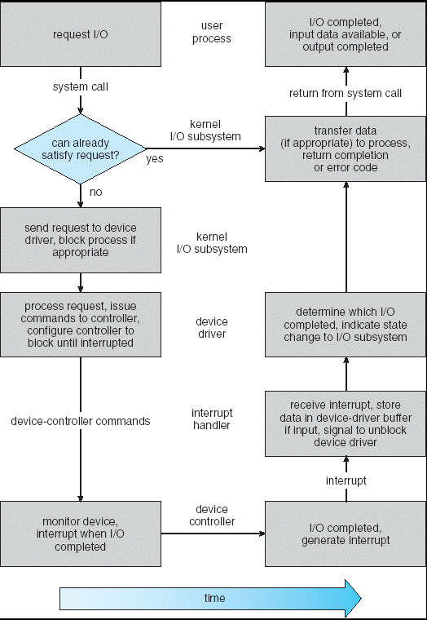
Recall: Life Cycle of An I/O Request
User
Program
Kernel I/O
Subsystem
Device Driver
Top Half
Device Driver
Bottom Half
Device
Hardware

Slide 8
Ways of Measuring Performance
Latency - time to complete a task
Measured in units of time (s, ms, us, …, hours, years)
Throughput or Bandwidth – rate at which tasks are performed
Measured in units of things per unit time (ops/s, GFLOP/s)
Start up or Overhead – time to initiate an operation
Most I/O operations are roughly linear in b bytes
Latency(b) = Overhead + b/TransferCapacity

Slide 9
Storage Devices
Magnetic disks
Storage that rarely becomes corrupted
Large capacity at low cost
Block level random access (except for SMR – later!)
Slow performance for random access
Better performance for sequential access
Flash memory
Storage that rarely becomes corrupted
Capacity at intermediate cost (5-20x disk)
Block level random access
Good performance for reads; worse for random writes
Wear patterns issue

Slide 10
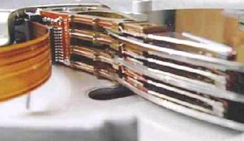
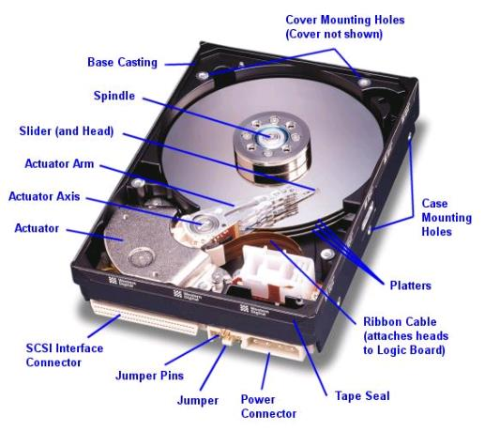
Hard Disk Drives (HDDs)
Read/Write Head Side View
IBM Personal Computer 1986
30MB Hard Disk for 500 dollars

Slide 11
The Amazing Magnetic Disk
Store data magnetically on thin metallic film bonded to rotating disk of glass, ceramic, or aluminum

Slide 12
The Amazing Magnetic Disk
Track: concentric circle on surface
Sectors: slice of a track
Smallest addressable unit
Are units of transfers
Cylinder all the tracks under the head at a given point on all surfaces

Slide 13
The Amazing Magnetic Disk
Track
Track lengths vary across disk: outside tracks have more sectors per track, higher bandwidth
Disk is organized into regions of tracks with the same number of sector/tracks
Usually, only outer half of radius is used
Sector
Head
Cylinder
Platter

Slide 14
Reading/Writing Data
Seek time: position the head/arm over the proper track
Rotational latency: wait for desired sector to rotate under r/w head
Transfer time: transfer a block of bits (sector) under r/w head

Slide 15
Reading/Writing Data
Request Time =
Queueing Time + Controller Time + Seek + Rotational + Transfer
Software
Queue
(Device Driver)
Hardware
Controller
Media Time
(Seek+Rot+Xfer)
Request
Result

Slide 16
Typical Numbers for Magnetic Disk
Parameter | Info/Range
Space/Density | Space: 14TB (Seagate), 8 platters, in 3½ inch form factor! Areal Density: ≥ 1 Terabit/square inch! (PMR, Helium, …)
Average Seek Time | Typically 4-6 milliseconds
Average Rotational Latency | Most laptop/desktop disks rotate at 3600-7200 RPM (16-8 ms/rotation). Server disks up to 15,000 RPM. Average latency is halfway around disk so 4-8 milliseconds
Controller Time | Depends on controller hardware
Transfer Time | Typically 50 to 250 MB/s. Depends on: Transfer size (usually a sector): 512B – 1KB per sector Rotation speed: 3600 RPM to 15000 RPM Recording density: bits per inch on a track Diameter: ranges from 1 in to 5.25 in
Cost | Used to drop by a factor of two every 1.5 years (or faster), now slowing down

Slide 17
Disk Performance Example
Key to using disk effectively (especially for file systems) is to minimize seek and rotational delays
Do access patterns influence how fast can read/write to disk?
Avg seek time of 5ms,
7200RPM ⇒
Time for rotation: 60000 (ms/min)/7200(rev/min) ~= 8ms
Transfer rate of 50MByte/s, block size of 4Kbyte ⇒ 4096 bytes/50×10⁶ (bytes/s) = 81.92 × 10⁻⁶ sec ≅
0.082 ms for 1 sector

Slide 18
Disk Performance Example
Read block from random place on disk (random reads):
Seek (5ms) + Rot. Delay (4ms) + Transfer (0.082ms) = 9.082ms
Approx 9ms to fetch/put data: 4096 bytes/9.082×10⁻³ s ≅ 451KB/s
Read block from random place in same cylinder:
Rot. Delay (4ms) + Transfer (0.082ms) = 4.082ms
Approx 4ms to fetch/put data: 4096 bytes/4.082×10⁻³ s ≅ 1.03MB/s
Read next block on same track (sequential reads):
Transfer (0.082ms): 4096 bytes/0.082×10⁻³ s ≅ 50MB/sec

Slide 19
When is Disk Performance Highest?
When there are big sequential reads, or
When there is so much work to do that they can be piggy backed (reordering queues—one moment)
OK to be inefficient when things are mostly idle
Bursts are both a threat and an opportunity
<your idea for optimization goes here>
Waste space for speed?

Slide 20
Disk Scheduling (1/3)
Disk can do only one request at a time; What order do you choose to do queued requests?
User
Requests
2,2
5,2
7,2
3,10
2,1
2,3
3
Head
Disk Head
2
1
4

Slide 21
Disk Scheduling (1/3)
User
Requests
2,2
5,2
7,2
3,10
2,1
2,3
Head
FIFO Order
Fair among requesters, but order of arrival may be to random spots on the disk
SSTF: Shortest seek time first
Pick the request that’s closest on the disk
Con: SSTF good at reducing seeks, but may lead to starvation

Slide 22
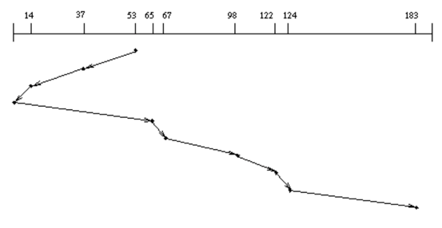
Disk Scheduling (2/3)
User
Requests
2,2
5,2
7,2
3,10
2,1
2,3
Head
SCAN: Implements an Elevator Algorithm: take the closest request in the direction of travel
No starvation, but retains flavor of SSTF

Slide 23
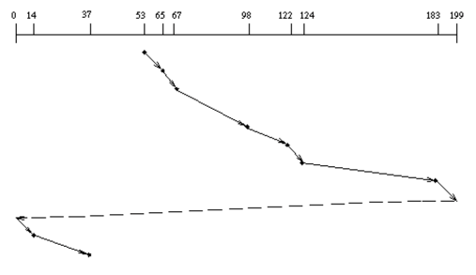
Disk Scheduling (3/3)
C-SCAN: Circular-Scan: only goes in one direction
Skips any requests on the way back
Fairer than SCAN, not biased towards pages in middle

Slide 24
Lots of Intelligence in the Controller
Sectors contain sophisticated error correcting codes
Disk head magnet has a field wider than track
Hide corruptions due to neighboring track writes
Sector sparing
Remap bad sectors transparently to spare sectors on the same surface
Slip sparing
Remap all sectors (when there is a bad sector) to preserve sequential behavior
Track skewing
Sector numbers offset from one track to the next, to allow for disk head movement for sequential ops

Slide 25
Hard Drive Prices over Time

Slide 26
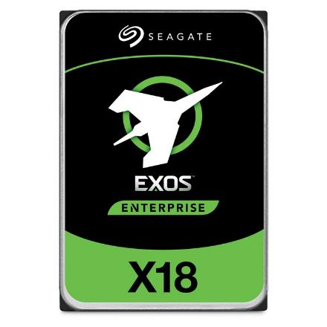
Example of Current HDDs
Seagate Exos X18 (2020)
18 TB hard disk
9 platters, 18 heads
Helium filled: reduce friction and power
4.16ms average seek time
4096 byte physical sectors
7200 RPMs
Dual 6 Gbps SATA /12Gbps SAS interface
270MB/s MAX transfer rate
Cache size: 256MB
Price: $ 562 (~ $0.03/GB)
IBM Personal Computer/AT (1986)
30 MB hard disk
30-40ms seek time
0.7-1 MB/s (est.)
Price: $500 ($17K/GB, 340,000x more expensive !!)

Slide 27
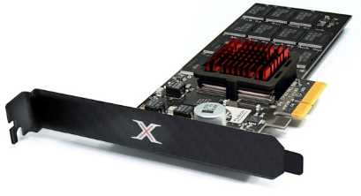
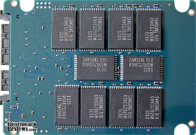
Solid State Drives
1995 – Replace rotating magnetic media with non-volatile memory (battery backed DRAM)
2009 – Use flash memory
Sector (4 KB page) addressable, but stores 4-64 “pages” per memory block
Trapped electrons distinguish between 1 and 0
No moving parts (no rotate/seek motors)
Eliminates seek and rotational delay (0.1-0.2ms access time)
Very low power and lightweight
Limited “write cycles”

Slide 28
The Flash Cell
Encode bit by trapping electrons into a cell
Single-level cell (SLC)
Single bit is stored within a transistor
Faster, more lasting (50k to 100k writes before wear out)
Multi-level cell (MLC)
Two/three bits are encoded into different levels of charge
Wear out much faster (1k to 10k writes)

Slide 29
Of banks, blocks, cells
Flash chips organized in banks
Banks can be accessed in parallel
Blocks 128 KB/256KB
(64 to 258 pages)
Pages Few KB
Cells 1 to 4 bits
Distinction between blocks and pages important in operations!
Bank
Block
Block
Page
Page
Page
Page
Cell
Cell
Cell
Cell
Cell
Cell
Cell
Cell
Cell
Cell
Cell
Cell
Cell
Cell
Cell
Cell

Slide 30
Low-level flash operations
How do you read?
Chip supports reading pages
10s of microseconds, independently of the previously read page
What about writing? More complicated!
Must first erase the block
Erase quite expensive (milliseconds)
Once block has been erased, can then program a page
Change 1s to 0s within a page.
100s of microseconds.
Blocks can only be erased a limited number of times!

Slide 31
Low-level flash operations
INVALID
ERASED
VALID

Slide 32
Low-level flash operations
Assume block of 4 pages. All valid.
Want to write Page 0
Step 1: erase full block
Step 2: program page 0

Slide 33
SSD Architecture
Recall that SSDs uses low-level Flash operations to provide same interface as HDD
read and write chunk (4KB) at a time
Reads are easy, but for writes, can only overwrite data one block (256KB) at a time!
Why not just erase and rewrite new version of entire 256KB block?
Erasure is very slow (milliseconds)
Each block has a finite lifetime, can only be erased and rewritten about 10K times
Heavily used blocks likely to wear out quickly

Slide 34
SSD Architecture (Simplified)

Slide 35
Flash Translation Layer (FTL)
Add a layer of indirection: the flash translation layer
Translates request for logical blocks (device interface) to low-level Flash blocks and pages
Reduce write amplification
Ratio of the total write traffic in bytes issues by the flash chip by the FTL devided by the total write traffic issued by the OS to the device
Avoid wear out
A single block should not be erased too often

Slide 36
FTL – Two Systems Principles
FTL uses indirection and copy-on-write
Maintains mapping tables in DRAM
Map virtual block numbers (which OS uses) to physical page numbers (which flash mem. controller uses)
Can now freely relocate data w/o OS knowing
Copy on Write/ Log-structured FTL
Don’t overwrite a page when OS updates its data
Instead, write new version in a free page
Update FTL mapping to point to new location

Slide 37
FTL Example
Mapping Table:
Mapping Table
a0->0,0
Mapping Table:
a0->0,0/a1->0,1
Initial
State
Block 0
Block 1
Block 0
Block 1
Write(a1)
Block 0
Block 1
Write(a0)
a0
a0
a1
E
E
E
E
V
E
E
E
V
V
E
E
Mapping Table:
a0->0,0/a1->1,0
Mapping Table:
a0->1,1/a1->1,0
Mapping Table:
a0->1,1/a1->1,0
Write(a1)
Block 0
Block 1
Write(a0)
Block 0
Block 1
Garbage Collect
Block 0
Block 1
a0
a1
a1
a0
a1
a1
a0
a1
a0
V
V
V
E
V
V
V
V
E
E
V
V

Slide 38
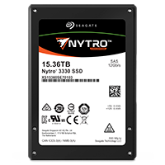
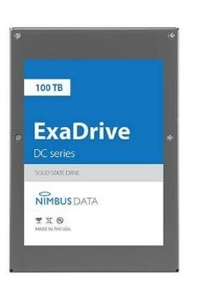
Some “Current” (large) 3.5in SSDs
Seagate Exos SSD: 15.36TB (2017)
Seq reads 860MB/s
Seq writes 920MB/s
Price (Amazon): $5495 ($0.36/GB)
Nimbus SSD: 100TB (2019)
Seq reads/writes: 500MB/s
Random Read Ops (IOPS): 100K
Unlimited writes for 5 years!
Price: ~ $40K? ($0.4/GB)
However, 50TB drive costs $12500 ($0.25/GB)

Slide 39
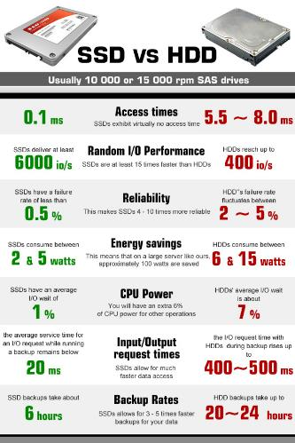
HDD vs. SSD Comparison
HDD | SDD
Require seek + rotation | No seeks
Not parallel (one head) | Parallel
Brittle (moving parts) | No moving parts
Random reads take 10s milliseconds | Random reads take 10s microseconds
Slow (Mechanical) | Wears out
Cheap/large storage | Expensive/smaller storage

Slide 40
Recall: I/O and Storage Layers
High Level I/O
Streams
Low Level I/O
File Descriptors
Syscall
open(), read(), write(), close(), …
Open File Descriptions
File System
Files/Directories/Indexes
I/O Driver
Commands and Data Transfers
Disks, Flash, Controllers, DMA

Slide 41
From Storage to File Systems
I/O API and
syscalls
Variable-Size Buffer
Memory Address
Logical Index, Typically 4 KB
File System
Block
Flash Trans. Layer
Hardware Devices
Sector(s)
Sector(s)
Sector(s)
Phys. Block
Phys Index., 4KB
Physical Index,
512B or 4KB
Erasure Page
HDD
SSD

Slide 42
Building a File System
Layer of OS that transforms block interface of disks (or other block devices) into Files, Directories, etc.

Slide 43
Building a File System
OS as an illusionist: Take limited hardware interface (array of blocks) and provide a more convenient/useful interface with:
Naming: Find file by name, not block numbers
Organize file names with directories
Organization: Map files to blocks
Protection: Enforce access restrictions
Reliability: Keep files intact despite crashes, failures, etc.

Slide 44
User vs. System View of a File
User’s view:
Durable Data Structures
System’s view (system call interface):
Collection of Bytes (UNIX)
Doesn’t matter to system what kind of data structures you want to store on disk!
System’s view (inside OS):
Collection of blocks (a block is a logical transfer unit, while a sector is the physical transfer unit)
Block size ≥ sector size; in UNIX, block size is 4KB

Slide 45

Translation from User to System View
File (Bytes)
File
System
What happens if user says: “give me bytes 2 – 12?”
Fetch block corresponding to those bytes
Return just the correct portion of the block
What about writing bytes 2 – 12?
Fetch block, modify relevant portion, write out block
Everything inside file system is in terms of whole-size blocks

Slide 46
Disk Management
Basic entities on a disk:
File: user-visible group of blocks arranged sequentially in logical space
Directory: user-visible index mapping names to files
The disk is accessed as linear array of sectors
Old: Physical Position [cylinder, surface, sector]
New: Logical Block Addressing (LBA)
Every sector has integer address
Controller translates from address ⇒ physical position
Shields OS from structure of disk

Slide 47
What Does the File System Need?
Track free disk blocks
Need to know where to put newly written data
Track which blocks contain data for which files
Need to know where to read a file from
Track files in a directory
Find list of file's blocks given its name
Where do we maintain all of this?
Somewhere on disk

