Slide 1
CS162 Operating Systems and Systems Programming Lecture 13 Deadlock
Professor Natacha Crooks
https://cs162.org/
Slides based on prior slide decks from David Culler, Ion Stoica, John Kubiatowicz, Alison Norman and Lorenzo Alvisi

Slide 2
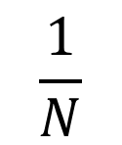
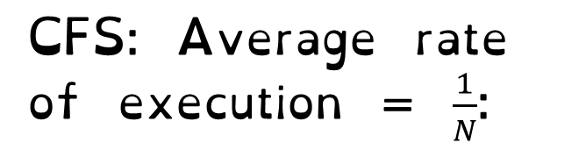
Linux Completely Fair Scheduler (CFS)
Basic Idea
Track CPU time per thread
CFS: Average rate of execution = $\frac{1}{N}$:
Scheduling Decision
“Repair” illusion of complete fairness
Choose thread with minimum CPU time
T₁
$$\frac{1}{N}$$
T₃
CPU Time
T₂

Slide 3
Linux Completely Fair Scheduler (CFS)
Fair by construction
Scheduling Cost is O(log n)
Threads are stored in a Red-Black tree.
Easy to capture interactivity
Sleeping threads don’t advance their CPU time, so automatically get a boost when wake up again

Slide 4
Linux CFS: Responsiveness
Low response time & Starvation-freedom
Make sure that everyone gets to run in a given period of time
Constraint 1: Target Latency
Period of time over which every process
gets service
Quanta = Target_Latency / n

Slide 5
Linux CFS: Latency
Constraint 1: Target Latency
Quanta = Target_Latency / n
Target Latency: 20 ms, 4 Processes
Each process gets 5ms time slice
Target Latency: 20 ms, 200 Processes
Each process gets 0.1ms time slice

Slide 6
Linux CFS: Throughput
Goal: Throughput
Avoid excessive overhead
Constraint 2: Minimum Granularity
Minimum length of any time slice
Target Latency 20 ms,
Minimum Granularity 1 ms, 200 processes
Each process gets 1 ms time slice

Slide 7
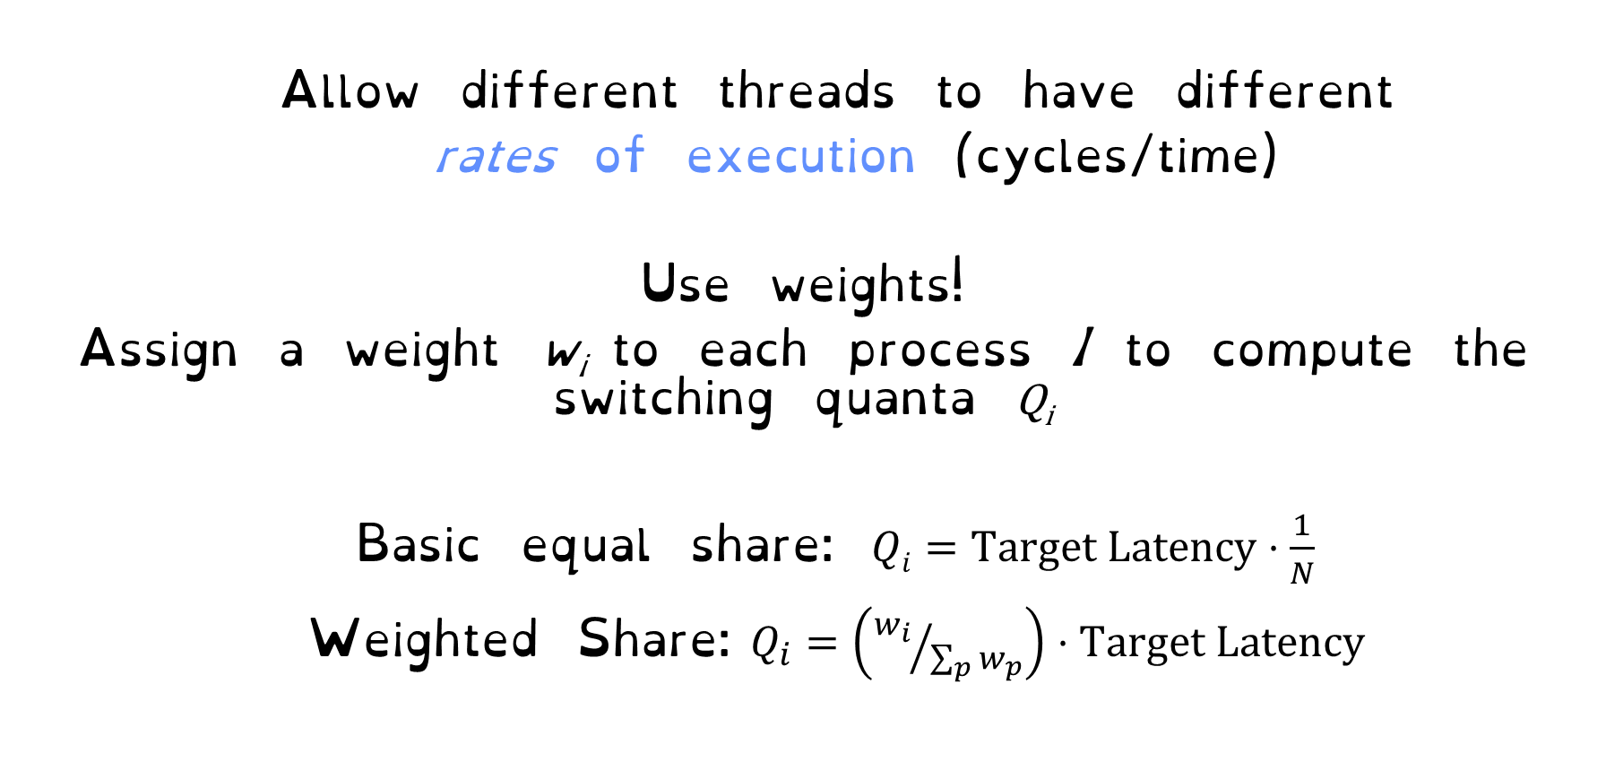
Linux CFS: Proportional Shares
Allow different threads to have different
rates of execution (cycles/time)
Use weights!
Assign a weight w_{i} to each process I to compute the switching quanta Q_{i}
Basic equal share: $Qi=Target Latency⋅\frac{1}{N}$
Weighted Share:$Q_{i}=\left({w_{i}}/{\sum_{p}{w_{p}}}\right)⋅Target Latency$

Slide 8
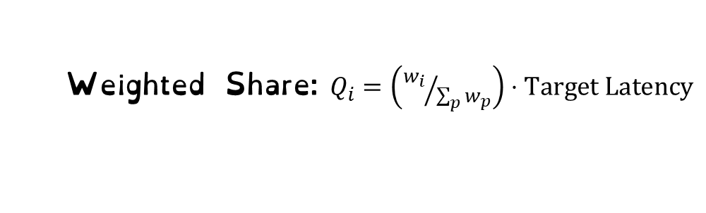
Linux CFS: Proportional Shares
Target Latency = 20ms
Minimum Granularity = 1ms
Two CPU-Bound Threads
Thread A has weight 1
Thread B has weight 4
What should the time slice of A and B be?
Weighted Share:$Q_{i}=\left({w_{i}}/{\sum_{p}{w_{p}}}\right)⋅Target Latency$
A = (1/5) * 20 = 4
B = (4/5) * 20 = 16

Slide 9
Linux CFS: Proportional Shares
Target Latency = 20ms
Minimum Granularity = 1ms
A timeslice = 4ms
B timeslice = 16 ms
Recall: Run the thread with the lowest amount of CPU use
A
B
0
0

Slide 10
Linux CFS: Proportional Shares
Target Latency = 20ms
Minimum Granularity = 1ms
A timeslice = 4ms
B timeslice = 16 ms
Recall: Run the thread with the lowest amount of CPU use
A
B
4
16
A
B

Slide 11
Linux CFS: Proportional Shares
Target Latency = 20ms
Minimum Granularity = 1ms
A timeslice = 4ms
B timeslice = 16 ms
Recall: Run the thread with the lowest amount of CPU use
A
B
8
16
A
B
A

Slide 12
Linux CFS: Proportional Shares
Target Latency = 20ms
Minimum Granularity = 1ms
A timeslice = 4ms
B timeslice = 16 ms
Recall: Run the thread with the lowest amount of CPU use
A
B
16
16
A
B
A
A
A

Slide 13
Linux CFS: Proportional Shares
Target Latency = 20ms
Minimum Granularity = 1ms
A timeslice = 4ms
B timeslice = 16 ms
A and B got 50% of the CPU. Something went wrong!
Recall: Run the thread with the lowest amount of CPU use
A
B
16
16
A
B
A
A
A

Slide 14

Virtual Runtime
Must track a thread's virtual runtime
rather than its true physical runtime
Higher weight: Virtual runtime increases more slowly
Lower weight: Virtual runtime increases more quickly
Virtual Runtime = Virtual Runtime + $\left(1/{w_{i}}\right)$ Physical Runtime

Slide 15
Linux CFS: Proportional Shares
Target Latency = 20ms
Minimum Granularity = 1ms
A timeslice = 4ms
B timeslice = 16 ms
Recall: Run the thread with the lowest amount of CPU use
A
B
0
0

Slide 16
Linux CFS: Proportional Shares
Target Latency = 20ms
Minimum Granularity = 1ms
A timeslice = 4ms
B timeslice = 16 ms
Virtual Runtime = 0 + Physical Runtime / Weight = 0 + 4/1
A
B
4
0
A

Slide 17
Linux CFS: Proportional Shares
Target Latency = 20ms
Minimum Granularity = 1ms
A timeslice = 4ms
B timeslice = 16 ms
Virtual Runtime = 0 + Physical Runtime / Weight = 0 + 16/4 = 4
A
B
4
4
A
B

Slide 18
Linux CFS: Proportional Shares
Target Latency = 20ms
Minimum Granularity = 1ms
A timeslice = 4ms
B timeslice = 16 ms
Virtual Runtime = 4 + Physical Runtime / Weight = 4 + 4/1 = 8
A
B
8
4
A
B
A

Slide 19
Linux CFS: Proportional Shares
Target Latency = 20ms
Minimum Granularity = 1ms
A timeslice = 4ms
B timeslice = 16 ms
Virtual Runtime = 4 + Physical Runtime / Weight = 4 + 16/4 = 8
A
B
8
8
A
B
A
B

Slide 20
Linux CFS: Proportional Shares
A “Physical” CPU utilization: 4 + 4 = 8
B “Physical” CPU utilization: 16 + 16 = 32
But equal virtual runtime!
CFS shares vruntime equally
A
B
8
8
A
B
A
B

Slide 21
Linux CFS: Proportional Shares
Physical
CPU Time
Virtual
CPU Time
16 (w_{B}=4)
B
B
A
4 (w_{A}=1)
A
What about new jobs or very sleepy jobs?

Slide 22
Linux CFS: Proportional Shares
Reuse nice value to reflect share, rather than priority
CFS uses nice values to scale weights exponentially
Weight=1024/(1.25)^{nice}

Slide 23
CFS & Priorities Cheat Sheet
Weight the real running time with priority of the task
Nice 0 is the reference: vruntime == real runtime ○
Nice < 0: vruntime increases slower than real time ○
Nice > 0: vruntime increases faster than real time

Slide 24
Summary: Schedulers in Linux
O(n) scheduler
Linux 2.4 to Linux 2.6
O(1) scheduler
Linux 2.6 to 2.6.22
CFS scheduler
Linux 2.6.23 onwards
Did not scale with large number of processes
Heuristics too complex
Proportional Fair Sharing. Throughput and Latency constraints
Gives all processes 1/N *virtual time * on CPU

Slide 25
Summary: Schedulers in Linux
O(n) scheduler
Linux 2.4 to Linux 2.6
O(1) scheduler
Linux 2.6 to 2.6.22
CFS scheduler
Linux 2.6.23 onwards
Did not scale with large number of processes
Heuristics too complex
Proportional Fair Sharing. Throughput and Latency constraints
Gives all processes 1/N *virtual time * on CPU

Slide 26


Understanding Deadlock
I will if you will
I will if you will

Slide 27
Deadlock: A Deadly type of Starvation
Deadlock: cyclic waiting for resources
Thread A owns Res 1 and is waiting for Res 2
Thread B owns Res 2 and is waiting for Res 1
Thread
A
Wait
For
Owned
By
Res 1
Res 2
Owned
By
Wait
For
Thread
B

Slide 28
Deadlock: A Deadly type of Starvation
Starvation: thread waits indefinitely
Deadlock implies starvation
but starvation does not imply deadlock
Starvation can end (but doesn’t have to)
Deadlock can’t end without external intervention

Slide 29
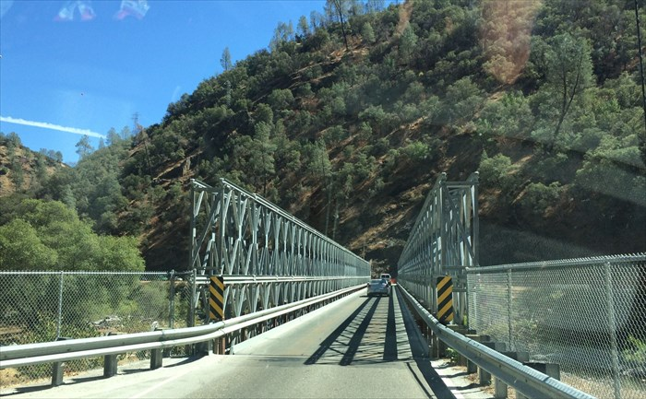
Example: Single-Lane Bridge Crossing

Slide 30
Bridge Crossing Example
Each segment of road can be viewed as a resource
Rules:
Car must own the segment under them
Must acquire segment that they are moving into
For bridge: traffic only in one direction at a time

Slide 31
Bridge Crossing Example
Car must own the segment under them
Must acquire segment that they are moving into
For bridge: traffic only in one direction at a time

Slide 32
Bridge Crossing Example
Honk!
Owned
By
Wait
For
Deadlock:
Circular waiting for resources
West Half
East Half
Owned
By
Wait
For

Slide 33
Bridge Crossing Example
Owned
By
Wait
For
Deadlock:
Circular waiting for resources
West Half
East Half
Owned
By
Wait
For
Could be resolved by “external” intervention:
fork-lifting a car of the bridge (equivalent to killing a thread)
Asking cars to backup
(equivalent to removing the resource from the thread)

Slide 34

Starvation does not mean deadlock!
Stop sign: purple car must wait for cars to release resources.
Cars on highway never do!
Purple car is starved

Slide 35
Deadlock with Locks
Thread A:
x.Acquire();
y.Acquire();
…
y.Release();
x.Release();
Thread B:
y.Acquire();
x.Acquire();
…
x.Release();
y.Release();
Thread
A
Owned
By
Wait
For
Lock x
Lock y
Wait
For
Thread
B
Owned
By
Will threads deadlock
a) Always b) Never c) Sometimes d) I’m still trying to cross the road
This lock pattern exhibits non-deterministic deadlock
A system is subject to deadlock if deadlock can happen in any execution

Slide 36
Deadlock with Locks: “Lucky” Case
Thread A:
x.Acquire();
y.Acquire();
…
y.Release();
x.Release();
Thread B:
y.Acquire();
x.Acquire();
…
x.Release();
y.Release();
Sometimes, schedule won’t trigger deadlock!

Slide 37
Other Types of Deadlock
Threads often block waiting for resources
Locks
Terminals
Printers
CD drives
Memory
Threads often block waiting for other threads
Pipes
Sockets
You can deadlock on any of these!

Slide 38





Dining Computer Scientists Problem
Five chopsticks/Five computer scientists
Need two chopsticks to eat

Slide 39
Free for all leads to deadlock

Slide 40
Intervention needed
Fixing deadlock needs external intervention!
How could we have prevented this?
- Give everyone two chopsticks
- Make everyone “give up” after a while
- Require everyone to pick up both chopsticks atomically

Slide 41
Four requirements for occurrence of deadlock
1) Mutual exclusion and bounded resources
Only one thread at a time can use a resource.
2) Hold and wait
Thread holding at least one resource is waiting to acquire additional resources held by other threads

Slide 42
Four requirements for occurrence of deadlock
3) No preemption
Resources are released only voluntarily by the thread holding the resource, after thread is finished with it
4) Circular wait
There exists a set {T₁, …, T_{n}} of waiting threads
T₁ is waiting for a resource that is held by T₂
T₂ is waiting for a resource that is held by T₃
…
T_{n} is waiting for a resource that is held by T₁

Slide 43
Detecting Deadlock: Resource-Allocation Graph
System Model
A set of Threads T₁, T₂, . . ., T_{n}
Resource types R₁, R₂, . . ., R_{m}
CPU cycles, memory space, I/O devices
Each resource type R_{i} has W_{i} instances
Each thread
Request() / Use() / Release() a resource:

Slide 44
Detecting Deadlock: Resource-Allocation Graph
Resource-Allocation Graph
V is partitioned into two types:
T = {T₁, T₂, …, T_{n}},
the set threads in the system.
R = {R₁, R₂, …, R_{m}},
the set of resource types in system
request edge – directed edge T₁ → R_{j}
assignment edge – directed edge R_{j} → T_{i}
Symbols
T₁
T₂
R₁
R₂

Slide 45
Resource-Allocation Graph Examples
R₁
R₂
R₁
R₂
R₁
T₂
T₁
T₂
T₃
T₁
T₂
T₃
T₁
T₃
R₃
T₄
R₄
R₃
R₂
R₄
Simple Resource
Allocation Graph
Allocation Graph With Deadlock
Allocation Graph With Cycle, but
No Deadlock

Slide 46
Deadlock Detection Algorithm
Let [X] represent an m-ary vector of non-negative integers (quantities of resources of each type)
[FreeResources]: Current free resources each type
[Request_{X}]: Current requests from thread X
[Alloc_{X}]: Current resources held by thread X

Slide 47
Deadlock Detection Algorithm
See if tasks can eventually terminate on their own
[Avail] = [FreeResources] Add all threads to UNFINISHED do {
done = true Foreach thread in UNFINISHED { if ([Request_{node}] <= [Avail]) { remove thread from UNFINISHED [Avail] = [Avail] + [Alloc_{node}] done = false } } } until(done)
Threads left in UNFINISHED ⇒ deadlocked

Slide 48
Deadlock Detection Algorithm
[Avail] = [FreeResources] Add all threads to UNFINISHED do {
done = true Foreach thread in UNFINISHED { if ([Request_{node}] <= [Avail]) { remove thread from UNFINISHED [Avail] = [Avail] + [Alloc_{node}] done = false } } } until(done)
Threads left in UNFINISHED ⇒ deadlocked
[Avail] = {0,0}
UNFINISHED = T1, T2, T3, T4
Looking at T1: [1,0] > [0,0]
Looking at T2: [0,0] <= [0,0]
Avail = [1,0]
UNFINISHED = T1,T3,T4
Looking at T3: [0,1] > [1,0]
Looking at T4
[0,0] <= [0,0]
Avail = [1,1]
UNFINISHED = T1, T3
Looking at T1: [1,0] <= [1,1]
Avail = [2,1]
UNFINISHED = T3
Looking at T3: [0,1] <= [2,1]
Avail = [2,2]
UNFINISHED = Empty!
R₁
T₂
T₁
T₃
T₄
R₂

Slide 49
How should a system deal with deadlock?
Deadlock prevention Write your code in a way that it isn’t prone to deadlock
Deadlock recovery
Let deadlock happen, and figure out how to recover from it
Deadlock avoidance
Dynamically delay resource requests so deadlock doesn’t happen
Deadlock denial
Ignore the possibility of deadlock

Slide 50
Deadlock prevention
Condition 1: Mutual exclusion and bounded resources
=> Provide sufficient resources
Condition 2: Hold and wait
Abort request or acquire requests atomically
Condition 3: No preemption
=> Preempt threads
Condition 4: Circular wait
=> Order resources and always acquire resources in the same way

Slide 51
Condition 1 Fix: (Virtually) Infinite Resources
Thread A
AllocateOrWait(1 MB)
AllocateOrWait(1 MB)
Free(1 MB)
Free(1 MB)
Thread B
AllocateOrWait(1 MB)
AllocateOrWait(1 MB)
Free(1 MB)
Free(1 MB)
With virtual memory we have “infinite” space so everything will always succeed

Slide 52
Condition 2 Fix: Request Resources Atomically
Rather than:
Thread A:
x.Acquire();
y.Acquire();
…
y.Release();
x.Release();
Thread B:
y.Acquire();
x.Acquire();
…
x.Release();
y.Release();
Consider instead:
Thread A:
Acquire_both(x, y);
…
y.Release();
x.Release();
Thread B:
Acquire_both(y, x);
…
x.Release();
y.Release();

Slide 53
Condition 3 Fix: Preemption
Force thread to give up resource
Common technique in databases using database aborts
A transaction is “aborted”: all of its actions are undone, and the transaction must be retried
Common technique in wireless networks:
Everyone speaks at once. When a resource collision is detected, retry at a new, random time

Slide 54
Condition 4 Fix: Circular Waiting
Force all threads to request resources
in the same order
Thread A:
x.Acquire();
y.Acquire();
…
y.Release();
x.Release();
Thread B:
y.Acquire();
x.Acquire();
…
x.Release();
y.Release();
Thread A:
x.Acquire();
y.Acquire();
…
y.Release();
x.Release();
Thread B:
x.Acquire();
y.Acquire();
…
y.Release();
x.Release();

Slide 55
Condition 4 Fix: Circular Waiting
1
Garcia: first 1 then 5
Crooks: first 2 then 1
Turing: first 3 then 2
Johnson: first 4 than 3
Liskov: first 5 then 4
If ensure that Garcia graphs chopstick 5 followed by 1, no deadlock!
5
2
3
4

Slide 56
How should a system deal with deadlock?
Deadlock prevention Write your code in a way that it isn’t prone to deadlock
Deadlock recovery
Let deadlock happen, and figure out how to recover from it
Deadlock avoidance
Dynamically delay resource requests so deadlock doesn’t happen
Deadlock denial
Ignore the possibility of deadlock

Slide 57
Techniques for Deadlock Avoidance
Attempt 1 When a thread requests a resource, OS checks if it would result in deadlock
If not, it grants the resource right away
If so, it waits for other threads to release resources

Slide 58
Techniques for Deadlock Avoidance
This does not work!
Thread A:
x.Acquire();
y.Acquire();
…
y.Release();
x.Release();
Thread B:
y.Acquire();
x.Acquire();
…
x.Release();
y.Release();
Blocks…
Wait?
But it’s already too late…

Slide 59
Deadlock Avoidance: Three States
Safe state
System can delay resource acquisition to prevent deadlock
Unsafe state
No deadlock yet…
But threads can request resources in a pattern that unavoidably leads to deadlock
Deadlocked state
There exists a deadlock in the system
Deadlock avoidance: prevent system from reaching an unsafe state

Slide 60
Deadlock Avoidance: Three States
Thread A:
x.Acquire();
y.Acquire();
…
y.Release();
x.Release();
Thread B:
y.Acquire();
x.Acquire();
…
x.Release();
y.Release();
A acquires x.
There exists a sequence A-A(y),A-R(y),A-R(x), B-A(y),
B-A(x), B-R(x), B-R(y) => safe state
B acquires y.
No sequence that won’t lead to deadlock. => unsafe state

Slide 61
Banker’s Algorithm for Avoiding Deadlock
Banker’s algorithm ensures never enter
an unsafe state.
Evaluate each request and grant if some ordering of threads is still deadlock free afterward
Technique: pretend each request is granted, then run deadlock detection algorithm

Slide 62
Banker’s Algorithm for Avoiding Deadlock
[Avail] = [FreeResources] Add all threads to UNFINISHED do {
done = true Foreach thread in UNFINISHED { if ([Request_{thread}] <= [Avail]) { remove thread from UNFINISHED [Avail] = [Avail] + [Alloc_{thread}] done = false } } } until(done)
[Avail] = [FreeResources] Add all threads to UNFINISHED do {
done = true Foreach threads in UNFINISHED { if ([Max_{threads}]-[Alloc_{thread}] <= [Avail]) { remove thread from UNFINISHED [Avail] = [Avail] + [Alloc_{thread}] done = false } } } until(done)

Slide 63
Banker’s Algorithm for Avoiding Deadlock
[Avail] = [FreeResources] Add all threads to UNFINISHED do {
done = true Foreach threads in UNFINISHED { if ([Max_{threads}]-[Alloc_{thread}] <= [Avail]) { remove thread from UNFINISHED [Avail] = [Avail] + [Alloc_{thread}] done = false } } } until(done)
Step 1: “Assume” request is made
Step 2: If request is made, is system still in SAFE state?
There exists a sequence {T₁, T₂, … T_{n}} such that all transactions finish
Step 3: If SAFE, grant resources. If UNSAFE, delay

Slide 64
Banker’s Algorithm for Avoiding Deadlock
[Avail] = [FreeResources] Add all threads to UNFINISHED do {
done = true Foreach threads in UNFINISHED { if ([Max_{threads}]-[Alloc_{thread}] <= [Avail]) { remove thread from UNFINISHED [Avail] = [Avail] + [Alloc_{thread}] done = false } } } until(done)
Thread A:
x.Acquire();
y.Acquire();
…
y.Release();
x.Release();
Thread B:
y.Acquire();
x.Acquire();
…
x.Release();
y.Release();
When Thread A acquires x:
Avail = [0,1]
For A: [1,1] – [1,0] <= [0,1]
Update Avail to = 1,1. Remove A from UNFINISHED
For B:
[1,1] – [0,0] <= [1,1]
Update Avail to = [1,1]. Remove B from UNFINISHED
Safe state!
When Thread B acquires y:
Avail = [0,0]
For A: [1,1] – [1,0] <= [0,0]
For B: [1,1] – [0,1] <= [0,0]
UNFINISHED not empty
Unsafe state! Must delay acquiring y!

Slide 65
Summary
Deadlock => Starvation, Starvation does not imply deadlock
Four conditions for deadlocks
Mutual exclusion
Hold and wait
No preemption
Circular wait
Techniques for addressing deadlock: prevention, recovery, avoidance, or denial
Banker’s algorithm for avoiding deadlock

