Slide 1
Core Data Services (CDS)
Tutorial 07: Learn about Associations to create "Joins on Demand"
13.11.2020, Alexander Maetzing
alexander.maetzing@quicksted.com

Slide 2
Associations
A classical Join and an Association are basically very similar: They combine the accesses to two or more tables into one SQL (SELECT-) statement in a CDS.
A Join inside a CDS is created statically as one combined access to the tables at designtime with an SQL CREATE statement. This so defined combined table access is always used at runtime of the CDS.
An Association defines also a Join between two tables at designtime. During activation for each available Association a Join is created via an own SQL CREATE statement (plus one SELECT for the access to the basis table). This leads to a set of SELECTs for the processing of the CDS-View.
At runtime however, the SELECTs to the Joins are only used if they are necessary (means the CDS selects data of both tables or the external access to the CDS requests data from both tables of the CDS). If the request is asking only for columns of the basis table, the SELECT only aims for that table at runtime.

Slide 3
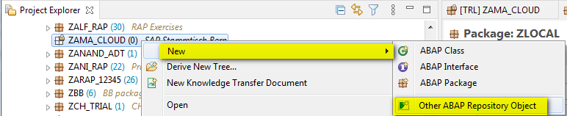
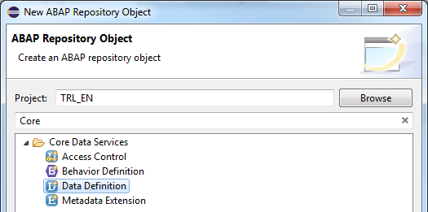
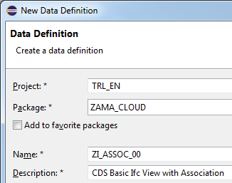
Step 01 - Create a new CDS-View (1)
Create a new ABAP Repository Object.
Choose Core Data Services -> Data Definition and create a CDS-View ZI_ASSOC_##.
_00

Slide 4
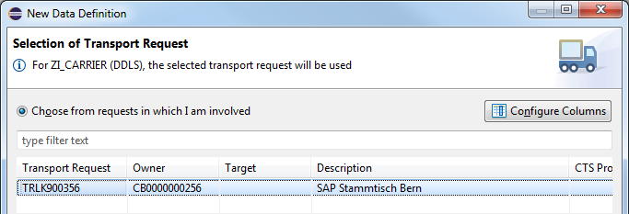
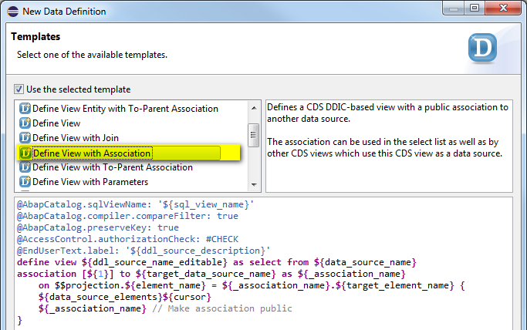
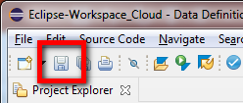
Step 01 - Create a new CDS-View (2)
Confirm the transport - and choose Next, not Finish!
Select template Define View with Association.
Don't forget to Save afterwards.

Slide 5
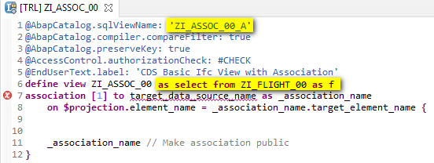
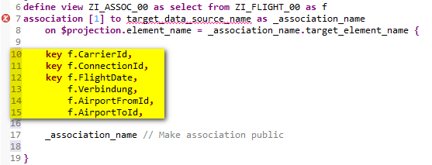
Step 02 - Fill header and field list
Name the SQL-View and use the in an earlier Tutorial defined CDS ZI_FLIGHT_00 as basic data source of the new CDS. Use an alias for that data source.
Choose only some of the columns of the basic data source for the field list.

Slide 6
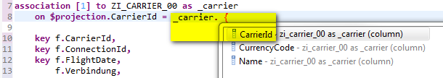
Step 03 - Define the Association
Define the Association in the header of the CDS. Choose the also already created CDS ZI_CARRIER_00 as association target and name the Association _carrier.
Please see that the name of the Association should start with the character "_".
The character in cornered brackets after the key word association represents a cardinality between source and target data source. This is more or less documentation but may raise syntax warnings if the cardinality "to n" is used.
Define the Join condition for the Association. While after the keyword $projection columns of the basic data source are expected, on the right side of the equal sign columns of the Association (means: the target data source) must be written.

Slide 7
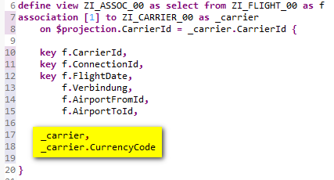
Step 04 - Expose the Association
Exposing an Association means to write down the theoretical possibility of the usage of the Join into the field list. For this write either the name of the association or selected fields of the association into the list.
Take care that each column used in the on-condition of the Association's definition is also in the field list (mandatory requirement!).
After the expose the target of the Association is visible for all consumers of the CDS View.
Don't forget to save and activate the CDS.

Slide 8
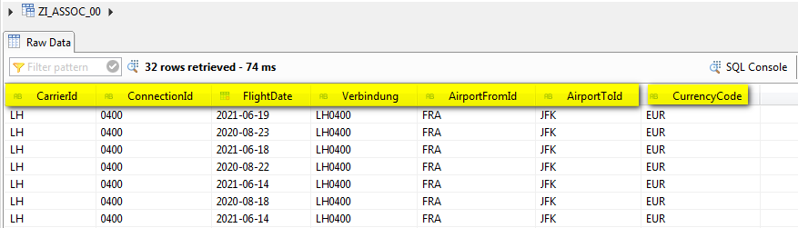
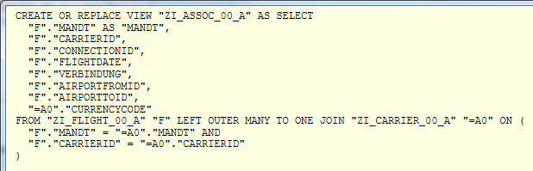
Step 05 - See the data preview
Use the data preview of the newly created CDS to have an access to the data. Note that only the data from the basic data source and the explicitely requested column from the target data source are shown.
Examine the SQL Create Statement (CDS editor -> Context Menue) for the CDS. Also here the usage of the Association is not shown.
Only the access to CurrencyCode is visible.

Slide 9

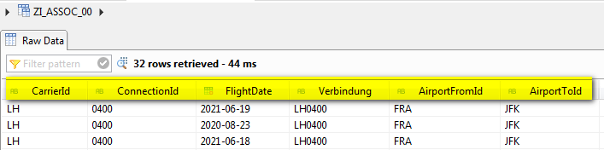
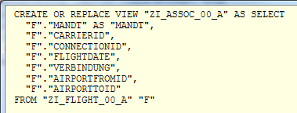
Step 06 - Change the exposition of the Association
Remove the explicitely mentioned field _carrier.CurrencyCode from the field list and see the data preview. Only the data from the basic data source is visible.
The SQL Create Statement (CDS editor -> Context Menue) doesn't even has a Join.

Slide 10
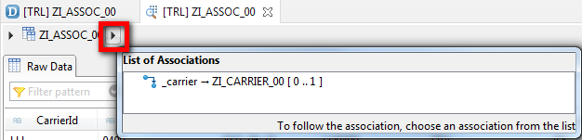
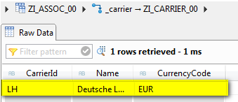
Step 07 - Consume the Association in the data preview
Call the data preview again and follow the small triangle after the name of the CDS-View ZI_ASSOC_##. A List of Association appears, showing _carrier.
Clicking _carrier the data preview follows the association and shows the entry of the target data source for a selected record of the source table. In the current case no record was selected and the first one was therefore chosen implicitely.
Note that before calling the association exposure (means: before clicking the small triangle) no Join was used. Only after that click the Join was processed by the runtime environment to achieve the result.

Slide 11
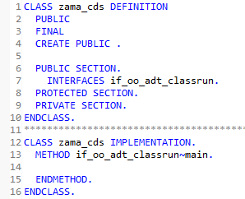

Step 08 - Access the basis table in ABAP (1)
Use the ABAP class already created in an earlier tutorial and reuse the interface method if_oo_adt_classrun~main().
Write a normal SELECT statement to the CDS-View ZI_ASSOC_##. Please note also that although this is a consumation of a CDS-View and should be done only to a Consumption View ZC_* because of simplicity reasons the Composite Interface View ZI_* is chosen as data source.

Slide 12
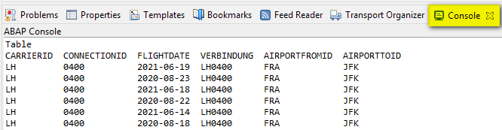
Step 08 - Access the basis table in ABAP (2)
The console output shows only data from the basis table ZI_FLIGHT_00. No access to the records of the associated table ZI_CARRIER_00 is shown.

Slide 13

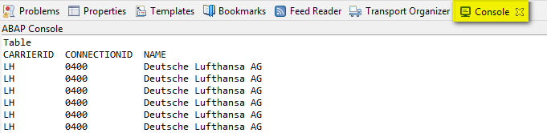
Step 09 - Consume the Association in ABAP (2)
Enhance the SELECT statement by an access to the exposed Association.
Note the syntax: the access to an Association must always start with the PathPrefix "\".
The similarity with the syntax of a modern ABAP Mesh access is not coincidentally.
Using OPEN SQL or ABAP SQL brings a resultset with a fully processed Join following the association (not only one resultset for a given row as in the ADT preview).

