Slide 1
❄
❄ ColdSense-DQ
A Data-Quality-Driven Cold-Chain Intelligence Platform
PROGRESS PRESENTATION
❄
CO3554 – Data Management Project
22/ENG/162 – W.P.A. Amarasekara
Notes:
Open with a one-line framing of the project: a data-quality layer for cold-chain IoT monitoring, built for Sri Lankan retail SMEs.

Slide 2
AGENDA
What I'll Cover Today
1
2
3
4
Project Overview
Is This Problem Real?
Progress & Live Demo
Limitations & Next Steps
What ColdSense-DQ is, and the problem it's built to solve
Industry evidence and my own analysis of real sensor data
The architecture, built and running — walked through live
What's honestly still missing, and what comes next
Notes:
Quick orientation slide, about 15 seconds. Lets the audience know where the presentation is headed before diving in.

Slide 3
PROJECT OVERVIEW
ColdSense-DQ: What It Does
A data-quality-driven cold-chain intelligence platform for Sri Lankan retail SMEs
IoT + Retail
Data
Data Quality
Layer
Analytics &
Risk Scoring
Dashboard &
Alerts
→
→
→
Temperature, humidity
+ sales records
Is this reading
trustworthy?
Anomalies, forecasts,
spoilage risk
Decisions on
verified data
Most monitoring systems alert on raw sensor readings directly — ColdSense-DQ scores whether the reading can be trusted first
Connects environmental conditions to real business outcomes: not just “too warm”, but an estimated revenue figure at risk
Built for SMEs that can't afford a large enterprise system — affordable and scalable, demonstrated today on real cold-chain reference data
Notes:
Give the 30-second pitch here: this sits between IoT sensors and the business decisions made from them, and its job is trust, not just collection.

Slide 4
BACKGROUND
The Problem: Data Nobody Verifies
1
2
3
Sensors exist, but nobody checks if they're lying
Environmental and business data live apart
Problems surface only after the damage is done
Calibration drift, missing readings, and network dropouts go unnoticed — the sensor keeps reporting, just not accurately.
Temperature/humidity readings and sales records sit in separate systems — Excel files, POS systems, sensor logs — with no link between them.
Existing systems alert on simple thresholds only, after the fact. No early warning, and no estimate of what it actually costs the business.
Notes:
This is the background section from the proposal, condensed for an audience seeing it for the first time. Keep it brief — the next slides are where this gets proven with evidence.

Slide 5
IS THIS PROBLEM REAL?
Grounding the Problem — Industry & Academic Evidence
Independently published findings on cold-chain failures and IoT sensor data quality
70–85%
16.7–29.2%
25–50%
32%
of monitored cold-chain products in France exceeded safe temperatures at some point in transit/storage
missing-value rates documented in real-world environmental IoT sensor deployments
global spoilage rate in perishable supply chains (FAO)
of monitored vaccine refrigerators in one study stayed within the safe range for their entire monitored period
Sri Lanka context
Sri Lanka's cold-chain sector is documented as underdeveloped, with high electricity cost and infrastructure gaps named as the main limiting factors. Nationwide power outages are a recurring, dated, real event — exactly the “power cuts” failure mode named in the proposal, not a hypothetical.
Sources: Time-Temperature Management Along the Food Cold Chain (agrireseau.net) • Sensor Data Quality: A Systematic Review, Springer • FAO • Keep Cool vaccine cold-chain study, PMC • Sri Lanka NCAP Cooling Strategy • 2020 Sri Lankan Blackouts, Wikipedia
Notes:
Move fast here, about 60-90 seconds. The point is only to establish the problem is industry-documented, not invented. Don't over-read the stats, just land them.

Slide 6
❄
IS THIS PROBLEM REAL?
And Here's What I Found In My Own Data
Not simulated. Not assumed. Measured by my own data-quality engine running on real IoT telemetry.
405,184
2,502
7
$1,024
real IoT sensor readings analyzed (3 devices, 8 days)
readings flagged unreliable — 2,038 gaps, 388 outliers, 76 noise events
confirmed safe-limit temperature excursions detected
revenue at risk identified, out of $7,571 in exposed sales (13.5%)
A debugging story, not a tuning story
My outlier check initially false-flagged ~10% of real readings as defective, because the sensor reports in coarse 0.1°C steps. I found this by validating against real data — not by assuming my code was right — and fixed it down to under 0.3%. That habit of verifying against reality, not just building a plausible-looking model, is the actual point of this project.
Notes:
This is the pivot slide. Say explicitly: that's the industry picture, here's what I found in my own analysis. The debugging story at the bottom is a strong credibility signal, don't rush past it.

Slide 7
INDUSTRY VALIDATION
What John Keells Told Us — Confirmed, Not Just Repeated
What John Keells said
What the literature confirms
What my system actually catches
“Poor sensor calibration causes
inaccurate readings”
Outliers/bias/drift are the
most-studied IoT fault categories
Outlier check — found real
glitch readings in the data
“Network errors lead to missing
or delayed data”
16.7–29.2% missing-value rates
in real deployments
Missing-data check — 2,038
real gap events found
“Difficult to separate sensor
faults from real temperature issues”
Named as an open problem in
IoT data-quality research
Drift check — plus one
documented, named blind spot
Three failure modes named in an unstructured industry conversation — all three independently confirmed in literature, and all three caught by name in my own system.
Notes:
Read this as a three-way triangulation: industry said it, research confirms it's common, my code catches it. That's the strongest form of evidence available at this stage.

Slide 8
PROGRESS SINCE PROPOSAL
The Architecture Diagram, Built — Box by Box
IoT Sensors
Data Quality
Layer
Enterprise
Data Lake
Anomaly Detection
/ Forecasting
Impact
Analysis
Decision
Dashboard
→
→
→
→
→
Sensor Data
Stream
4 checks +
trust score
Postgres /
TimescaleDB
Isolation Forest
+ ARIMA
Spoilage risk +
revenue at risk
Live, role-
gated web app
Sensor Data Stream is now a real, authenticated ingestion path — not a placeholder
Device-authenticated POST /api/ingest/readings — the exact HTTP path a real sensor gateway would call, kept separate from staff/admin logins
Data Quality Framework: 4 independent checks (missing, outlier, drift, noise) combined into a single trust score, enforced before analytics ever runs
Analytics: Isolation Forest anomaly detection + ARIMA forecasting (auto-selected by AIC), with a documented fallback
Enterprise access: 4-tier role hierarchy (Staff → Quality Supervisor → Operations Manager → Administrator), enforced server-side on every request
Full web dashboard: Real-Time Monitoring, Data Quality, Alerts, Risk & Business Impact, Reports (PDF export), User Management
Notes:
This slide shows the proposal's own diagram realized, box by box. Emphasize the ingestion API specifically — it's the piece most likely to get a follow-up question.

Slide 9
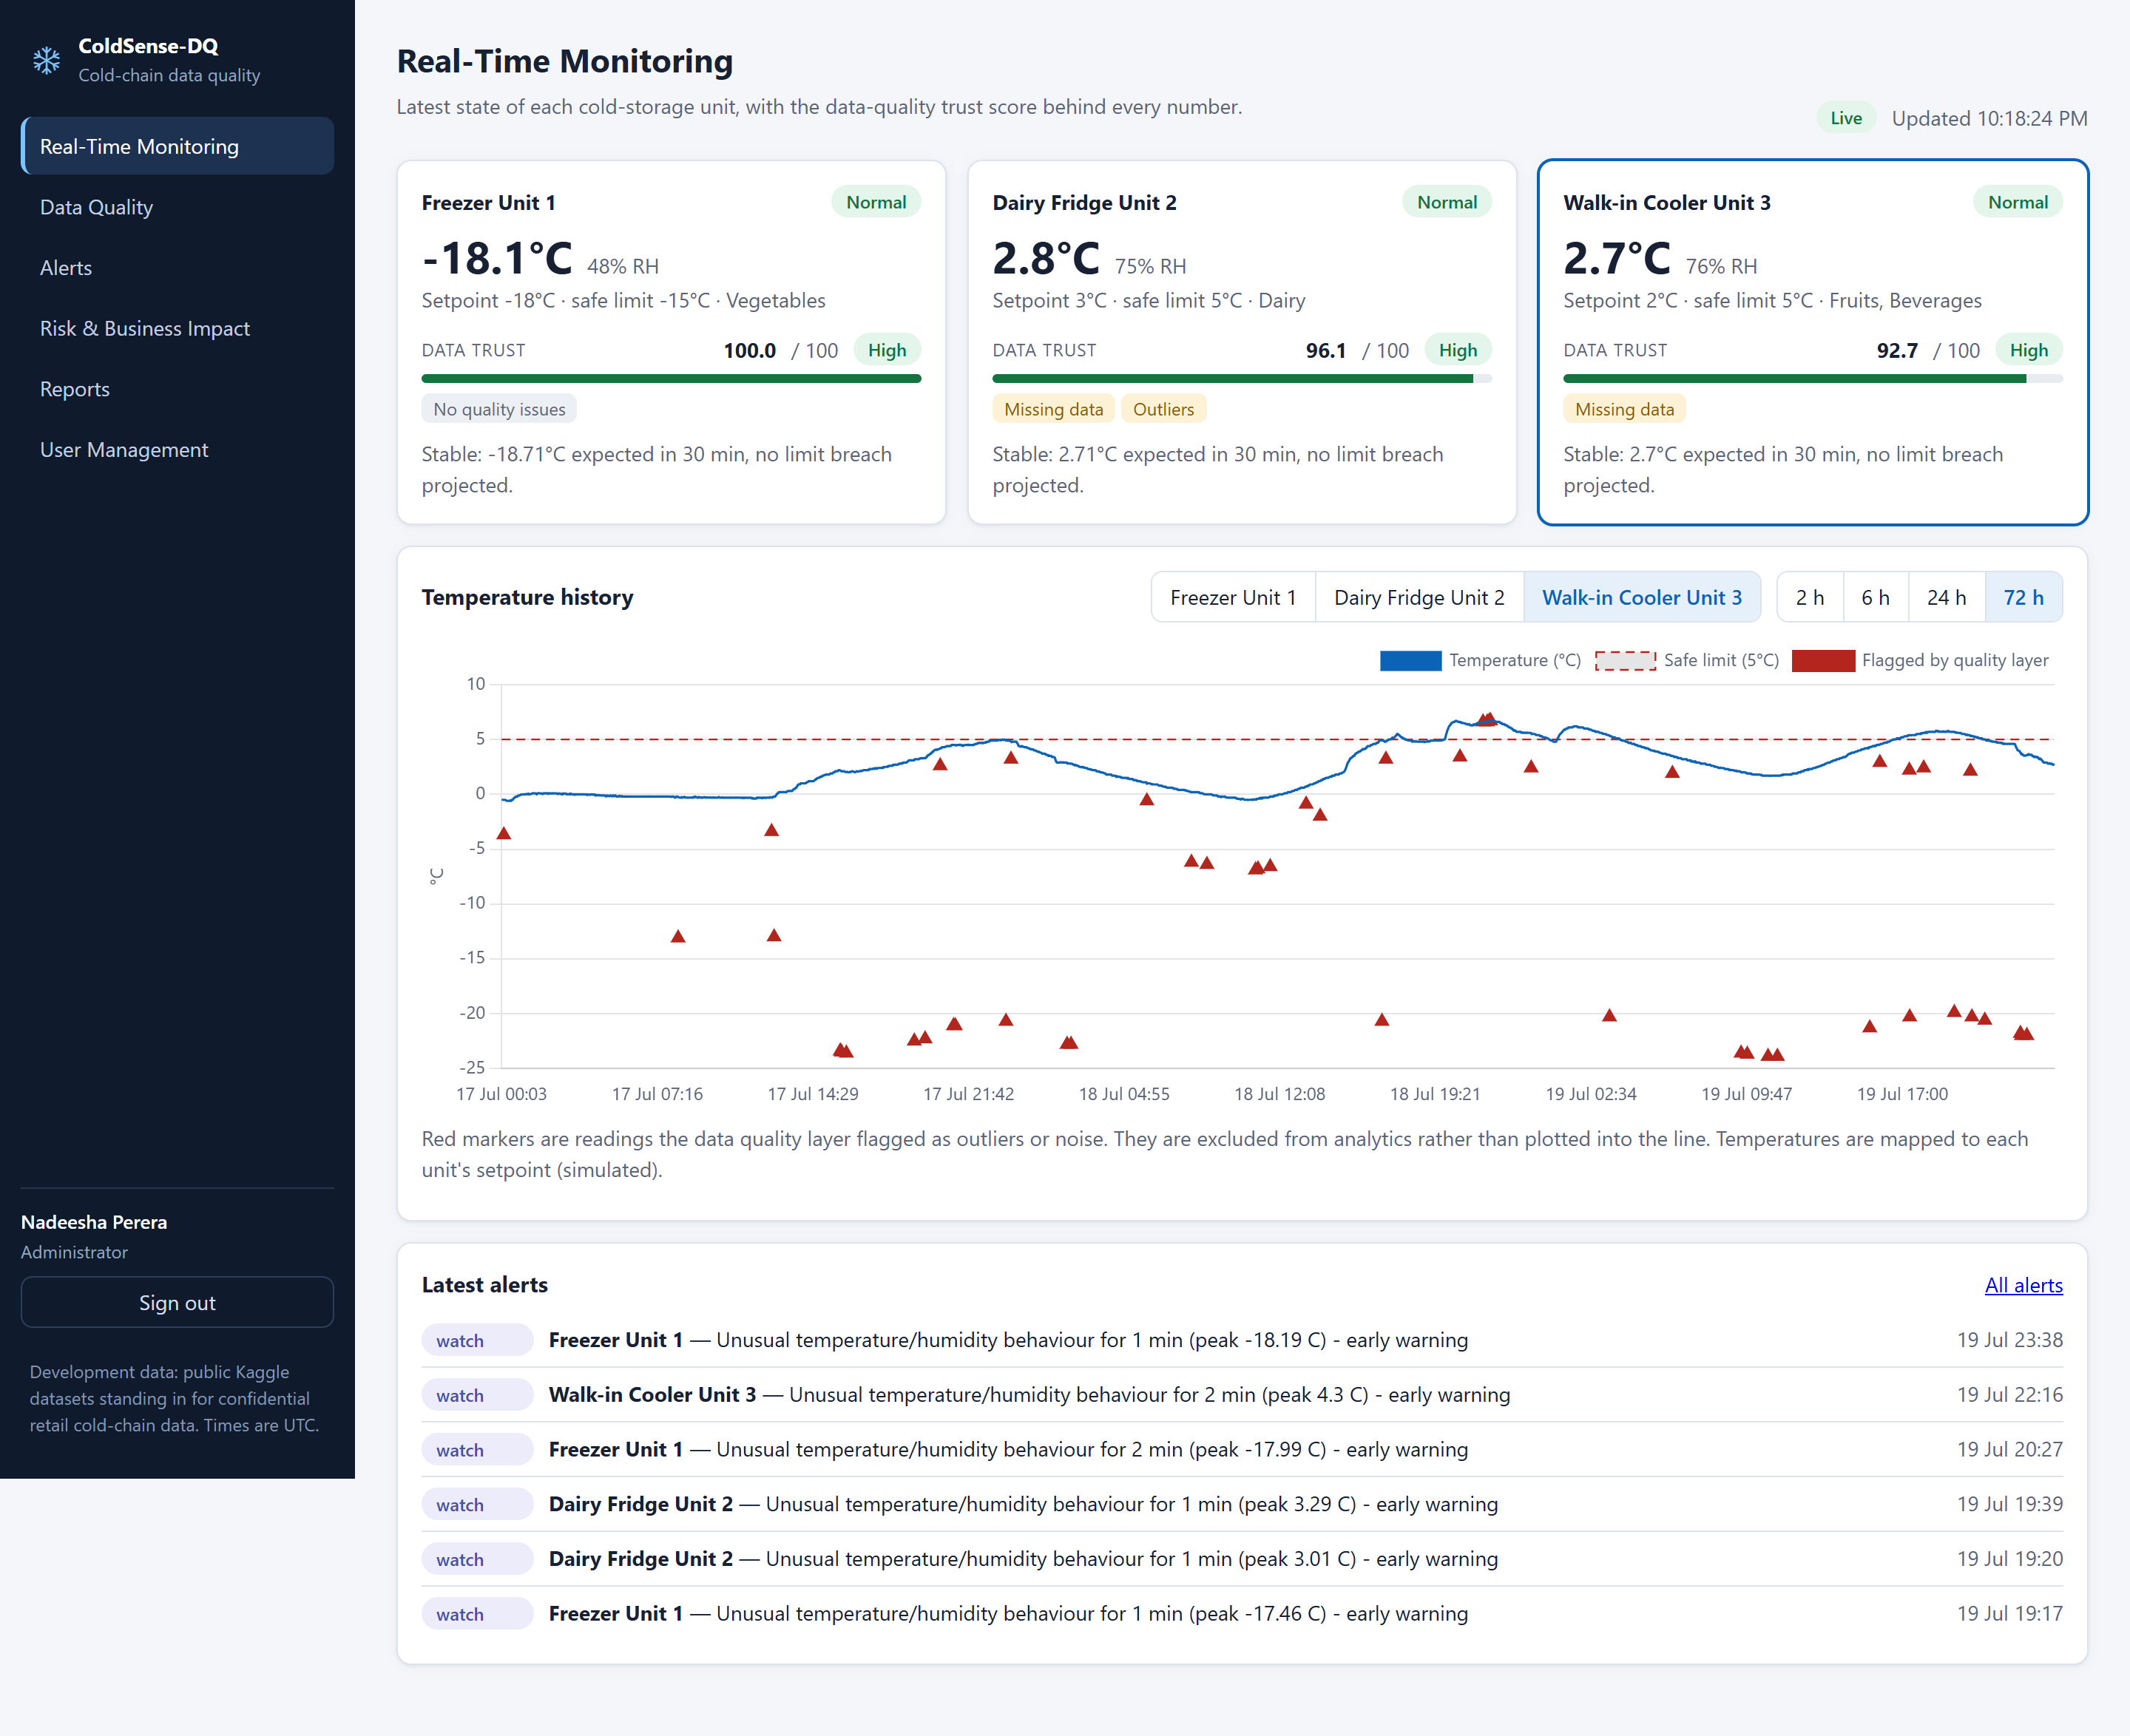
LIVE DEMO — 1 OF 5
Real-Time Monitoring
Trust score is recomputed live from the newest ~30 minutes on every request — not a static label
Red triangles: real glitch readings from the actual Kaggle sensor dataset, automatically excluded
Forecast is ARIMA (auto order selection), with a linear-trend fallback
Dashed line is the unit's safe limit — note the real excursions above it
Notes:
If the live feed is running, mention the readings are arriving through the real ingestion API right now.

Slide 10
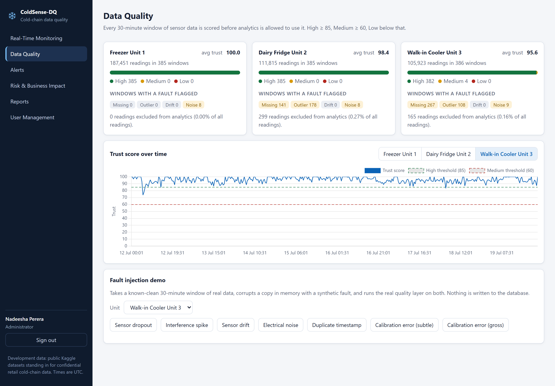
LIVE DEMO — 2 OF 5
Data Quality — The Core Contribution
405K real readings, under 0.3% excluded as glitches, nearly every window scores High — an honest result, not a tuned one. The fault-injection demo (next) is what shows the layer reacting.
Notes:
Say plainly the real data is mostly clean — that's expected and correct, not a weak result.

Slide 11
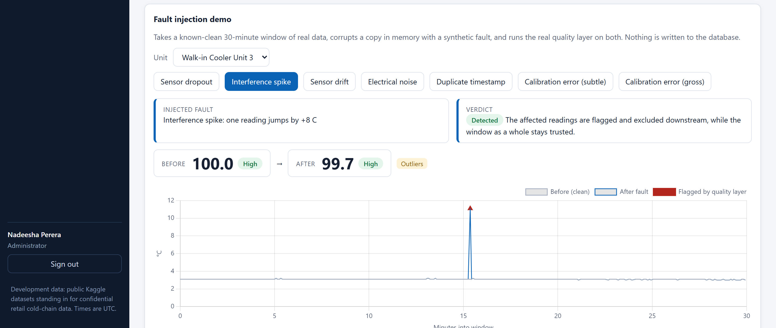
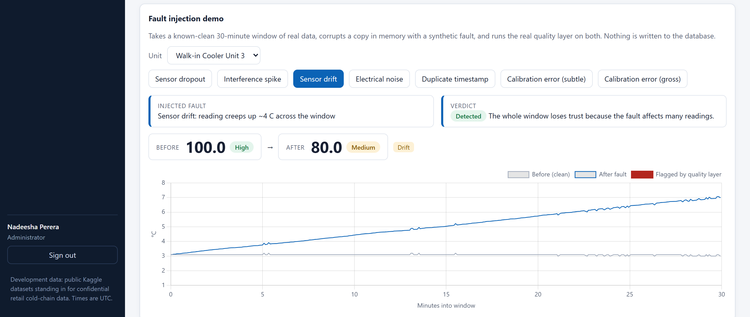
LIVE DEMO — 3 OF 5
Fault Injection — Isolated vs. Systemic Faults
Same real 30-minute window, corrupted in memory with a synthetic fault, scored by the real engine
Isolated fault → excluded, not trusted-away
Systemic fault → the whole window loses trust
100 → 99.7, stays High. One bad reading is flagged and excluded downstream — it doesn't need to poison the whole window.
100 → 80, drops to Medium. Drift biases every reading in the window, not just one — so it can never be rated High.
Notes:
This is the single most important slide in the deck. It proves understanding of WHY data quality is hard, not just that anomalies can be flagged. Let the contrast speak, don't rush it.

Slide 12
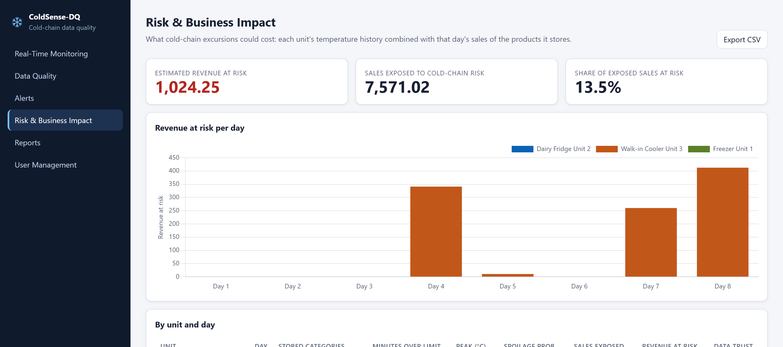
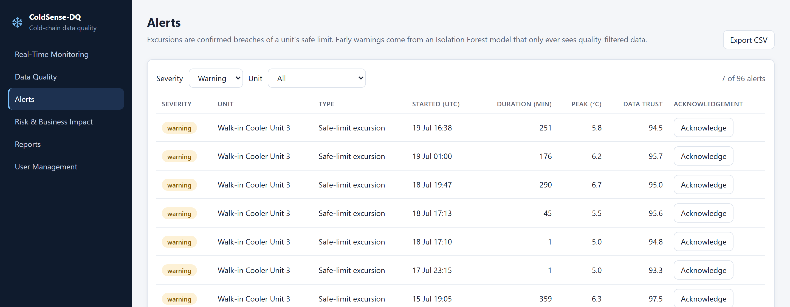
LIVE DEMO — 4 OF 5
Alerts & Risk Impact — From Detection to a Dollar Figure
Confirmed excursions (rule-based) vs. early warnings (Isolation Forest, quality-filtered data only) • Revenue at risk = exposed sales × spoilage probability, which rises with minutes spent above the safe limit • Every acknowledgement and every estimate carries the data-trust score behind it
Notes:
Walk-in Cooler Unit 3 is the only unit that ever breaches its limit, chiefly days 4, 7 and 8. State plainly that the impact model is a documented heuristic, not a calibrated spoilage model.

Slide 13
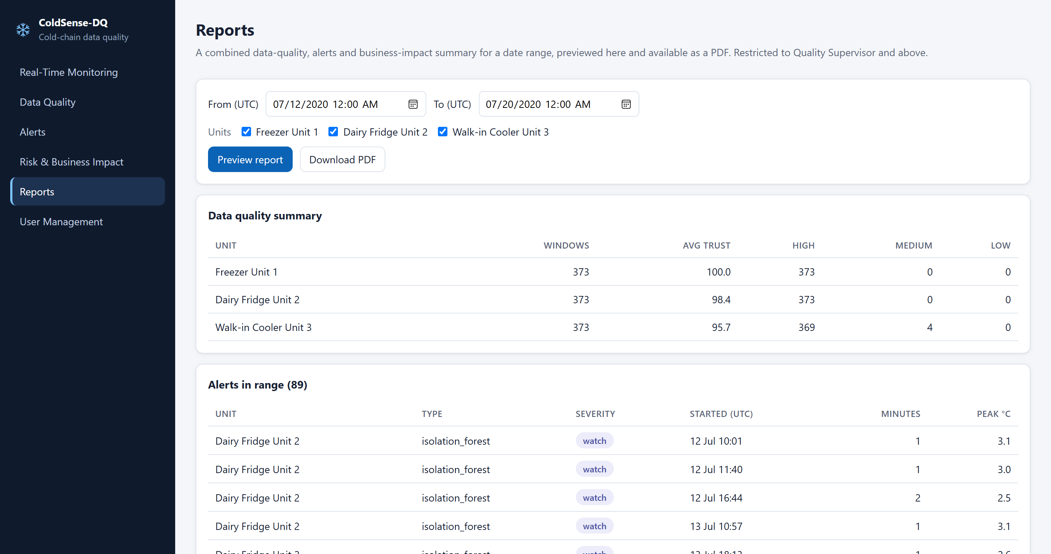
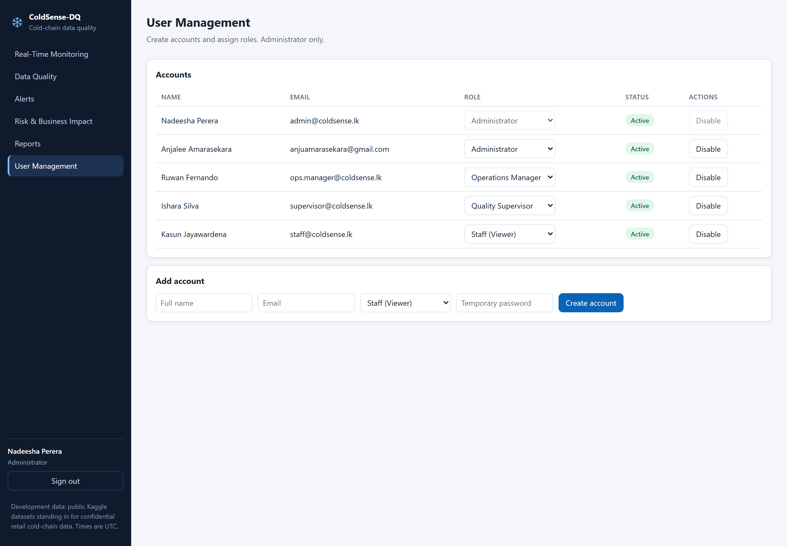
LIVE DEMO — 5 OF 5
Reports & Enterprise Access Control
PDF export of the combined quality / alerts / impact summary • 4-tier role hierarchy — Staff, Quality Supervisor, Operations Manager, Administrator — enforced server-side on every request, not just hidden in the UI
Notes:
If time allows, show the staff-restricted view here live: the same fault-injection buttons, disabled, with the role requirement named.

Slide 14
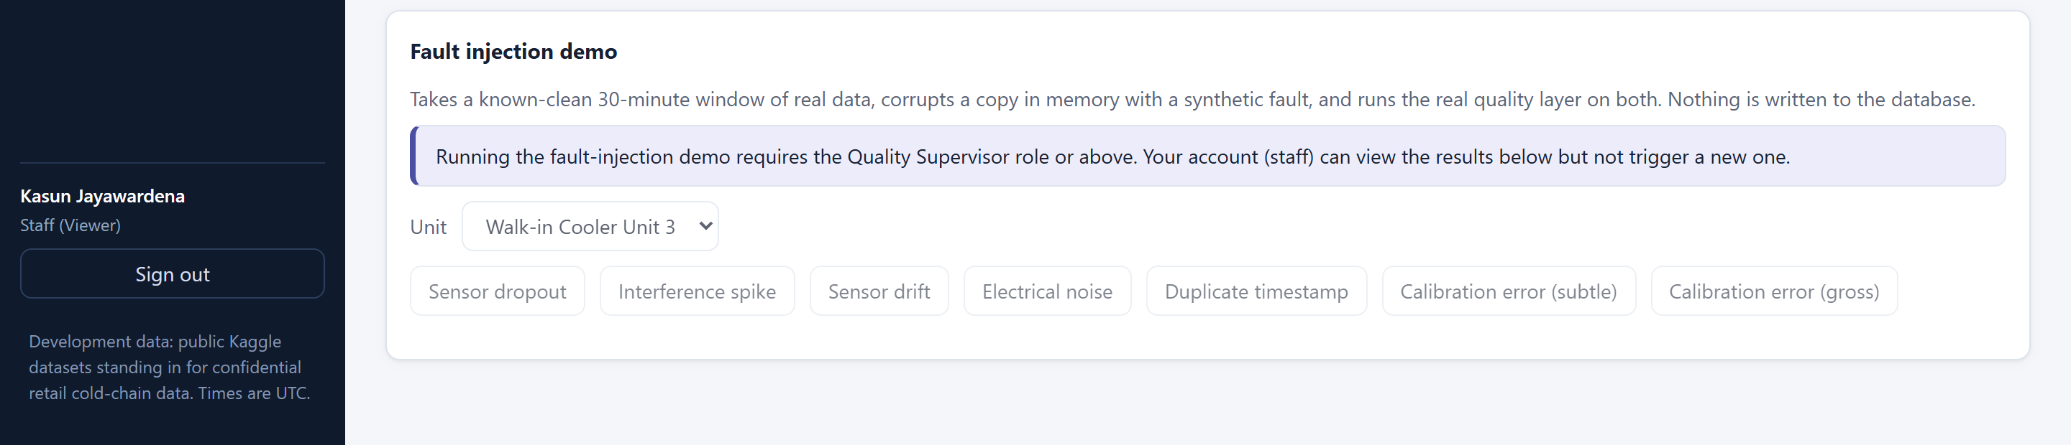
INTELLECTUAL HONESTY
What This System Cannot Do Yet — Named on Purpose
Subtle calibration bias is undetectable from one sensor
A constant in-range offset looks identical to a genuinely warmer unit using single-sensor statistics. Needs cross-sensor comparison or reference calibration — a named test pins this down rather than hiding it.
Staff role: demo controls visibly disabled with the required role named
Device authentication uses one shared API key
Fine for a demo; a real deployment would provision one key or certificate per device.
Operations Manager is a placeholder tier today
The role hierarchy is real and enforced, but no feature yet specifically needs a middle tier — threshold configuration is the natural next fit.
Naming a limitation before being asked is stronger evidence of understanding than claiming the system is complete.
Notes:
Volunteer this before questions. It reads as far more competent than being caught out by a reviewer who finds the gap themselves.

Slide 15
REMAINING WORK
Next Steps to Final Submission
1
2
3
4
Cross-sensor calibration checks
Alert notifications
Audit logging
Validation on real industry data
Close the one named blind spot using multi-sensor comparison
Push alerts out (email/SMS) instead of requiring a dashboard visit
Track who ran the demo, changed a role, or acknowledged an alert
Re-run the same pipeline against real John Keells-style cold-chain data once available
The data-quality layer, analytics, and enterprise access control are built and demonstrated today — what remains is depth, not direction.
Notes:
Close the progress section on a confident, forward-looking note before Q&A.

Slide 16
❄
Thank You
ColdSense-DQ — Questions & Live Demo
❄
Notes:
Offer to open the live dashboard again for any specific question — having it already running removes friction.

