Slide 1
Retail Sales and Profit Analysis — Superstore Dataset
Data Analyst Internship assessment task
Presented By
Anjali M N

Slide 2
1. Project Overview
Goal: Analyze retail sales and profit trends using the Superstore dataset.
Objectives:
• Understand and profile retail transaction data.
• Clean and preprocess the dataset.
• Identify sales and profit patterns across regions and categories.
• Deliver 5 key data-driven insights for business strategy.

Slide 3
2. Dataset Information
• Source: Kaggle – Sample Superstore Dataset by Vivek
• Records: ~10,000 | Columns: 21 | Duration: 2014–2017
• Key Features: Sales, Profit, Discount, Quantity, Region, Category, Sub-Category
• Business Domain: Retail & E-commerce

Slide 4
3. Data Cleaning and Preparation
Steps performed:
• Removed duplicates and missing values
• Converted date fields to datetime format
• Created Profit Margin = Profit / Sales
• Extracted Year and Month from Order Date
• Validated dataset consistency and data types

Slide 5
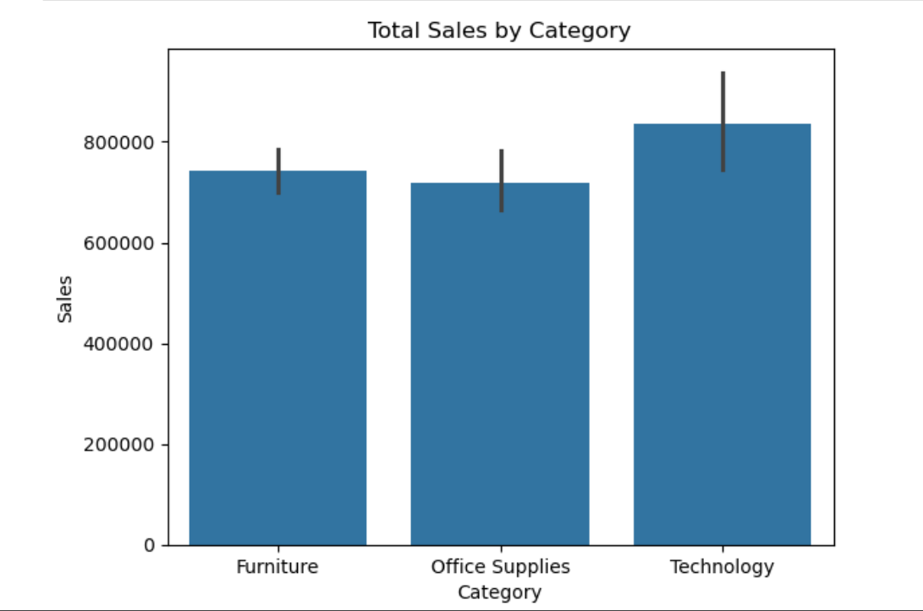
Total Sales by Category

Slide 6
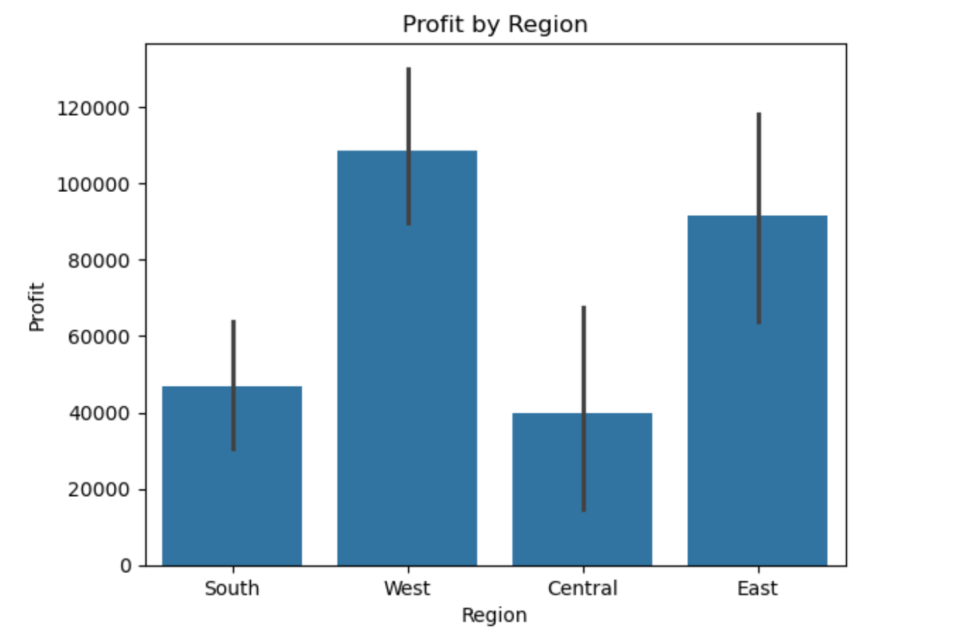
Profit by Region

Slide 7
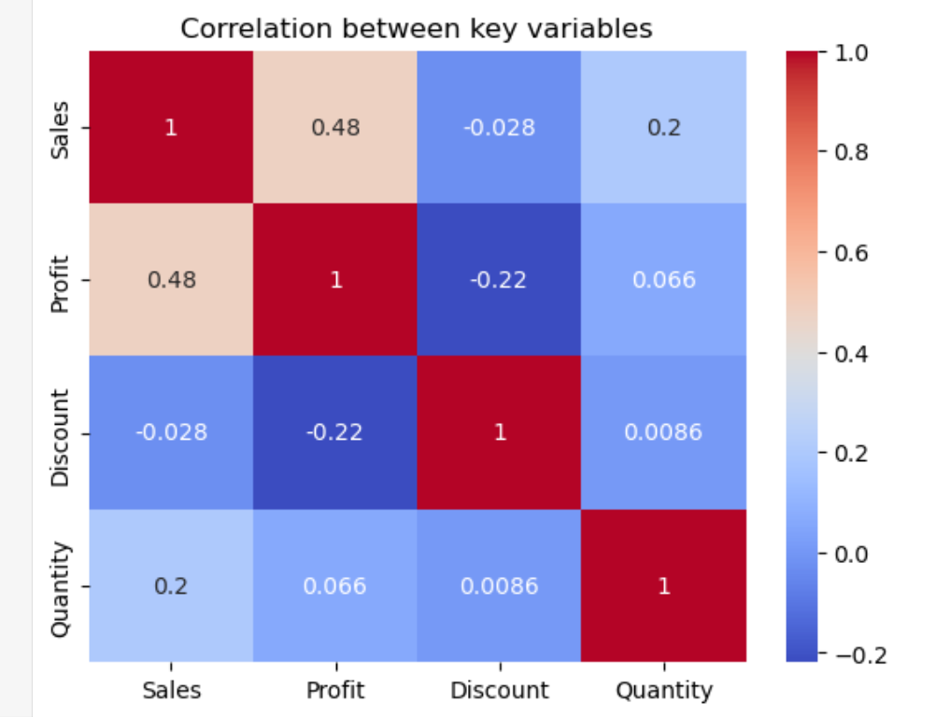
Correlation Heatmap

Slide 8
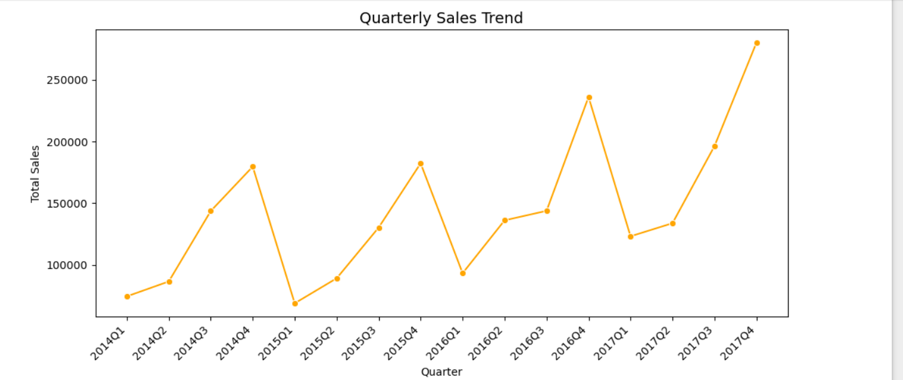
Quarterly Sales Trend

Slide 9
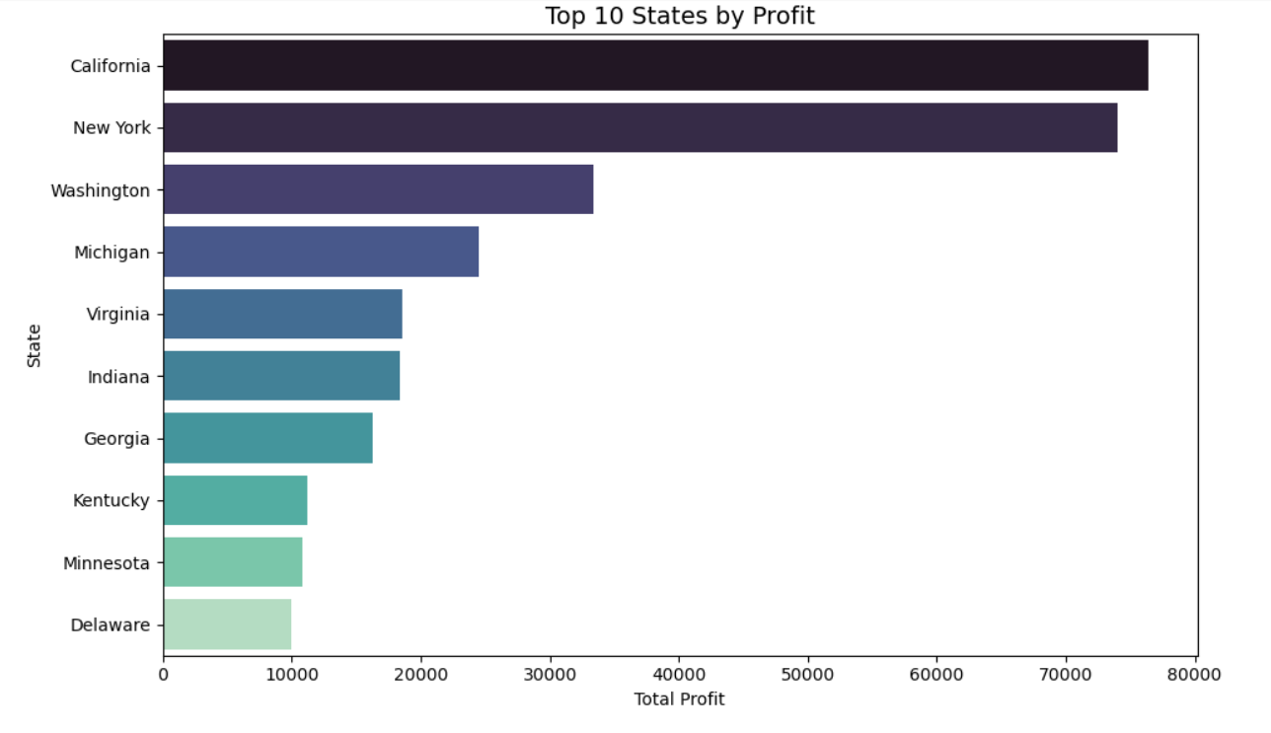
Top 10 States by Profit

Slide 10
4. Key Insights & Business Implications
• Technology category drives highest sales.
• West region leads in profit; Central region underperforms.
• High discounts reduce profit margins.
• Q4 shows consistent sales growth each year.
• California and New York are top profit-generating states.

Slide 11
5. Conclusion
• The analysis highlights opportunities to optimize pricing, focus on profitable regions, and prepare for Q4 demand surges.
• Business should invest in technology and office supply segments.

