Slide 1
AGENDA
ADAPTIVE TRAFFIC CONTROL WITH
DEEP REINFORCEMENT LEARNING

Slide 2
Table of Contents
1.Reinforcement Learning
1.1 Introduction
1.2 Element of reinforcement learning
2.Frameworks
2.1 Tensor Flow
2.2 Keras
3.Adaptive Traffic Control with Deep Reinforcement
Learning

Slide 3
Introduction
Machine learning:
Definition : Machine learning is a scientific discipline that is concerned with the design and development of algorithms that allow computers to learn based on data, such as from sensor data or databases.

Slide 4
MACHINE LEARNING TYPES:
.Supervised learning :It allows you to collect data or produce a data output from the previous experience.
.Unsupervised learning : It is where you only have input data and no corresponding output variables.
.Reinforcement learning:It is in the context of artificial intelligence, is a type of dynamic programming that trains algorithms using a system of reward and punishment. reinforcement algorithm, or agent, learns by interacting with its environment.

Slide 5
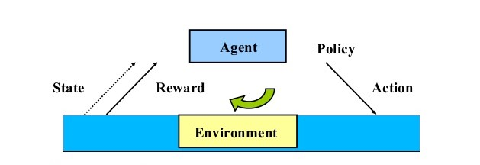
Elements of Reinforcement Learning

Slide 6
Agent: Who interact with the environment
Environment: External conditions
Policy:
.Defines the agent’s behaviour at a given time
.A mapping from states to actions
.Lookup tables or simple function

Slide 7
Reward function :
.Defines the goal in an RL problem
.Policy is altered to achieve this goal
Value function:
. Reward function indicates what is good in an immediate
sense while a value function specifies what is good in
the long run.
Model of the environment :
. Predict mimic behaviour of environment,
.Used for planning & if Know current state and action
then predict the resultant next state and next r

Slide 8
2.FRAMEWORKS
2.1 TENSORFLOW
It is a free and open-source software library for dataflow and differential programming across a range of tasks.
It is a symbolic math library, and is also used for machine learning applications such as neuralnetworks
It is used for both research and production at Google
Tensor Flow was developed by the Google Brain team for internal Google use. It was released under the Apache License 2.0 on November 9, 2015.

Slide 9
2.2 KERAS
. It is an open-source neural network library written in Python.
In 2017, Google's Tensor Flow team decided to support Keras in Tensor Flow's core library.
Designed to enable fast experimentation with deep neural networks

Slide 10
3.ADAPTIVE TRAFFIC CONTROL WITH DEEP REINFORCEMENT LEARNING
Introduction : The rapid increase in automobiles on roadways has naturally lead to traffic congestions all over the world, forcing drivers to sit idly in their cars wasting time and needlessly consuming fuel. Ride sharing and infrastructural improvements can help mitigate this but one of the key components to handling traffic congestion is traffic light timing.

Slide 11
Traffic light control policies are often not optimized, leading to cars waiting pointlessly for non-existent traffic to pass on the crossing road. We feel that traffic light control policy can be greatly improved by implementing machine learning concepts. Our project focuses on implementing a learning algorithm that will allow traffic control devices to study traffic patterns/behaviours for a given intersection and optimize traffic flow by

Slide 12
We do this with a Q-Learning technique, similarly seen in previous works such as Gao et. al. and Genders et. al, where an intersection is knowledgeable of the presence of vehicles and their speed as they approach the intersection. From this information, the intersection is able to learn a set of state and action policies that allow traffic lights to make optimized decisions based on their current state.

Slide 13
Our work seeks to alleviate traffic congestion on roads across the world by making intersections more aware of traffic presence and giving them the ability to take appropriate action to optimize traffic flow and minimize waiting time.

Slide 14
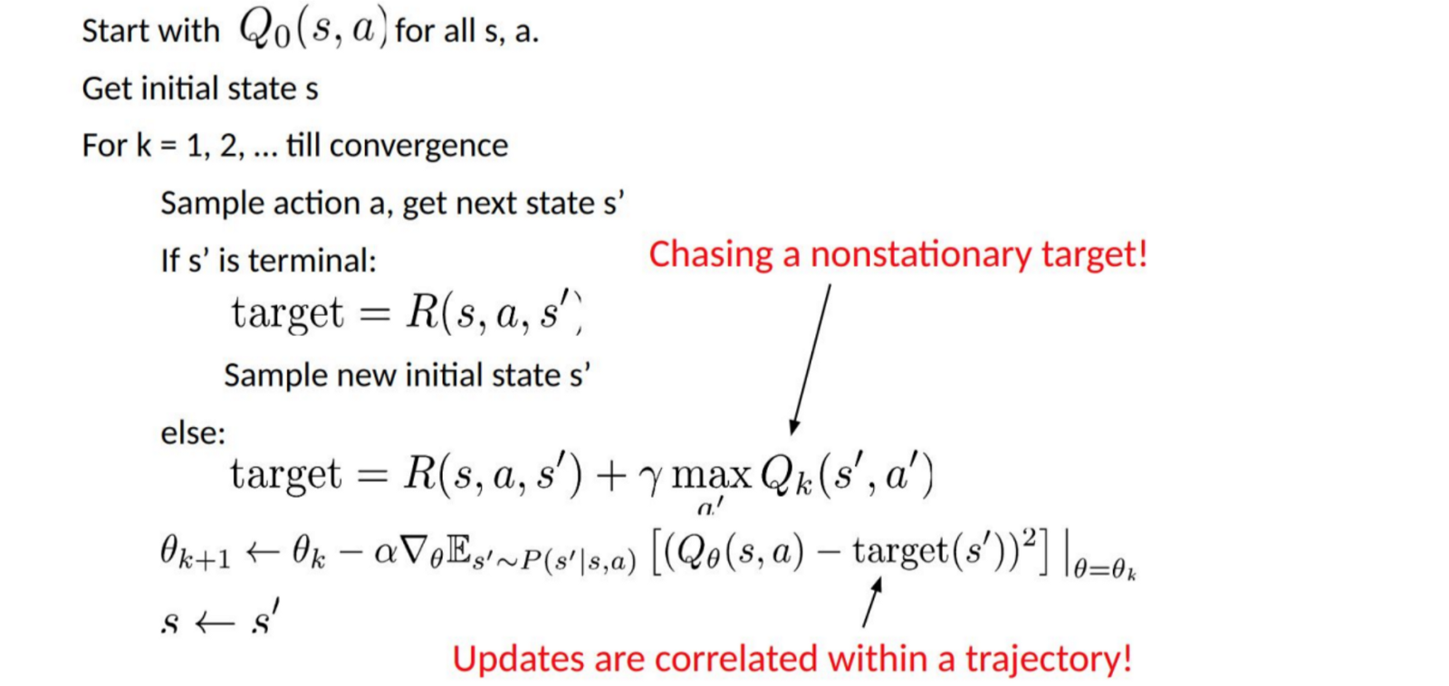
Q-Learning Algorithm

Slide 15
s = a particular state (room)
a = action (moving between the rooms)
s′ = state to which the robot goes from s
𝜸 = discount factor (we will get to it in a moment)
R(s, a) = a reward function which takes a state s and action a and outputs a reward value
V(s) = value of being in a particular state (the footprint)

