Slide 1



SPECIAL ECONOMIC ZONE
A PERSPECTIVE VIEW
-
Office of the
Zonal Development Commissioner, FSEZ
For SEZs and EOUs in East and North Eastern Region
Ministry of Commerce & Industry
Government of India

Slide 2
The Indian scenario
India was one of the first countries in the South Asian region to adopt SEZs, establishing an EPZ in 1965.
In the 1990s, in the context of economic liberalization, many of the controls that had stymied SEZ operations in the 70s were removed. A new EXIM policy introduced in 2000 permitted state governments as well as the private sector to establish SEZs.
The SEZ Act in 2005 aimed to push private sector investment to support industrial development. The Act converted EPZs to SEZs and clarified the rules for establishing other SEZs, resulting in a proliferation of new zone plans.
Today, 267 SEZs are operational, around 65% of which specialize in ICT-related manufacturing and services. Because of the country’s economic progress, the present policy has been changed and is continuously evolving in a manner, so as to, give more freedom to both the business fraternity and the SEZ objectives.

Slide 3
Historical Trend of SEZs in India
Phase 1
Initial Phase (1964-1984)
Establishment of Kandla FTZ in 1965 and SEEPZ Mumbai in 1973
Phase 2 & 3
Expansion and Consolidation Phase (1985-1991 & 1991-2000)
Noida, Madras, Cochi and Vizag EPZs were established.
Phase 4
Expansionary Growth Phase (Post 2000 to present)
New EXIM Policy adopted, leading to conversion of EPZs to SEZs and creation of new SEZs.
Falta EPZ established in 1984
EOU Scheme introduced.
EPZs underwent restructuring, simplification & rationalisation.
SEZ Act in 2005 enacted and formulation of SEZ Rules in 2006.
Presently, 379 notified SEZs, out of which, 267 are operational SEZs, covering total 47480 hectares of area.

Slide 4
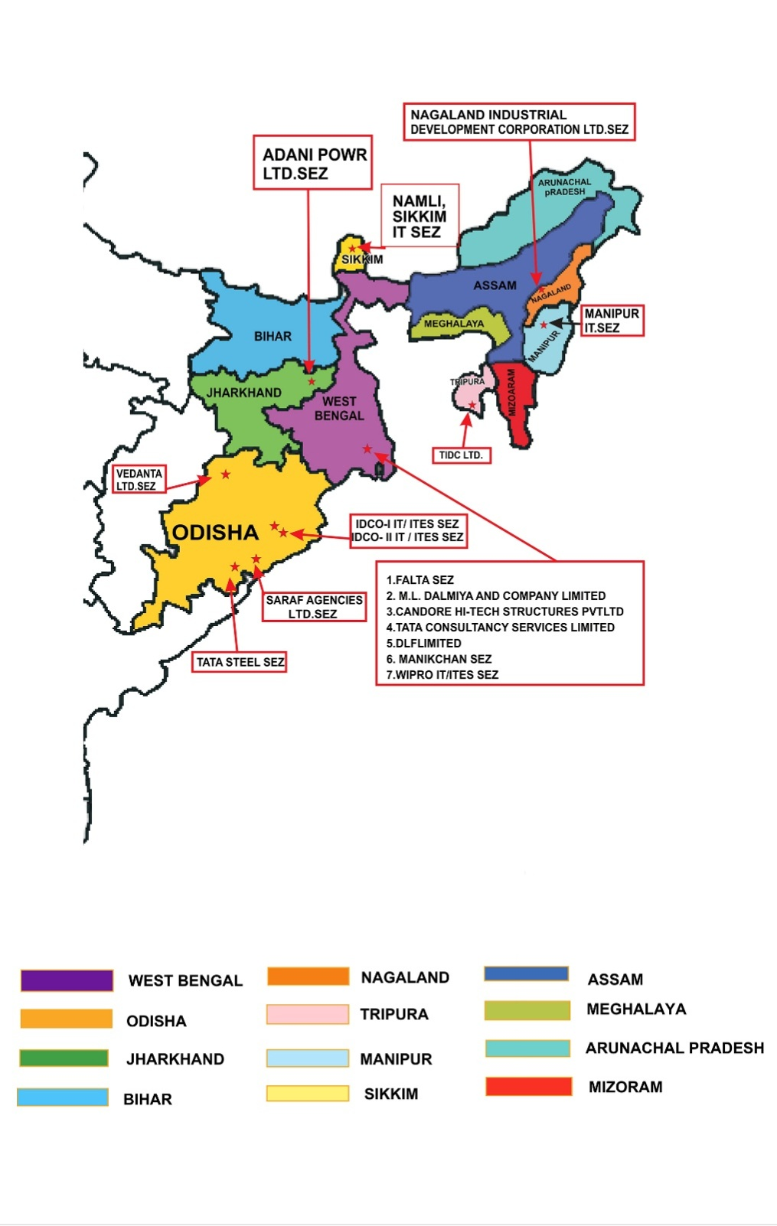
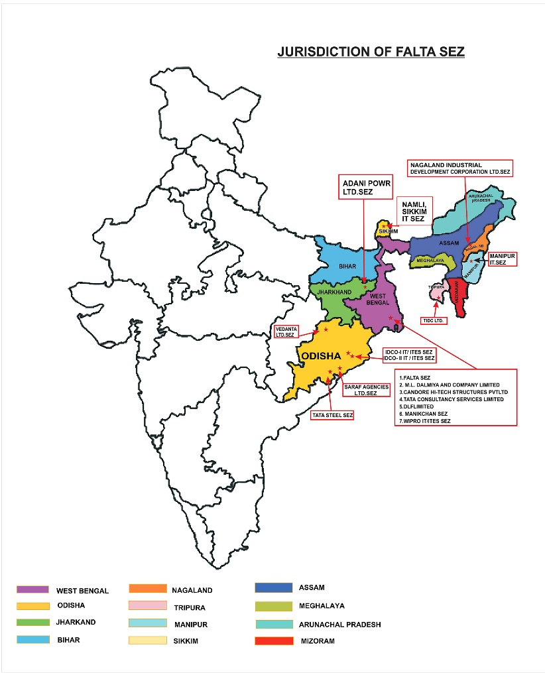
Jurisdiction of Falta SEZ

Slide 5
New SEZs in Last three years
20th August 2019 -Adani Power (Jharkhand) Ltd SEZ :
Godda District, Jharkhand
Sector Specific Power SEZ
Land Area: 222.668 Hectares.
Proposed Investment : Rs. 14,817 Crores
Direct Employment Proposed: Men-5800,Women-200
Project: Ultra Super Critical Thermal Power Project, units of 2 X 800 MW, Complete Power is proposed to be Exported sale to Bangladesh Govt.

Slide 6
16.12.2019 - Agro Based SEZ,
Sabroom, Tripura
Investment – 635 Crores
Employment – 5000 Approx
Land Area – 16.35 Hectares.
Developer – TIDC LTD Tripura.
Present Status(as on 08.11.2021) –
a) construction of Boundary wall with gate completed 95%.
b)E-Tender by TIDC floated for selection of
Co- Developer
c) TIDC has approached to ADB for financial assistance.

Slide 7
8th June, 2021 - IT/ITES SEZ at Namli, Sikkim
Name of the Developer:- Department of Information Technology, Government of Sikkim
At Namli, 8th Mile, Ranipol, East Sikkim
Land Area :- 6.32 Hectares
Proposed Investment in Infrastructure by the Developer:- Rs.50 Crore
Proposed Exports and Employment from the Zone as submitted by the Developer:-
 | Year1 | Year2 | Year3 | Year4 | Year5
Exports | 20 Crores | 40 Crores | 60 Crores | 80 Crores | 100 Crores
Direct Employment | 200 | 400 | 600 | 800 | 1000
Indirect Employment | 800 | 1200 | 1800 | 2600 | 4000

Slide 9
FALTA SPECIAL ECONOMIC ZONE
Sez Wise Merchandise Exports from-April to July ( FY-2023-24 vs FY-2022-23 )
Sez Name | FY-2023-24 | FY-2022-23 | Change In Inr | Inr terms | Growth in Inr (+) ve or (-) Ve
 | INR (Rs. In Cr.) | INR (Rs. In Cr.)
VEDANTA ALUMINIUM LTD. | ₹ 7,410 | ₹ 8,591 | -₹ 1,181 | -14% | -ve
FALTA SPECIAL ECONOMIC ZONE | ₹ 744 | ₹ 610 | ₹ 134 | +22% | +ve
MANIKANCHAN SPECIAL ECONOMIC ZONE | ₹ 312 | ₹ 344 | -₹ 32 | -9% | -ve
SARAF AGENCIES PVT. LTD. | ₹ 29 | ₹ 132 | -₹ 103 | -78% | -ve
TATA STEEL SPECIAL ECONOMIC ZONE LIMITED | ₹ 4 | ₹ 0 | ₹ 4 |  | +ve
ADANI POWER (JHARKHAND) LIMITED | ₹ 0 | ₹ 0 | ₹ 0

Slide 10
FALTA SPECIAL ECONOMIC ZONE
Sez Wise Software and Service Exports from-April to July ( FY-2023-24 vs FY-2022-23 )
Sez Name | FY-2023-24 | FY-2022-23 | Change In Inr | Inr terms | Growth in Inr (+) ve or (-) Ve
 | INR (Rs. In Cr.) | INR (Rs. In Cr.)
TATA CONSULTANCY SERVICES | ₹ 3,691 | ₹ 3,190 | ₹ 501 | +14% | +ve
Orissa Industrial Infrastructure Development Corporation (IDCO) (IT/ITES SEZ) | ₹ 672 | ₹ 627 | ₹ 46 | +7% | +ve
Orissa Industrial Infrastructure Development Corporation (IDCO)IT knowledge park | ₹ 6,661 | ₹ 382 | ₹ 6,278 | +94% | +ve
DLF Limited (IT/ITES SEZ) | ₹ 608 | ₹ 539 | ₹ 69 | +11% | +ve
Wipro Special Economic Zone | ₹ 324 | ₹ 389 | -₹ 65 | -20% | -ve
Candor Kolkata One Hi-tech Structures Pvt Ltd | ₹ 2,245 | ₹ 2,038 | ₹ 207 | +9% | +ve
Kolkata IT Park | ₹ 115 | ₹ 109 | ₹ 6 | +5% | +ve

Slide 13
Merchandise Exports for various SEZ 2023-24 (Rs in Cr.)

Slide 14
Service Exports for Various SEZ 2023-24 (Rs. In Cr.)

Slide 17
EOU – Performance (Rs. In crore)
Year wise export figure for the last five years
2015-16 | 2016-17 | 2017-18 | 2018-19 | 2019-20 | 2020-21 | 2021-22 (up to Mar Prov.) | 2022-23 (up to March 2023 Prov.) | 2023-24 (up to July 2023-24)
1974.63 | 1915.23 | 2019.99 | 2146.68 | 1804.17 | 2024.50 | 2035.02 | 2008.99 | 494.17

Slide 18
Challenges faced
Shallow Port Facility at Kolkata Port and Haldia Port.
Out of 55km distance from Kolkata Airport to the Falta Zone , approx 40kms is NH, which requires widening at some overcrowded yet crucial locations.
Scarcity of containers – operational hurdles at Kolkata Port.
Resulting in more freight charges and increased turnaround time.

Slide 19
Way Forward – Upgrade to Next Level
1. Innovation-driven SEZs
2. R&D based SEZs
(Biotech, Nanotech, Robotics)
3. Cross-border SEZs
4. Tourism-based SEZs
5. Health-Tourism SEZs
6. Special region-specific benefits may be considered to be extended on differential basis to counter regional imbalance of financial growth.

Slide 20
Present Level to Next Level
High Tech:
Meeting the need of the world & Indian consumption for import substitution.
- Mobile manufacturing
- Computer hardware manufacturing
- Solar Cell manufacturing
- Aeronautics & Space Technology
IOT, Big Data, 3D Printing, Advance Robotics, Drones & Artificial Intelligence.
Microbiology, Bio-technology, Nano-technology

Slide 21
Sustainable Development – Goal of UN
Kyoto & Paris agreement – Sustainable development is the key.
Green & Clean SEZs.
Utilization of newer energy sources/Green energy, Plantation, Ground Water Recharge, Solid Waste management, Effluent Treatment Plant, Zero discharge to water bodies.
Value addition to agriculture to have inclusive growth benefit to the farmer.
Skill Development.
Social Impact – Labour law, Social Security, Industrial Safety, Capacity building

Slide 22
Thank You

