Slide 1

COVID-19 Trends Analysis: Exploring Disease Conditions, Vaccination Rates and Mortality Trends
Nayana Palathinkal Shibu – x23174960
Gayathri Gangadharan – x22203427
Anjali Augestin – x23155086

Slide 2
INTRODUCTION
Analyzing the trend of COVID -19 in the United States.
Examining the diseases contributing to the mortality rate of COVID-19.
Assessing the impact of COVID-19 vaccination on the death rate of COVID-19.
Visualizing both the diseases influencing the mortality rate of COVID-19 and the effectiveness of COVID-19 vaccination in reducing the death rate associated with the COVID-19.

Slide 3
DATASETS
Our first dataset provides provisional counts of deaths occurred by month, categorized by age group, sex and race, for specific underlying causes of death.
Our second dataset contains Conditions Contributing to COVID-19 Deaths, by State and age group.
Our third dataset contains COVID-19 vaccination status by ZIP Code and age group.

Slide 4
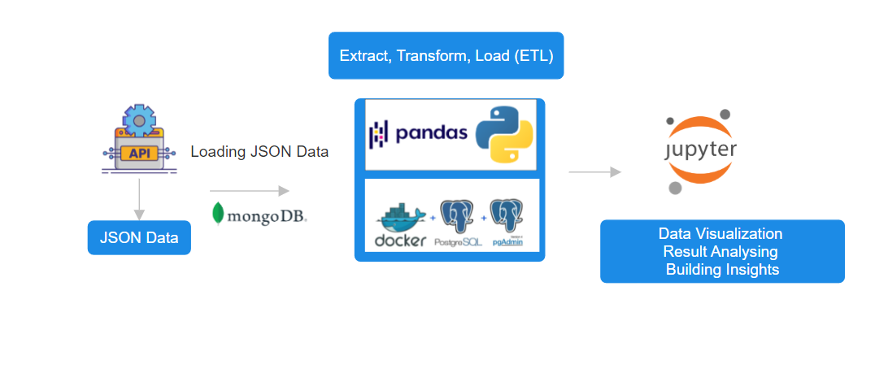
METHODOLOGY

Slide 5
TECHNOLOGIES
Jupyter Notebook - web application that allows you to create and share documents that contain live code, equations, visualizations, and narrative text.
Docker Desktop - An application for building, managing, and running Docker containers on desktop operating systems
MongoDB Compass - is the official graphical user interface (GUI) for MongoDB
pgAdmin - Open-source administration and development platform for PostgreSQL
Github

Slide 6
LIBRARIES UTILIZED
Seaborn - For statistical graphic in python
Pymongo - Tools for interacting with MongoDB database
requests - To interact with web services, APIs, and websites.
pandas - Used for data manipulation and analysis.
Numpy - For scientific computing in Python.
Matplotlib - For creating static, animated, and interactive visualizations
Plotly - To create interactive data visualizations.
Sqlalchemy - To interact with a wide variety of databases which enables to create data models

Slide 7
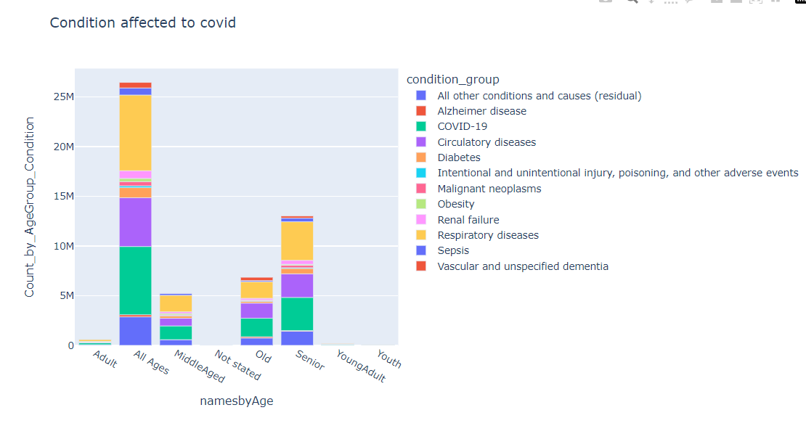
EVALUATION AND RESULTS

Slide 8
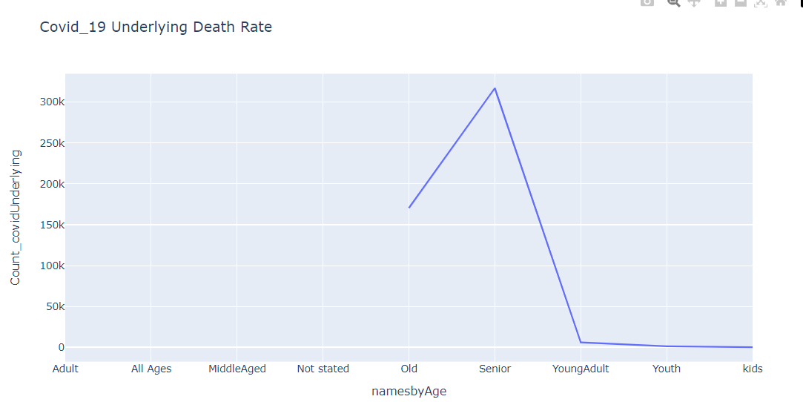
EVALUATION AND RESULTS

Slide 9
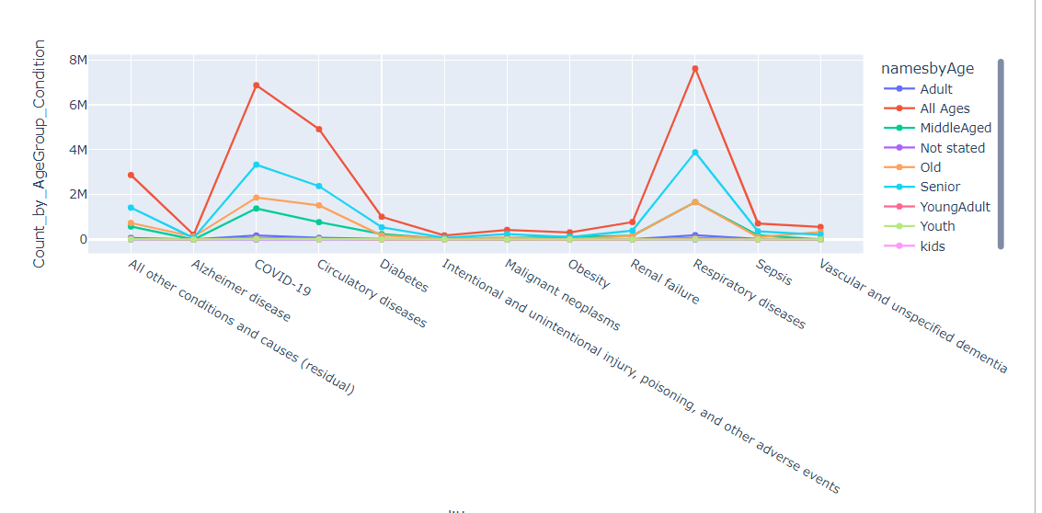
EVALUATION AND RESULTS

Slide 10
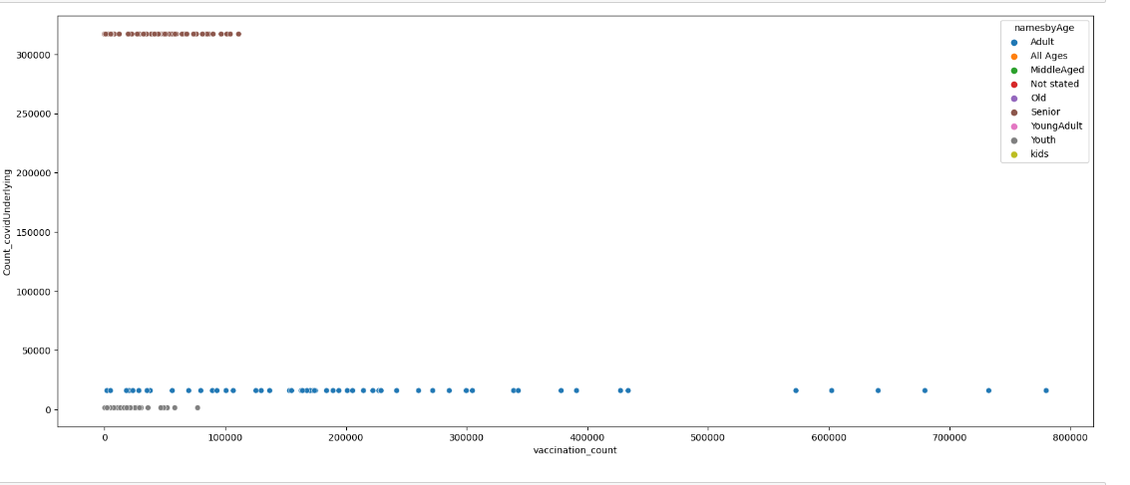
EVALUATION AND RESULTS

Slide 11
CONCLUSION
Individuals with pre-existing respiratory conditions, particularly seniors are more prone to COVID-19 death.
COVID-19 mortality rate is highest for seniors.
Seniors age group demonstrate lower vaccination rates, correlating with higher mortality rates due to COVID-19.

Slide 12
REFERENCES
M. O. Abdelsamad and A. Z. Karrar, "An Interactive Dashboard for Monitoring the Spread of COVID-19 in Sudan," 2020 International Conference on Computer, Control, Electrical, and Electronics Engineering (ICCCEEE), Khartoum, Sudan, 2021, pp. 1-6, doi: 10.1109/ICCCEEE49695.2021.9429561. Analysis},
Meng, S. Cheng and A. Kumar, "Big Data Visualization Analysis: Distribution of COVID-19 Mortality and Vaccination in the US," 2022 International Symposium on Electrical, Electronics and Information Engineering (ISEEIE), Chiang Mai, Thailand, 2022, pp. 8-12, doi: 10.1109/ISEEIE55684.2022.00009.
M. R. Mufid, A. Basofi, S. Mawaddah, K. Khotimah and N. Fuad, "Risk Diagnosis and Mitigation System of COVID-19 Using Expert System and Web Scraping," 2020 International Electronics Symposium (IES), Surabaya, Indonesia, 2020, pp. 577-583, doi: 10.1109/IES50839.2020.9231619.
Avinash Navlani; Armando Fandango; Ivan Idris, Python Data Analysis: Perform data collection, data processing, wrangling, visualization, and model building using Python , Packt Publishing, 2021.
Jonathan Rioux, Data Analysis with Python and PySpark , Manning, 2022.

