Slide 1
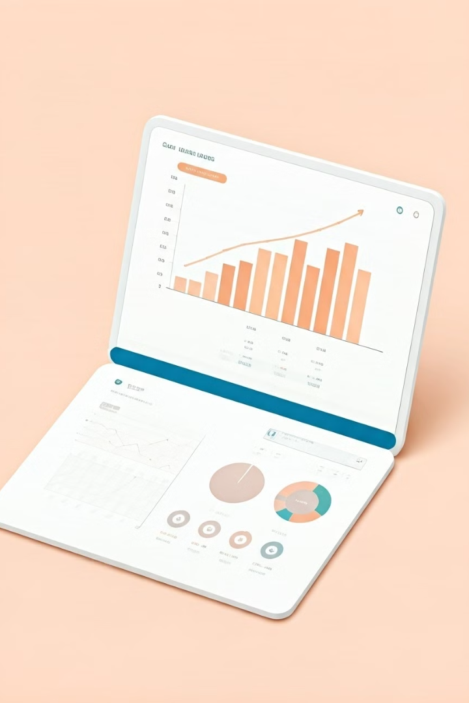

Google Play Store Dataset: Insights and Analytics
This presentation explores key insights derived from the Google Play Store dataset using interactive visualizations. We'll delve into app performance, user engagement, and trends to understand how apps thrive in this dynamic market.
by Anjali Khare

Slide 2
Introduction to the Google Play Store dataset
What is the dataset?
Key data points
It contains detailed information about apps available on the Google Play Store, spanning various categories and genres. This data allows for comprehensive analysis of app performance and user behavior.
The dataset includes app details like name, category, rating, reviews, size, installs, type, price, content rating, genres, last updated, and Android version.

Slide 3
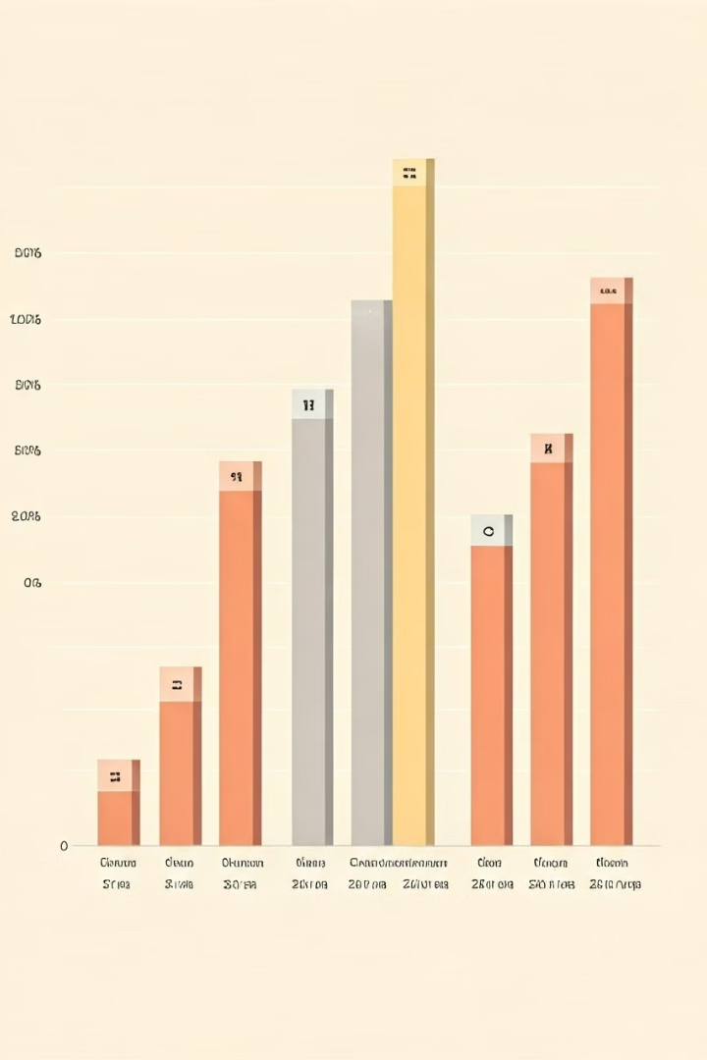
Understanding app categories and genres
Category Analysis
Genre Exploration
The dataset enables us to analyze the distribution of apps across major categories, like games, tools, social, and productivity. We can understand the popularity and growth of each category.
Genre analysis allows us to investigate the popularity of specific genres within each category, identifying potential niches and trends within the app market.
Trends and Insights
Visualizing the distribution of apps by category and genre helps us identify emerging trends and popular app types, allowing us to understand user preferences.

Slide 4
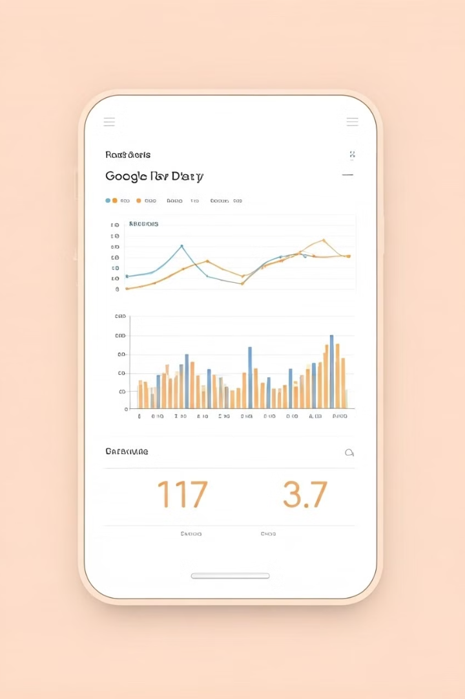




Evaluating app performance metrics
Rating
Downloads
The average rating of an app reflects user satisfaction and can significantly influence its visibility and downloads.
Total downloads measure an app's popularity and reach, indicating its success in attracting users.
Reviews
Engagement
User reviews provide valuable insights into user experience and can highlight areas for improvement.
Metrics like daily active users (DAUs), session duration, and user retention indicate how effectively an app keeps users engaged.

Slide 5

Visualizing user engagement with interactive dashboards
Explore app usage trends over time, identifying peak usage periods and patterns.
Visualize user interactions with different app features, understanding the most used and popular features.
1
2
3
Analyze user activity across different regions, identifying geographical variations in app engagement.

Slide 6
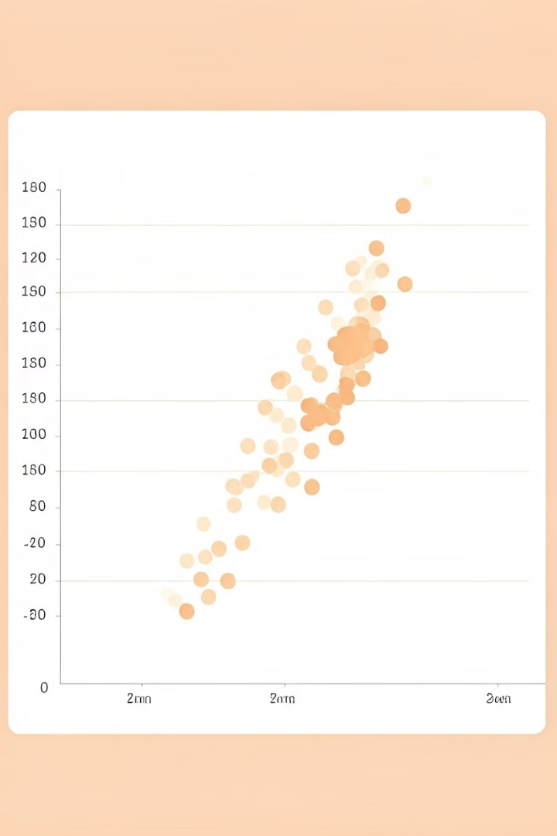



Analyzing app ratings and reviews
Identify the most common reasons behind positive and negative reviews, understanding user sentiment.
Analyze trends in reviews over time, identifying potential issues or improvements needed.
Identify patterns in user feedback based on app features, understanding user expectations.

Slide 7
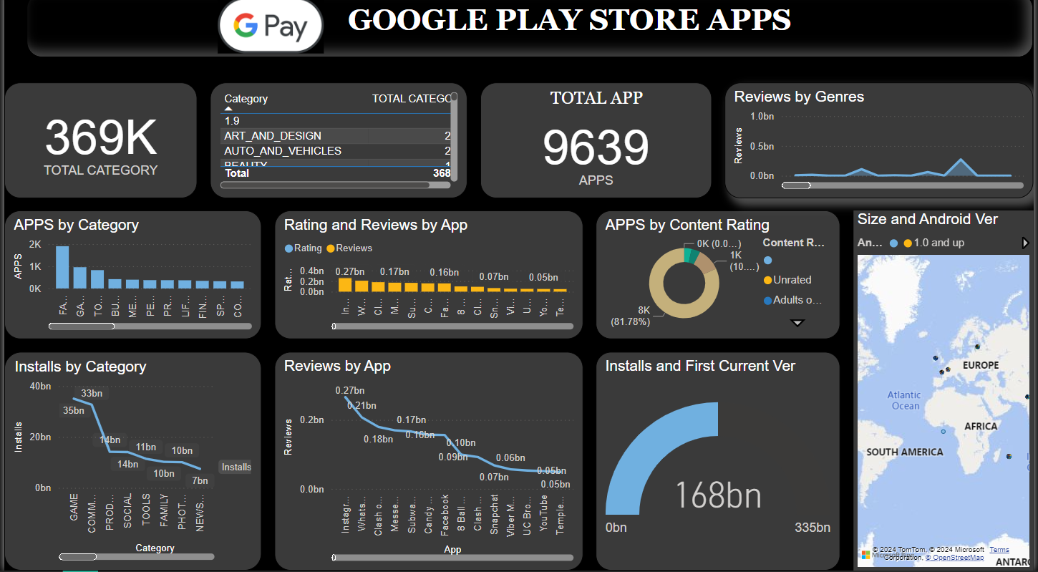

Slide 8

Conclusion and key takeaways
1
2
3
Data-Driven Decisions
User Understanding
Continuous Improvement
The Google Play Store dataset provides valuable insights for making data-driven decisions about app development, marketing, and user engagement.
Analyzing user behavior and feedback is crucial for creating successful and engaging apps.
Regular monitoring of app performance metrics and user feedback enables continuous improvement and optimization.

