Slide 1


.Shop Customer Data: Insights and Visualizations
by anjali khare

Slide 2
Introduction to the Dataset
The .Shop Customer Data dataset provides a wealth of information about customer demographics, purchasing behavior, and product interactions. This analysis will reveal key insights and actionable recommendations for enhancing customer satisfaction, optimizing product offerings, and driving sales growth.
The dataset contains various attributes such as customer ID, age, gender, location, purchase history, product categories, and purchase dates. This rich data provides a comprehensive view of customer behavior and preferences, allowing us to uncover valuable patterns and trends.

Slide 3
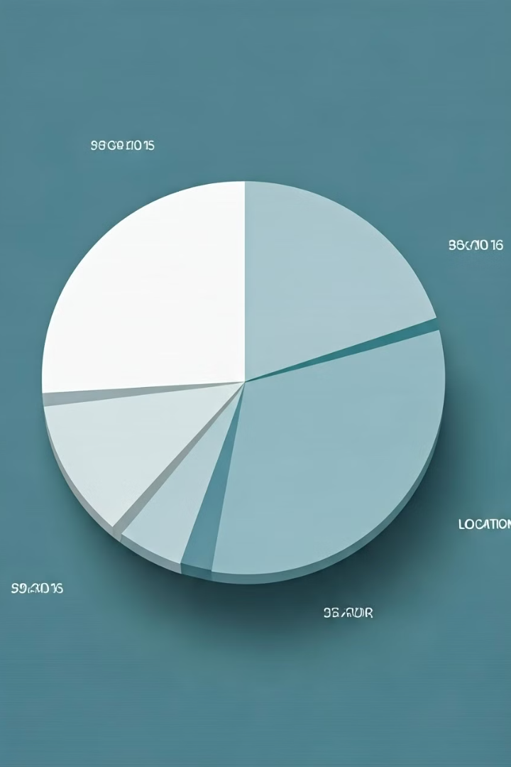
Demographic Analysis of Customers
Age Distribution
Gender Breakdown
Understanding the age distribution of customers is crucial for tailoring marketing campaigns and product offerings to specific demographics.
Analyzing the gender composition of the customer base allows for targeted marketing efforts and product development strategies that cater to different preferences.
Geographic Segmentation
Identifying regional customer concentrations helps businesses optimize logistics, distribution, and marketing campaigns for specific geographic areas.

Slide 4
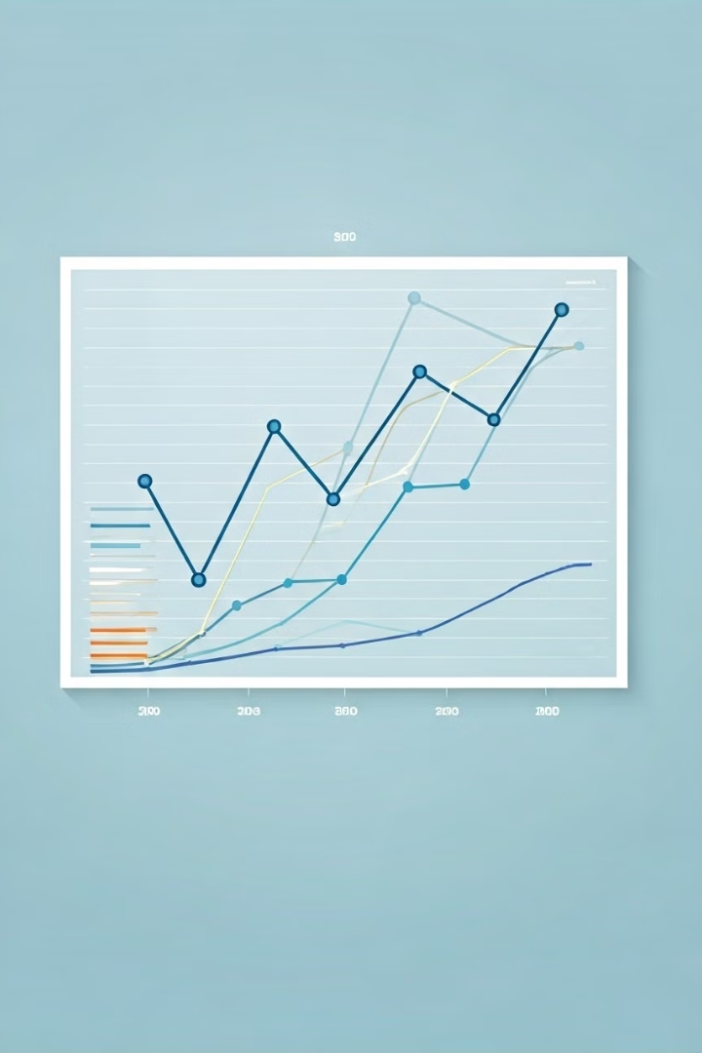
Purchasing Behavior Patterns
1
Purchase Frequency
Analyzing the frequency of purchases helps identify loyal customers and understand the buying patterns of different customer segments.
2
Average Order Value
Evaluating the average value of customer orders provides insights into customer spending habits and potential upselling opportunities.
3
Seasonal Trends
Understanding seasonal variations in purchase behavior helps businesses optimize inventory management, pricing strategies, and marketing campaigns.

Slide 5
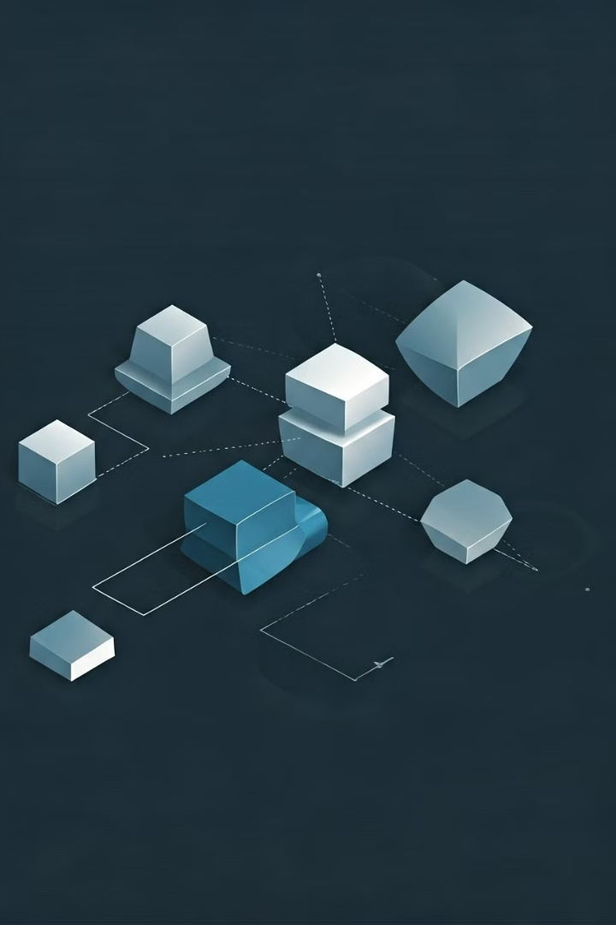



Product Affinity and Cross-Selling Opportunities
Product Bundling
Identifying products frequently purchased together allows for creating attractive product bundles and increasing average order values.
Cross-Selling Strategies
Understanding which products customers are likely to purchase based on their previous buying behavior enables effective cross-selling campaigns.
Product Recommendations
Personalized product recommendations based on past purchases and browsing history enhance customer experience and drive sales.

Slide 6



Customer Segmentation and Targeted Marketing
High-Value Customers
1
These customers are loyal and spend significant amounts, requiring personalized attention and loyalty programs.
Mid-Value Customers
2
These customers are a good balance of frequency and value, requiring targeted promotions and product recommendations.
Low-Value Customers
3
These customers have low purchase frequency and value, requiring strategic reactivation campaigns and incentivized offers.

Slide 7
Identifying High-Value Customers
RFM Analysis
1
Analyzing recency, frequency, and monetary value of purchases allows for identifying high-value customers and understanding their behavior patterns.
Loyalty Programs
2
Implementing loyalty programs with rewards and exclusive offers incentivizes repeat purchases and fosters customer loyalty.
Personalized Communication
3
Providing personalized communication and tailored offers to high-value customers enhances their experience and strengthens the customer relationship.

Slide 8
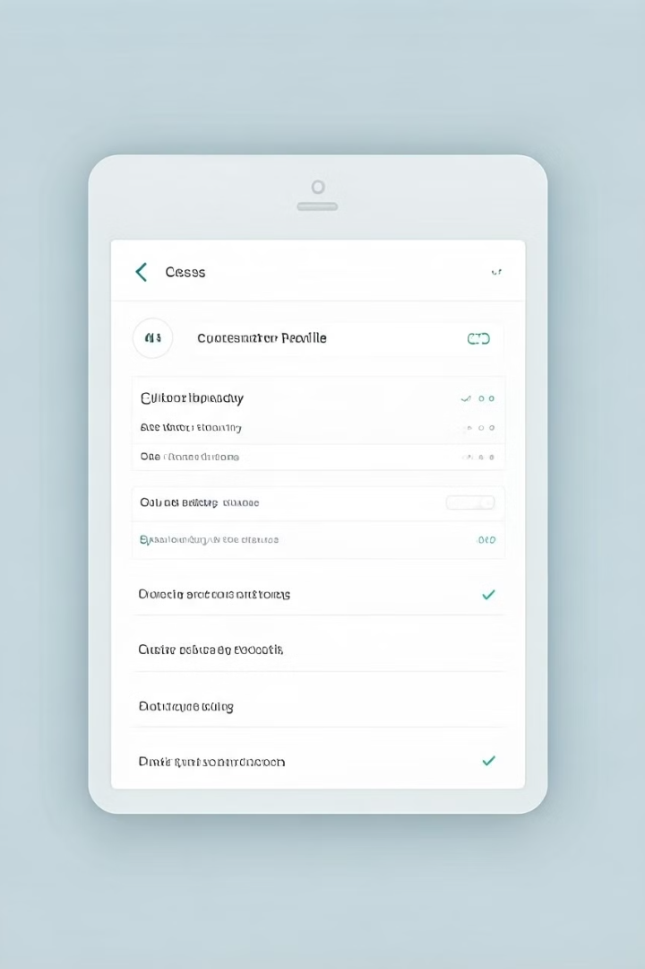
Optimizing the Customer Experience
1
2
Customer Support
Website Usability
Providing excellent customer support through various channels ensures quick resolution of issues and enhances customer satisfaction.
Optimizing website usability, navigation, and search functionality enhances customer experience and reduces cart abandonment.
3
4
Delivery Optimization
Return Policy
Offering fast, reliable, and affordable shipping options enhances the overall shopping experience and encourages repeat purchases.
Implementing a clear and hassle-free return policy builds trust and encourages customers to make purchases without hesitation.

Slide 9



Actionable Insights and Recommendations
Enhance Customer Satisfaction
Optimize Product Offerings
Drive Sales Growth
Implement customer feedback mechanisms, provide personalized support, and optimize website usability.
Analyze purchase data, identify product gaps, and leverage cross-selling opportunities to optimize product offerings.
Develop targeted marketing campaigns, personalize recommendations, and optimize pricing strategies to drive sales growth.

