Slide 1
Cloud Based E-Learning Platform
Anjali Upadhyaya-1SU19CI007
Ridhisha Alva-1SU19CI015
7th SEM CTIS
Project Guide : MR Daniel Francis S

Slide 2
AGENDA
Abstract
Introduction
Literature Survey
Motivation to Implement
Existing Methodology
Proposed Methodology
Modules
System Architecture Diagram
Implementation
Result
Conclusion
References

Slide 3
ABSTRACT
E-learning web application helps student to create and communicate new ideas. Learner will get the chance to uplift their skill and gain knowledge apart from school/college education. There are many e-learning web application available all are developed using scripting languages. In this project we are going to develop e-learning web application using Amazon WordPress and other aws services.

Slide 4
INTRODUCTION
Objective: The objective of the project is to build e-learning web application through AWS along with Chatbot. Now a days there are lots of paradigms for getting knowledge or to learn one of the most promising paradigm for education is e-learning. In 21st century, E-learning has become such a huge demand that almost everyone is willing to try and gain knowledge from these platform. Anyone can access their dashboard from anywhere by just having a good internet connection.

Slide 5
INTRODUCTION (cont…)
Cloud Computing: Cloud Computing is a term referred to storing and accessing data over the internet globally and it does not store any data on the hard disk of our personal computer. Cloud Computing is a new paradigm that provides an appropriate pool of computing resources with its dynamic scalability and usage of virtualized resources as a service through the Internet. Cloud computing deliver services autonomously based on demand and provides sufficient network access, data resource environment and effectual flexibility.

Slide 6
INTRODUCTION (cont…)
Chatbot: Chatbots are conversational tools that perform routine tasks efficiently. People like them because they help them get through those tasks quickly so they can focus their attention on high-level, strategic, and engaging activities that require human capabilities that cannot be replicated by machines.
AWS: The Amazon Web Services platform provides more than 200 fully featured services from data centers located all over the world, and is the world's most comprehensive cloud platform. Developers can access them from anywhere at the time of need.

Slide 7
INTRODUCTION (cont…)
H/W & S/W Requirements
AWS services
512 MB memory
512 Bandwidth
20 GB SSD Disk
1 Virtual CPU
Laptop or computer
Web Browser

Slide 8
INTRODUCTION (cont…)
Problem Statement: To provide e-learning web application to the user without any delay using AWS services.

Slide 9
LITERATURE SURVEY
Cloud Computing Based Learning Web Application Through Amazon Web Services :This paper presents Dynamic E-Learning Portal using WordPress through Amazon Web Services (AWS). The paper mainly consists of 10 Amazon Cloud Services and Google Firebase. The main aim of this project is to provide E-Learning Courses for Engineering Students. Technologies used—Amazon RDS, Amazon SNS,Amazon Route53, Amazon S3, Amazon VPS, Amazon LightSail,Amazon Transfer Family, IAM (Identity Access Management), WordPress and Firebase by Google

Slide 10
LITERATURE SURVEY(cont…)
E-Learning using Cloud Computing: This paper presents the benefits of using cloud computing for e-learning. There are many educational institutions that cannot afford such investments, and cloud computing is the best solution. Anyone can access various application platforms and resources through the web pages on-demand. It will help us review the current status and probable considerations to adopt the cloud technology

Slide 11
LITERATURE SURVEY(cont…)
An E-learning System Architecture based on Cloud Computing: This paper introduces the characteristics of the current E-Learning and then analyses the concept of cloud computing and describes the architecture of cloud computing platform by combining the features of E-Learning.
Cloud-Based E-Learning: A Proposed Model and Benefits by Using E-Learning Based on Cloud Computing for Educational Institution: This paper discuss the current state and challenges in e-learning and then explained the basic concept and previous proposed architectures of cloud computing.

Slide 12
LITERATURE SURVEY(cont…)
Chatbot for E-Learning: A Case of Study: This paper presents the realization of a prototype of a Chatbot in educational domain. It has been developed a system to provide support to students on some courses.
Building Chatbot Using Amazon Lex and Integrating with A Chat Application: The lambda function runs a script that collects input in the form of plain text or by using voice recognition using the microphone connected to it, which is sent to the Amazon Lex to be processed using various services provided by Amazon Web Services. Then the chatbot sends back a suitable response to the user through the speaker connected to the device or in the form of plain text.

Slide 13
Motivation To Implement
To provide E-learning platform for the students
Cost-effective
Availability
Time management
To help students to gain more knowledge

Slide 14
Existing Methodology
In existing system Web Application, they deploy a Dynamic E-Learning Portal Amazon Web Services (AWS). The project mainly consists of 10 Amazon Cloud Services and Google Firebase. Technologies used—Amazon RDS, Amazon SNS, Amazon Route53, Amazon S3, Amazon VPS, Amazon LightSail, Amazon Transfer Family, IAM (Identity Access Management), WordPress and Firebase by Google.
And some other e-learning web applications are developed using scripting, design and styling languages ex- Udemy,coursera ex..

Slide 15
Proposed Methodology
In our project we are developing E-learning web application with the help of WordPress and then we are deploying it with the help of AWS services like Amazon CloudFront, Amazon API gateway, ELB, VPC, RDS, S3, EC2, EBS, LightSail, AS, SNS, AMI, Route53
Along with this a smart chatbot using Amazon Lex

Slide 16
Modules
Course Management System: A course management system is a section which is provided for accessing the course contents in various formats, manages student enrolment, and monitors the performance of a student.
Student Portal: Student portals involve the information on courses offered, transcripts, exam schedules, department contact numbers, timetables, and email programs. It is generally used to describe the login page in which students can enter the name of the user and password to access educational program for the organization and other learning materials.

Slide 17
MODULES(cont…)
Online Assignment Tool: Assignment tool permits the students for submitting the tasks online and their online feedback can be observed. It allows for setting up a location for every student to present an assignment. It is structured for both individual student and group’s submission. Students can submit a wide range of file types and links for web-based items. It is an effective method to deploy, receive, and digitally grade assignments for the student.

Slide 18
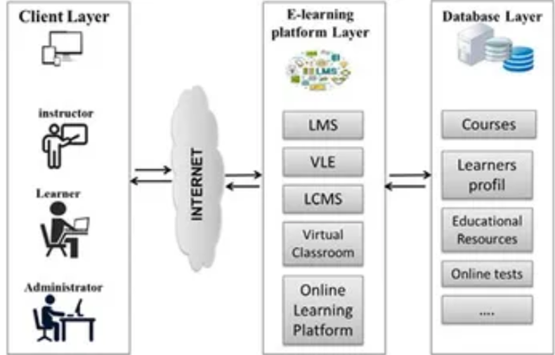
SYSTEM ARCHITECTURE DIAGRAM

Slide 19
Implementation
Open Amazon Management Console
Open amazon S3 service
Create S3 bucket to store materials related to courses .
Create A VPC
Name the VPC
Create an Internet gateway.
Attach Internet Gateway with VPC

Slide 20
Implementation(cont…)
Create 2 subnets.
Create public route table.
Attach one subnet with route table
Launch an EC2 instance inside a public subnet where you will deploy the WordPress website.
Visit the EC2 console and click Launch Instances
In Choose an Amazon Machine Image (AMI) page, select Amazon Wordpress image from AWS marketplace

Slide 21
Implementation(cont…)
In Choose an Instance Type page, select t2.micro
Click Next: Configure Instance Details button
In Configure Instance Details page
For Network, select the VPC you have created in the last STEP
For Subnet, select PublicSubnet1
Click Next: Add Storage → Next: Add Tags

Slide 22
Implementation(cont…)
For Assign a security group, select Create a new Security Group
For the Security group name, enter public-instance-sg
In the pre-created rule, For Source, select My IP, your IP will be auto-detected, and click Review and Launch → Launch
Select Create a new key pair, Enter the Key pair name and click Download key pair
Finally, Launch the instance

Slide 23
Implementation(cont…)
launch MySQL database in a private subnet
Visit RDS console, click Create Database
For Engine options, select MySQL
For Templates, select Free tier,
In Settings section,
For DB identifier, enter wordpress,

Slide 24
Implementation(cont…)
For Credentials Settings, enter your Master username and Master password(for example: #12345678aA)
In Connectivity section,
For Virtual private cloud (VPC), select Vpc, you created in last time
Click Additional connectivity configuration to show more configuration
For Public access, select No
For VPC security group, select Create new and enter db-sg in New VPC security group name

Slide 25
Implementation(cont…)
Scroll down and click Additional configuration,
For Initial database name, enter wordpress,
Finally, click Create database
Modify security group of RDS and EC2 instance
Visit EC2 dashboard, select public-instance-sg
Click Edit inbound rules button

Slide 26
Implementation(cont…)
Click Add rule, For Type, select MYSQL/Aurora,
For Source, select custom and find the db-sg, and click Save rules
Click Add rule, For Type, select HTTP,
For Source, select My IP , and click Save rules
Visit Security Groups page, select db-sg,
Click Edit inbound rules button
Click Add rule, For Type, select MYSQL/Aurora,

Slide 27
Implementation(cont…)
For Source, select custom and find the public-instance-sg, and click Save Rules
Set Up the Wordpress Environment
Visit EC2 console,
Connect to instance
Create a E-learning website in wordpress
Setup RDS database connection using plugins for student registration
Add courses

Slide 28
Implementation(cont…)
Create dashboard, home page etc for the website
Set up Elastic Load Balancers for the website to handle load
Setup Cloudfront distribution to set domain name

Slide 29
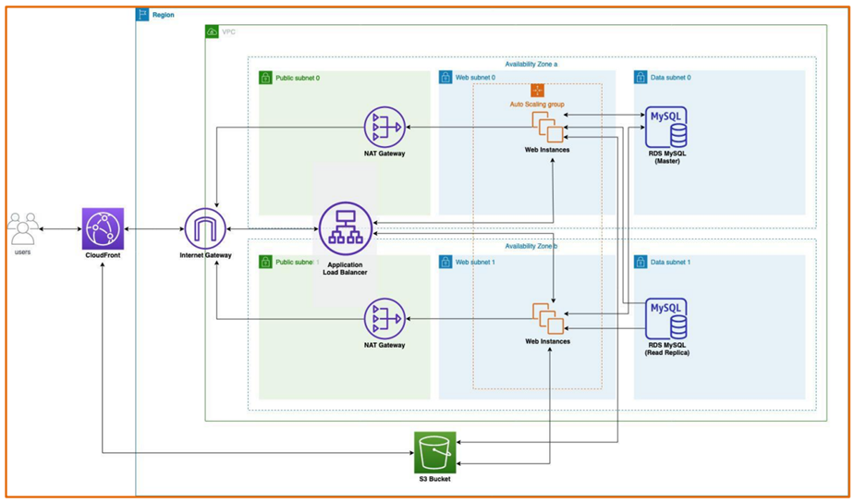

Slide 30
CONCLUSION
E-learning has become a popular way of learning, and this project focuses on developing a dynamic e-learning portal using WordPress through Amazon Web Services (AWS).
The literature survey explored the existing literature on e-learning, WordPress, and the technologies used in this project.
The literature revealed that e-learning is a growing market, and WordPress is an ideal platform for building e-learning portals.
Additionally, AWS offer several services that are essential for building an e-learning portal.

Slide 31
REFERENCES
SaiAkash Neela, Yashwanth Neyyala, VamsiNadh Pendem, Kanishk Peryala, Vasantham Vijay Kumar, “Cloud Computing Based Learning Web Application Through Amazon Web Services”, 2021 7th International Conference on Advanced Computing and Communication Systems (ICACCS)
Utpal Jyoti Bora, Majidul Ahmed, “E-Learning using Cloud Computing”, International Journal of Science and Modern Engineering (IJISME), ISSN: 2319-6386, Volume-1 Issue-2, January 2013

Slide 32
REFERENCES (cont…)
M. A. H. Masud and X. Huang, "An e-learning system architecture based on cloud computing," system, vol. 10, 2012.
N. Selviandro and Z. A. Hasibuan, "Cloud-Based elearning:a proposed model and benefits by using elearning based on cloud computing for educational institution," in Information and Communication Technology-EurAsia Conference, 2013, pp. 192-201 [10] . Peter Mell

Slide 33
REFERENCES (cont…)
Francesco Colace, Massimo De Santo, Marco Lombardi, Francesco Pascale and Antonio Pietrosanto Dlln, University of Salcrno, Fisciano,Italy, “Chatbot for E-learning: A case of Study”, International Journal of Mechanical Engineering and Robotics Research Vol. 7,No. 5, September 2018
A S S K Sreeharsha, Sai Mohan Kesapragada, “Building Chatbot Using Amazon Lex and Integrating with A Chat Application”, Researchgate, April 2022, DOI: 10.55041/IJSREM12145

Slide 34


