Slide 1
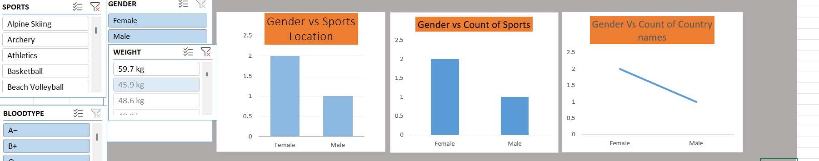
Sports Dashboard Analysis using Microsoft Excel
Project Description
Developed an interactive Excel dashboard using Pivot Tables, Pivot Charts and Slicers.
Analyzes athlete data including Gender, Sports, Country, Weight, Blood Type and Salary.
Provides dynamic filtering for quick insights and reporting.

Slide 2
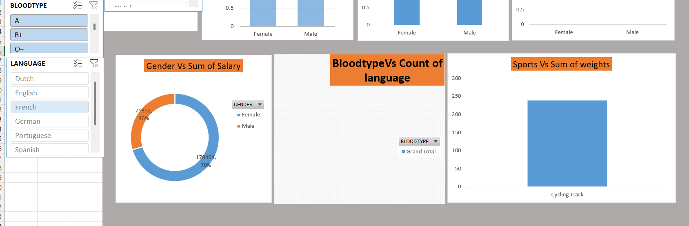
Dashboard Overview
Highlights
Interactive dashboard with slicers.
Gender, Sports and Country comparisons.
Dynamic filtering.

Slide 3
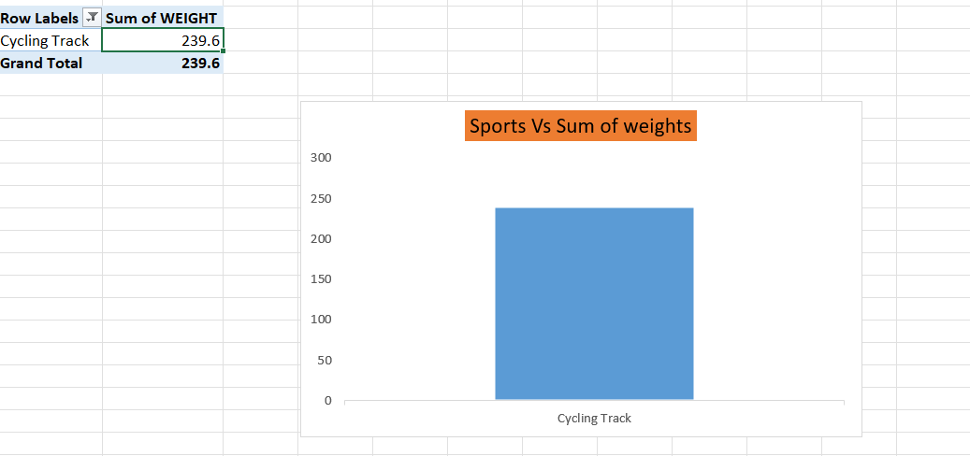
Weight Analysis
Highlights
Displays total weight by selected sport.
Cycling Track selected in current view.
Useful for sports-wise comparison.

Slide 4
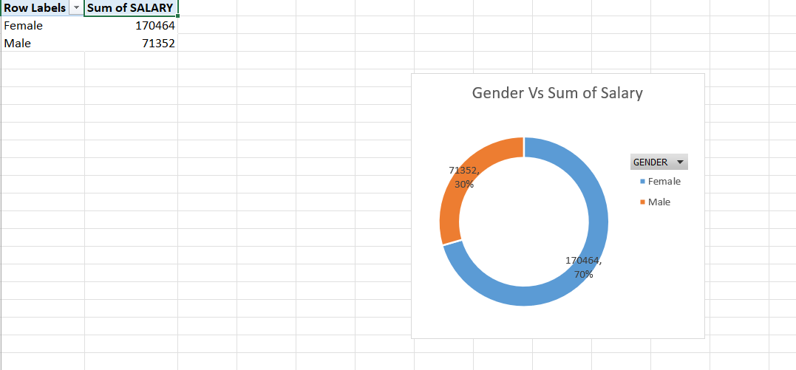
Salary Analysis
Highlights
Female Salary: 170,464
Male Salary: 71,352
Female share ~70%, Male ~30%.

Slide 5
Conclusion
Conclusion
The Sports Dashboard successfully transforms raw athlete data into meaningful visual insights.
Interactive slicers allow quick exploration by gender, sport, language and blood type.
Excel dashboards improve reporting efficiency and support data-driven decisions.

Slide 6
Thank You!
Thank You! Questions & Answers

