Slide 1

Statistics Project
By: Anjali Pal

Slide 2
Contents
Problem Statement
Dataset description
Tests Used
Assumptions
Methodology
Code
Setting up hypothesis
Results
Inferences

Slide 3
Problem Statement
The aim of the project was to identify whether Students & Outcome column has any correlation between them or not using the Chi-Square test.
This means that we need to test for independence between the two variables.

Slide 4
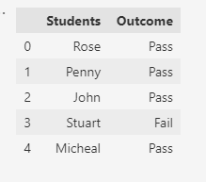
Dataset description
The data provided contains two columns namely Students and Outcome Column.
Data has 2 columns and 100 rows.
The Student column had 5 unique students : Rose, Penny, John, Stewart, Micheal.
The Outcome column had 2 unique outcomes: Pass or Fail
First 5 rows of the dataset are shown on the right side of screen.

Slide 5
Tests Used
We’ll use Chi Square Test for Independence to solve this question.
The Chi-square test of independence is a statistical hypothesis test used to determine whether two categorical/nominal variables are likely to be related or not.
Hypothesis for this test:
Null Hypothesis, H₀: There is no relationship between the two variables i.e. the variables are independent.
Alternative Hypothesis, H₁: There is relationship between the two variables i.e. the variables are dependent.

Slide 6
Assumptions
Assumptions for chi square test for independence are:
The data in the cells should be frequencies, or counts of cases
The levels (or categories) of the variables are mutually exclusive.
The study groups must be independent
There are 2 variables, and both are measured as categories, usually at the nominal level. However, data may be ordinal data. Interval or ratio data that have been collapsed into ordinal categories may also be used.
Cell values should not be less than 5

Slide 7
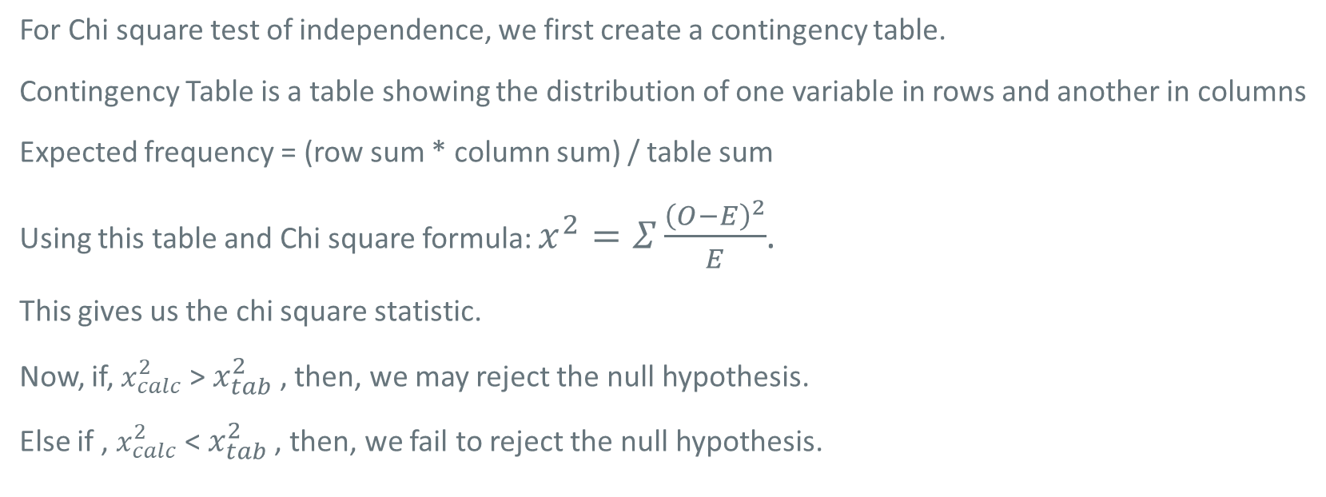
Methodology
For Chi square test of independence, we first create a contingency table.
Contingency Table is a table showing the distribution of one variable in rows and another in columns
Expected frequency = (row sum * column sum) / table sum
Using this table and Chi square formula: $x^{2}=Σ\frac{{\left(O−E\right)}^{2}}{E}$.
This gives us the chi square statistic.
Now, if, $x_{calc}^{2}$ > $x_{tab}^{2}$ , then, we may reject the null hypothesis.
Else if , $x_{calc}^{2}$ < $x_{tab}^{2}$ , then, we fail to reject the null hypothesis.

Slide 8
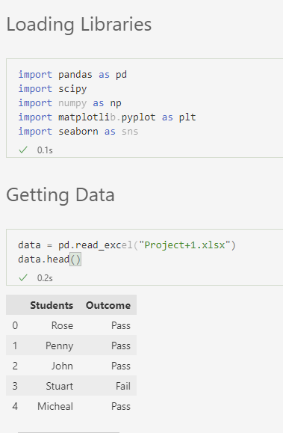
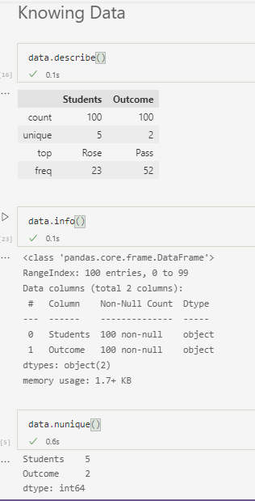
Code – Part 1
Loading the data and knowing more about the variables present and their properties is an important task.

Slide 9
Setting up Hypothesis
Hypothesis for this test:
Null Hypothesis, Ho: There is no relationship between the Students and Outcome i.e. Students and Outcome are independent.
Alternative Hypothesis, H1: There is relationship between the Students and Outcome i.e. Students and Outcome are dependent.
This is a non parametric test.

Slide 10
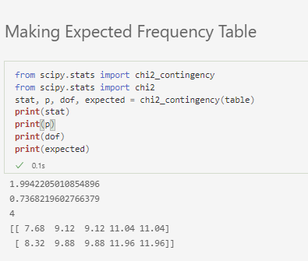
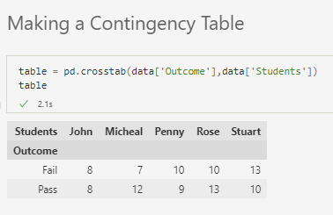
Code – Part 2

Slide 11
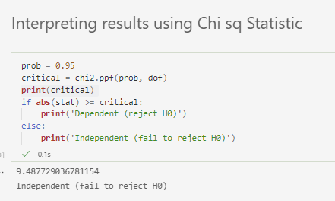
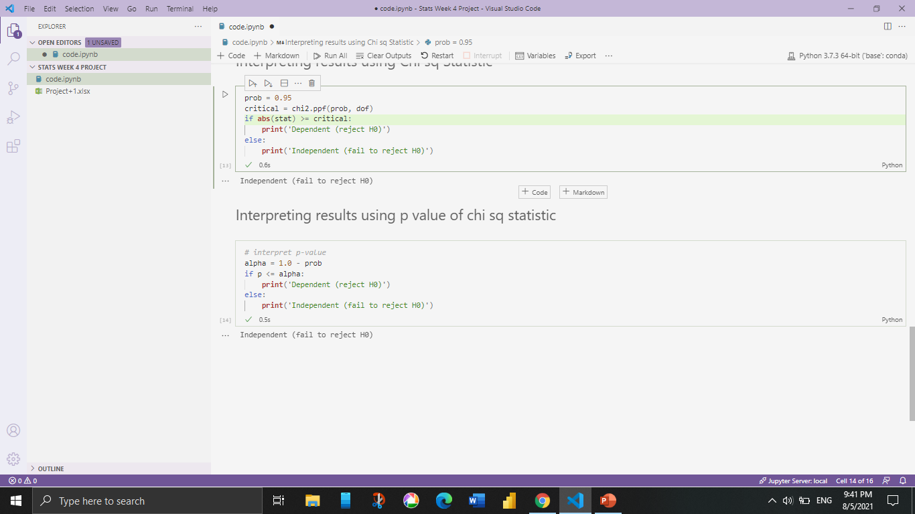
Code – Part 3

Slide 12
Results
Expected Frequencies are: [ [ 7.68 9.12 9.12 11.04 11.04]
[ 8.32 9.88 9.88 11.96 11.96] ]
The Chi Square calculated value is 1.994220
The Chi Square tabulated value is 9.4877
The p value is 0.7368
The degrees of freedom are 4

Slide 13
Inference
The Chi Square calculated is less than Chi Square tabulated, so, we can say that we fail to reject the null hypothesis at 5% level of significance and conclude that there is no relationship between the Students and Outcome i.e. Students and Outcome is independent.
Also, the p value of the Chi Square test is 0.7368 which is greater than 0.05, we may conclude that so, we can say that we fail to reject the null hypothesis at 5% level of significance and conclude that there is no relationship between the Students and Outcome i.e. Students and Outcome is independent.

Slide 14
THANK YOU!

