Slide 1


Project Presentation on :
MOVIE RECOMMENDATION
ENGINE
TEAM 48:
TEAM MEMBERS:
Anjali Pal
Niranjan Jena
Prakhar Gupta
Satyajit Kumar
Soumyabrata Ghosh

Slide 2
MOVIE RECOMMENDATION SYSTEM
Recommender System is a system that seeks to predict or filter preferences according to the user’s choices.
They are utilized in a variety of areas, and are most commonly recognized as playlist generators for video and music services like Netflix, YouTube and Spotify, product recommenders for services such as Amazon, or content recommenders for social media platforms such as Facebook and Twitter.

Slide 3
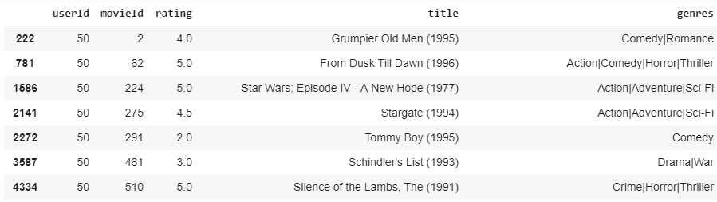
Movie Lens Latest Dataset for education and development
This dataset (ml-latest-small) describes 5-star rating and activity from [MovieLens] (http://movielens.org), a movie recommendation service. It contains 100836 ratings across 9742 movies. These data were created by 610 users between March 29, 1996 and September 24, 2018. This dataset was generated on September 26, 2018.

Slide 4
APPROACHES
The three most prominent approaches in Recommendation Systems are:
1. Collaborative System
2. Content Based System
3. Hybrid System (Collaborative + Content)

Slide 5
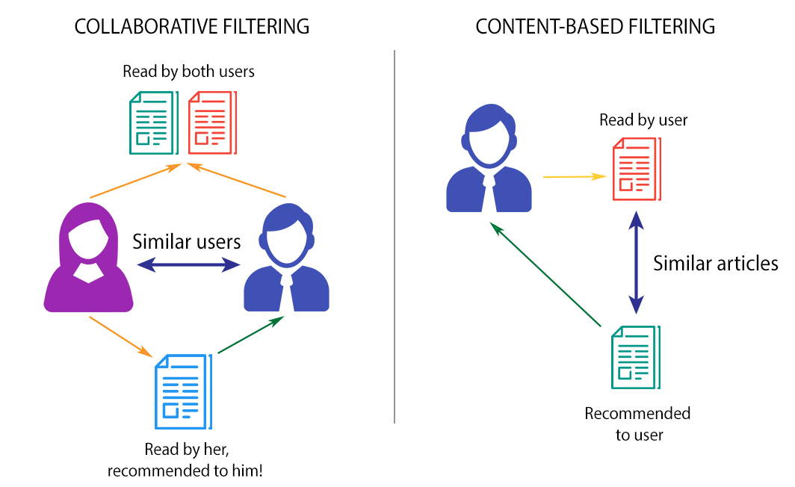

Slide 6
Content Based Approach
A content based recommender works with data that the user provides, either explicitly (rating) or implicitly (clicking on a link). Based on that data, a user profile is generated, which is then used to make suggestions to the user.
As the user provides more inputs or takes actions on the recommendations, the engine becomes more and more accurate.

Slide 7
Collaborative Based Approach
Collaborative filtering is a method of making automatic predictions (filtering) about the interests of a user by collecting preferences or taste information from many users (collaborating).
The underlying assumption of the collaborative filtering approach is that if a person A has the same opinion as a person B on an issue, A is more likely to have B's opinion on a different issue than that of a randomly chosen person.

Slide 8
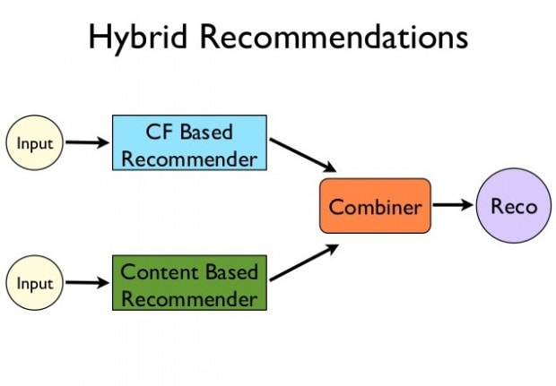

Slide 9
Content Filtering Algorithm
Here , we have only taken into account the three movies , the user has provided.
Based on the genres , the system tries to find similar movies using cosine similarity.

Slide 10
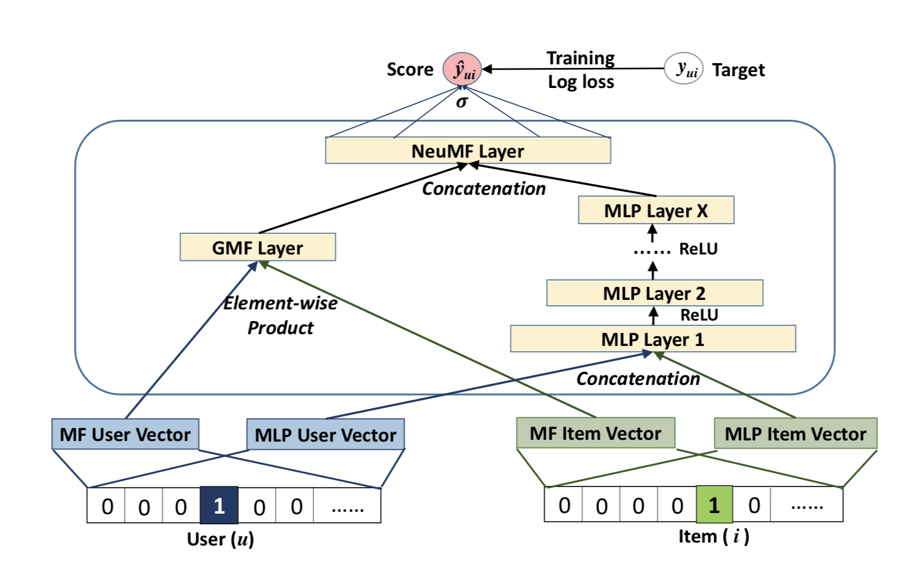
Deep Matrix Factorization

Slide 11
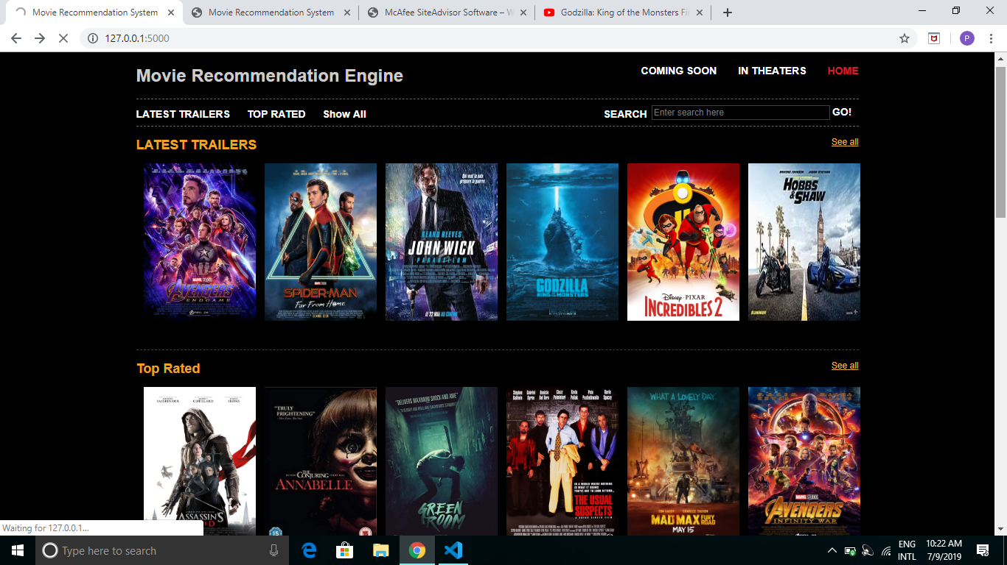

Slide 12
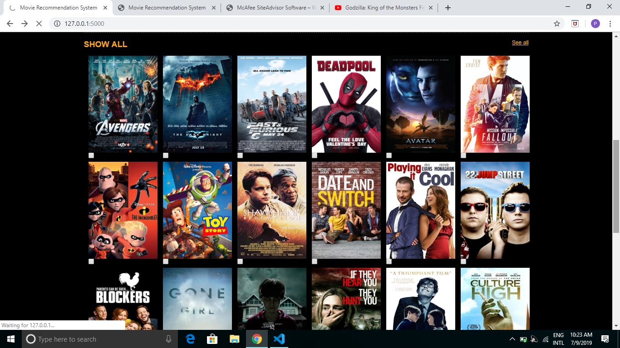

Slide 13
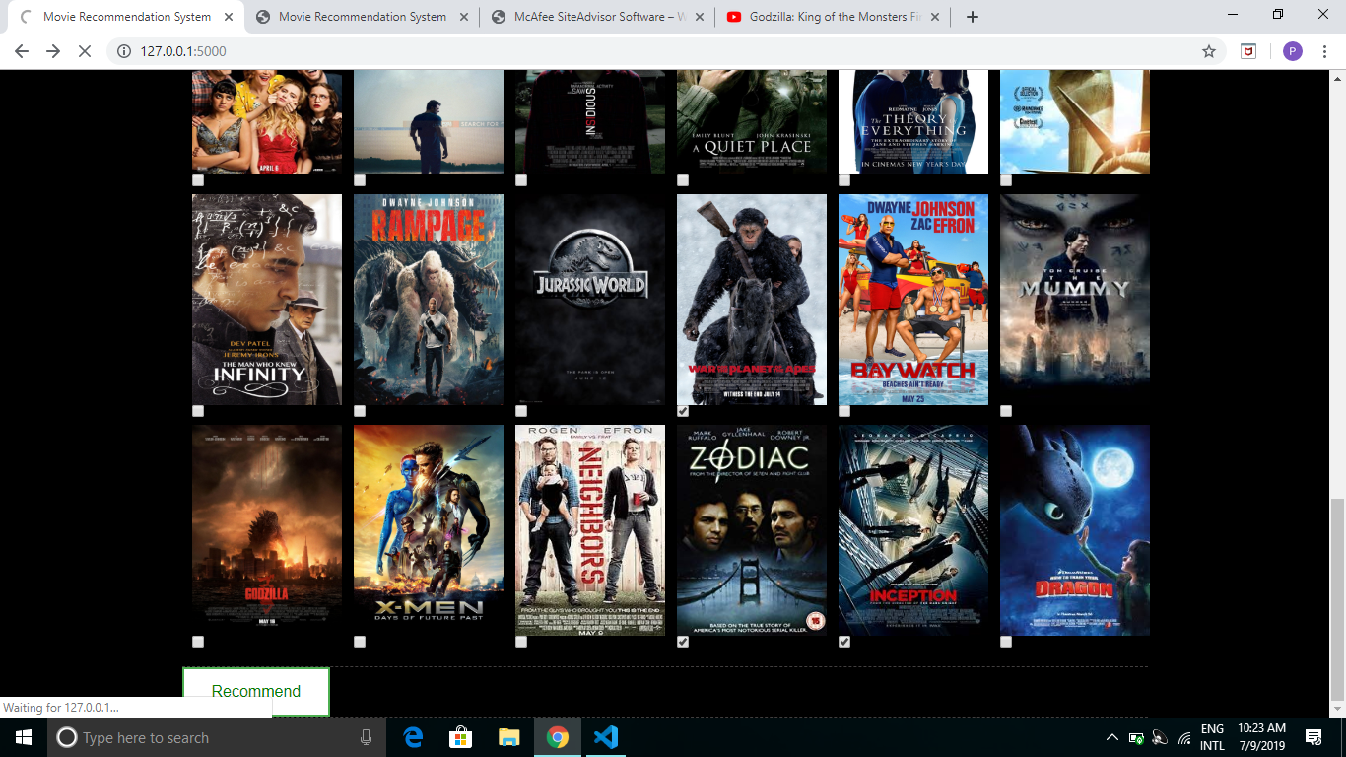

Slide 14
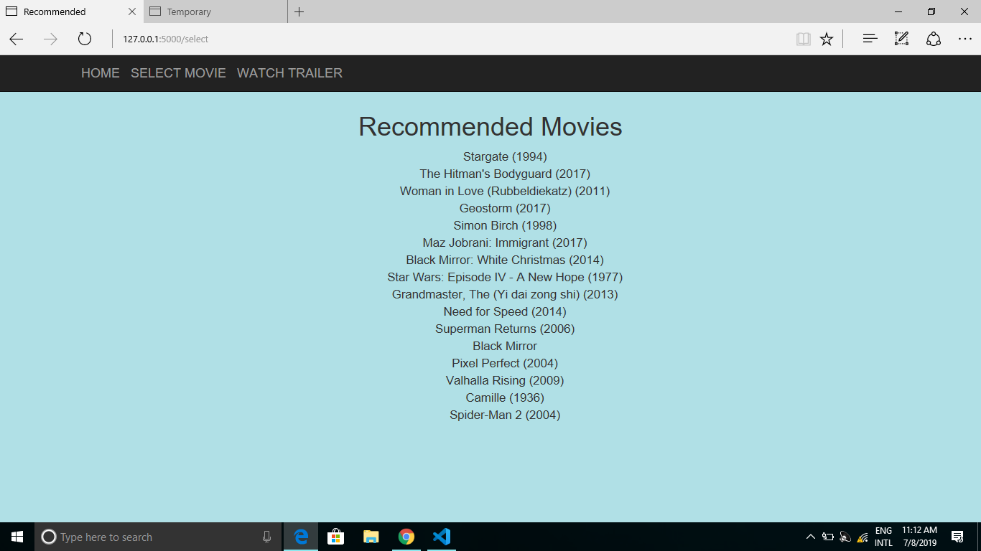

Slide 15
REFERENCES:
1. Research Paper:
https://dl.acm.org/citation.cfm?id=3052569
By: He Xiangnan , Liao Lizi , et.al
Published in 2017
2. https://nipunbatra.github.io/blog/2017/neural-collaborative-filtering.html
3. GeeksForGeeks
4. Analytics Vidhya

