Slide 1

NexNote
Full-Stack Notes App with Complete CI/CD
A production-grade MERN stack application — React, Node.js, MongoDB — backed by a fully automated DevOps pipeline: Docker, Kubernetes, Jenkins, GitHub Actions, Prometheus & Grafana.
REACT
NODE.JS
MONGODB
DOCKER
K8S
Redis
JENKINS
GITHUB ACTIONS
PROMETHEUS
GRAFANA
EC2
Alertmanager
[Anjali]
🎯 Key Takeaway: NexNote demonstrates a complete, production-ready DevOps pipeline — from code commit to monitored deployment.

Slide 2

Why DevOps? The Problem Solved
❌ Before DevOps
✅ After DevOps
Manual deployment — 30+ minutes per release
Human errors causing unexpected downtime
Inconsistent environments across dev, staging, prod
No visibility into deployment health
Automated deployment — under 5 minutes
Zero downtime with rolling updates
Consistent, reproducible containerized environments
Real-time monitoring with Prometheus & Grafana
Code push → Everything automatic.
🎯 Key Takeaway: DevOps eliminates manual to0l — every code push triggers a reliable, automated deployment pipeline.

Slide 3
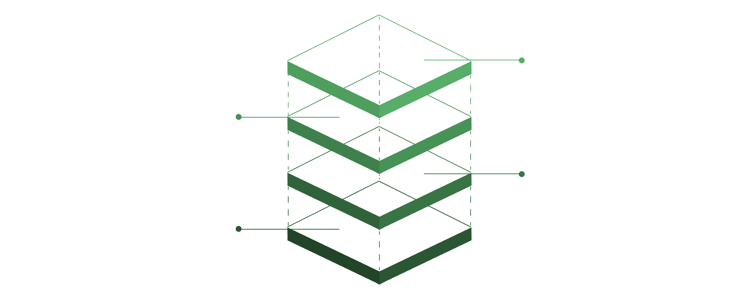

Project Architecture
NexNote's architecture follows a clean three-tier microservices model — each component isolated in its own Docker container, orchestrated by Kubernetes on AWS EC2.
Kubernetes Cluster
Orchestrates containers on EC2
MongoDB Database
Persistent data in DB container
Node.js Backend
API container handling requests
React Frontend
SPA served by Nginx container
Frontend: React SPA served via Nginx in a container
Backend: Node.js + Express REST API
Database: MongoDB — persistent storage with StatefulSet
All three run as Docker containers on Kubernetes (K3s)
🎯 Key Takeaway: Containerized, decoupled architecture enables independent scaling, deployment, and fault isolation.

Slide 4
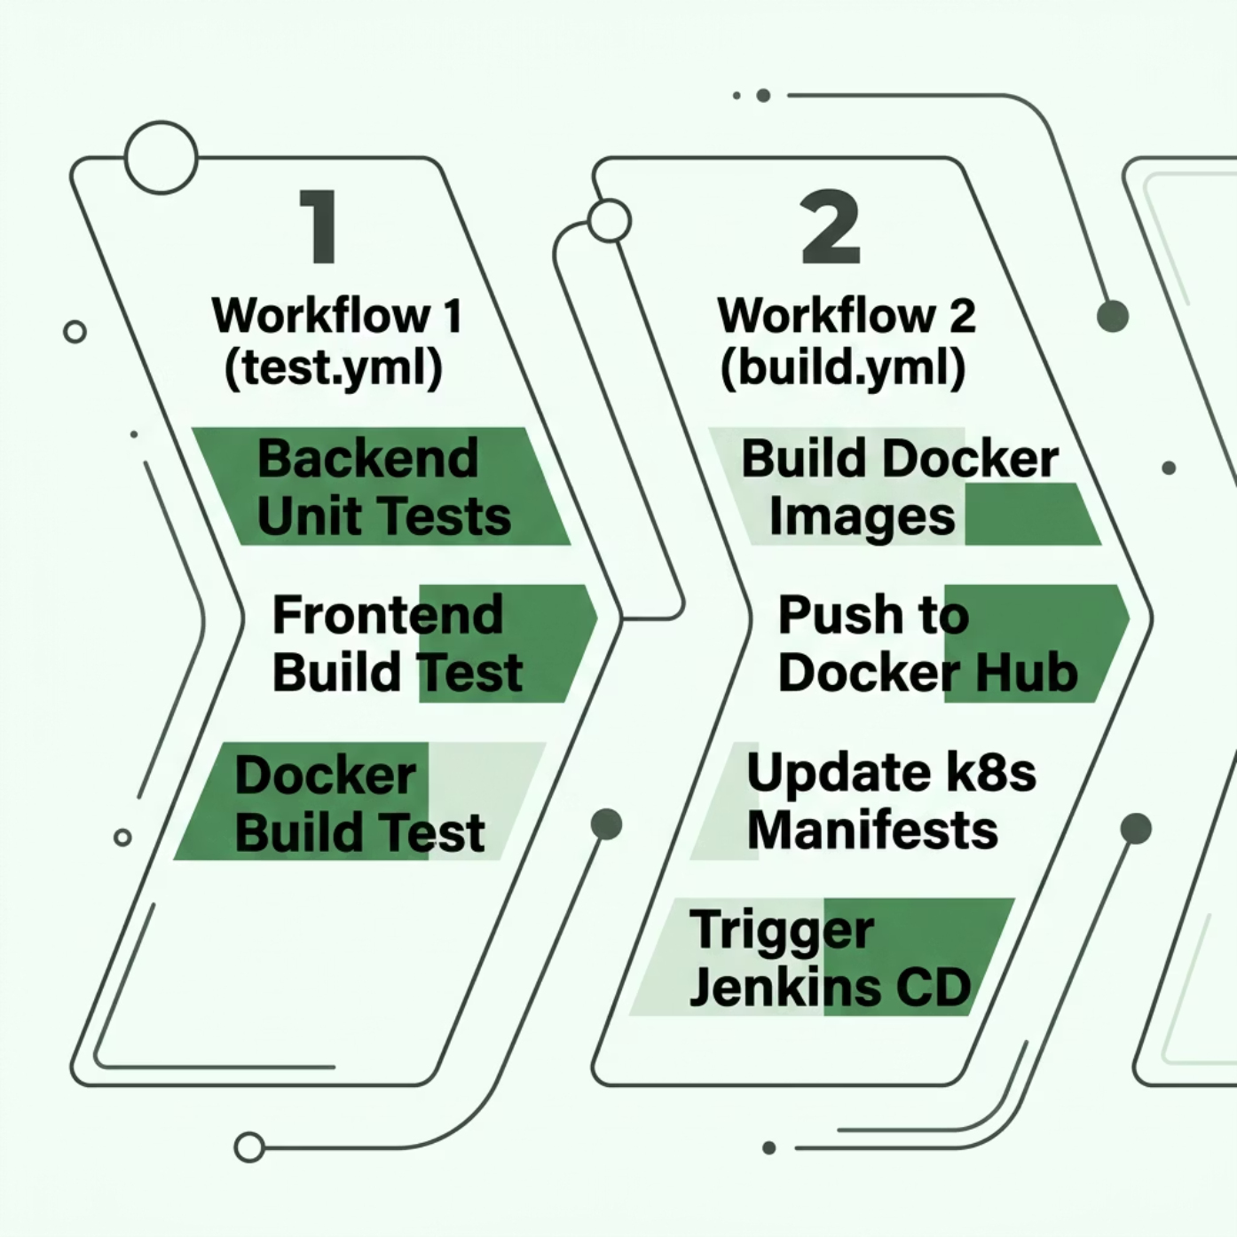


GitHub Actions — CI Pipeline
GitHub Actions runs two automated workflows on every git push — validating code quality before any deployment proceeds.
test.yml
Runs backend unit tests via npm test
Validates frontend build with npm run build
Tests Docker image build succeeds
build.yml
Builds & tags Docker images
Pushes to Docker Hub
Updates Kubernetes manifests
Triggers Jenkins via webhook
🎯 Key Takeaway: GitHub Actions gates every commit — only tested, buildable code reaches the deployment stage.

Slide 5
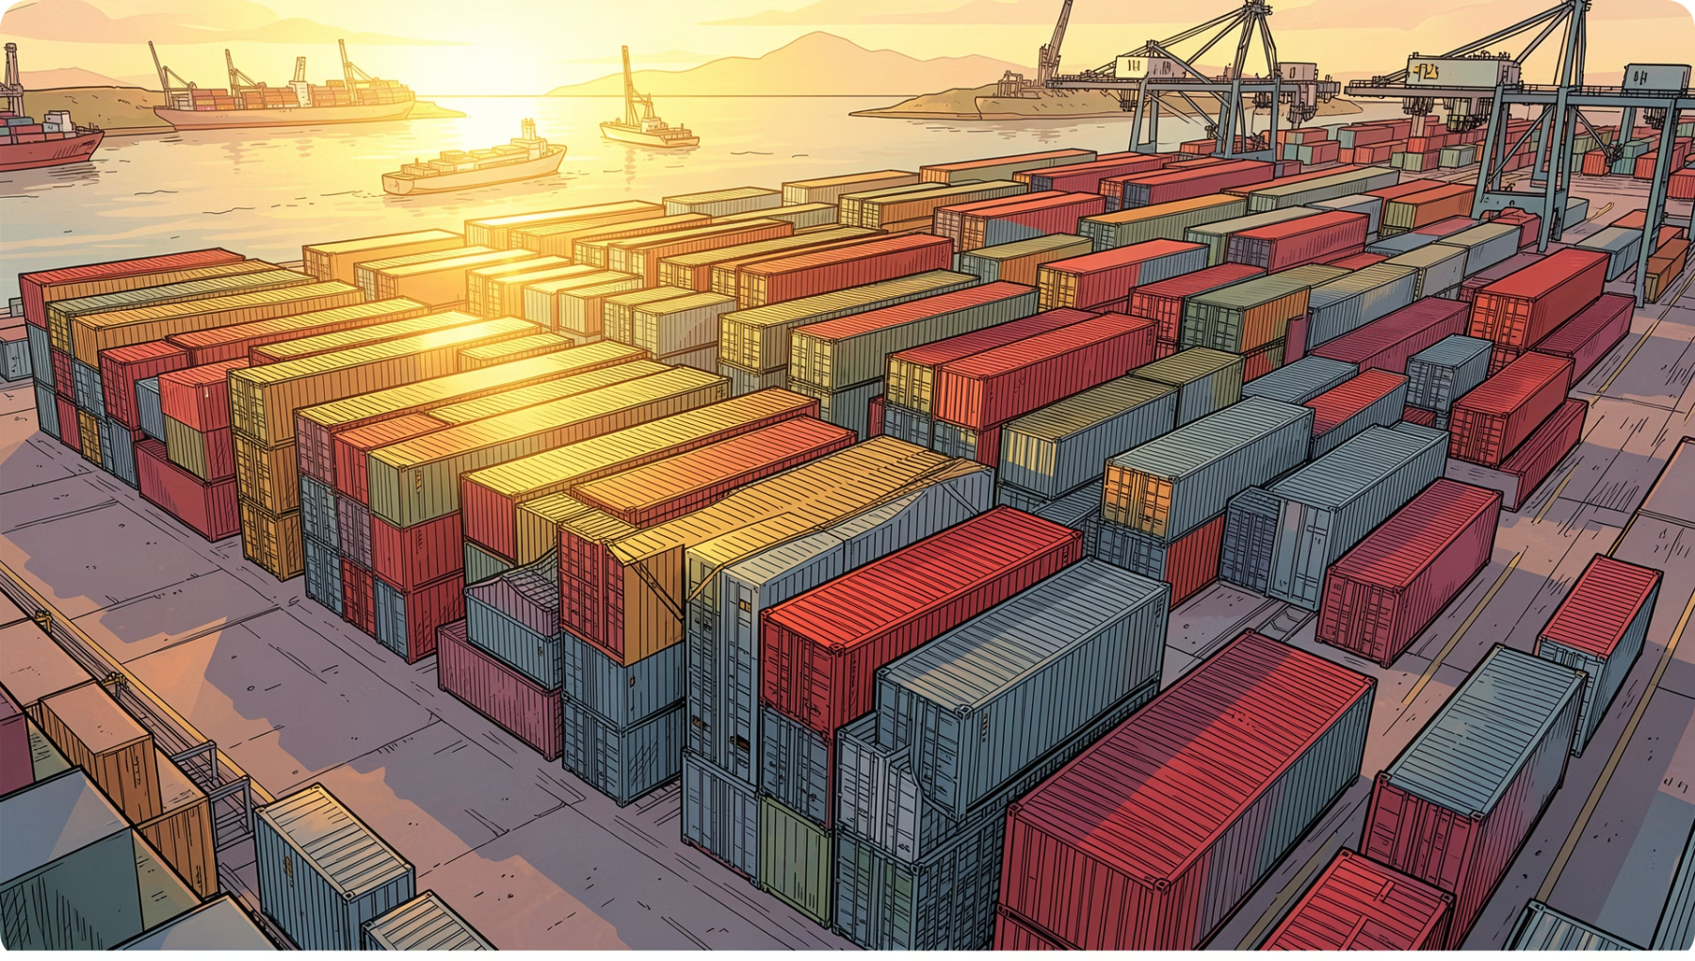
Docker — Containerization
Why Docker?
Docker packages the app with all dependencies — eliminating "works on my machine" problems. Images are portable, lightweight, and consistent across environments.
Backend Dockerfile
FROM node:18-alpine
WORKDIR /app
COPY package*.json ./
RUN npm ci --only=production
COPY . .
EXPOSE 5000
CMD ["node", "server.js"]
Frontend Dockerfile — Multi-Stage
FROM node:18 AS build
...npm run build
FROM nginx:alpine
COPY --from=build /build /usr/share/nginx/html
🎯 Key Takeaway: Multi-stage builds keep images lean — Alpine for backend, Nginx for frontend — reducing attack surface and image size.

Slide 6

Jenkins — CD Pipeline
GitHub Actions triggers Jenkins automatically. Jenkins executes kubectl commands to roll out new versions to Kubernetes — zero manual steps.
📋 Jenkinsfile Stages
Sample Jenkinsfile
1
pipeline {
agent any
stages {
stage('Deploy Backend') {
steps {
sh 'kubectl apply -f backend.yaml'
}
}
stage('Deploy Frontend') {
steps {
sh 'kubectl apply -f frontend.yaml'
}
}
stage('Verify') {
steps {
sh 'kubectl rollout status deployment/backend'
}
}
}
}
Deploy Backend
kubectl apply -f backend.yaml
2
Deploy Frontend
kubectl apply -f frontend.yaml
3
Verify Deployment
kubectl rollout status
🎯 Key Takeaway: Jenkins bridges CI and Kubernetes — orchestrating deployments and verifying rollout success automatically.

Slide 7


Kubernetes — Container Orchestration
My Setup: K3s on AWS EC2
K3s is a lightweight, CNCF-certified Kubernetes — ideal for learning and small-scale production on a single EC2 instance.
Key Features in Use
Self-Healing: Failed pods auto-restart
Scaling: 2 replicas per deployment
Rolling Updates: Zero-downtime deploys
Manifests: namespace.yaml, backend.yaml, frontend.yaml, mongodb.yaml
Verify with kubectl
kubectl get pods -n nexnote
kubectl get deployments -n nexnote
🎯 Key Takeaway: Kubernetes automates container lifecycle management — healing, scaling, and updating without manual intervention.

Slide 8
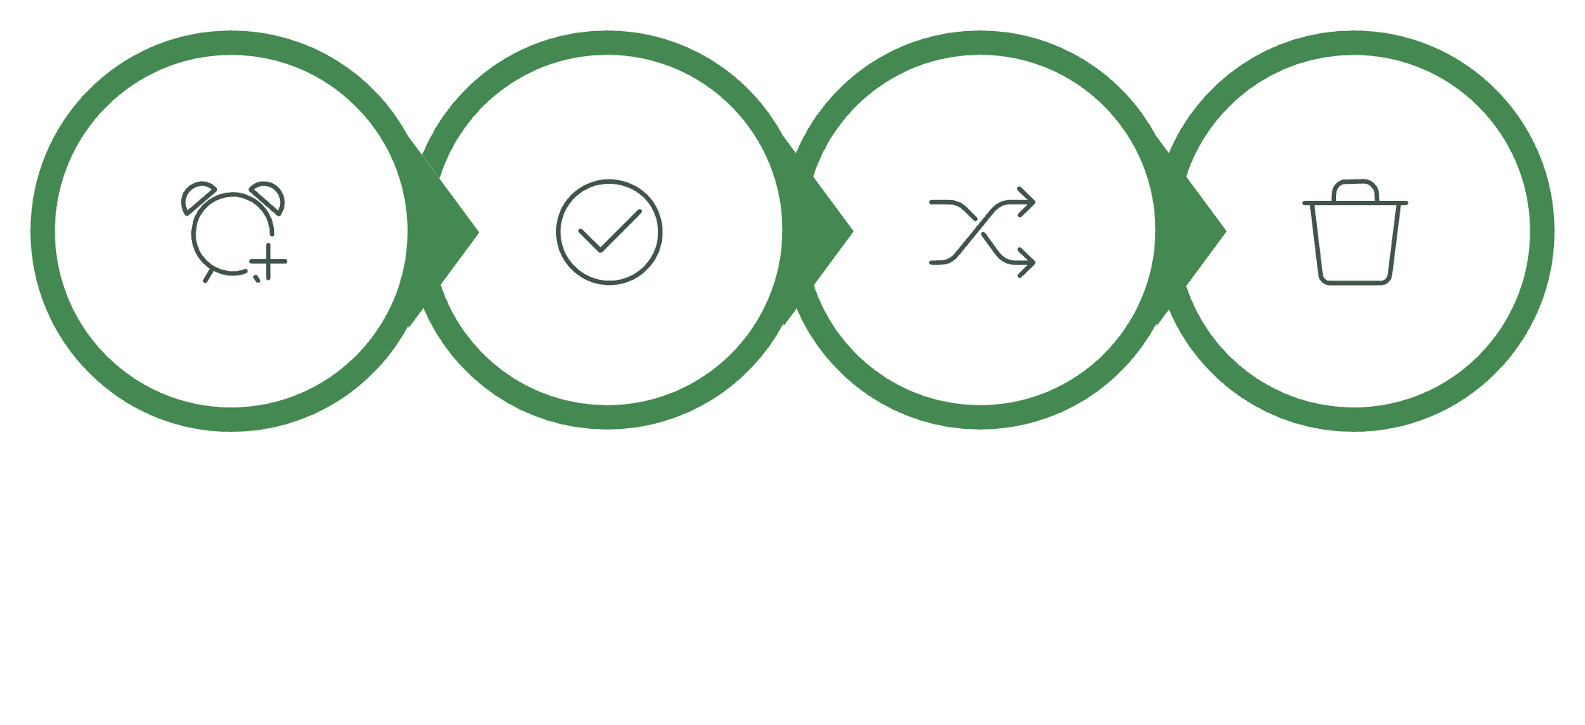

Rolling Update — Zero Downtime Deployment
A rolling update gradually replaces old pods with new ones — users never experience an interruption.
New Pod Created
Ready Probe Passed
Traffic Shifts
Old Pod Terminated
Trigger a Rolling Update
What Happens
New pod starts with updated image
Readiness probe confirms health
Traffic routes to new pod
Old pod gracefully terminates
kubectl set image deployment/backend \
backend=myuser/nexnote-backend:v2
kubectl rollout status deployment/backend
🎯 Key Takeaway: Rolling updates ensure seamless deployments — new pods are ready before old ones are removed.

Slide 9

Monitoring — Prometheus + Grafana
📊 Stack Overview
Sample PromQL Queries
Deployed via kube-prometheus-stack Helm chart — collects metrics from all pods, nodes, and containers.
container_cpu_usage_seconds_total{namespace="nexnote"}
kube_pod_status_phase{namespace="nexnote"}
rate(container_cpu_usage_seconds_total[5m])
6 Custom Grafana Dashboards
Deployment Replicas & Pod Status
Pod Restarts & Running Pods
CPU Usage & Memory Usage
Metrics Collected
Alertmanager
CPU & memory per pod
Pod restart count
Replica availability
Node health status
Triggers alerts on pod failures, high CPU, or restarts.
🎯 Key Takeaway: Prometheus + Grafana provides full observability — catching issues before they become outages.

Slide 10
Results & Conclusion
✅ Complete CI/CD
🚀 Zero Manual Steps
Push → Test → Build → Deploy → Monitor
Fully automated from commit to cluster
⚡ Zero Downtime
📈 Real-Time Alerts
Rolling updates keep the app always live
Prometheus + Grafana + Alertmanager
🔧 Tools Used
🔭 Future Scope
Frontend
React + Nginx
ArgoCD — GitOps-based continuous delivery
Slack Alerts — Real-time failure notifications
Load Testing — k6 for performance validation
Horizontal Pod Autoscaler — Auto-scaling on load
Backend
Node.js + Express
Database
MongoDB
Container
Docker
Orchestration
Kubernetes (K3s)
CI
GitHub Actions
CD
Jenkins
Monitoring
Prometheus + Grafana
🎯 Key Takeaway: NexNote proves that a student project can achieve production-grade DevOps — automated, observable, and resilient.

