Slide 1

Predicting Wine Quality Based on Chemical Properties
Submitted by:
Anjali Velu Ramalingam

Slide 2
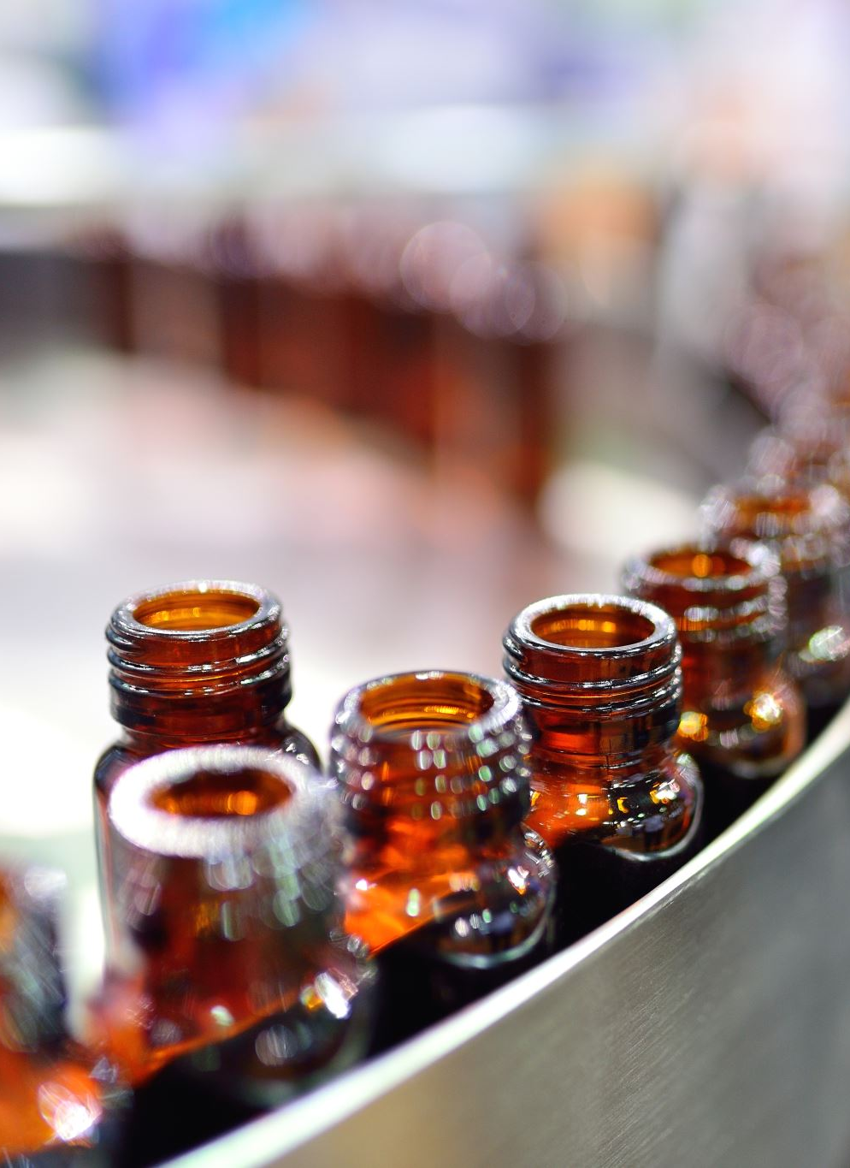
Objective
The goal of this project was to predict wine quality based on its chemical attributes using machine learning models and to derive actionable business insights for a winery.

Slide 3
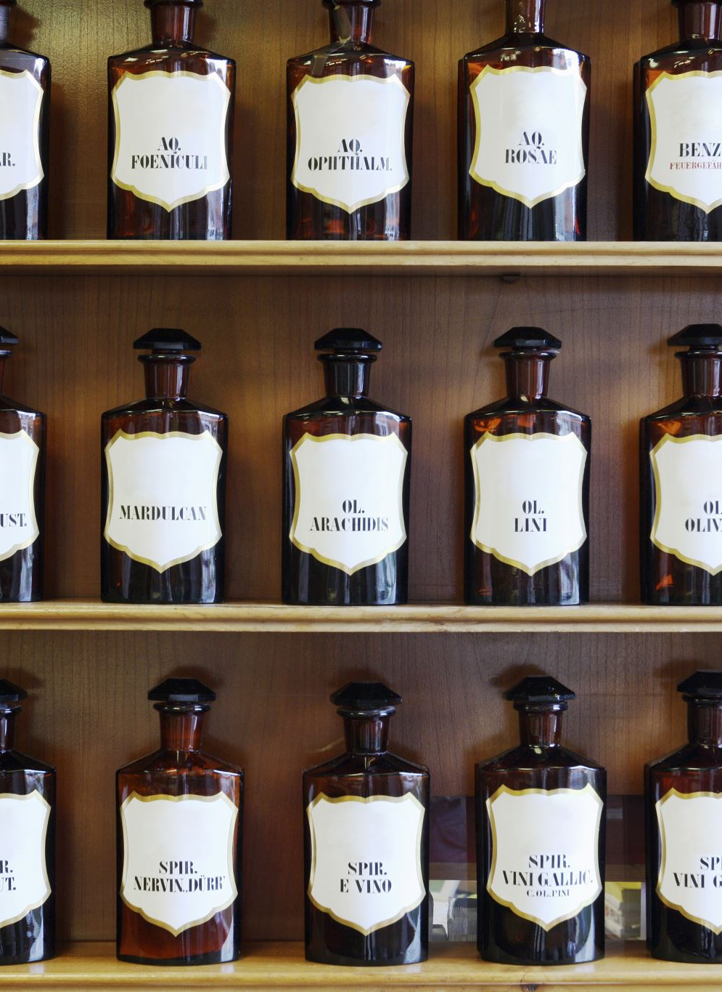
Key Findings
1. Exploratory Data Analysis (EDA)
Dataset Overview:
  1,999 rows, 12 features, and the target variable quality.
  Features such as alcohol, sulphates, and volatile acidity show significant relationships with wine quality.
Insights:
  Higher alcohol content is positively correlated with higher quality ratings.
  Wines with balanced acidity and residual sugar tend to score higher.

Slide 4
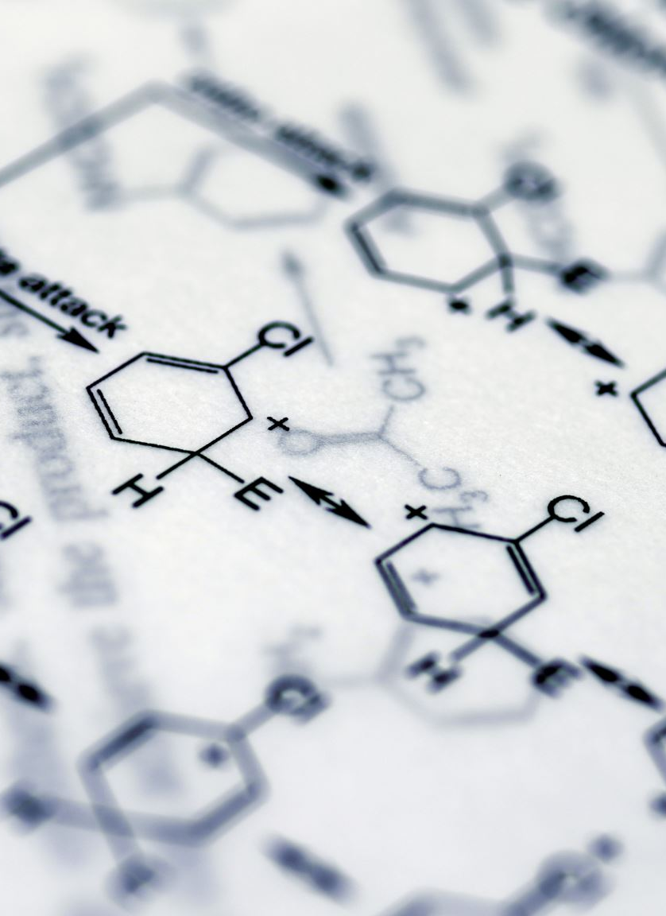
2. Data Preprocessing
Outliers:
  Outliers in residual sugar and volatile acidity were treated using the Interquartile Range (IQR) method.
Scaling:
  Standard Scaler was applied to normalize features like density and alcohol.
Feature Transformation:
  New features, such as sugar_acidity_ratio and sulfur_dioxide_ratio, were created to improve model performance.

Slide 5

3. Feature Engineering
Feature Selection:
  Recursive Feature Elimination (RFE) and Correlation Analysis identified key predictors: alcohol, sulphates, volatile acidity, and density.
Dimensionality Reduction:
  PCA reduced the dataset to principal components, retaining 95% of the variance.

Slide 6

4. Model Building
Classification:
  Model: Random Forest Classifier.
  Performance:
    Accuracy: ~90%.
    Precision, Recall, and F1-Score were high, particularly for the "Medium" quality category.

Slide 7
Regression: Model: Linear Regression.
Performance:
RMSE: 0.65 (on a scale of 0–10).
R² Score: ~75%, indicating a good fit for predicting continuous quality scores.

Slide 8
Clustering:
K-Means:
3 clusters identified based on chemical properties.
Silhouette Score: 0.57.
DBSCAN:
Effective in identifying dense clusters but did not generalize well due to sparsity in data.

Slide 9
5. Business Insights
Key Predictors of Quality:
Alcohol and sulphates were the strongest indicators of higher quality.
Residual sugar and volatile acidity also significantly impacted quality.
Clustering Insights:
Cluster 1: Wines with high acidity and low alcohol, suited for budget-conscious customers.
Cluster 2: Premium wines with balanced sweetness and high alcohol content.

Slide 10
6. Limitations
Imbalanced quality scores (majority of wines rated 5 or 6) may have influenced model performance.
DBSCAN clustering struggled with sparse clusters due to dataset size and feature distribution.

Slide 11
7. Future Work
Use advanced feature selection techniques to improve predictive accuracy further.
1
Collect more diverse data to balance the distribution of quality ratings.
2
Explore ensemble clustering methods for better segmentation.
3

Slide 12
Recommendations
Production Adjustments:
Increase alcohol levels and control acidity for higher quality wines.
Marketing Strategies:
Highlight Cluster 2 wines as premium options.
Promote Cluster 1 wines as refreshing, everyday options.
Quality Control:
Focus on monitoring alcohol and sulphates during production.

Slide 13

Thank You

