Slide 1

Faasos Food Delivery Analysis
Presented by: Anjali K.
Last Updated : 8th July 2025

Slide 2
Objective :
To assess order patterns, delivery performance, and customer behavior for January 2021, with the aim of improving delivery reliability, retention, and peak-time operations.

Slide 3
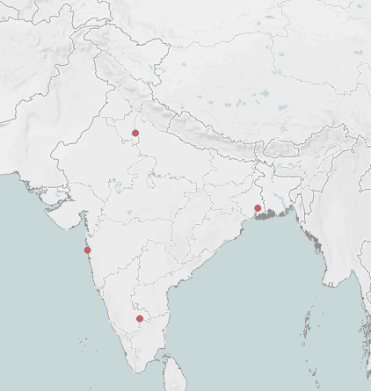
Data Overview:
The food delivery business operates across five major Indian cities: Bangalore, Delhi, Kolkata, Mumbai, and New Delhi.
The data has been analyzed for one month, from January 1 to January 31, 2021, capturing the store’s operations during this period.
This analysis provides key insights into order patterns, delivery performance, and customer behavior in the first month of recorded operations.

Slide 4
High cancellation rate (29%) suggests operational inefficiencies — due to long wait times, unassigned drivers, or customer impatience.
A notable share of cancellations happened before driver assignment or due to delayed delivery times (30–41 minutes), indicating room for improvement in order processing and dispatch speed.
Customer cancellations are more frequent in Bangalore & Mumbai hinting at geographic or logistical challenges specific to these areas.
The best-selling rolls during the period were the Non-Veg Roll with 25 orders, followed by the Veg Roll with 18 orders, and the Paneer Roll with 13 orders.
Notes:
High Shipped but Low Delivered: Shipped orders (10,127) exceed delivered (9,874), which means ~250 orders are stuck in transit, returned-to-origin (RTO), or undelivered.
Choose Reliable Delivery Partners
-Partner with well-rated --logistics providers that specialize in your regions.
-Let customers choose between standard, express, or scheduled delivery slots — improves convenience and reduces refusal-at-door.
About 9,890 orders are still marked as Processing fulfillment times might be slow. Stock popular products closer to high-demand regions to reduce shipping time.

Slide 5
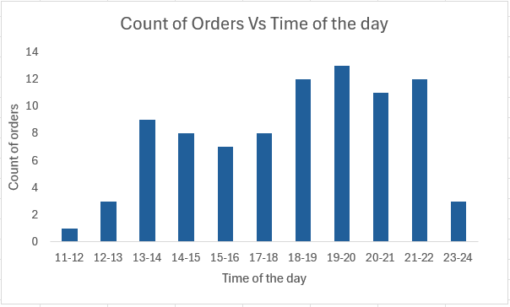
Orders peak during lunch (12–2 PM) and evening (6–10 PM), with highest activity between 1–2 PM and 4–10 PM.
Order volumes are highest on Fridays and Saturdays, and lowest on Mondays.
Increasing driver availability during these peak hours to reduce delays. Introducing lunch specials and late-night deals to capitalize on demand.
We can add more staff and consider extending operating hours on weekends to handle increased demand. We can use Mondays for staff training and run special promotions to stimulate sales.

Slide 6
Drivers take an average of ~10 minutes to reach HQ, with top performers (IDs: 22, 13, 2, 1, 9) and underperformers (IDs: 23, 21) identified.
We can review route familiarity and readiness of low-performing drivers to reduce delays and recognize and incentivize top performers to maintain high efficiency.
Driver success rates showed significant variation between individuals. Drivers with high success rates can be rewarded and retained to encourage consistent performance.
Drivers with lower success rates should be supported through proper training or coaching.
Notes:
Absence of structured loyalty programs or consistent follow-up limits repeat engagement.
Limited emotional connection with the brand and low brand recall among customers.
Collect and act on customer feedback — show customers their opinions matter.
Stay in touch with email, SMS, or WhatsApp campaigns — keep the brand top-of-mind.
**Surprise customers with exclusive previews, birthday offers, or freebies.
*** Build a community around the brand — engage via social media, contests, and content.

Slide 7
CONCLUSION

Slide 8
Conclusion
1
2
3
Nearly 29% of orders were cancelled, with many cancellations occurring before driver assignment or due to long wait times (30–41 minutes). This points to inefficiencies in order processing and dispatch that need urgent attention.
Order volumes peaked during lunch and evening hours, especially on Fridays and Saturdays
Driver performance varied significantly across the team.
Top performers should be rewarded to encourage consistency.
Underperformers need focused training to improve delivery speed.
Notes:
---Improving product quality, descriptions, and introducing loyalty programs are essential.
--Marketing efforts and inventory planning should prioritize these profitable segments while also exploring opportunities with younger audiences through trend-driven, affordable products.
--Strengthening logistics, after-sales support, and proactive customer engagement will reduce cancellations and improve satisfaction.

Slide 9
Appendix:
High Cancellation Rate Due to Operational Delays: Nearly 29% of orders were cancelled, with many cancellations occurring before driver assignment or due to long wait times (30–41 minutes). This points to inefficiencies in order processing and dispatch that need urgent attention.
Time and Geography Affect Performance: Order volumes peaked during lunch and evening hours, especially on Fridays and Saturdays. Bangalore and Mumbai had higher cancellation rates, indicating location-specific challenges in logistics or staffing that must be addressed for smoother operations.
Driver Performance is Uneven and Impacts Delivery Efficiency: Driver efficiency varied greatly, with some drivers consistently underperforming. Top performers should be rewarded to boost morale, while low performers need targeted training to reduce delays and improve customer satisfaction.

Slide 10
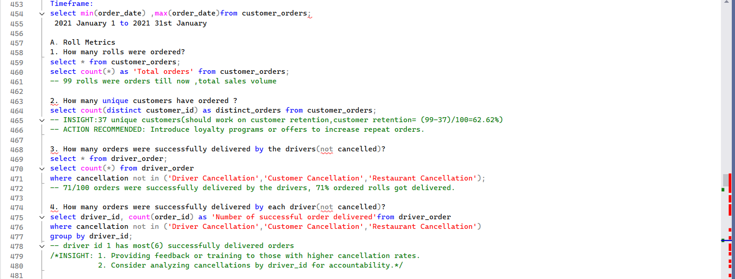
SQL Queries used to for data analysis in Microsoft SQL Server

Slide 11
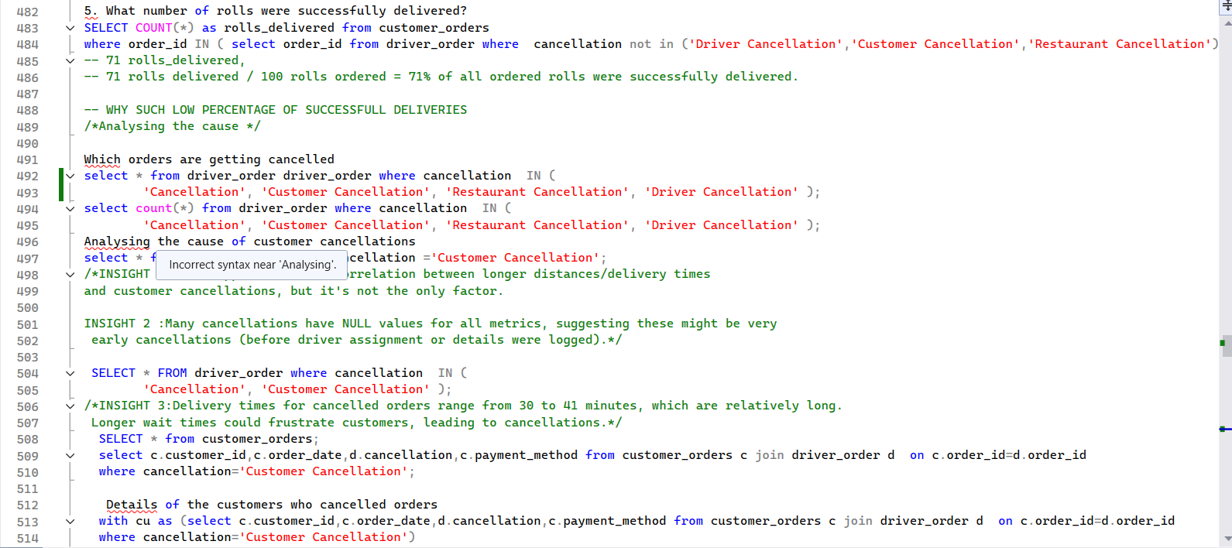

Slide 12
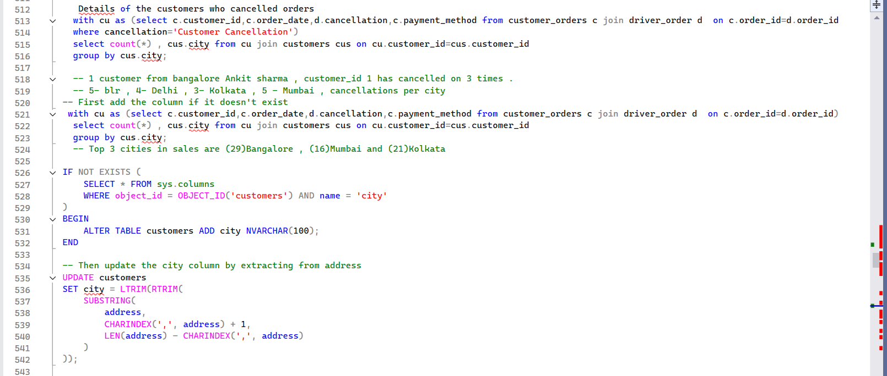

Slide 13
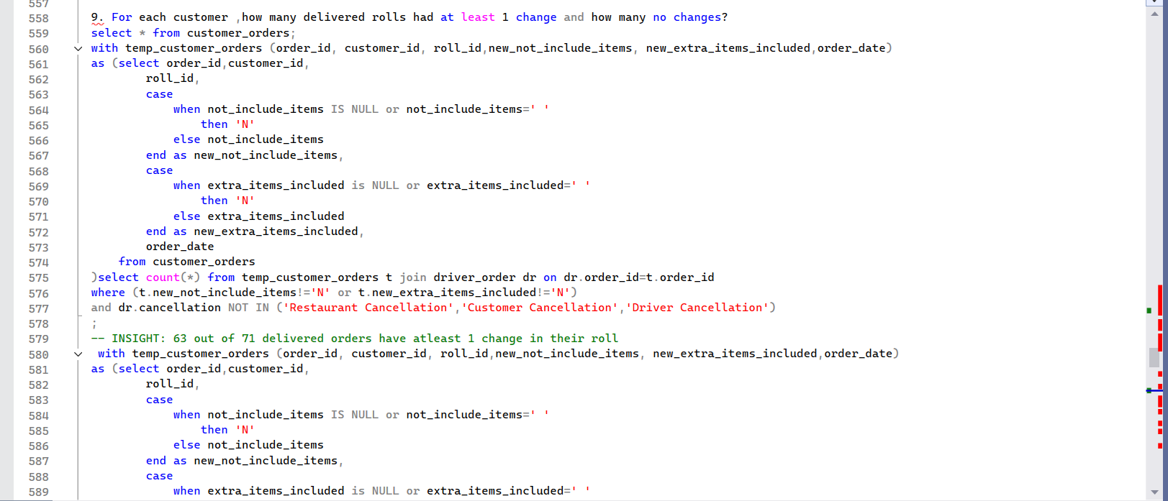

Slide 14
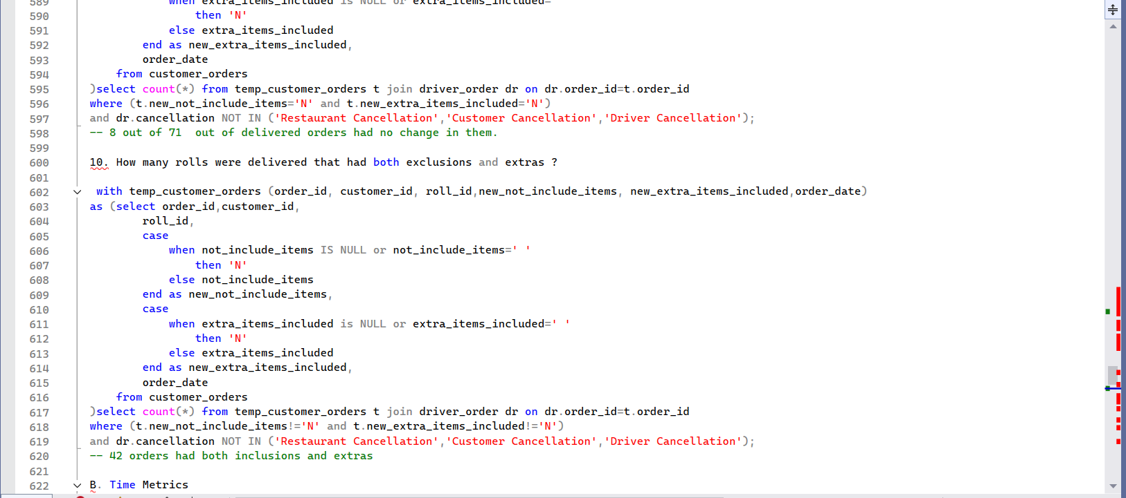

Slide 15
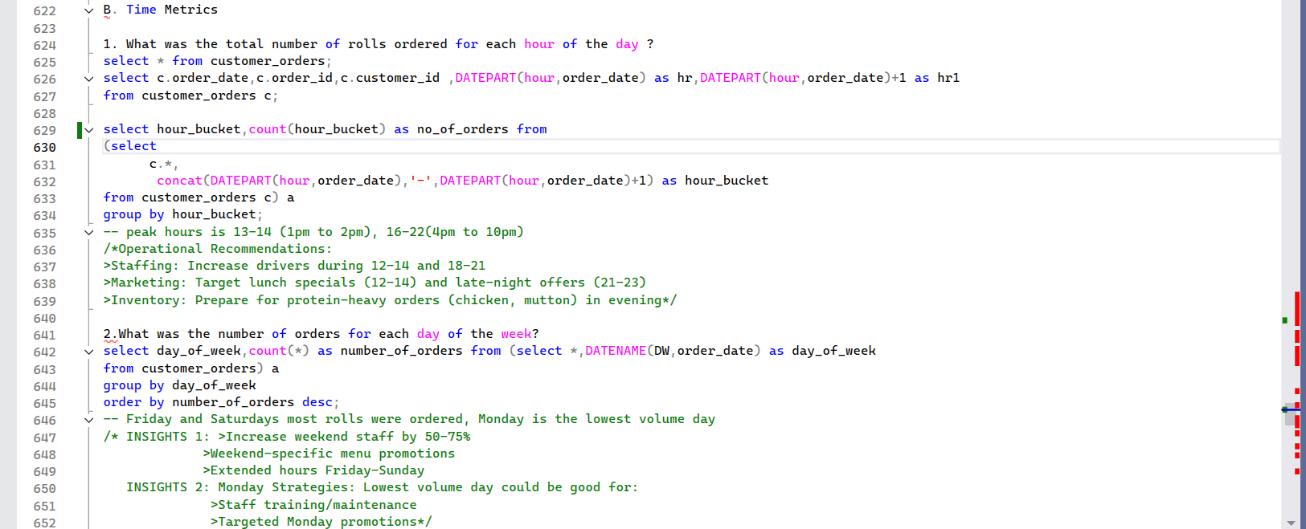

Slide 16
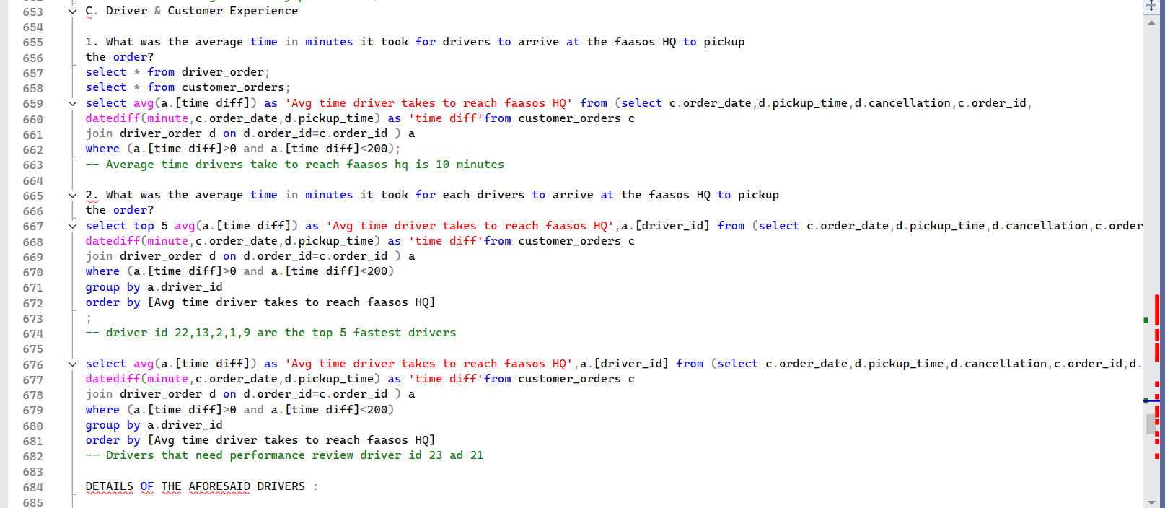

Slide 17
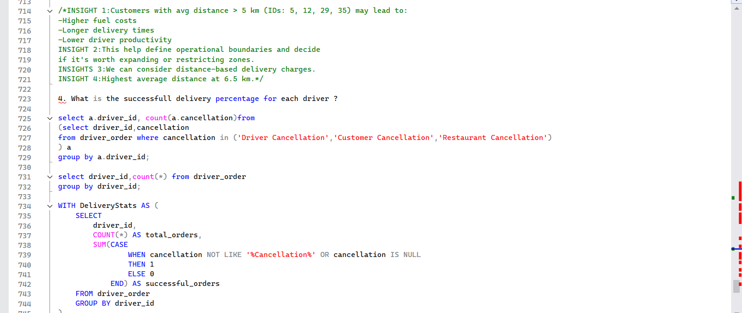

Slide 18
