Slide 1

PATIENT BILLING SOFTWARE
Project By: Manvendra Dattatrey, Reena Yadav, Shubhi Agarwal, Anjali Pandey, Anushree Goswami
Faculty: Dr. Ranjana Vyas
Mentor: Atul Yadav

Slide 2
ABOUT PROJECT
This project is aimed at developing a Patient Billing Software system that is of importance to a hospital. This system can be used to maintain the location (bed no.) of each patient either in the ward or the ICU. Information about the patient and the charges to be paid is also stored.
Existing patient information is already stored in the database. Any new patient information can be stored in the database(MySql) via a patient information input screen.

Slide 3
What do we need?
Software:
Netbeans
My Sql
Microsoft PowerPoint

Slide 4
UML Diagrams
Class Diagram

Slide 5
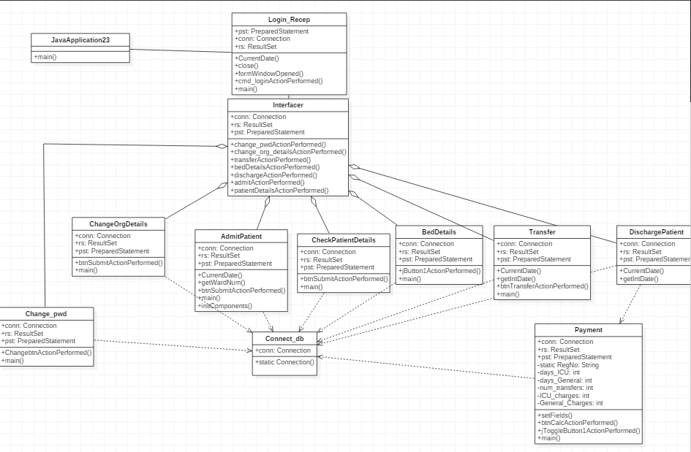

Slide 6
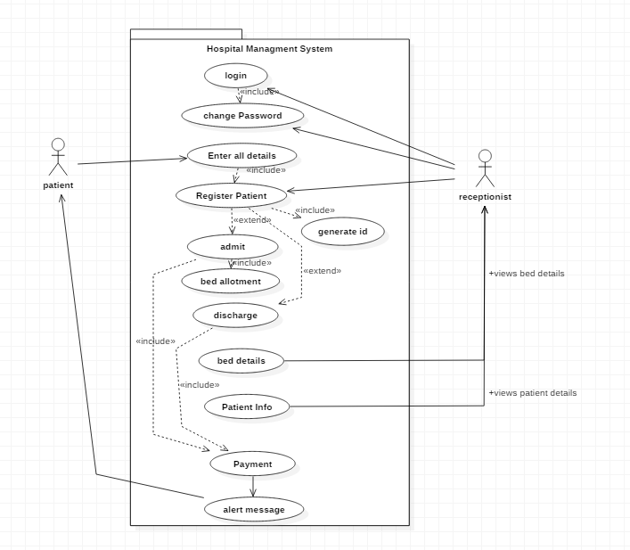
UML Diagrams
Use Case Diagram

Slide 7
UML Diagrams
Activity Diagram

Slide 8
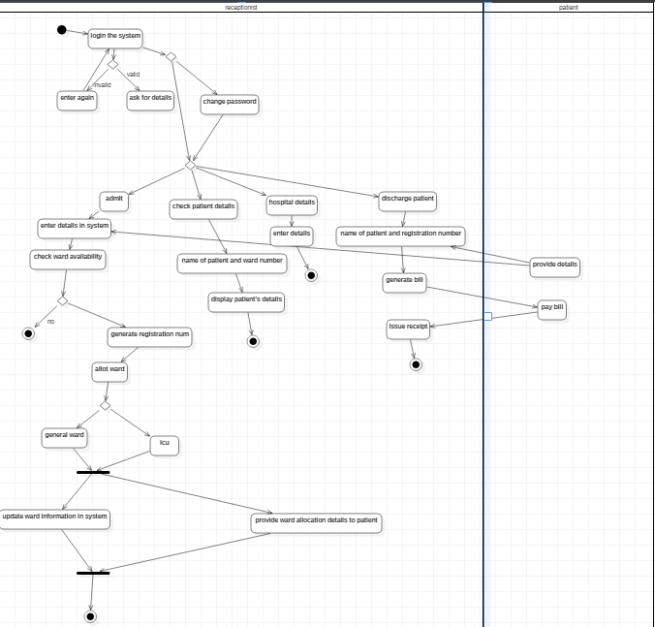

Slide 9
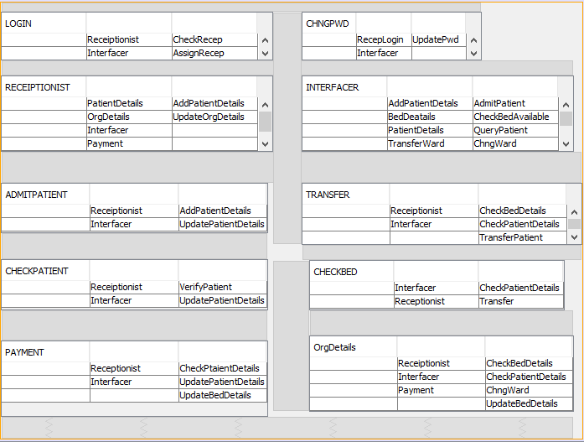
UML Diagrams
CRC Diagram

Slide 10
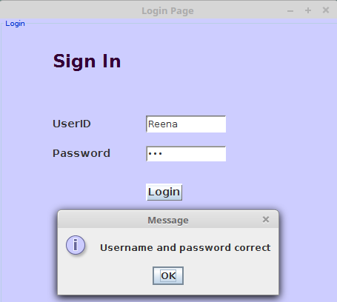
GUI Frames
1. Login: Enter credentials of Receptionist.
User ID
Password

Slide 11
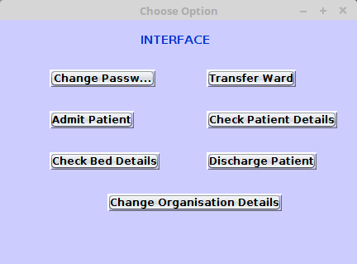
GUI Frames
2. Interfacer: An Interface to all other frames.
Change Password
Change Organization Details
Admit Patient
Check Patient Details
Check Bed Details
Transfer Ward
Discharge Patient

Slide 12
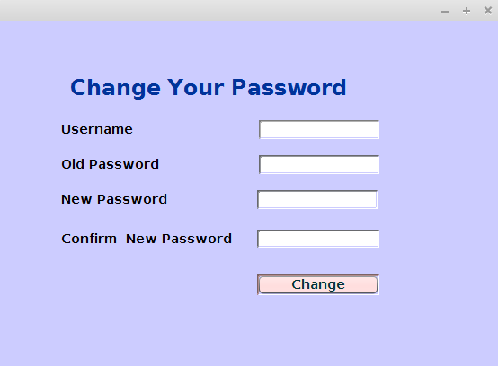
GUI Frames
3. Change Password: Change Password for Receptionist.
Username
Old Password
New Password
Confirm New Password

Slide 13
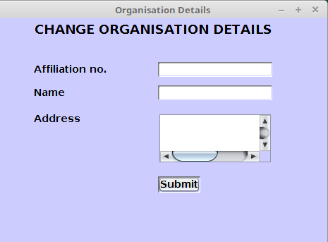
GUI Frames
4. Change Organisation Details: Enter the Hosptial details.
Affiliation No.
Hospital Name
Address

Slide 14
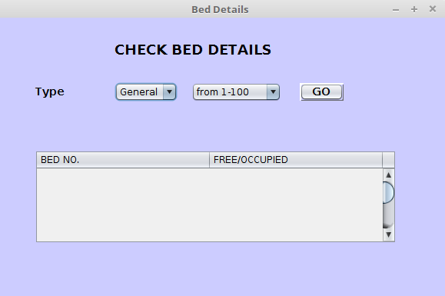
GUI Frames
5. Check Bed Details: Check Availability of Beds.
User ID
Password

Slide 15
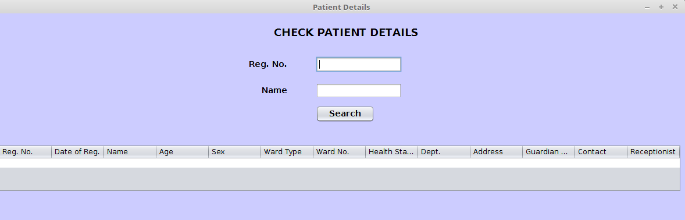
GUI Frames
6. Check Patient Details: Check details of admitted Patients.
Registration No.
Patient Name
Tabular form of Patient Details

Slide 16
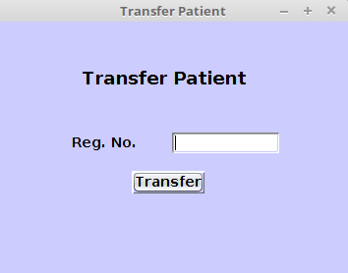
GUI Frames
7. Transfer Patient: Transfer Patient from one ward to other.
Registration No.

Slide 17
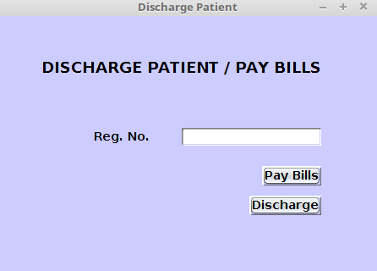
GUI Frames
8. Discharge Patient: Pay the bill and discharge the Patient.
Pay bill
Discharge

Slide 18
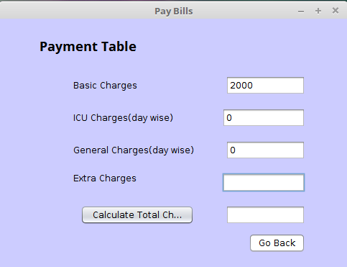
GUI Frames
9. Payment Details: Pay the bill.
Basic Charges
ICU Charges
General Charges
Extra Charges

Slide 19
Objectives Achieved
Software can Perform following tasks:
Login to the system through the first page of the application.
Change the password after logging into the system.
Enter / edit the organization code and address.
Enter the ward number for the patient either in the General ward or the ICU.
Settle all bills pending to be paid by a patient before the patient’s discharge.
Keep a track of all beds occupied / free in both the ward and the ICU.
Keep a track of all transfers of patients from the General ward to the ICU and vice versa.
View information of all patients details, their admit time and the amount to be paid based on the treatment given and the ward selected.
Update the table fields (patient details, the amount to be paid / any balance remaining, the ward number, the bed number, the registration number, case number, etc.) as soon as a new patient is being admitted into the hospital or being discharged from the hospital.

Slide 20
Thank You

