Slide 1
Data Base Management System
By
Dr. Ranjana Vyas
DAAD Fellow (Technical Uni. Kaiserlautern - Germany)
Indian Institute of Information Technology, Allahabad

Slide 2
Database Management System:Contents
Data – Information – Knowledge
Chronology: Data & Knowledge Engineering
DBMS Definition & Application
Why DBMS ?
  Developing Information Systems
  Transaction Management
  DBMS Types & users
DBMS languages
  DDL Vs. DML
DBMS Architecture
  Client-server based
  Web-based architecture
DBMS Implementation
  Data Modeling
    E-R Diagram
    From diagram to Tables
  Data Base design
  Data Querying: Concepts & Constructs
  Query / Report format design, development.
Recent trends in DBMS
Notes:
Ranjana vyas

Slide 3
Our Approach….
Conceptual understanding & then Implementation...
  Case Study & Modeling discussions
    Assignments, Group presentations
  Practical on SQL, PL/SQL on Oracle
  Database Designing: Concepts & Tests
  Mini-project using DBMS & GUI
  Recent Trends in DBMS:NoRel-MongoDB
Reference Material:
  Database system concepts by Abraham Silberschatz ; Henry F. Korth ; S. Sudarshan
  Fundamentals of Database Systems by Elmasri, Ramez; Navathe, Shamkant B.
  Book on SQL / Oracle : Complete Reference
Before Mid-Sem
After Mid-Sem
Notes:
Ranjana vyas

Slide 4
Continuous Evaluation…
As a part of continuous evaluation policy of semester system, Quiz can be organized in any of the Lecture schedule, without prior information.
Quiz marks will be part of your final evaluation.
Best of three Quizzes will be considered for final award

Slide 5
“ We are pouring in data but starving in Knowledge ”
Jiawei Han

Slide 6
DBMS : Data, Information, Knowledge
Computer processing requires data, which is a collection of raw facts, figures and symbols, such as numbers, words, images, video and sound, given to the computer during the input phase.
Computer processes the data to create Information which is data that is organized, meaningful, and useful.
During the output Phase, the information that has been created is put into some form, such as a printed report.
  A DBMS processes the data & provide information.
Knowledge is not simply the information presented, but is information further processed with intelligent mechanism incorporating experience, domain knowledge and specialized techniques.
To generate (business) insight / strategy based on the Knowledge acquired from IT based systems. KDD ( Knowledge Discovery in Database) is an significant concept related to data mining and business intelligence.

Slide 7
Data Engineering-Chronological Development
Evolutionary steps | Business query | Enabling technologies | Product vendors | Characteristics
Data Collection (1960s) | “ What was my total revenue in the last five years” | Computers, tapes, disks | IBM | Retrospective, static data delivery
Data access (1980s) | “ What were A.C unit sales in New England last March? | Relational Databases, SQL, ODBC | Oracle, Sybase, Informix, IBM,Microsoft | Retrospective dynamic data delivery at record level.
Data Warehousing & Decision support systems1990s) | “ What were A.C.unit sales in New England last March? Drill down to Boston.” | OLAP, Multi -dimensional databases, DW | Pilot, Comshare, Arbor,Cognos, Microstrategy. | Retrospective, dynamic data delivery at multiple levels.
Data Mining (Emerging ) | “What’s likely to happen to Boston’s A.C.unit sales next month? Why ? | Advanced algorithms, multiprocessor computers, massive databases. | Pilot, Lockheed, IBM, SGI, Mineset etc. | Prospective, proactive information delivery.
Big Data Analytics (Emerging | “What’s best strategy to Win US Presidential Election ? Barack Obama won in 2012 ? | Distributed File System-MapReduce and Hadoop | Seisint Inc. (now LexisNexis Group), Google. | Prospective, proactive information delivery for 3Vs of Data-Volume, Velocity, Variety
Notes:
Ranjana vyas

Slide 8
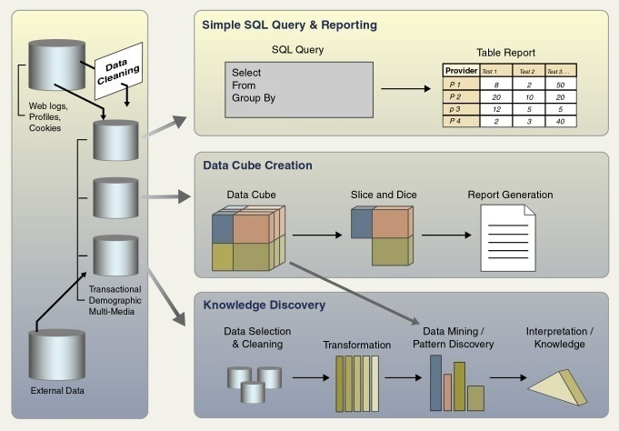
Data Engineering Systems

Slide 9
Database Management System (DBMS)
Data Base - Collection of interrelated data
DBMS is designed to manage large bodies of data, contains information about a particular enterprise.
DBMS - Set of programs to access the data.
DBMS provides an environment that is both convenient and efficient to use.
Database Applications:
  Banking: all transactions uses DBMS
  Railways: reservations, train-schedules (first database in a geographical distributed)
  Universities: registration, grades
  Sales: customers, products, purchases
  Manufacturing: production, inventory, orders, supply chain
  Human resources: employee records, salaries, tax deductions
  Accessing Data through Mobile phones via Internet…
Databases touch all aspects of our lives.
Notes:
Ranjana vyas

Slide 10
Database Management system
Purpose of Database Systems: Developing Information system
Data Models
  DBMS Languages : Procedural Language Vs Non-procedural Language
  SQL & PL SQL
Transaction Management & Storage Management
Database Administrator
Database Users
Overall System Structure
Notes:
Ranjana vyas

Slide 11
Developing Information systems
The purpose of a implementing a database system in any organization is to develop an effective Information System in the organization.
What is information system?
Information system is an “computerization of some existing manual /system which after automation provides useful information to the targeted user.
One of the most popular example of an information system is computerization of “Railway Reservation Systems”
Developed by “CRIS” [Centre for Railways Information Systems] Is providing very valuable information like
1.Availability of trains between two stations .
2. Availability of Tickets in a particular Train, on particular date etc.
3. Booking a Ticket online.
Being used as Web based system it is sound implementation of DBMS !
Notes:
Ranjana vyas

Slide 12
DBMS & Information systems
Did we ever bother to see how this computerization of railways reservation system would have first conceived, designed, developed and implemented.
Database designing is important step for developing such a system ,
Same is true for developing a business information system for a big corporate house like Hindustan Lever , Godrej, Reliance group of companies etc.
Database system has evolved a “systematic mechanism for this aspect of developing information system and the very initial step is called “Modeling ”
Notes:
Ranjana vyas

Slide 13
Purpose of Database Systems
In the early days, database applications were built directly on top of file systems using any programming language…..
  Using C / C++ and its files for storing data
Transaction Management is typical example which highlights the significance of a DBMS.
  In case of transferring funds from one bank A/C to other if System failure occurs !
  This failure may occur at any stage & the system failures (e.g., power failures, operating system crashes) will result not only as a transaction failure but may be in serious inconsistencies in database.
  Money withdrawn from one Account ( and network fails) so not received in the Other A/C. !
  Also in concurrent transactions how to ensure the consistency of the database.
And many other problems….

Slide 14
Purpose of Database Systems
Drawbacks of using file systems to store data:
  Data redundancy and inconsistency
    Multiple file formats, duplication of information in different files
  Difficulty in accessing data
    Need to write a new program to carry out each new task
  Data isolation — multiple files and formats
  Integrity problems
    Integrity constraints (e.g. account balance >0 ) become “buried” in program code rather than being stated explicitly
    Hard to add new constraints or change existing ones

Slide 15
Purpose of Database Systems (Cont.)
Drawbacks of using file systems (cont.)
  Atomicity of updates
    Failures may leave database in an inconsistent state with partial updates carried out
    Example: Transfer of funds from one account to another should either complete or not happen at all
  Concurrent access by multiple users
    Concurrent accessed needed for performance
    Uncontrolled concurrent accesses can lead to inconsistencies
      Example: Two people reading a balance and updating it at the same time
  Security problems
    Hard to provide user access to some, but not all, data
Database Management systems offer solutions to all the above problems

Slide 16
DBMS Implementation
Querying the DBMS
DBMS Architecture
DBMS Front End - Back End
DBMS Query Languages: Procedural Vs Non-Procedural

Slide 17
Database implementation
Date Base Modeling:
  E-R Modeling : Purpose.
    E-R model for Banking Enterprise, Car Insurance Company
Date Base Design: 03 Phases
Conversion of ER model into Table
    Table Creation
Data Base Languages & Querying
  Relation Algebra
  Query Language : Procedural & Non-procedural
  DDL, DML
Notes:
Ranjana vyas

Slide 18
Data Base Management System
Users
        Ordinary Users interact
        with DBMS via Menu in Front-End
        Application like Visual Basic.
        Whereas Sophisticated Users
        & Database administrator
        interacts with DBMS
        via SQL interface or directly
        with Oracle / MS SQL Server / IBM DB-2
Front-end
Database
Application
DBMS
Database
Notes:
Ranjana vyas

Slide 19
Database Architecture
The architecture of a database systems is greatly influenced by the underlying computer system on which the database is running:
Centralized
Client-server
Parallel (multiple processors and disks)
Distributed
Data Base Application Architecture can be categorized as
Two-Tier and Three Tier Architecture

Slide 20
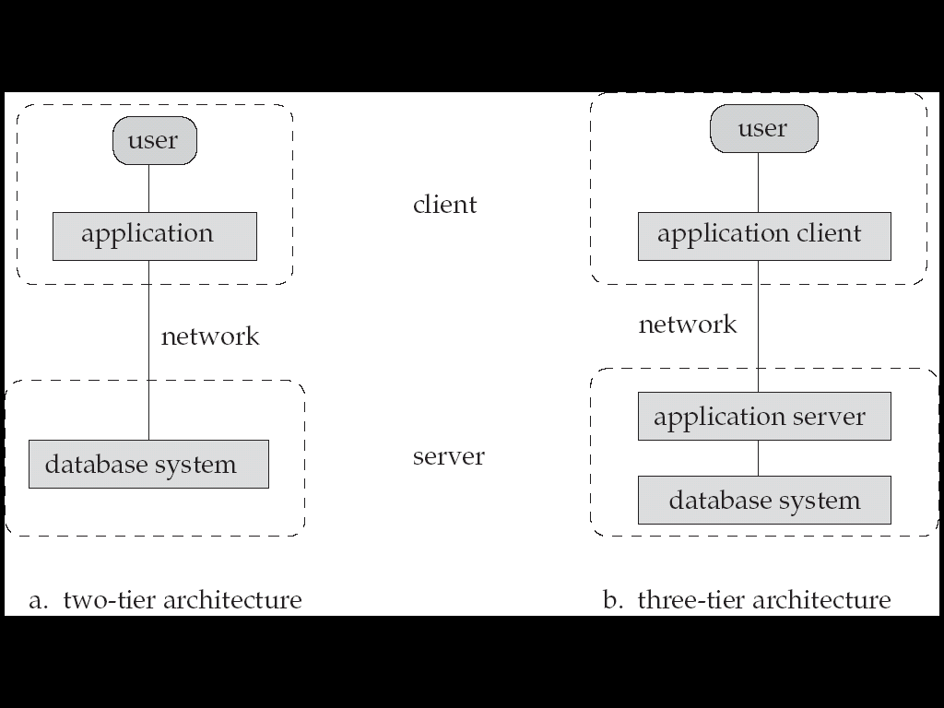
Database Application Architectures
(web browser)
Old
Modern
Two-tier architecture: E.g. client programs using ODBC/JDBC to
communicate with a database
Three-tier architecture: E.g. web-based applications, and applications built using “middleware”

Slide 21
Web Interfaces to Databases
Web has become an important Front End to databases for large number of application categories.
Most database users do not use a query language like SQL. But following are used for interacting with Database;
  Forms - for submitting user input and
  Graphical user interfaces - for submitting user input
  Report generators for receiving output
Web interfaces involves use of Web technology ( HTML, Scripting languages etc) for interacting with databases.
Many interfaces are Web-based and large number of them uses Java based technologies

Slide 22
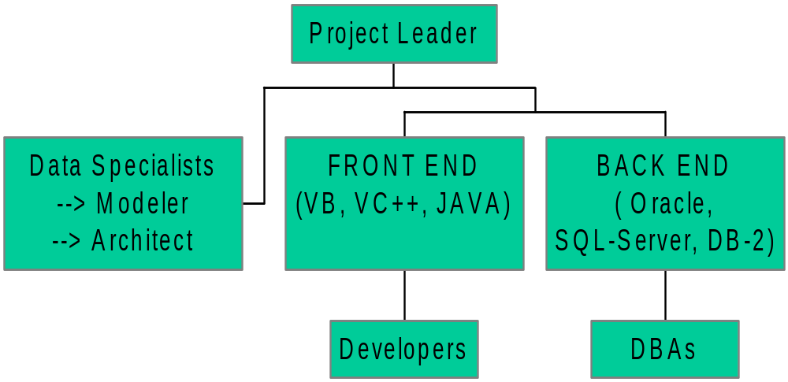
DBMS Team
Notes:
Ranjana vyas

Slide 23
Week # 2
DBMS Users & DBMS Structure

Slide 24
Database Users
Users are differentiated by the way they expect to interact with the system
Application programmers – interact with system through DML calls
Sophisticated users –give requests in a database query language
Specialized users – write specialized database applications that do not fit into the traditional data processing framework
Naive users – invoke one of the permanent application programs that have been written previously
  E.g. people accessing database over the web, bank tellers, clerical staff
Notes:
Ranjana vyas

Slide 25

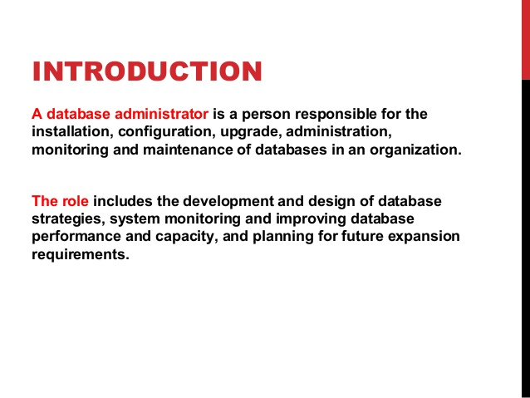
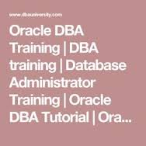

Slide 26
Database Administrator
Coordinates all the activities of the database system;
The database administrator has a good understanding of the enterprise’s information resources and needs.
Database administrator's duties include:
  Schema definition
  Storage structure and access method definition
  Schema and physical organization modification
  Granting user authority to access the database
  Specifying integrity constraints
  Monitoring performance and responding to changes in requirements
Notes:
Ranjana vyas

Slide 27
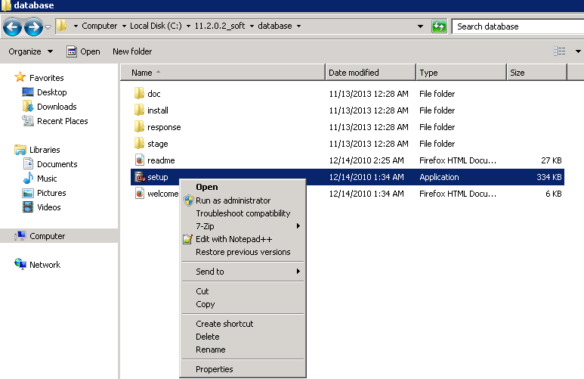

Slide 28

Data base User categories & Architecture

Slide 29
View of Data
A database system is a collection of interrelated files and a set of programs that allow users to access and modify these files. A major purpose of a database system is to provide users with an abstract view of the data. That is, the system hides certain details of how the data are stored and maintained.
  Physical level.
  Logical level
  View level

Slide 30
Physical level:-The lowest level of abstraction describes how the data are actually stored. The physical level describes complex low-level data structures in detail.
Logical level:-The next-higher level of abstraction describes what data are stored in the database, and what relationships exist among those data.
The logical level thus describes the entire database in terms of a small number of relatively simple structures.
Database administrators, who must decide what information to keep in the database, use the logical level of abstraction.

Slide 31
View level. The highest level of abstraction describes only part of the entire database.
  Even though the logical level uses simpler structures, complexity remains because of the variety of information stored in a large database.
  Many users of the database system do not need all this information; instead, they need to access only a part of the database. The view level of abstraction exists to simplify their interaction with the system. The system may provide many views for the same database.

Slide 32
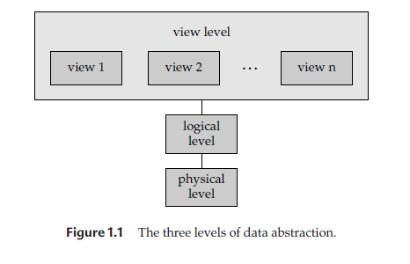
Only part of the entire database
describes the entire database
The lowest level of abstraction describes how the data are actually stored.

Slide 33
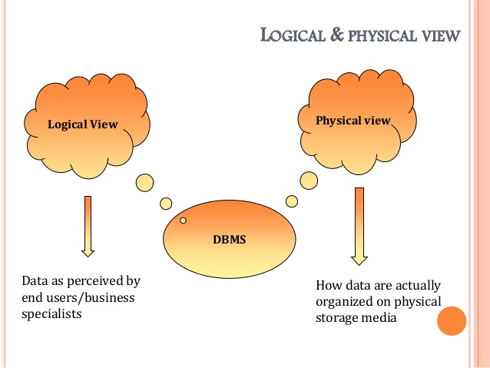

Slide 34
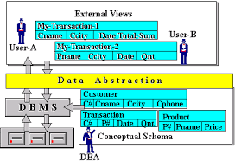

Slide 35
Instances and Schemas
Databases change over time as information is inserted and deleted.
  The collection of information stored in the database at a particular moment is called an instance of the database.
  The overall design of the database is called the database schema.
Schemas :
  Changed infrequently, if at all. The concept of database schemas and instances can be understood by analogy to a program written in a programming language.
  A database schema corresponds to the variable declarations (along with associated type definitions) in a program.
  Each variable has a particular value at a given instant. The values of the variables in a program at a point in time correspond to an instance of a database schema.

Slide 36
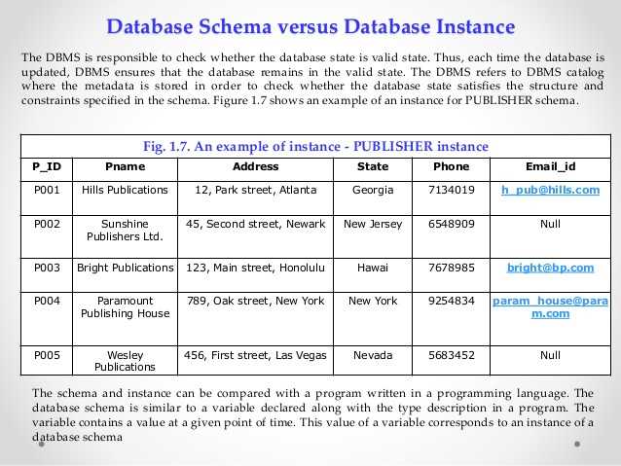
Database changes over time when information is inserted or deleted.
The collection of information stored in the database at a particular moment is called an instance of the database.
The overall design of the database is called the database schema.

Slide 37
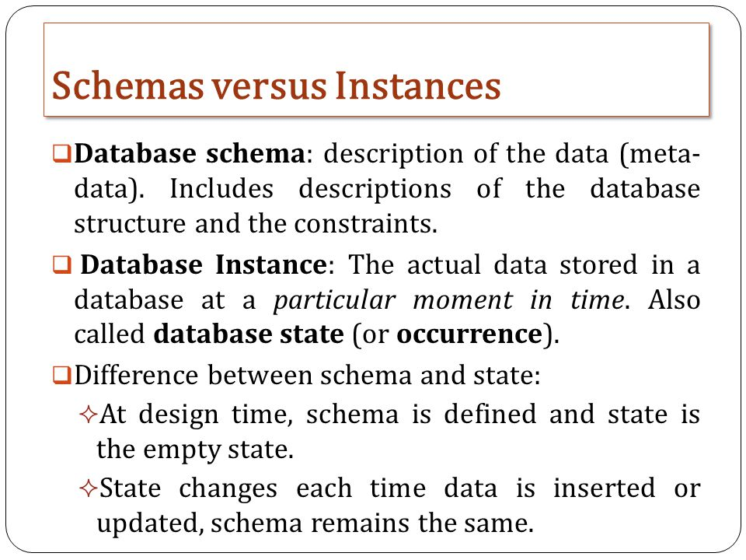

Slide 38
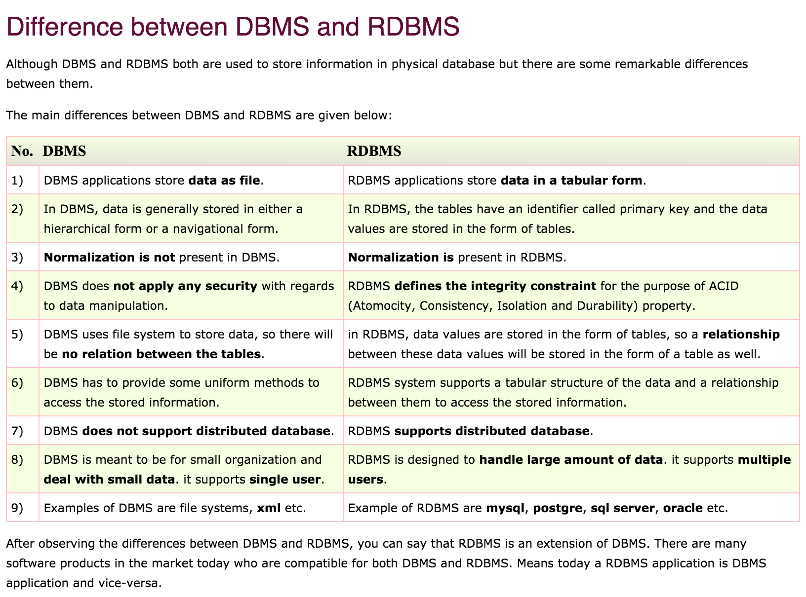

Slide 39
What is a Transaction
A transaction is an event which occurs on the database.
Transaction reads a value from the database or writes a value to the database.
Transaction can both read and write on the database, there are some fundamental differences between these two classes of operations.
A read operation does not change the image of the database in any way.
But a write operation, whether performed with the intention of inserting, updating or deleting data from the database, changes the image of the database. That is, we may say that these transactions bring the database from an image which
existed before the transaction occurred (called the Before Image or BFIM) to an image which exists after the transaction occurred (called the After Image or AFIM).

Slide 40
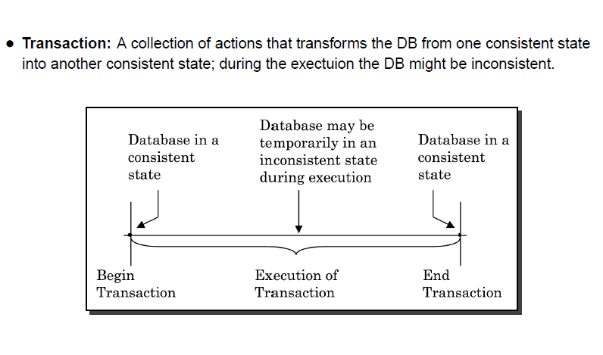

Slide 41
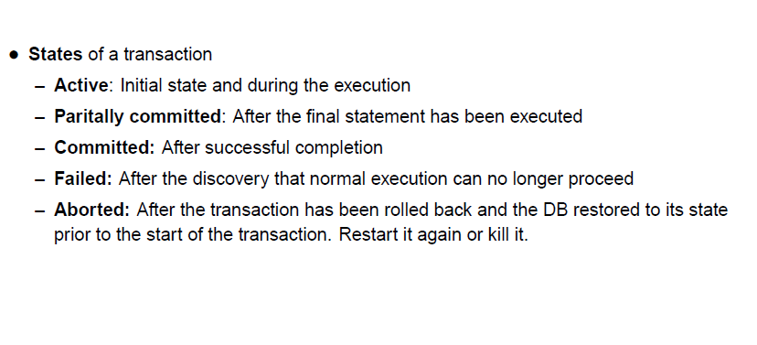

Slide 42
What is transaction in database
Database transaction is collection of SQL queries which forms a logical one task.
For transaction to be completed successfully all SQL queries has to run successfully.
Database transaction executes either all or none, so for example if your database transaction contains 4 SQL queries and if one of them fails then change made by other 3 queries will be rolled back
Database always remain consistent whether transaction succeeded or failed.
Transaction is implemented in database using transaction, commit and rollback.\
  Commit writes the changes made by transaction into database and
  rollback removes temporary changes logged in transaction log by database transaction.

Slide 43
Why transaction is required in database
Database is used to store data required by real life application.
e.g. Banking, Healthcare, Finance etc.
All your money stored in banks is stored in database, all your shares of DIMAT account is stored in database and many application constantly work on these data.
In order to protect data and keep it consistent any changes in this data needs to be done in transaction so that even in case of failure data remain in previous state before start of transaction.

Slide 44
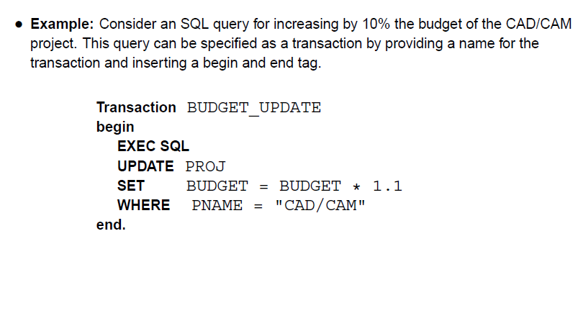

Slide 45
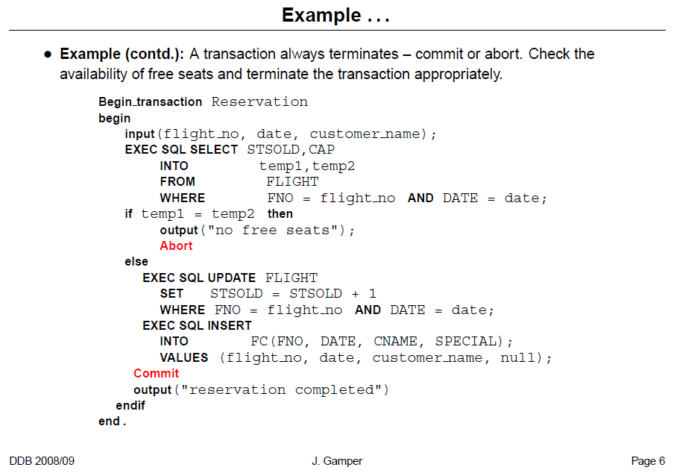

Slide 46
Transactions
A transaction is a sequence of queries and update statements executed as a single unit
  Transactions are started implicitly and terminated by one of
    commit work: makes all updates of the transaction permanent in the database
    rollback work: undoes all updates performed by the transaction.
Motivating example
  Transfer of money from one account to another involves two steps:
    deduct from one account and credit to another
  If one steps succeeds and the other fails, database is in an inconsistent state
  Therefore, either both steps should succeed or neither should
If any step of a transaction fails, all work done by the transaction can be undone by rollback work.
Rollback of incomplete transactions is done automatically, in case of system failures

Slide 47
Transactions (Cont.)
In most database systems, each SQL statement that executes successfully is automatically committed.
  Each transaction would then consist of only a single statement
  Automatic commit can usually be turned off, allowing multi-statement transactions, but how to do so depends on the database system
  Another option in SQL:1999: enclose statements within
  begin atomic
  …
  end

Slide 48
Example of ATM
(Automated Tailor Machine); we all use to withdraw and transfer money by using ATM.
If you break withdrawal operation into individual steps you will find:
1)Verify account details.
2) Accept withdrawal request
3) Check balance
4) Update balance
4) Dispense money

Slide 49
Cont…
Suppose your account balance is 1000$ and you make a withdrawal request of 900$.
At fourth step your balance is updated to 900$ and ATM machine stops working due to power outage
Once power comes back and you again tried to withdraw money you surprised by seeing your balance just 100$ instead of 1000$.
  This is not acceptable by any person in the world:) so we need transaction to perform such task.
  If SQL statements would have been executed inside transaction in database balance would be either 100$ until money has been dispensed or 1000$ if money has not been dispensed.

Slide 50
How to implement transaction in SQL
Database transaction is implemented in SQL using three keywords start transaction, commit and rollback.
once you type start transaction, database starts a transaction and execute all subsequent SQL statements in transaction and keep track of all of them to either commit or rollback changes.
Commit keywords saves then changes made by transaction into database and after commit change is normally visible to other transaction though is subject to isolation level.
In case you encountered any error while executing individual sql statements inside database transaction, you can rollback all your changes by executing "rollback" command.

Slide 51
Database Transaction Example
To understand database transaction better let's see a real life example of transaction in database.
For this example we will assume we have an Account table which represent a Bank Account and we will transfer money from one account to another account
Request: transfer 900$ from Account 9001 to 9002

Slide 52
Example
start transaction select balance from Account where Account_Number ='9001'; select balance from Account where Account_Number='9002'; update Account set balance=balance-900 here Account_Number='9001' ; update Account set balance=balance+900 here Account_Number='9002' ; commit; //if all sql queries succed rollback; //if any of Sql queries failed or error

Slide 53
Transaction Concept
A transaction is a unit of program execution that accesses and possibly updates various data items.
E.g. transaction to transfer $50 from account A to account B:
  1. read(A)
  2. A := A – 50
  3. write(A)
  4. read(B)
  5. B := B + 50
  6. write(B)
Two main issues to deal with:
  Failures of various kinds, such as hardware failures and system crashes
  Concurrent execution of multiple transactions

Slide 54
Example of Fund Transfer
Transaction to transfer $50 from account A to account B:
  1. read(A)
  2. A := A – 50
  3. write(A)
  4. read(B)
  5. B := B + 50
  6. write(B)
Atomicity requirement
  if the transaction fails after step 3 and before step 6, money will be “lost” leading to an inconsistent database state
    Failure could be due to software or hardware
  the system should ensure that updates of a partially executed transaction are not reflected in the database
Durability requirement — once the user has been notified that the transaction has completed (i.e., the transfer of the $50 has taken place), the updates to the database by the transaction must persist even if there are software or hardware failures.

Slide 55
Example of Fund Transfer (Cont.)
Transaction to transfer $50 from account A to account B:
  1. read(A)
  2. A := A – 50
  3. write(A)
  4. read(B)
  5. B := B + 50
  6. write(B)
Consistency requirement in above example:
  the sum of A and B is unchanged by the execution of the transaction
In general, consistency requirements include
    Explicitly specified integrity constraints such as primary keys and foreign keys
    Implicit integrity constraints
      e.g. sum of balances of all accounts, minus sum of loan amounts must equal value of cash-in-hand
  A transaction must see a consistent database.
  During transaction execution the database may be temporarily inconsistent.
  When the transaction completes successfully the database must be consistent
    Erroneous transaction logic can lead to inconsistency

Slide 56
Example of Fund Transfer (Cont.)
Isolation requirement — if between steps 3 and 6, another transaction T2 is allowed to access the partially updated database, it will see an inconsistent database (the sum A + B will be less than it should be).
T1 T2
  1. read(A)
  2. A := A – 50
  3. write(A)
  read(A), read(B), print(A+B)
  4. read(B)
  5. B := B + 50
  6. write(B
Isolation can be ensured trivially by running transactions serially
  that is, one after the other.
However, executing multiple transactions concurrently has significant benefits, as we will see later.

Slide 57
Transaction Management
A transaction is a logical unit of work that contains one or more SQL statements.
A transaction is an atomic unit. The effects of all the SQL statements in a transaction can be either all committed (applied to the database) or all rolled back (undone from the database).
A transaction begins with the first executable SQL statement. A transaction ends when it is committed or rolled back.
Concept of a transaction, consider a banking database.
  When a bank customer transfers money from a savings account to a checking account, the transaction can consist of three separate operations:
Decrement the savings account
Increment the checking account
Record the transaction in the transaction journal

Slide 58
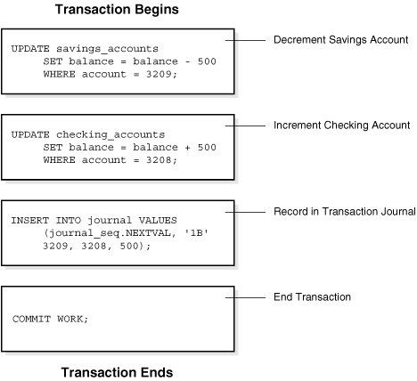
Oracle must allow for two situations.
However, if a problem such as insufficient funds, invalid account number, or a hardware failure prevents one or two of the statements in the transaction from completing, the entire transaction must be rolled back so that the balance of all accounts is correct.

Slide 59
Two-Phase Commit Protocol
The Two-phase commit protocol (2PC), which requires a global recovery manager, or coordinator, to maintain information needed for recovery, in addition to the local recovery managers and the information they maintain (log, tables).
The two-phase commit protocol has certain drawbacks that led to the development of the three-phase commit protocol.
The biggest drawback of 2PC is that it is a blocking protocol. Failure of the coordinator blocks all participating sites, causing them to wait until the coordinator recovers.
This can cause performance degradation, especially if participants are holding locks to shared resources
Three-Phase Commit Protocol:-

Slide 60
Transaction Management
A transaction can be defined as a group of tasks. A single task is the minimum processing unit which cannot be divided further.
Let’s take an example of a simple transaction. Suppose a bank employee transfers Rs 500 from A's account to B's account. This very simple and small transaction involves several low-level tasks.
A’s Account Open_Account(A) Old_Balance = A.balance New_Balance = Old_Balance - 500 A.balance = New_Balance Close_Account(A)
B’s Account Open_Account(B) Old_Balance = B.balance New_Balance = Old_Balance + 500 B.balance = New_Balance Close_Account(B)

Slide 61
The Four Properties of Transactions
Every transaction, for whatever purpose it is being used, has the following four properties.
Taking the initial letters of these four properties we collectively call them the ACID Properties.
Atomicity
Consistency
Isolation
Durability

Slide 62
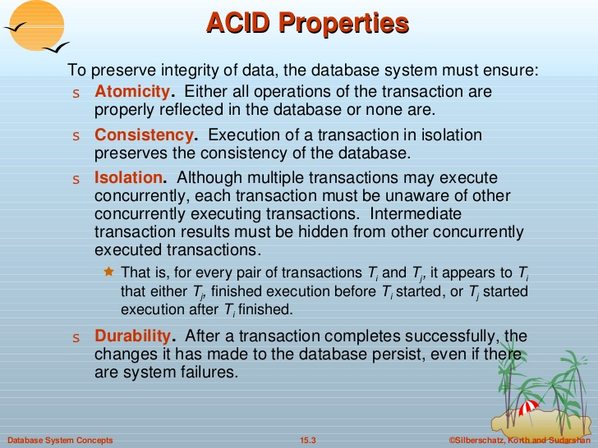

Slide 63
Atomicity
This means that either all of the instructions within the transaction will be reflected in the database, or none of them will be reflected.
Say for example, we have two accounts A and B, each containing Rs 1000/-.
We now start a transaction to deposit Rs 100/- from account A to Account B.
Read A;
A = A – 100;
Write A;(if failure occurs), What happens now?
Read B;
B = B + 100;
Write B;
Now, suppose there is a power failure just after instruction 3 (Write A) has been complete. What happens now? After the system recovers the AFIM will show Rs 900/- in A, but the same Rs 1000/- in B. It would be said that Rs 100/- evaporated in thin air for the power failure. Clearly such a situation is not acceptable.
The solution is to keep every value calculated by the instruction of the transaction not in any stable storage (hard disc) but in a volatile storage (RAM), until the transaction completes its last instruction.
When we see that there has not been any error we do something known as a COMMIT operation. Its job is to write every temporarily calculated value from the volatile storage on to the stable storage.
In this way, even if power fails at instruction 3, the post recovery image of the database will show accounts A and B both containing Rs 1000/-, as if the failed transaction had never occurred.

Slide 64
Consistency:
If we execute a particular transaction in isolation or together with other transaction, (i.e. presumably in a multi-programming environment), the transaction will yield the same expected result.
To give better performance, every database management system supports the execution of multiple transactions at the same time, using CPU Time Sharing.
Concurrently executing transactions may have to deal with the problem of sharable resources, i.e. resources that multiple transactions are trying to read/write at the same time.
For example, we may have a table or a record on which two transaction are trying to read or write at the same time. Careful mechanisms are created in order to prevent mismanagement of these sharable resources, so that there should not be any change in the way a transaction performs.
A transaction which deposits Rs 100/- to account A must deposit the same amount whether it is acting alone or in conjunction with another transaction that may be trying to deposit or withdraw some amount at the same time.

Slide 65
Isolation:
In case multiple transactions are executing concurrently and trying to access a sharable resource at the same time, the system should create an ordering in their execution so that they should not create any anomaly in the value stored at the sharable resource.
There are several ways to achieve this and the most popular one is using some kind of locking mechanism.
Again, if you have the concept of Operating Systems, then you should remember the semaphores, how it is used by a process to make a resource busy before starting to use it, and how it is used to release the resource after the usage is over.
Other processes intending to access that same resource must wait during this time. Locking is almost similar. It states that a transaction must first lock the data item that it wishes to access, and release the lock when the accessing is no longer required.
Once a transaction locks the data item, other transactions wishing to access the same data item must wait until the lock is released.

Slide 66
Durability:
It states that once a transaction has been complete the changes it has made should be permanent.
As we have seen in the explanation of the Atomicity property, the transaction, if completes successfully, is committed.
Once the COMMIT is done, the changes which the transaction has made to the database are immediately written into permanent storage. So, after the transaction has been committed successfully, there is no question of any loss of information even if the power fails. Committing a transaction guarantees that the AFIM has been reached.
There are several ways Atomicity and Durability can be implemented.
One of them is called Shadow Copy. In this scheme a database pointer is used to point to the BFIM of the database. During the transaction, all the temporary changes are recorded into a Shadow Copy, which is an exact copy of the original database plus the changes made by the transaction, which is the AFIM. Now, if the transaction is required to COMMIT, then the database pointer is updated to point to the AFIM copy, and the BFIM copy is discarded. On the other hand, if the transaction is not committed, then the database pointer is not updated. It keeps pointing to the BFIM, and the AFIM is discarded. This is a simple scheme, but takes a lot of memory space and time to implement.
If you study carefully, you can understand that Atomicity and Durability is essentially the same thing, just as Consistency and Isolation is essentially the same thing.

Slide 67
Transaction States
There are the following six states in which a transaction may exist:
Active: The initial state when the transaction has just started execution.
Partially Committed: At any given point of time if the transaction is executing properly, then it is going towards it COMMIT POINT. The values generated during the execution are all stored in volatile storage.
Failed:If the transaction fails for some reason. The temporary values are no longer required, and the transaction is set to ROLLBACK. It means that any change made to the database by this transaction up to the point of the failure must be undone. If the failed transaction has withdrawn Rs. 100/- from account A, then the ROLLBACK operation should add Rs 100/- to account A.
Aborted: When the ROLLBACK operation is over, the database reaches the BFIM. The transaction is now said to have been aborted.
Committed: If no failure occurs then the transaction reaches the COMMIT POINT. All the temporary values are written to the stable storage and the transaction is said to have been committed.
Terminated: Either committed or aborted, the transaction finally reaches this state. The whole process can be described using the following diagram:

Slide 68
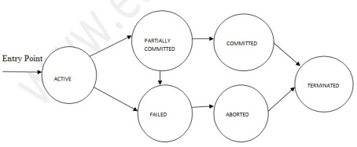

Slide 69
Transaction Isolation
Transaction-processing systems usually allow multiple transactions to run con-currently. Allowing multiple transactions to update data concurrently causes several complications with consistency of the data, as we saw earlier.
Ensuring consistency inspite of concurrent execution of transactions requires extra work;
  it is far easier to insist that transactions run serially —that is, one at a time, each starting only after the previous one has completed. However, there are two good reasons for allowing concurrency:
    Improved throughput and resource u tilization .
    Reduced waiting time

Slide 70

Implementation of Atomicity and Durability
The recovery-management component of a database system implements the support for atomicity and durability.
E.g. the shadow-database scheme:
  all updates are made on a shadow copy of the database
    db_pointer is made to point to the updated shadow copy after the transaction reaches partial commit and all updated pages have been flushed to disk.

Slide 71
There are following commands used to control transactions
COMMIT: to save the changes.
ROLLBACK: to rollback the changes.
SAVEPOINT: creates points within groups of transactions in which to ROLLBACK
SET TRANSACTION: Places a name on a transaction.
Transactional control commands are only used with the DML commands INSERT, UPDATE and DELETE only. They can not be used while creating tables or dropping them because these operations are automatically commited in the database.

Slide 72
The COMMIT Command:
The COMMIT command is the transactional command used to save changes invoked by a transaction to the database.
The COMMIT command saves all transactions to the database since the last COMMIT or ROLLBACK command.
The syntax for COMMIT command is as follows:
SQL> DELETE FROM CUSTOMERS WHERE AGE = 25; SQL> COMMIT;
SQL> DELETE FROM CUSTOMERS WHERE AGE = 25; SQL> ROLLBACK;

Slide 73
The SAVEPOINT Command:
A SAVEPOINT is a point in a transaction when you can roll the transaction back to a certain point without rolling back the entire transaction.
The syntax for SAVEPOINT command is as follows:
SAVEPOINT SAVEPOINT_NAME;
This command serves only in the creation of a SAVEPOINT among transactional statements. The ROLLBACK command is used to undo a group of transactions.
The syntax for rolling back to a SAVEPOINT is as follows:
ROLLBACK TO SAVEPOINT_NAME;

Slide 74
Beginning of a Transaction
A transaction begins when the first executable SQL statement is encountered.
An executable SQL statement is a SQL statement that generates calls to a database instance, including DML and DDL statements and the SET TRANSACTION statement.
When a transaction begins, Oracle Database assigns the transaction to an available undo data segment to record the undo entries for the new transaction. A transaction ID is not allocated until an undo segment and transaction table slot are allocated, which occurs during the first DML statement. A transaction ID is unique to a transaction and represents the undo segment number, slot, and sequence number.

Slide 75
The following example execute an UPDATE statement to begin a transaction and queries V$TRANSACTION for details about the transaction:
SQL> UPDATE hr.employees SET salary=salary;
107 rows updated.
SQL> SELECT XID AS "txn id", XIDUSN AS "undo seg", XIDSLOT AS "slot",
2 XIDSQN AS "seq", STATUS AS "txn status"
3 FROM V$TRANSACTION;
txn id undo seg slot seq txn status
---------------- ---------- ---------- ---------- ----------------
0600060037000000 6 6 55 ACTIVE

Slide 76
End of a Transaction
A transaction ends when any of the following actions occurs:
A user issues a COMMIT or ROLLBACK statement without a SAVEPOINT clause.
In a commit, a user explicitly or implicitly requested that the changes in the transaction be made permanent. Changes made by the transaction are permanent and visible to other users only after a transaction commits
A user runs a DDL command such as CREATE, DROP, RENAME, or ALTER.
The database issues an implicit COMMIT statement before and after every DDL statement.
If the current transaction contains DML statements, then Oracle Database first commits the transaction and then runs and commits the DDL statement as a new, single-statement transaction.
A user exits normally from most Oracle Database utilities and tools, causing the current transaction to be implicitly committed.
  Applications should always explicitly commit or undo transactions before program termination.

Slide 77
After one transaction ends, the next executable SQL statement automatically starts the following transaction.
Example executes an UPDATE to start a transaction,
ends the transaction with a ROLLBACK statement, and then executes an UPDATE to start a new transaction. (note that the transaction IDs are different):
SQL> UPDATE hr.employees SET salary=salary;
107 rows updated.
SQL> SELECT XID, STATUS FROM V$TRANSACTION;
XID STATUS
---------------- ----------------
0800090033000000 ACTIVE

Slide 78
This operation is a statement –level rollback . This operation has the following characteristics:
A SQL statement that does not succeed causes the loss only of work it would have performed itself.
The unsuccessful statement does not cause the loss of any work that preceded it in the current transaction.
For example, if the execution of the second UPDATE statement in causes an error and is rolled back, then the work performed by the first UPDATE statement is not rolled back. The first UPDATE statement can be committed or rolled back explicitly by the user.
The effect of the rollback is as if the statement had never been run.
Any side effects of an atomic statement, for example, triggers invoked upon execution of the statement, are considered part of the atomic statement. Either all work generated as part of the atomic statement succeeds or none does.
An example of an error causing a statement-level rollback is an attempt to insert a duplicate primary key. Single SQL statements involved in a deadlock, which is competition for the same data, can also cause a statement-level rollback. However, errors discovered during SQL statement parsing, such as a syntax error, have not yet been run and so do not cause a statement-level rollback.

Slide 79
Time | Session | Explanation
t0 | COMMIT; | This statement ends any existing transaction in the session.
t1 | SET TRANSACTION NAME 'sal_update'; | This statement begins a transaction and names it sal_update.
t2 | UPDATE employees SET salary = 7000 WHERE last_name = 'Banda'; | This statement updates the salary for Banda to 7000.
t3 | SAVEPOINT after_banda_sal; | This statement creates a savepoint named after_banda_sal, enabling changes in this transaction to be rolled back to this point.
t4 | UPDATE employees SET salary = 12000 WHERE last_name = 'Greene'; | This statement updates the salary for Greene to 12000.
t5 | SAVEPOINT after_greene_sal; | This statement creates a savepoint named after_greene_sal, enabling changes in this transaction to be rolled back to this point.

Slide 80
t6 | ROLLBACK TO SAVEPOINT after_banda_sal; | This statement rolls back the transaction to t3, undoing the update to Greene's salary at t4. The sal_update transaction has not ended.
t7 | UPDATE employees SET salary = 11000 WHERE last_name = 'Greene'; | This statement updates the salary for Greene to 11000 in transaction sal_update.
t8 | ROLLBACK; | This statement rolls back all changes in transaction sal_update, ending the transaction.
t9 | SET TRANSACTION NAME 'sal_update2'; | This statement begins a new transaction in the session and names it sal_update2.
t10 | UPDATE employees SET salary = 7050 WHERE last_name = 'Banda'; | This statement updates the salary for Banda to 7050.
t11 | UPDATE employees SET salary = 10950 WHERE last_name = 'Greene'; | This statement updates the salary for Greene to 10950.
t12 | COMMIT; | This statement commits all changes made in transaction sal_update2, ending the transaction. The commit guarantees that the changes are saved in the online redo log files.

Slide 81
Concurrency Control
When multiple transactions are trying to access the same sharable resource, there could arise many problems if the access control is not done properly.
There are some important mechanisms to which access control can be maintained.
Earlier we talked about theoretical concepts like, serializability but the practical concept of this can be implemented by using Locks and Timestamps.
Some protocols where Locks and Timestamps can be used to provide an environment in which concurrent transactions can preserve their Consistency and Isolation properties.

Slide 82
Lock Based Protocol
A lock is nothing but a mechanism that tells the DBMS whether a particular data item is being used by any transaction for read/write purpose.
Since there are two types of operations, i.e. read and write, whose basic nature are different, the locks for read and write operation may behave differently.
Read operation performed by different transactions on the same data item poses less of a challenge. The value of the data item, if constant, can be read by any number of transactions at any given time.

Slide 83
Write operation is something different. When a transaction writes some value into a data item, the content of that data item remains in an inconsistent state, starting from the moment when the writing operation begins up to the moment the writing operation is over.
If we allow any other transaction to read/write the value of the data item during the write operation, those transaction will read an inconsistent value or overwrite the value being written by the first transaction.
In both the cases anomalies will creep into the database.

Slide 84
The relationship between Shared and Exclusive Lock can be represented by the following table which is known as Lock Matrix.
Locks already existing :-
Shared Exclusive
TRUE FALSE
Shared FALSE FALSE
Exclusive
How Should Lock be Used?

Slide 85
Read/Write
read( X) - which transfers the data item X from the database to a variable, also called X, in a buffer in main memory belonging to the transaction that executed the read operation.
write (X)- which transfers the value in the variable X in the main-memory buffer of the transaction that executed the write to the data item X in the database.

Slide 86
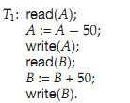
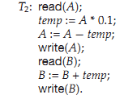
Two Transactions
T1 and T2 be two transactions that transfer funds from one account to another.
Tr a n s a c t i o n T2 transfers 10 percent of the balance from account A to account B .It is deﬁned a Transaction T1 transfers $50 from account A to account B . It i s d eﬁned as:

Slide 87
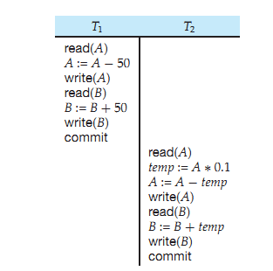
Two Transaction
current values of accounts A and B are $1000 and $2000, respec-tively. Suppose also that the two transactions are executed one at a time in the order T1 followed by T2 .
sequence of Instruction steps is in chronological order from top to
bottom, with instructions.The ﬁnal values of accounts A and B ,after the execution
T1 appearing in the
left column
T2 appearing in the right column

Slide 88
The ﬁnal values of accounts A and B ,after the execution in takes place, are $855 $2145, respectively.
Thus, the total amount of money in accounts A and B —that is, the sum A + B — is pre served after the execution of both transactions.

Slide 89
The simple rule for locking can be derived from here. If a transaction is reading the content of a sharable data item, then any number of other processes can be allowed to read the content of the same data item. But if any transaction is writing into a sharable data item, then no other transaction will be allowed to read or write that same data item.
Depending upon the rules we have found, we can classify the locks into two types.
Shared Lock: A transaction may acquire shared lock on a data item in order to read its content. The lock is shared in the sense that any other transaction can acquire the shared lock on that same data item for reading purpose.
Exclusive Lock: A transaction may acquire exclusive lock on a data item in order to both read/write into it. The lock is excusive in the sense that no other transaction can acquire any kind of lock (either shared or exclusive) on that same data item.

Slide 90
Concurrent Execution
A schedule is a collection of many transactions which is implemented as a unit. Depending upon how these transactions are arranged in within a schedule, a schedule can be of two types:
Serial: The transactions are executed one after another, in a non-preemptive manner.
Concurrent: The transactions are executed in a preemptive, time shared method.
In Serial schedule, there is no question of sharing a single data item among many transactions, because not more than a single transaction is executing at any point of time. However, a serial schedule is inefficient in the sense that the transactions suffer for having a longer waiting time and response time, as well as low amount of resource utilization.
In concurrent schedule, CPU time is shared among two or more transactions in order to run them concurrently. However, this creates the possibility that more than one transaction may need to access a single data item for read/write purpose and the database could contain inconsistent value if such accesses are not handled properly

Slide 91
SQL programmers are responsible for starting and ending transactions at points that enforce the logical consistency of the data.
The programmer must define the sequence of data modifications that leave the data in a consistent state relative to the organization's business rules.
The programmer includes these modification statements in a single transaction so that the SQL Server Database Engine can enforce the physical integrity of the transaction.
It is the responsibility of an enterprise database system, such as an instance of the Database Engine, to provide mechanisms ensuring the physical integrity of each transaction. The Database Engine provides:

Slide 92
What is Lock?
A lock is a variable associated with a data item that describes the status of the item with respect to possible operations that can be applied to it.
Generally, there is one lock for each data item in the database. Locks are used as a means of synchronizing the access by concurrent transactions to the database item.

Slide 93
Binary Locks
A binary lock can have two states or values: locked and unlocked.
A distinct lock is associated with each database item A.
If the value of the lock on A is 1, item A cannot be accessed by a database operation that requests the item.
If the value of the lock on A is 0 then item can be accessed when requested.
We refer to the current value of the lock associated with item A as LOCK (A).
There are two operations, lock item and unlock item are used with binary locking A transaction requests access to an item A by first issuing a lock item (A) operation.
If LOCK (A) = 1, the transaction is forced to wait. If LOCK (A) = 0 it is set to 1 (the transaction locks the item) and the transaction is allowed to access item A.
When the transaction is through using the item, it issues an unlock item (A) operation, which sets LOCK (A) to 0 (unlocks the item) so that A may be accessed by other transactions. Hence binary lock enforces mutual exclusiol1 on the data item.

Slide 94
Locking facilities that preserve transaction isolation.
Logging facilities ensure transaction durability. For fully durable transactions the log record is hardened to disk before the transactions commits.
Thus, even if the server hardware, operating system, or the instance of the Database Engine itself fails, the instance uses the transaction logs upon restart to automatically roll back any uncompleted transactions to the point of the system failure.
Delayed durable transactions commit before the transaction log record is hardened to disk. Such transactions may be lost if there is a system failure before the log record is hardened to disk. For more information on delayed transaction durability see the topic Transaction Durability.
Transaction management features that enforce transaction atomicity and consistency. After a transaction has started, it must be successfully completed (committed), or the Database Engine undoes all of the data modifications made since the transaction started. This operation is referred to as rolling back a transaction because it returns the data to the state it was prior to those changes.

Slide 95
Rules of Binary Locks
If the simple binary locking scheme described here is used, every transaction must obey the following rules:
1. A transaction must issue the operation lock_ item (A) before any read _item (A) or write, item operations are performed in T.
2. A transaction T must issue the operation unlock _item (A) after all read_ item (A) and write _item (A) operations are completed in T.
3. A transaction T will not issue a lock _item (A) operation if it already holds the lock on Item A.
4. A transaction T will not issue an unlock _item (A) operation unless it already holds the lock on item A.
5. The lock manager module of the DBMS can enforce these rules. Between the Lock _ item (A) and unlock _item (A) operations in transaction T, is said to hold the lock on item A. At most one transaction can hold the lock on a particular item. Thus no two transactions can access the' same item concurrently.

Slide 96
Database implementation
Date Base Design: 03 Phases
Modeling:
  E-R Modeling : Purpose.
    E-R model for Banking Enterprise, Car Insurance Company
Conversion of ER model into Table
    Table Creation
Data Base Languages & Querying
  Relation Algebra
  Query Language : Procedural & Non-procedural
  DDL, DML
Notes:
Ranjana vyas

Slide 97
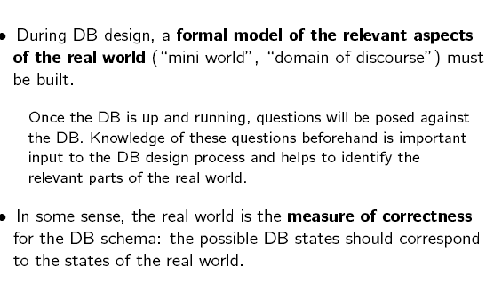
Database Design

Slide 98
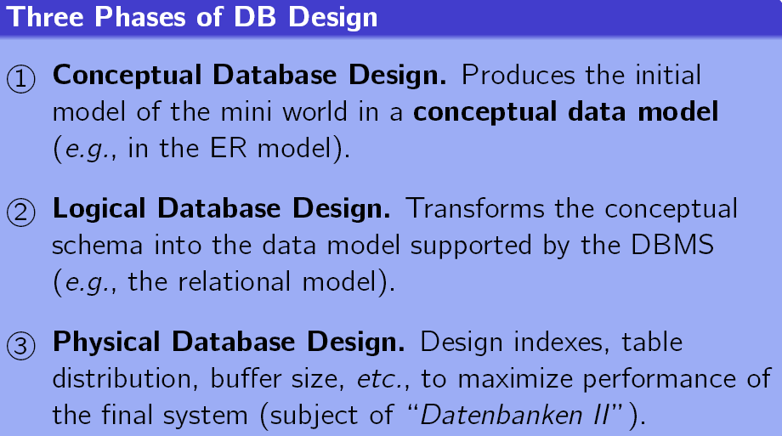
Database Design
The Normalization Theory in Database also relates to Logical Database Design

Slide 99
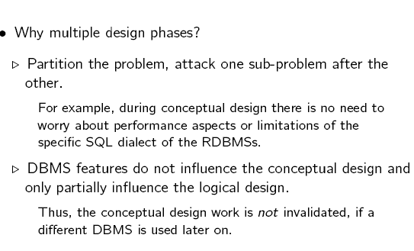
Database Design

Slide 100
Data Models
A collection of tools for describing
  data
  data relationships
  data semantics
  data constraints
Entity-Relationship model
Relational model
Other models:
  Object-Oriented model
  Semi-structured data models
  Older models: network model and hierarchical model

Slide 101
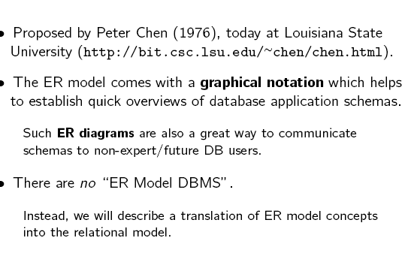
ER Model

Slide 102
Week # 4

Slide 103
DBMS
DBMS Concepts: Relational Model & Querying mechanism
  Concepts of Keys
  Integrity Constraints & Referential Integrity
SQL Constructs
  SQL & PL-SQL
  Querying the database

Slide 104
DDL, DML, DCL and TCL commands & difference b/w them?

Slide 105
DDL – Data Definition Language: statements used to Create, Alter, Drop Database Objects.
Some examples:
– CREATE: used to define new objects
– ALTER: used to modify the definition of existing objects
– DROP: used to remove existing entities.
– TRUNCATE TABLE: used to remove all rows from a table without logging the individual row deletions.
– UPDATE STATISTICS: used to update query optimization statistics on a table or indexed view.

Slide 106
DML – Data Manipulation Language
DML – Data Manipulation Language: statements used to Retrieve, Insert, Update, Remove and Manage data within DB objects. Some examples:
SELECT: retrieves one or more rows from a Table or View.
INSERT: insert one or more rows from a Table or View.
UPDATE: changes existing data in a Table or View.
DELETE: removes one or more rows from a Table or View.
BULK INSERT: imports a data file into a database Table or View in a user-specified format.
MERGE: performs Insert, Update and/or Delete operations on a Target table based on the
results of a JOIN with a source table in one Transaction.
READTEXT: reads text, ntext, or image values from a text, ntext, or image column
UPDATETEXT: updates an existing text, ntext, or image field.
WRITETEXT: permits minimally logged, interactive updating of an existing text, ntext, or
image column.

Slide 107
DCL – Data Control Language: statements used to control the access of data stored in database and provide data security.
GRANT: -grants permissions on a securable to a principal.
REVOKE:- removes a previously granted or denied permission.
SETUSER: -allows a member of the sysadmin fixed server role or db_owner fixed database role to impersonate another user.
EXECUTE AS, statement: -sets the execution context of a session.
EXECUTE AS, clause: -define the execution context of the following user-defined modules: functions (except inline table-valued functions), procedures, queues, and triggers.
REVERT:- switches the execution context back to the caller of the last EXECUTE AS statement.
OPEN MASTER KEY:- opens the Database Master Key of the current database.
– CLOSE MASTER KEY:- closes the master key of the current database.
– OPEN SYMMETRIC KEY:- Decrypts a symmetric key and makes it available for use.
– CLOSE SYMMETRIC KEY:- closes a symmetric key, or closes all symmetric keys open in the current session . permission through its group or role memberships.

Slide 108
TCL – Transaction Control Language: statements used to manage the changes made by DML statements. It allows statements to be grouped together into logical transactions.
BEGIN DISTRIBUTED TRANSACTION: specifies the start of a Transact-SQL distributed transaction managed by Microsoft Distributed Transaction Coordinator (MS DTC).
– BEGIN TRANSACTION: marks the starting point of an explicit, local transaction. BEGIN TRANSACTION increments @@TRANCOUNT by 1.
– COMMIT TRANSACTION: marks the end of a successful implicit or explicit transaction.
– COMMIT WORK: marks the end of a transaction.
– ROLLBACK TRANSACTION: rolls back an explicit or implicit transaction to the beginning of the transaction, or to a savepoint inside the transaction.
– ROLLBACK WORK: rolls back a user-specified transaction to the beginning of the transaction.
– SAVE TRANSACTION: sets a save point within a transaction.

Slide 109

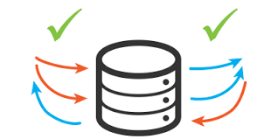
Concurrency control

Slide 110
Concurrency Control
Lock-Based Protocols
Timestamp-Based Protocols
Validation-Based Protocols
Multiple Granularity
Multiversion Schemes
Insert and Delete Operations
Concurrency in Index Structures

Slide 111
Simple database model
transaction
manager
pre-processing of operations; dealing with
distribution
scheduler
determines relative order of execution of operations
knows about volatile and stable storage
data manager
Responsible for commit and abort; also, system failures when
volatile memory is lost; also media failures.
Can return database to a state that contains all the updates of
committed transactions and none of uncommitted ones.
recovery manager
cache manager
Manages volatile storage (the cache – in memory data);.
Operates on database
database
Database concurrency control and recovery

Slide 112
Lock-Based Protocols
A lock is a variable associated with a data item that describes the status of the item with respect to possible operations that can be applied to it. Generally, there is one lock for each data item in the database.
Locks are used as a means of synchronizing the access by concurrent transactions to the database item.
A lock is a mechanism to control concurrent access to a data item
Data items can be locked in two modes :
1. exclusive (X) mode. Data item can be both read as well as
written. X-lock is requested using lock-X instruction.
2. shared (S) mode. Data item can only be read. S-lock is
requested using lock-S instruction.
Lock requests are made to concurrency-control manager. Transaction can proceed only after request is granted.

Slide 113
When there are multiple transactions executing at the same time on same data, it may affect the result of the transaction. Hence it is necessary to maintain the order of execution of those transactions. In addition, it should not alter the ACID property of a transaction.
In order to maintain the concurrent access of transactions, two protocols are introduced.
Lock Based Protocol
Binary Lock data
  shared / exclusive lock

Slide 114
Two protocols
Lock Based Protocol: - Lock is in other words called as access. In this type of protocol any transaction will not be processed until the transaction gets the lock on the record. That means any transaction will not retrieve or insert or update or delete the data unless it gets the access to that particular data.
These locks are broadly classified as Binary locks and shared / exclusive locks.
In binary lock data can either be locked or unlocked. It will have only these two states. It can be locked for retrieve or insert or update or delete the data or unlocked for not using the data.
  In shared / exclusive lock technique the data is said to be exclusively locked if for insert / update /delete.
  When it is exclusively locked no other transaction can read or write the data. When a data is read from the database, then its lock is shared i.e.; the data can be read by other transaction too but it cannot be changed while retrieving the data.

Slide 115
Lock based protocols are of 4 types
Simplistic Lock Protocol: -
  As the name suggests it is the simplest way of locking the data during the transaction.
  This protocol allows all the transaction to get the lock on the data before insert / update /delete on it.
  After completing the transaction, it will unlock the data.

Slide 116
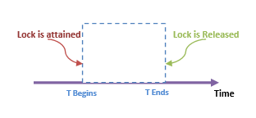
Pre-claiming Protocol: -
  In this protocol, it evaluates the transaction to list all the data items on which transaction needs lock. It then requests DBMS for the lock on all those data items before the transaction begins. If DBMS gives the lock on all the data, then this protocol allows the transaction to begin. Once the transaction is complete, it releases all the locks.If all locks are given by DBMS, then it reverts the transactions and waits for the lock.
For example, if we have to calculate total marks of 3 subjects, then this protocol will evaluate the transaction and list the locks on subject1 marks, subject2 marks and then subject3 marks. Once it gets all the locks, it will start the transaction.

Slide 117
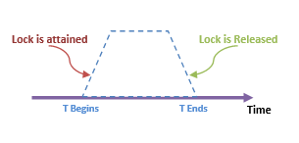
Two Phase Locking Protocol (2PL):
- In this type of protocol, as the transaction begins to execute, it starts requesting for the locks that it needs.
It goes on requesting for the locks as and when it is needed. Hence it has a growing phase of locks. At one stage it will have all the locks.
Once the transaction is complete it goes on releasing the locks. Hence it will have descending phase of locks. Thus this protocol has two phases – growing phase of locks and shrinking phase of locks.

Slide 118
For example,
If we have to calculate total marks of 3 subjects, then this protocol will go on asking for the locks on subject1 marks, subject2 marks and then subject3 marks. As and when it gets the locks on the subject marks it reads the marks. It does not wait till all the locks are received. Then it will have total calculation. Once it is complete it release the lock on subject3 marks, subject2 marks and subject1 marks.
In this protocol, if we need to have exclusive lock on any data for writing, then we have to first get the shared lock for reading. Then we have to request / modify the lock to exclusive lock.

Slide 119
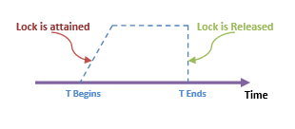
strict Two Phase Locking (Strict 2PL):
- This protocol is similar to 2PL in the first phase. Once it receives the lock on the data, it completes the transaction.
  Here it does not release the locks as it is used and no more required. It waits till whole transaction to complete and commit, then it releases all the locks at a time. This protocol hence does not have shrinking phase of lock release.
In the example of calculating total marks of 3 subjects,
locks are achieved at growing phase of the transaction and once it receives all the locks, it executes the transaction. Once the transaction is fully complete, it releases all the locks together.

Slide 120

Lock-Based Protocols (Cont.)
Lock-compatibility matrix
A transaction may be granted a lock on an item if the requested lock is compatible with locks already held on the item by other transactions
Any number of transactions can hold shared locks on an item,
  but if any transaction holds an exclusive on the item no other transaction may hold any lock on the item.
If a lock cannot be granted, the requesting transaction is made to wait till all incompatible locks held by other transactions have been released. The lock is then granted.

Slide 121
Lock-Based Protocols (Cont.)
Example of a transaction performing locking:
T₂: lock-S(A);
read (A);
unlock(A);
lock-S(B);
read (B);
unlock(B);
display(A+B)
Locking as above is not sufficient to guarantee serializability — if A and B get updated in-between the read of A and B, the displayed sum would be wrong.
A locking protocol is a set of rules followed by all transactions while requesting and releasing locks. Locking protocols restrict the set of possible schedules.

Slide 122

Pitfalls of Lock-Based Protocols
Consider the partial schedule
Neither T₃ nor T₄ can make progress — executing lock-S(B) causes T₄ to wait for T₃ to release its lock on B, while executing lock-X(A) causes T₃ to wait for T₄ to release its lock on A.
Such a situation is called a deadlock.
  To handle a deadlock one of T₃ or T₄ must be rolled back
  and its locks released.

Slide 123
Pitfalls of Lock-Based Protocols (Cont.)
The potential for deadlock exists in most locking protocols. Deadlocks are a necessary evil.
Starvation is also possible if concurrency control manager is badly designed. For example:
  A transaction may be waiting for an X-lock on an item, while a sequence of other transactions request and are granted an S-lock on the same item.
  The same transaction is repeatedly rolled back due to deadlocks.
Concurrency control manager can be designed to prevent starvation.

Slide 124
The Two-Phase Locking Protocol
This is a protocol which ensures conflict-serializable schedules.
Phase 1: Growing Phase
  transaction may obtain locks
  transaction may not release locks
Phase 2: Shrinking Phase
  transaction may release locks
  transaction may not obtain locks
The protocol assures serializability. It can be proved that the transactions can be serialized in the order of their lock points (i.e. the point where a transaction acquired its final lock).

Slide 125
The Two-Phase Locking Protocol (Cont.)
Two-phase locking does not ensure freedom from deadlocks
Cascading roll-back is possible under two-phase locking. To avoid this, follow a modified protocol called strict two-phase locking. Here a transaction must hold all its exclusive locks till it commits/aborts.
Rigorous two-phase locking is even stricter: here all locks are held till commit/abort. In this protocol transactions can be serialized in the order in which they commit.

Slide 126
The Two-Phase Locking Protocol (Cont.)
There can be conflict serializable schedules that cannot be obtained if two-phase locking is used.
However, in the absence of extra information (e.g., ordering of access to data), two-phase locking is needed for conflict serializability in the following sense:
Given a transaction T_{i} that does not follow two-phase locking, we can find a transaction T_{j} that uses two-phase locking, and a schedule for T_{i} and T_{j} that is not conflict serializable.

Slide 127
Lock Conversions
Two-phase locking with lock conversions:
– First Phase:
  can acquire a lock-S on item
  can acquire a lock-X on item
  can convert a lock-S to a lock-X (upgrade)
– Second Phase:
  can release a lock-S
  can release a lock-X
  can convert a lock-X to a lock-S (downgrade)
This protocol assures serializability. But still relies on the programmer to insert the various locking instructions.

Slide 128


Slide 129
Automatic Acquisition of Locks
A transaction T_{i} issues the standard read/write instruction, without explicit locking calls.
The operation read(D) is processed as:
if T_{i} has a lock on D
then
read(D)
else begin
if necessary wait until no other
transaction has a lock-X on D
grant T_{i} a lock-S on D;
read(D)
end

Slide 130
Automatic Acquisition of Locks (Cont.)
write(D) is processed as:
if T_{i} has a lock-X on D
then
write(D)
else begin
if necessary wait until no other trans. has any lock on D,
if T_{i} has a lock-S on D
then
upgrade lock on D to lock-X
else
grant T_{i} a lock-X on D
write(D)
end;
All locks are released after commit or abort

Slide 131
Implementation of Locking
A lock manager can be implemented as a separate process to which transactions send lock and unlock requests
The lock manager replies to a lock request by sending a lock grant messages (or a message asking the transaction to roll back, in case of a deadlock)
The requesting transaction waits until its request is answered
The lock manager maintains a data-structure called a lock table to record granted locks and pending requests
The lock table is usually implemented as an in-memory hash table indexed on the name of the data item being locked

Slide 132

Lock Table
Black rectangles indicate granted locks, white ones indicate waiting requests
Lock table also records the type of lock granted or requested
New request is added to the end of the queue of requests for the data item, and granted if it is compatible with all earlier locks
Unlock requests result in the request being deleted, and later requests are checked to see if they can now be granted
If transaction aborts, all waiting or granted requests of the transaction are deleted
  lock manager may keep a list of locks held by each transaction, to implement this efficiently
Granted
Waiting

Slide 133
Graph-Based Protocols
Graph-based protocols are an alternative to two-phase locking
Impose a partial ordering → on the set D = {d₁, d₂ ,..., d_{h}} of all data items.
  If d_{i} → d_{j} then any transaction accessing both d_{i} and d_{j} must access d_{i} before accessing d_{j}.
  Implies that the set D may now be viewed as a directed acyclic graph, called a database graph.
The tree-protocol is a simple kind of graph protocol.

Slide 134
when there are multiple transactions executing at the same time on same data, it may affect the result of the transaction. Hence it is necessary to maintain the order of execution of those transactions. In addition, it should not alter the ACID property of a transaction.
In order to maintain the concurrent access of transactions, two protocols are introduced.
Lock Based Protocol
Binary Lock data
shared / exclusive lock

Slide 135
Two protocols
Lock Based Protocol: - Lock is in other words called as access. In this type of protocol any transaction will not be processed until the transaction gets the lock on the record. That means any transaction will not retrieve or insert or update or delete the data unless it gets the access to that particular data.
These locks are broadly classified as Binary locks and shared / exclusive locks.
In binary lock data can either be locked or unlocked. It will have only these two states. It can be locked for retrieve or insert or update or delete the data or unlocked for not using the data.
  In shared / exclusive lock technique the data is said to be exclusively locked if for insert / update /delete. When it is exclusively locked no other transaction can read or write the data. When a data is read from the database, then its lock is shared i.e.; the data can be read by other transaction too but it cannot be changed while retrieving the data.

Slide 136
Lock based protocols are of 4 types
Simplistic Lock Protocol: -
  As the name suggests it is the simplest way of locking the data during the transaction.
  This protocol allows all the transaction to get the lock on the data before insert / update /delete on it.
  After completing the transaction, it will unlock the data.

Slide 137
Pre-claiming Protocol: -
  In this protocol, it evaluates the transaction to list all the data items on which transaction needs lock. It then requests DBMS for the lock on all those data items before the transaction begins. If DBMS gives the lock on all the data, then this protocol allows the transaction to begin. Once the transaction is complete, it releases all the locks.If all locks are given by DBMS, then it reverts the transactions and waits for the lock.
For example, if we have to calculate total marks of 3 subjects, then this protocol will evaluate the transaction and list the locks on subject1 marks, subject2 marks and then subject3 marks. Once it gets all the locks, it will start the transaction.

Slide 138
Two Phase Locking Protocol (2PL):
- In this type of protocol, as the transaction begins to execute, it starts requesting for the locks that it needs. It goes on requesting for the locks as and when it is needed. Hence it has a growing phase of locks. At one stage it will have all the locks. Once the transaction is complete it goes on releasing the locks. Hence it will have descending phase of locks. Thus this protocol has two phases – growing phase of locks and shrinking phase of locks.

Slide 139
Time Stamp Based Protocol:
- As we have seen above in lock based protocol, it acquires locks at the time of execution.
But in this method, as soon as a transaction is created it assigns the order of the transaction. The order of the transaction is nothing but the ascending order of the transaction creation.
The priority for older transaction is given to execute first. This protocol uses system time or logical counter to determine the time stamp of the transaction.
Suppose there are two transactions T1 and T2. Suppose T1 has entered the system at time 0005 and T2 has entered the system at 0008 clock time. Priority will be given to T1 to execute first as it is entered the system first.

Slide 140
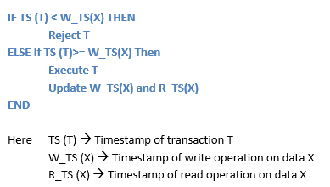
In addition to the timestamp of a transaction, this protocol also maintains the timestamp of last ‘read’ and ‘write’ operation on a data. Based on the timestamp of transaction and the data which it is accessing a timestamp ordering protocol is defined. If a transaction T is a read transaction on data X then
if there is an active write operation on data X when a transaction T is requesting for X, then reject the transaction T.
If the transaction T is started as soon as write is complete or no going write operation on X, then execute T.
. For example, if there is an update on marks1 on MARKS table and meanwhile there is a request to read marks1, then do not perform read marks1.
This is because there is an update being happening on marks1. If there was an update on marks1 which is executed long back or it is complete just now and there is a request to read marks1, then system will allow reading marks1.

Slide 141
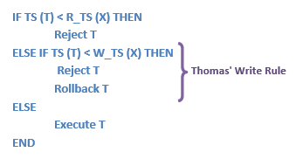
If a transaction T is a write transaction on data X then
This algorithm describes about write operation. If there is an active read or write on data X, and at the same time if the transaction T is requesting for X, then the transaction is rejected. If there is no active read / write operation on X, then execute the transaction.
Suppose T1 is reading marks1 from MARKS table.
Meanwhile transaction T2 begins and tries to update marks1 in MARKS. Then the transaction T2 is rejected and rolled back.

Slide 142
Graph-Based Protocols
Graph-based protocols are an alternative to two-phase locking
Impose a partial ordering → on the set D = {d₁, d₂ ,..., d_{h}} of all data items.
  If d_{i} → d_{j} then any transaction accessing both d_{i} and d_{j} must access d_{i} before accessing d_{j}.
  Implies that the set D may now be viewed as a directed acyclic graph, called a database graph.
The tree-protocol is a simple kind of graph protocol.

Slide 143

Tree Protocol
Only exclusive locks are allowed.
The first lock by T_{i} may be on any data item. Subsequently, a data Q can be locked by T_{i} only if the parent of Q is currently locked by T_{i}.
Data items may be unlocked at any time.
A data item that has been locked and unlocked by T_{i} cannot subsequently be relocked by T_{i}

Slide 144
Graph-Based Protocols (Cont.)
The tree protocol ensures conflict serializability as well as freedom from deadlock.
Unlocking may occur earlier in the tree-locking protocol than in the two-phase locking protocol.
  shorter waiting times, and increase in concurrency
  protocol is deadlock-free, no rollbacks are required
Drawbacks
  Protocol does not guarantee recoverability or cascade freedom
    Need to introduce commit dependencies to ensure recoverability
  Transactions may have to lock data items that they do not access.
    increased locking overhead, and additional waiting time
    potential decrease in concurrency
Schedules not possible under two-phase locking are possible under tree protocol, and vice versa.

Slide 145
Multiple Granularity
Allow data items to be of various sizes and define a hierarchy of data granularities, where the small granularities are nested within larger ones
Can be represented graphically as a tree (but don't confuse with tree-locking protocol)
When a transaction locks a node in the tree explicitly, it implicitly locks all the node's descendents in the same mode.
Granularity of locking (level in tree where locking is done):
  fine granularity (lower in tree): high concurrency, high locking overhead
  coarse granularity (higher in tree): low locking overhead, low concurrency

Slide 146

Example of Granularity Hierarchy
The levels, starting from the coarsest (top) level are
  database
  area
  file
  record

Slide 147
Intention Lock Modes
In addition to S and X lock modes, there are three additional lock modes with multiple granularity:
  intention-shared (IS): indicates explicit locking at a lower level of the tree but only with shared locks.
  intention-exclusive (IX): indicates explicit locking at a lower level with exclusive or shared locks
  shared and intention-exclusive (SIX): the subtree rooted by that node is locked explicitly in shared mode and explicit locking is being done at a lower level with exclusive-mode locks.
intention locks allow a higher level node to be locked in S or X mode without having to check all descendent nodes.

Slide 148
Compatibility Matrix with
Intention Lock Modes
The compatibility matrix for all lock modes is:
IS
IX
S
S IX
X
IS
✓
✓
✓
✓
×
IX
✓
✓
×
×
×
S
✓
×
✓
×
×
S IX
✓
×
×
×
×
X
×
×
×
×
×

Slide 149
Multiple Granularity Locking Scheme
Transaction T_{i} can lock a node Q, using the following rules:
  The lock compatibility matrix must be observed.
  The root of the tree must be locked first, and may be locked in any mode.
  A node Q can be locked by T_{i} in S or IS mode only if the parent of Q is currently locked by T_{i} in either IX or IS mode.
  A node Q can be locked by T_{i} in X, SIX, or IX mode only if the parent of Q is currently locked by T_{i} in either IX or SIX mode.
  T_{i} can lock a node only if it has not previously unlocked any node (that is, T_{i} is two-phase).
  T_{i} can unlock a node Q only if none of the children of Q are currently locked by T_{i}.
Observe that locks are acquired in root-to-leaf order, whereas they are released in leaf-to-root order.

Slide 150
Deadlock Handling
Consider the following two transactions:
T₁: write (X) T₂: write(Y)
write(Y) write(X)
Schedule with deadlock
T₁
T₂
lock-X on X
write (X)
lock-X on Y
write (X)
wait for lock-X on X
wait for lock-X on Y

Slide 151
Deadlock Handling
System is deadlocked if there is a set of transactions such that every transaction in the set is waiting for another transaction in the set.
Deadlock prevention protocols ensure that the system will never enter into a deadlock state. Some prevention strategies :
  Require that each transaction locks all its data items before it begins execution (predeclaration).
  Impose partial ordering of all data items and require that a transaction can lock data items only in the order specified by the partial order (graph-based protocol).

Slide 152
More Deadlock Prevention Strategies
Following schemes use transaction timestamps for the sake of deadlock prevention alone.
wait-die scheme — non-preemptive
  older transaction may wait for younger one to release data item. Younger transactions never wait for older ones; they are rolled back instead.
  a transaction may die several times before acquiring needed data item
wound-wait scheme — preemptive
  older transaction wounds (forces rollback) of younger transaction instead of waiting for it. Younger transactions may wait for older ones.
  may be fewer rollbacks than wait-die scheme.

Slide 153
Deadlock prevention (Cont.)
Both in wait-die and in wound-wait schemes, a rolled back transactions is restarted with its original timestamp. Older transactions thus have precedence over newer ones, and starvation is hence avoided.
Timeout-Based Schemes :
  a transaction waits for a lock only for a specified amount of time. After that, the wait times out and the transaction is rolled back.
  thus deadlocks are not possible
  simple to implement; but starvation is possible. Also difficult to determine good value of the timeout interval.

Slide 154
Deadlock Detection
Deadlocks can be described as a wait-for graph, which consists of a pair G = (V,E),
  V is a set of vertices (all the transactions in the system)
  E is a set of edges; each element is an ordered pair T_{i} →T_{j}.
If T_{i} → T_{j} is in E, then there is a directed edge from T_{i} to T_{j}, implying that T_{i} is waiting for T_{j} to release a data item.
When T_{i} requests a data item currently being held by T_{j}, then the edge T_{i} T_{j} is inserted in the wait-for graph. This edge is removed only when T_{j} is no longer holding a data item needed by T_{i}.
The system is in a deadlock state if and only if the wait-for graph has a cycle. Must invoke a deadlock-detection algorithm periodically to look for cycles.

Slide 155


Deadlock Detection (Cont.)
Wait-for graph without a cycle
Wait-for graph with a cycle

Slide 156
Deadlock Recovery
When deadlock is detected :
  Some transaction will have to rolled back (made a victim) to break deadlock. Select that transaction as victim that will incur minimum cost.
  Rollback -- determine how far to roll back transaction
    Total rollback: Abort the transaction and then restart it.
    More effective to roll back transaction only as far as necessary to break deadlock.
  Starvation happens if same transaction is always chosen as victim. Include the number of rollbacks in the cost factor to avoid starvation

