Slide 1
Functional Dependency
Higher Normal Forms & Design issues
Designing RDBMS with Normalization

Slide 2
Database Management System
RDBMS Design
Normalization & Overview of Normal Forms
  First Normal Form
Functional Dependencies
  Second Normal Form & Third Normal Form
  Higher Normal Form
Decomposition & Properties of Decomposition
Overall Database Design Process & Problem Solving
Notes:
Ranjana vyas

Slide 3
Functional Dependency:Revision
Functional Dependency :
Inter – relation among attributes of an entity.
Let R be a relation on the relation scheme R, then R satisfies the functional – dependency X -→ Y
If a given set of values for each attribute in X uniquely determines each of the values of the attributes in Y.
( X determines Y
Y functionally dependent on X )
FD’s can be used to group the attributes into Relation-scheme, which is in a particular Normal forms
Approach of Normalization :
Step I : Test the given Relation scheme for any Normal form
Step II : If the given R-scheme is not in any N.F. (2NF/3NF)
Step III : Decompose the Relation-scheme into small Relation-schema.
Step IV : Test the decomposed schema for Normal forms.

Slide 4
Design Goals & Pitfalls with FDs
The basic objective of normalization is to reduce the various anomalies in the database.
Normalization can be looked upon as a process of analyzing the given relation schemas based on their FDs and primary keys to achieve the desirable properties of ;
  Minimizing redundancy
  Minimizing the insertion, deletion, and update anomalies.
How to identify FDs and prime / nonprime attributes?
  An Attribute A in a relation is called a prime attribute if A is a part of any candidate key of the relation.
There are some pitfalls in FDs identifying !

Slide 5
Decomposition
The bad design suggests that we should decompose that table.
It is generally not sufficient to check separately that each relation schema in the database is, say, in 2NF or 3NF.
Rather, the process of normalization through decomposition must also confirm the existence of additional properties that the relation schemas, taken together should possess;
  The Lossless join,
  The dependency preservation property, which ensures that each functional dependency is represented in some individual relations resulting after decomposition.

Slide 6
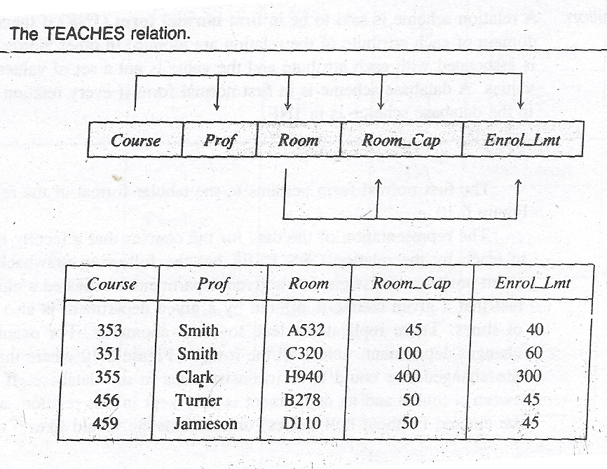
Normal Form Test for TEACHES
The relation scheme for the relation TEACHES is (Prof, Course, Room, Room_Cap,Enrol_lmt)
The domain of the attribute Prof is all the faulty members of the university.
The domain of the attribute Course is the courses offered by the university.
The domain of Room is the rooms in the buildings of the university.
The domain of Room_Cap is an integer value indicating the seating capacity of the room.
Let us consider Teaches Relation for testing whether it fulfills any Normal Form ?
What are the FDs in this scheme ?
TEACHES contains attributes Professor, Course, Room, Room_Cap, Enrol_Lmt (Enrolment Limit).

Slide 7
Design - Analysis
Go for Normal Form Tests ?
The Teaches relation is in First Normal Form or not ?
Identify the FDs in Scheme.
Should FDs be identified only by observing the tuples/data ?
Analyse the FDs and see how will it work ?
Go for higher Normal Form Tests ?
What is the remedy of the problem ?

Slide 8
Teaches Relation
Which Normal Form ?
What are the Key Attributes ?
What are the Non-Key Attributes ?
Find out Functional Dependencies ?
Are Non –key attribute functionally-dependent
on the key – attributes.?

Slide 9
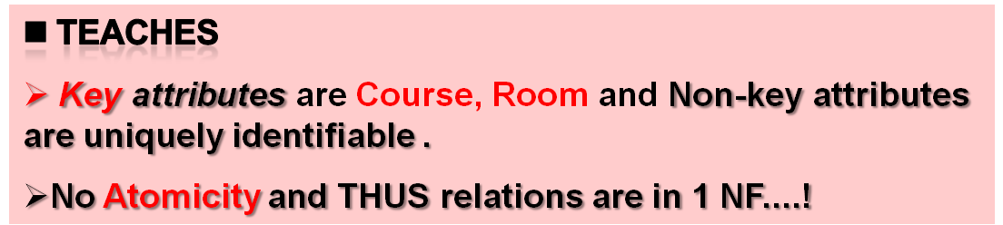
First Normal Form…?

Slide 10
FDs in Scheme
The domain of the Enrlo_Lmt is also integer value and should be less than or equal to the corresponding value for Room_Cap.
The TEACHES relation is in first normal form since it’s attributes contain only atomic values and there are key attributes uniquely identifying record.
FDs ?
The course is scheduled in a given room and each Course uniquely identifies Room
Course → Room
since the room has the given maximum number of available seats, there is a functional dependency
Room →Room_Cap And hence from transitivity
Course → Room → Room_Cap
Thus the functional dependencies in this relation are
{Course → (Prof, Room, Room_Cap, Enrol_Lmt),
Room→ Room_Cap}

Slide 11
FDs Analysis
The Given Schema TEACHES: Which Normal Form?

Slide 12
Analysis of Scheme
There is another transitive dependency (Here we assume that Enrol_Lmt is the upper limit on registration for a course and is based solely on the room capacity)
Room → Room_Cap → Enrol_Lmt
The presence of these transitive dependency in TEACHES will cause the following problems:
  The capacity of a room cannot be entered in the database unless a course is scheduled in the room ( Insert Anamoly)and
  The capacity of a room in which only one course is scheduled will be deleted if the only course scheduled in that room is deleted. ( Delete Anamoly)
  Because the same room can appear more than once in the database, there could be inconsistencies between the multiple occurrences of the attribute pair Room and Room_Cap.

Slide 13
Why Anomalies?
TEACHES ( Professor, Course, Room, Room_Cap, Enrol_Lmt )
Anomalies occur in the given TEACHES scheme because of partial dependencies;
  which means Non-key attributes are NOT functionally dependent on Key attributes !
  This violates the condition of Second Normal form !
  Thus the given relation is in First Normal Form only.
  We have to Decompose the relation .

Slide 14
Remember Second Normal Form
2NF :- A Relation is said to be in 2NF;
1. IF it is in 1NF and
2. Non –key attribute are functionally-dependent
on the key – attributes.
further ,if the key has more than one attribute ,then no non key attributes should be functionally dependent upon a part of the key attributes.
1NF deals with Key Attributes whereas 2NF requires analysis of Non-Key attributes as well...!
In the Teaches Relation, there are two key attributes – Course, Room and three non-key attributes......Prof, Room_Cap, Enrol_Lmt….

Slide 15
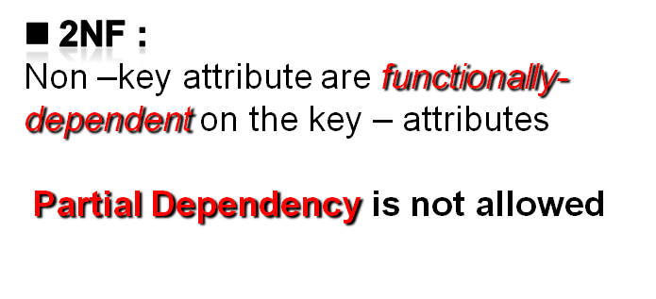
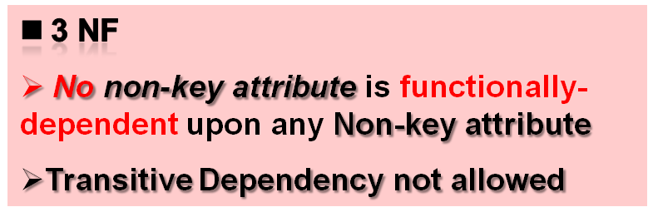
Remember 2 NF & 3 NF…
Key attribute
A
B
C
D
Non-key attribute
E
Entity
F
G

Slide 16
Decomposition for higher Normal Form
The bad design suggests that we should decompose that table.
The Teaches Relation with 05 attributes needs to be decomposed ..!
But the process of decomposition must also have existence of additional properties;
  The Lossless join,
  The dependency preservation property, which ensures that each functional dependency is represented in some individual relations resulting after decomposition.
After decomposition into smaller tables, we have to check whether the new tables fulfill the higher normal form Tests...

Slide 17
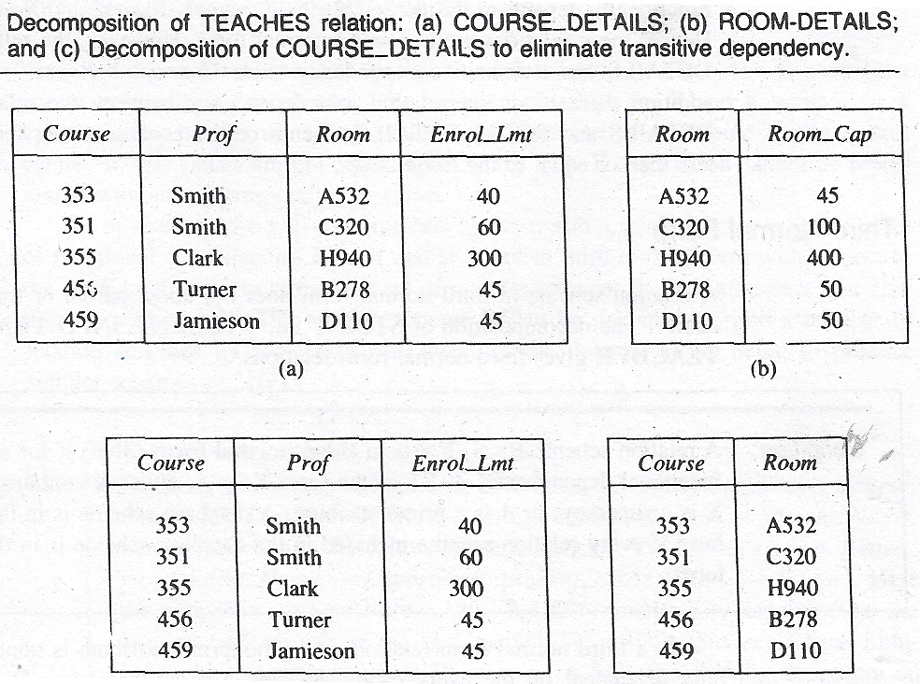
Decomposition of Relation & 2NF
Here Course is Key attribute for COURSE_DETAILS and Room is key attribute for ROOM_DETAILS
The Decomposed Relation does not have Partial Dependency.
Thus the Schema is now in Second Normal Form .

Slide 18
Is Second Normal Form capable to remove all anomalies and give good Database implementation ?

Slide 19
2NF....No Anomaly ?
Although 2 NF does not give any Partial dependency but there can be other possibilities of anomalies because of dependencies,
We can not insert a Room value in the relation alongwith an Enrol_Lmt value unless we have a Course value to go alongwith Room value.
There is a interrelation join dependency between COURSE_DETAILS and ROOM_DETAILS to enforce the constraint that the Enrol_Lmt be less than or equal to the Room_Cap.
Relation COURSE_DETAILS has a Transitive dependency
Course → Room → Enrol_Lmt
Non-key attribute is functionally dependent on another non key attribute !

Slide 20
Further decomposition & 3 NF ?
The Decomposed Relation does not have Transitive Dependency.
Thus the Schema is now in Third Normal Form .

Slide 21
Normal Forms & Decomposition
Case Study of TEACHES Relation
  First Normal Form?
  Anomalies in 1NF
  Decomposition for 2NF
  Is 2NF without anomalies?
  Decomposition for 3NF
  Decomposition principles
  Definition of 3NF
    Need for Closure
  Armstrong Axiom for Closure

Slide 22
Keys & Functional Dependencies
K is a superkey for relation schema R if and only if K → R
K is a candidate key for R if and only if
  K → R, and
  for no α ⊂ K, α → R
Functional dependencies allow us to express constraints that cannot be expressed using superkeys.
Theory of FDs further discusses:
Closure of FDs- Armstrong Axioms
We expect to find out all valid Functional Dependencies which hold true:
loan-number → amount
loan-number → branch-name
but we would not expect the following to hold:
loan-number → customer-name

Slide 23
Third Normal Form :
Third Normal Form :
A relation scheme is said to be in 3 NF if ;
It is in 2 NF.
No non-key attribute is functionally-dependent upon any Non-key attribute.
Thus, there should be no transitive-dependency of a non-key attribute on the primary key.
3 NF Scheme does not allow partial dependencies like in 2NF but additionally 3NF does not allow any transitive dependencies.
Another Defn of Third Normal Form:-
A relation scheme R < S, F > is in 3 NF if for all non-trivial Functional dependencies in F + (closure of F) of the form X → A, either X contains a key (i.e. X is a super-key) or A is a prime attribute

Slide 24
Database Management System
DBMS Design Analyses : 1NF, 2 NF, 3NF & BCNF
Why Higher Normal Forms?
  Closure of FDs & Armstrong Axioms
  3NF and BCNF: Achievability
Third Normal Form & BC Normal Form
Multivalued Dependencies and Fourth Normal Form
Do we need 4 NF and 5 NF ?
Notes:
Ranjana vyas

Slide 25
Boyce–Codd normal form (or BCNF or 3.5NF) is a normal form used in database normalization.
It is a slightly stronger version of the third normal form (3NF).
BCNF was developed in 1974 by Raymond F. Boyce and Edgar F. Codd to address certain types of anomaly not dealt with by 3NF as originally defined.

Slide 26
RDBMS Design Issues
Third Normal Form
&
BCNF

Slide 27
BCNF will require the concepts of Closure of FDs
Armstrong Axioms…

Slide 28
Third Normal Form
A relation schema R is in third normal form (3NF) if for all:
α → β in F ⁺
at least one of the following holds:
  α → β is trivial (i.e., β ∈ α)
  α is a superkey for R
  Each attribute A in β – α is contained in a candidate key for R.
  (NOTE: each attribute may be in a different candidate key)
If a relation is in BCNF it is in 3NF (since in BCNF one of the first two conditions above must hold).
Third condition is a minimal relaxation of BCNF to ensure dependency preservation (will see why later).

Slide 29
Achievability of BCNF
In some cases, a non-BCNF table cannot be decomposed into tables that satisfy BCNF and preserve the dependencies that held in the original table.
Beeri and Bernstein showed in 1979 that, for example, a set of functional dependencies {AB → C, C → B} cannot be represented by a BCNF schema.
  Thus, unlike the first three normal forms, BCNF is not always achievable.
3 NF has been also defined by using Closure of FDs
  What is Closure of FDs?

Slide 30
Functional Dependencies
A functional dependency is trivial if it is satisfied by all instances of a relation
  Example:
    customer_name, loan_number → customer_name
    customer_name → customer_name
  In general, α → β is trivial if β ⊆ α
Loss less Join : so there is no information loss after decomposition
Dependency Preservation : Ensures that each functional dependency is represented in some relation after decomposition.

Slide 31
Closure of a Set of Functional Dependencies
We can find all of F⁺ by applying Armstrong’s Axioms:
  if β ⊆ α, then α → β (reflexivity)
  if α → β, then γ α → γ β (augmentation)
  if α → β, and β → γ, then α → γ (transitivity)
These rules are
  sound (generate only functional dependencies that actually hold) and
  complete (generate all functional dependencies that hold).

Slide 32
Closure of a Set of Functional Dependencies
Given a set F set of functional dependencies, there are certain other functional dependencies that are logically implied by F.
  E.g. If A → B and B → C, then we can infer that A → C
The set of all functional dependencies logically implied by F is the closure of F.
We denote the closure of F by F⁺.
We can find all of F⁺ by applying Armstrong’s Axioms:
  if β ⊆ α, then α → β (reflexivity)
  if α → β, then γ α → γ β (augmentation)
  if α → β, and β → γ, then α → γ (transitivity)
These rules are
  sound (generate only functional dependencies that actually hold) and
  complete (generate all functional dependencies that hold).

Slide 33
Example
R = (A, B, C, G, H, I)
F = { A → B
A → C
CG → H
CG → I
B → H}
some members of F⁺
  A → H
    by transitivity from A → B and B → H
  AG → I
    by augmenting A → C with G, to get AG → CG
    and then transitivity with CG → I
  CG → HI
    from CG → H and CG → I : “union rule” can be inferred from
      definition of functional dependencies, or
      Augmentation of CG → I to infer CG → CGI, augmentation of
      CG → H to infer CGI → HI, and then transitivity

Slide 34
Normalization Using Functional Dependencies
When we decompose a relation schema R with a set of functional dependencies F into R₁, R₂,.., R_{n} we want
  Lossless-join decomposition: Otherwise decomposition would result in information loss.
  No redundancy: The relations R_{i} preferably should be in either Boyce-Codd Normal Form or Third Normal Form.
  Dependency preservation: Let F_{i} be the set of dependencies F⁺ that include only attributes in R_{i}.
    Preferably the decomposition should be dependency preserving, that is, (F₁ ∪ F₂ ∪ … ∪ F_{n})⁺ = F⁺
    Otherwise, checking updates for violation of functional dependencies may require computing joins, which is expensive.

Slide 35
Third Normal Form
A relation schema R is in third normal form (3NF) if for all:
α → β in F⁺
at least one of the following holds:
  α → β is trivial (i.e., β ∈ α)
  α is a superkey for R
  Each attribute A in β – α is contained in a candidate key for R.
  (NOTE: each attribute may be in a different candidate key)
If a relation is in BCNF it is in 3NF (since in BCNF one of the first two conditions above must hold).
Third condition is a minimal relaxation of BCNF to ensure dependency preservation (will see why later).

Slide 36
BCNF
A relation schema R is in BCNF with respect to a set F of functional
dependencies if for all functional dependencies in F ⁺ of the form
α→ β, where α ⊆ R and β ⊆ R, at least one of the following holds:
α → β is trivial (i.e., β ⊆ α)
α is a superkey for R
  Boyce-Codd normal form (or BCNF) requires that there are no non-trivial functional dependencies of attributes on something else than a superset of a candidate key.
  At this stage, all attributes are dependent on a key, a whole key and nothing but a key (excluding trivial dependencies, like A->A).

Slide 37
Third Normal Form: Motivation
There are some situations where
  BCNF is not dependency preserving, and
  efficient checking for FD violation on updates is important
Solution: define a weaker normal form, called Third Normal Form.
  Allows some redundancy (with resultant problems; we will see examples later)
  But FDs can be checked on individual relations without computing a join.
  There is always a lossless-join, dependency-preserving decomposition into 3NF.

Slide 38
Why BCNF….
When a relation has more than one candidate key, anomalies may result even though the relation is in 3NF.
3NF does not deal satisfactorily with the case of a relation with overlapping candidate keys
  i.e. composite candidate keys with at least one attribute in common.
BCNF is based on the concept of a determinant.
  A determinant is any attribute (simple or composite) on which some other attribute is fully functionally dependent.
A relation is in BCNF is, and only if, every determinant is a candidate key.

Slide 39
Boyce–Codd normal form (BCNF)
Difference between 3NF and BCNF is that for a functional dependency A → B,
3NF allows this dependency in a relation if B is a primary-key attribute and A is not a candidate key.
Whereas, BCNF insists that for this dependency to remain in a relation, A must be a candidate key.
Every relation in BCNF is also in 3NF. However, relation in 3NF may not be in BCNF.

Slide 40
Third Normal Form : Closure
Third Normal Form :
A relation scheme is said to be in 3 NF if ;
It is in 2 NF.
No non-key attribute is functionally-dependent upon any Non-key attribute.
Thus, there should be no transitive-dependency of a non-key attribute on the primary key.
3 NF Scheme does not allow partial dependencies like in 2NF but additionally 3NF does not allow any transitive dependencies.
A relation scheme R < S, F > is in 3 NF if for all non-trivial Functional dependencies in F + (closure of F) of the form X → A, either X contains a key (i.e. X is a super-key) or A is a prime attribute

Slide 41
Boyce–Codd normal form (BCNF)
Violation of BCNF is quite rare.
Potential to violate BCNF may occur in a relation that:
  contains two (or more) composite candidate keys;
  the candidate keys overlap (i.e. have at least one attribute in common).

Slide 42
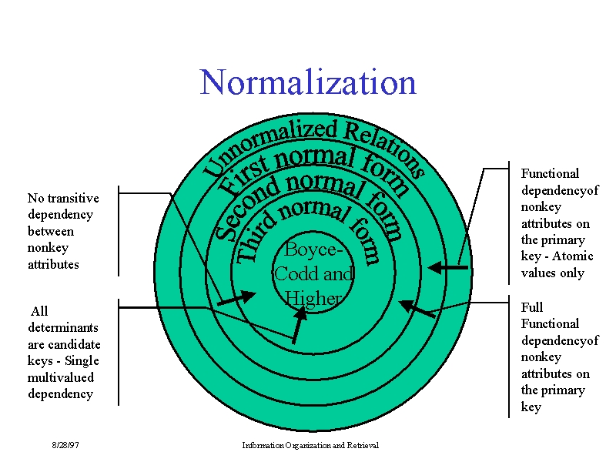

Slide 43
2 NF & 3 NF…
Key attribute
A
B
C
D
Non-key attribute
E
Entity
F
G
. 2NF :
Non –key attribute are functionally-dependent on the key – attributes
Partial Dependency is not allowed
3 NF
No non-key attribute is functionally-dependent upon any Non-key attribute
Transitive Dependency not allowed

Slide 44
Database Management System
DBMS Design Analyses : 1NF, 2 NF & 3NF
Why Higher Normal Forms?
  Closure of FDs & Armstrong Axioms
  3NF and BCNF: Achievability
Third Normal Form & BC Normal Form
Multivalued Dependencies and Fourth Normal Form
Overall Database Design Process
Notes:
Ranjana vyas

