Slide 1
Database Tables and Normalization
Normalization is a process for assigning attributes to entities. It reduces data redundancies and helps eliminate the data anomalies.
Probably most valuable as a way of evaluating and correcting DB design
Normalization works through a series of stages called normal forms:
  First normal form (1NF)
  Second normal form (2NF)
  Third normal form (3NF)
  Fourth normal form (4NF)
The highest level of normalization is not always desirable for real-world reasons
Notes:
I think that the way to get a good database design is to use E/R modeling, and check the resulting design using normalization theory. Normalization is harder, so get the design the more intuitive way
- But don’t feel that you have to start with a poor design then improve it. If, via E/R modeling you design a database that is in 3NF directly, that is Great
3NF is what people in the real world shoot for. But there can be reasons for not going that far. Often this involves trading-off speed of retrieval vs speed of update, data redundancy, and risks of inconsistencies and anomalies

Slide 2
Database Tables and Normalization
The Need for Normalization
  Case of a Construction Company
    Building project -- Project number, Name, Employees assigned to the project.
    Employee -- Employee number, Name, Job classification
    The company charges its clients by billing the hours spent on each project. The hourly billing rate is dependent on the employee’s position.
    Periodically, a report is generated.

Slide 3
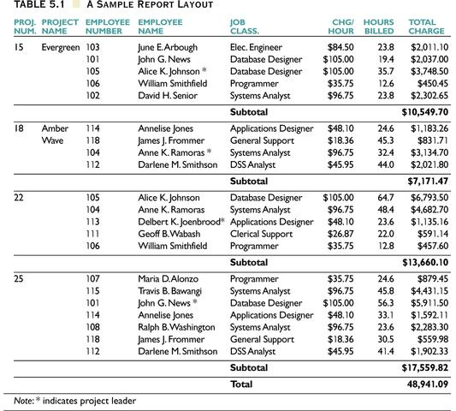

Slide 4
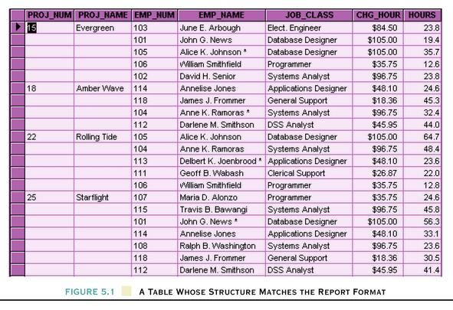
A Table Whose Structure Matches the Report Format

Slide 5
Database Tables and Normalization
Problems with the design based on report Handout
  Just doesn’t fit in a Relational DB – not a table
  The student number is intended to be part of a primary key, but it contains nulls.
  The table displays data redundancies.
  The table entries invite data inconsistencies.
  The data redundancies yield the following anomalies:
    Update anomalies.
    Addition anomalies.
    Deletion anomalies.
Notes:
< DO with Univ redundancies in professor, time, room, title, description, … each redundancy is a risk for inconsistency ;
update anomaly – modifying the room for a class requires potentially many changes – if not done – inconsistent;
insert anomaly – cannot insert a student without having course info to go with them;
delete anomaly – deletion of all sections for a course loses info about the course as well (and have to make sure get all students in the sections or inconsistent >

Slide 6
The Normalization Process
Each table represents a single subject
No data item will be unnecessarily stored in more than one table
All attributes in a table are dependent on the primary key

Slide 7
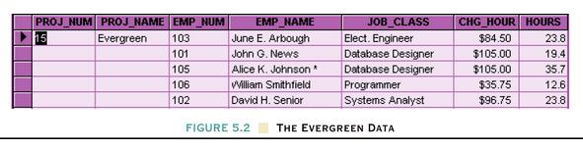
Database Tables and Normalization
Conversion to First Normal Form
  A relational table must not contain repeating groups.
    (repeating groups involve set of multiple entries in given attribute(s)
  Repeating groups do not fit in a rectangular table
  Repeating groups can be eliminated by adding the appropriate entry in at least the primary key column(s).
.
.
<Substitute Univ Unnormalized>
.
.
.
.
.
.
Figure 5.2 The Evergreen Data

Slide 8
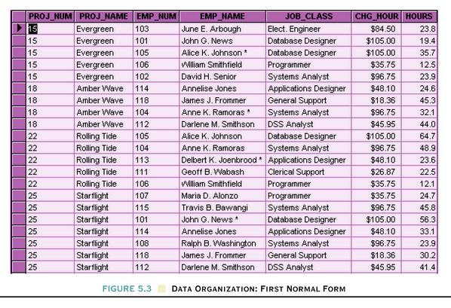
Data Organization: First Normal Form

Slide 9
Prepare for Further Normalization: Identify the Primary Key
Primary key must uniquely identify all attribute values
(particularly if you’re going to need further normalization) PK may be composite of multiple attributes

Slide 10
Prepare for Further Normalization: Identify all Dependencies
Remember Functional Dependencies?
  A ➔ B means that if you know A then you know B; OR more technically
  For any given value of A, there is exactly one value of B
Dependencies identified through understanding organization and its Business Rules
Dependencies can be depicted with the help of a diagram
Dependency diagram:
  Depicts all dependencies found within a given table structure
  Helpful in getting bird’s-eye view of all relationships among a table’s attributes
  Use makes it much less likely that an important dependency will be overlooked

Slide 11
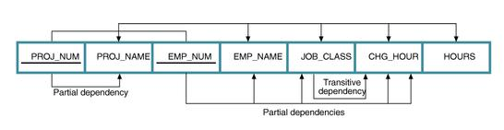
Database Tables and Normalization
Dependency Diagram
  The primary key components are bold, underlined, and shaded in a different color.
  The arrows above entities indicate all desirable dependencies, i.e., dependencies that are based on PK.
  The arrows below the dependency diagram indicate less desirable dependencies -- partial dependencies and transitive dependencies.

Slide 12
Database Tables and Normalization
1NF Definition
  The term first normal form (1NF) describes the tabular format in which:
    All the key attributes are defined.
    There are no repeating groups in the table.
    All attributes are dependent on the primary key.
  If the table has any partial dependencies or transitive dependencies then You may end up with anomalies during
    Inserts
    Deletes
    Updates
Notes:
DBMS automatically enforces the first two requirements here

Slide 13
Database Tables and Normalization
Conversion to Second Normal Form
  Starting with the 1NF format, the database can be converted into the 2NF format by
    Writing each key component on a separate line, and then writing the original key on the last line and
    Writing the dependent attributes after each new key.
    PROJECT (PROJ_NUM, PROJ_NAME)
    EMPLOYEE (EMP_NUM, EMP_NAME, JOB_CLASS, CHG_HOUR)
    ASSIGN (PROJ_NUM, EMP_NUM, HOURS)
Notes:
<do with univ>
STUDENT(ID, Fname,M, Lname, Year, Major,Credits, GPA, Hometown, BalanceDue)
SECTION(Index, Dept, Class, Sect, Prof, Time, Room, Stop, Enroll, Prereq, Title, Description)
ENROLLMENTS(Student, Index, Grade)

Slide 14
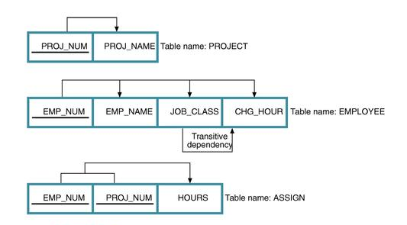
Second Normal Form (2NF) Conversion Results

Slide 15
Database Tables and Normalization
2NF Definition
  A table is in 2NF if:
    It is in 1NF and
    It includes no partial dependencies; that is, no attribute is dependent on only a portion of the primary key.
    (It is still possible for a table in 2NF to exhibit transitive dependency; that is, one or more attributes may be functionally dependent on nonkey attributes.)
Notes:
…
Since violation of 2NF involves partial dependencies, if table PK is a single attribute (not composite), then the table must be in 2NF if it is in 1NF

Slide 16
2NF is Not Good Enough
Examine 2NF Current Sections Offered
  Definitely In 2NF
  Problem – data still redundant
  Anomalies on insert, delete, modify
  Caused because table is really about more than one thing
Transitive dependency is the root of the problem
Notes:
… all attributes fully FD on class index
… see repeating info on course title and description
… can’t insert info on a new course until there is a section for it. Any sections inserted must duplicate course title and description – opportunity for inconsistency.
delete – if all sections for a course are deleted, info about the course is lost
modify – if course title is changed, it must be changed under every section or inconsistent data will exist
… if we had identified course and section as separate entities in E/R modeling, we wouldn’t be in this predicament
Dept, class ➔ Course title … dept,class ➔ description etc

Slide 17
Database Tables and Normalization
3NF Definition
  A table is in 3NF if:
    It is in 2NF and
    It contains no transitive dependencies.

Slide 18
Database Tables and Normalization
Conversion to Third Normal Form
  Create a separate table with attributes in a transitive functional dependence relationship.
    Any determinant (LHS of FD) gets its own table
    Any attributes dependent on it (RHS of FD) go in that table
    Remove dependent attributes from the previous table
    PROJECT (PROJ_NUM, PROJ_NAME)
    ASSIGN (PROJ_NUM, EMP_NUM, HOURS)
    EMPLOYEE (EMP_NUM, EMP_NAME, JOB_CLASS)
    JOB (JOB_CLASS, CHG_HOUR)
Notes:
SECTION(Index, Dept, Class, Sect, Prof, Time, Room, Stop, Enroll)
CATALOGCLASS(Dept, Class, Title, Description)

Slide 19
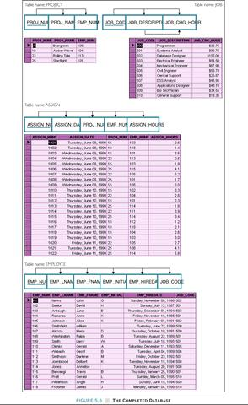
Figure
The Completed Database

Slide 20
Improving the Design
The following changes may be useful:
  Following Naming conventions for attributes
  Attribute atomicity
  Adding attributes
  Adding relationships
  Refining PKs – Composite PKs are a pain, but be careful about replacing them with auto keys because you produce transitive dependencies
  Maintaining historical accuracy – ensure that values that may change that need to be preserved are stored (not left to be derived)
Notes:
e.g. start with tablename, then add attribute description (e.g. STUD_GPA )
… breaking down into smallest parts increases flexibility (e.g. LName, FName, Middle, instead of Name)
… identifying additional attributes that fit in tables – easier to add attributes BEFORE loading data than anytime after
… look to identify any missed relationships – easier to add BEFORE loading data than anytime after
… e.g. PRODUCT price * ORDER_Number = ORDER_Extended_Price - but if the product price changes then the extended price would be wrong if calculated in the future instead of being stored

Slide 21
Database Tables and Normalization
Boyce-Codd Normal Form (BCNF)
  A table is in Boyce-Codd normal form (BCNF) if every determinant in the table is a candidate key.
    (A determinant is any attribute whose value determines other values with a row. )
  If a table contains only one candidate key, the 3NF and the BCNF are equivalent.
  BCNF is a special case of 3NF.
  Figure illustrates a table that is in 3NF but not in BCNF, and how the table can be decomposed to conform to the BCNF form.
BCNF doesn’t come up very often, DB designers typically aim for 3NF
Notes:
… LHS of FD
… most tables in 3NF are also in BCNF without any further adjustment
… but this is a weird example … we wouldn’t have gotten into this situation with effective E/R modeling
… I usually only expect students to know when BCNF might become an issue – when table has more than one candidate key and at least one of them is composite

Slide 22
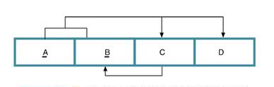
A Table That Is In 3NF But Not In BCNF
Notes:
<SKIP>
A,B is PK, A,C is a candidate Key too
C➔ B has a determinant that is not a candidate key (just part of one)

Slide 23
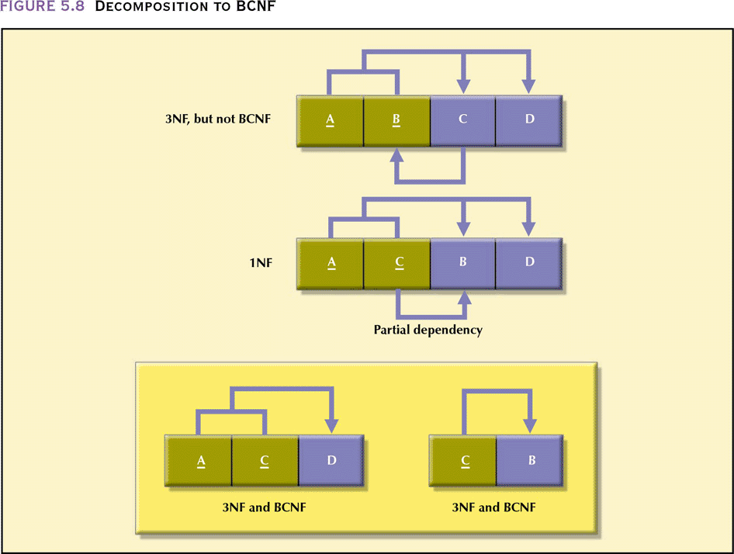
The Decomposition of a Table Structure to Meet
BCNF Requirements

Slide 24
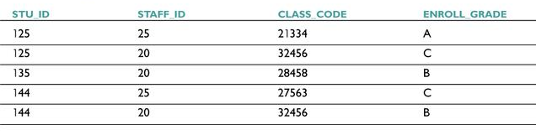
Sample Data for a BCNF Conversion

Slide 25
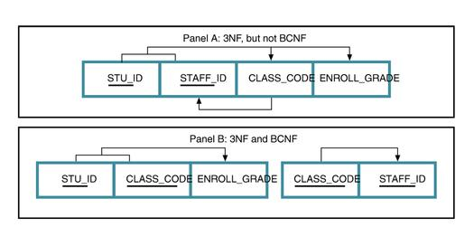
Decomposition into BCNF

Slide 26
Database Tables and Normalization
BCNF Definition
  A table is in BCNF if every determinant in that table is a candidate key. If a table contains only one candidate key, 3NF and BCNF are equivalent.

Slide 27
Normalization and Database Design
Normalization should be part of the design process
  Many real world DBs have been naively created and suffered from resulting anomalies
E-R Diagram provides macro view
Normalization provides micro view of entities
  Focuses on characteristics of specific entities
  May yield additional entities
Difficult to separate normalization from E-R modeling
Business rules must be determined for BOTH

Slide 28
Normalization and Database Design
Database Design and Normalization Example:
(Construction Company)
  Summary of Operations:
    The company manages many projects.
    Each project requires the services of many employees.
    An employee may be assigned to several different projects.
    Some employees are not assigned to a project and perform duties not specifically related to a project. Some employees are part of a labor pool, to be shared by all project teams.
    Each employee has a (single) primary job classification. This job classification determines the hourly billing rate.
    Many employees can have the same job classification.

Slide 29
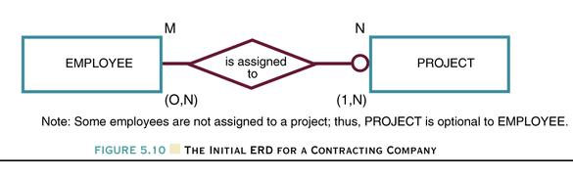
Normalization and Database Design
Two Initial Entities:
    PROJECT (PROJ_NUM, PROJ_NAME)
    EMPLOYEE (EMP_NUM, EMP_LNAME, EMP_FNAME, EMP_INITIAL, JOB_DESCRIPTION, JOB_CHG_HOUR)
Figure 5.10 The Initial ERD for a Contracting Company
Notes:
<SKIP>

Slide 30
Normalization and Database Design
Three Entities After Transitive Dependency Removed
    PROJECT (PROJ_NUM, PROJ_NAME)
    EMPLOYEE (EMP_NUM, EMP_LNAME, EMP_FNAME, EMP_INITIAL, JOB_CODE)
    JOB (JOB_CODE, JOB_DESCRIPTION, JOB_CHG_HOUR)
Notes:
<SKIP>

Slide 31
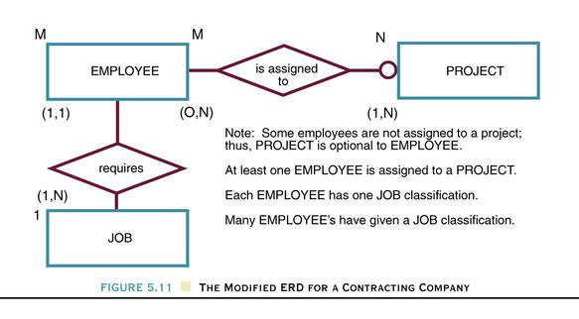
The Modified ERD For A Contracting Company
Figure 5.11
Notes:
<skip >

Slide 32
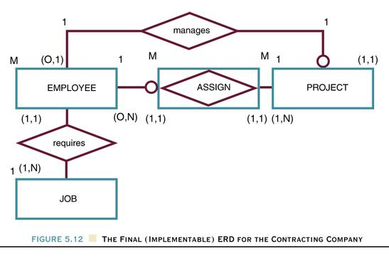
Normalization and Database Design
Creation of the Composite Entity ASSIGN
Figure 5.13 The Final (Implementable) ERD for the Contracting Company
Notes:
<SKIP – well maybe show final diagram >

Slide 33
Normalization and Database Design
Attribute ASSIGN_HOUR is assigned to the composite entity ASSIGN.
“Manages” relationship is created between EMPLOYEE and PROJECT.
    PROJECT (PROJ_NUM, PROJ_NAME, EMP_NUM)
    EMPLOYEE (EMP_NUM, EMP_LNAME, EMP_FNAME, EMP_INITIAL, EMP_HIREDATE, JOB_CODE)
    JOB (JOB_CODE, JOB_DESCRIPTION, JOB_CHG_HOUR)
    ASSIGN (ASSIGN_NUM, ASSIGN_DATE, PROJ_NUM, EMP_NUM, ASSIGN_HOURS)
Notes:
<SKIP>

Slide 34
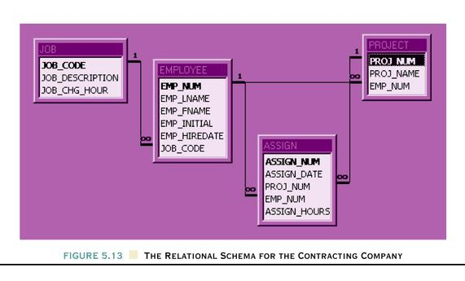
The Relational Schema For The Contracting Company
No longer a Figure
Notes:
<SKIP >

Slide 35
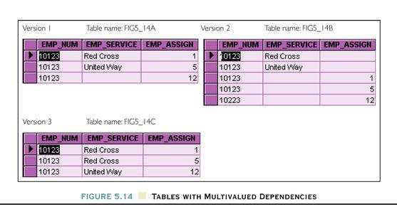
Higher-Level Normal Forms
4NF Definition
  A table is in 4NF if it is in 3NF and has no multiple sets of multivalued dependencies.
Figure 5.14 Tables with Multivalued Dependencies
Notes:
< we will not discuss higher normal forms – which come up infrequently >

Slide 36
Fourth Normal Form
Table is in fourth normal form (4NF) if
  It is in 3NF
  Has no multiple sets of multivalued dependencies
4NF is largely academic if tables conform to the following two rules:
  All attributes are dependent on primary key but independent of each other
  No row contains two or more multivalued facts about an entity
Notes:
<SKIP>

Slide 37
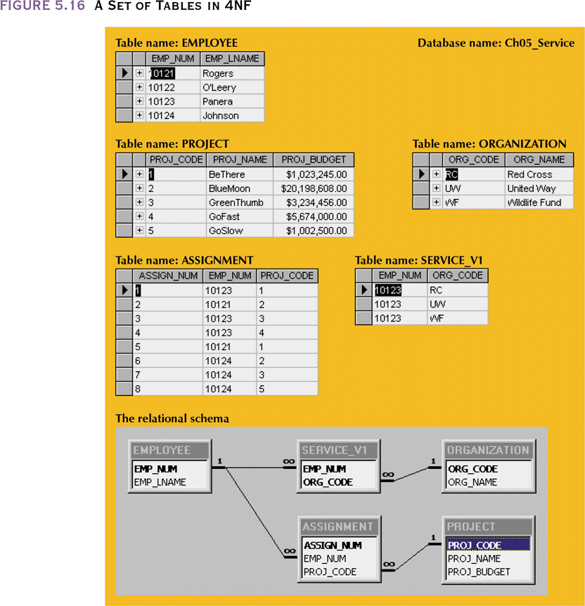
A Set of Tables in 4NF
Notes:
<SKIP>

Slide 38
Denormalization
Normalization is only one of many database design goals.
Normalized (decomposed) tables require additional processing, reducing system speed.
  More joins of tables
  More disk accesses
Normalization purity is often difficult to sustain in the modern database environment.
  The conflict between design efficiency, information requirements, and processing speed are often resolved through compromises that include denormalization.
Notes:
<important! >
Classic counter example – Zip code ➔ city, zip code ➔ state
Risk of anomalies is low because zip code / city connection rarely changes (insert anomalies exist – type the wrong zip code in). Tradeoff is joins whenever reporting on addresses
I filled out a web form recently and it flagged my city as wrong based on my zip code – IT SHOULDN’T HAVE ASKED ME TO TYPE IN THE CITY THEN !!!!!!! (user unfriendly)
Another example – in Student, #Credits → Year in School
Denormalization should (when done) always be done with an explicit understanding of the tradeoffs being made
(and never for the DESIGNER’s convenience)

Slide 39
Denormalization (continued)
Unnormalized tables in a production database tend to have these defects:
  Risks of inconsistency MUST be managed
    Application program should ensure that inconsistency does not happen
  Data updates are less efficient because programs that read and update tables must deal with larger tables
  Indexing is much more cumbersome
  Unnormalized tables yield no simple strategies for creating virtual tables known as views
Use denormalization cautiously
Understand why—under some circumstances—unnormalized tables are a better choice
Notes:
Denormalization should (when done) always be done with an explicit understanding of the tradeoffs being made
(and never for the DESIGNER’s convenience)

Slide 40
Summary
Normalization is a table design technique aimed at minimizing data redundancies
First three normal forms (1NF, 2NF, and 3NF) are most commonly encountered
Normalization is an important part—but only a part—of the design process
Continue the iterative ER process until all entities and their attributes are defined and all equivalent tables are in 3NF

Slide 41
Summary (continued)
A table in 3NF may contain multivalued dependencies that produce either numerous null values or redundant data
It may be necessary to convert a 3NF table to the fourth normal form (4NF) by
  splitting such a table to remove multivalued dependencies
Tables are sometimes denormalized to yield less I/O which increases processing speed

Slide 42
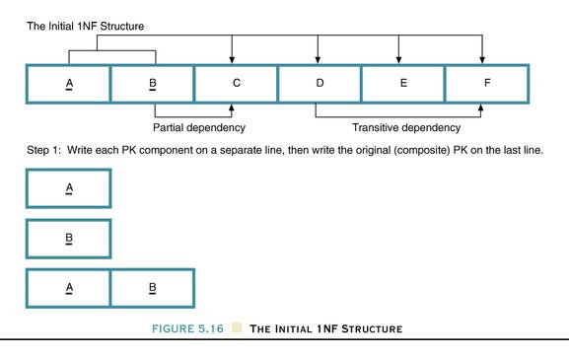
The Initial 1NF Structure
Figure 5.17
Notes:
<Review>
<FROM CHAPT SUMMARY – but too abstract>

Slide 43
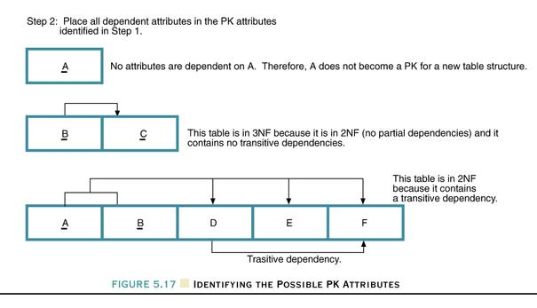
Identifying the Possible PK Attributes
Figure 5.18
Notes:
<review>

Slide 44
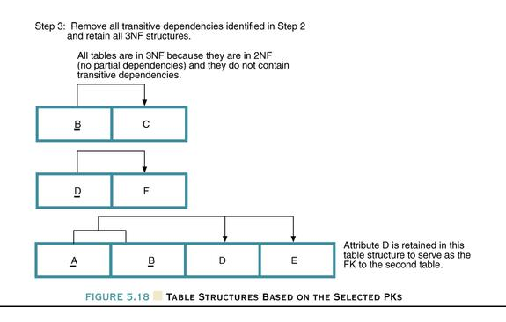
Table Structures Based On The Selected PKs
Figure 5.19
Notes:
<review>

Slide 45

End Chapter 5

