Slide 1
Recipe Preparation AI Agent
IBM HACKATHON PROJECT
Presented By: Anjali Bhadoriya
Student name : Anjali Bhadoriya
College Name & Department : ITM University Gwalior & B.Tech(CSE)

Slide 2
OUTLINE
Problem Statement
Technology used
Wow factor
End users
Result
Conclusion
Git-hub Link
Future scope
IBM Certifications

Slide 3
Problem Statement
In many households, people struggle with deciding what to cook using the limited ingredients they already have. This often leads to food wastage or unnecessary shopping. Additionally, those with dietary restrictions or limited cooking skills face challenges in preparing meals efficiently.
Proposed Solution
The Recipe Preparation Agent is an AI-powered assistant that helps users cook smartly by suggesting meal ideas based on available groceries.
Using RAG (Retrieval-Augmented Generation), it provides step-by-step cooking instructions, ingredient substitutions, dietary adjustments, and cooking tips.
This solution is built using IBM Cloud Lite Services and IBM Granite models on Watsonx.

Slide 4
Technology used
IBM Cloud Lite Services
Natural Language Processing (NLP)
Retrieval-Augmented Generation (RAG)
IBM Granite Foundation Model
Watsonx Prompt Lab

Slide 5
IBM cloud services used
IBM Cloud Watsonx AI Studio
IBM Cloud Watsonx AI runtime
IBM Cloud Agent Lab
IBM Granite foundation model
Cloud Object Storage (COS)

Slide 6
Wow factors
This AI agent transforms everyday cooking into a smart, efficient, and sustainable experience. It doesn't just suggest recipes — it adapts them intelligently to what the user has on hand.
Unique Features:
Ingredient-Aware Intelligence: Generates recipes tailored to available groceries, minimizing waste.
Smart Substitutions: Automatically offers ingredient alternatives based on regional availability or dietary needs.
RAG-Based Personalization: Uses Retrieval-Augmented Generation (RAG) to fetch the best-suited recipe logic and dynamically generate step-by-step instructions.
Cooking Tips & Health Tweaks: Suggests low-oil, gluten-free, or vegan adjustments as needed.
Real-time Suggestions: Delivers fast, contextualized recipe responses for daily use.
Supports Sustainability: Helps reduce food waste by turning leftover pantry items into practical meals.

Slide 7
End users
Home Cooks
Working Professionals
Students
Culinary Enthusiasts
Anyone with random groceries in the kitchen

Slide 8
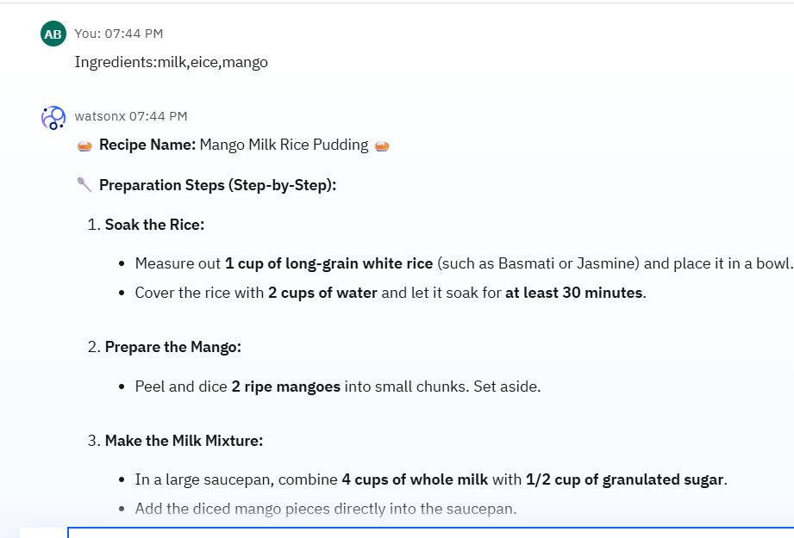
Results

Slide 9
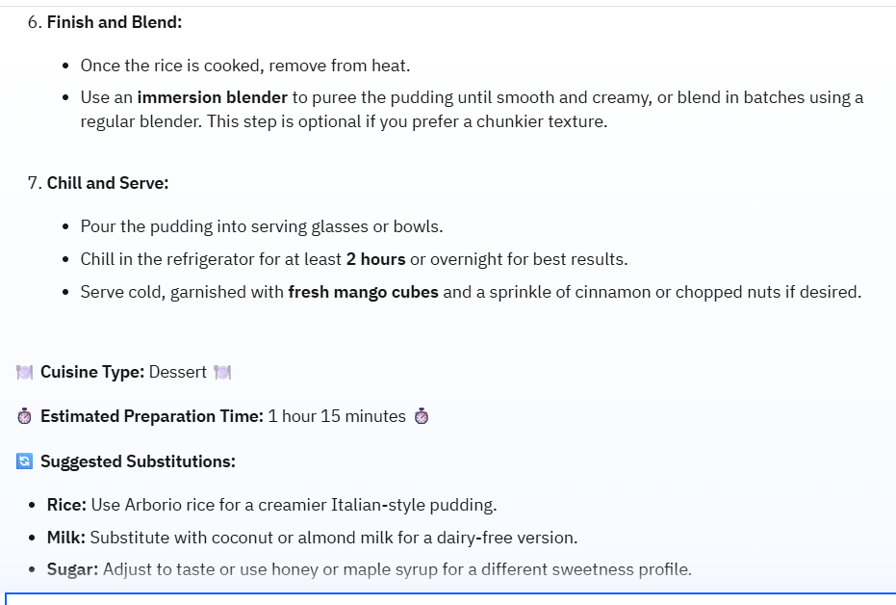
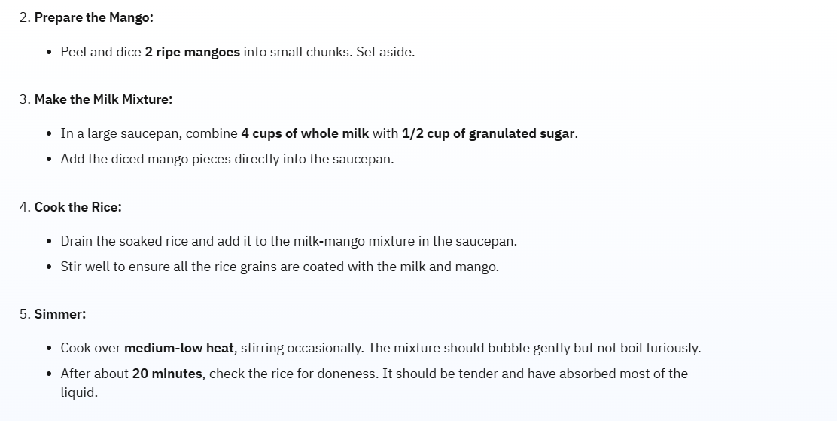
Results

Slide 10
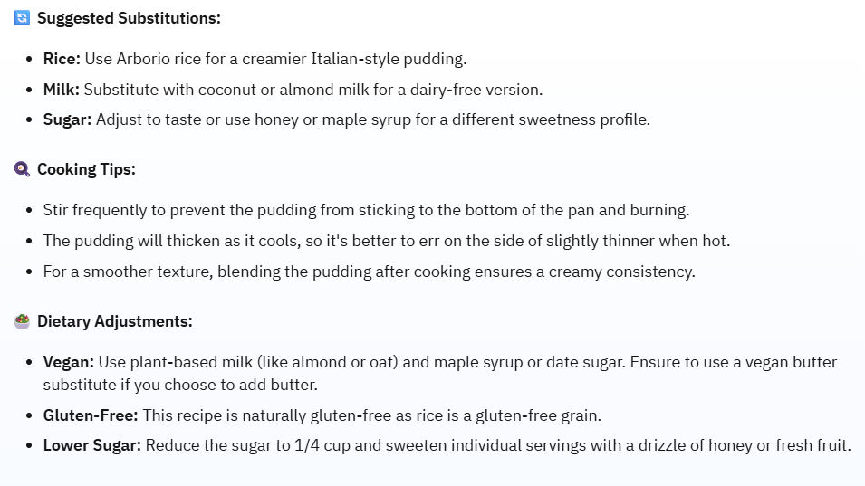
Results
Deployed AI Agent

Slide 11
Conclusion
The agent makes cooking simple and efficient
Encourages sustainable food usage
Meets all aspects of Problem Statement 16
Leverages IBM Cloud + Granite model + RAG effective

Slide 12
GitHub Link
https://github.com/AnjaliB22/recipe-preparation-agent

Slide 13
Future scope
Voice assistant integration
Mobile app interface
Multi-language support
Calorie estimation & nutritional insights
Smart meal planning for the week

Slide 14
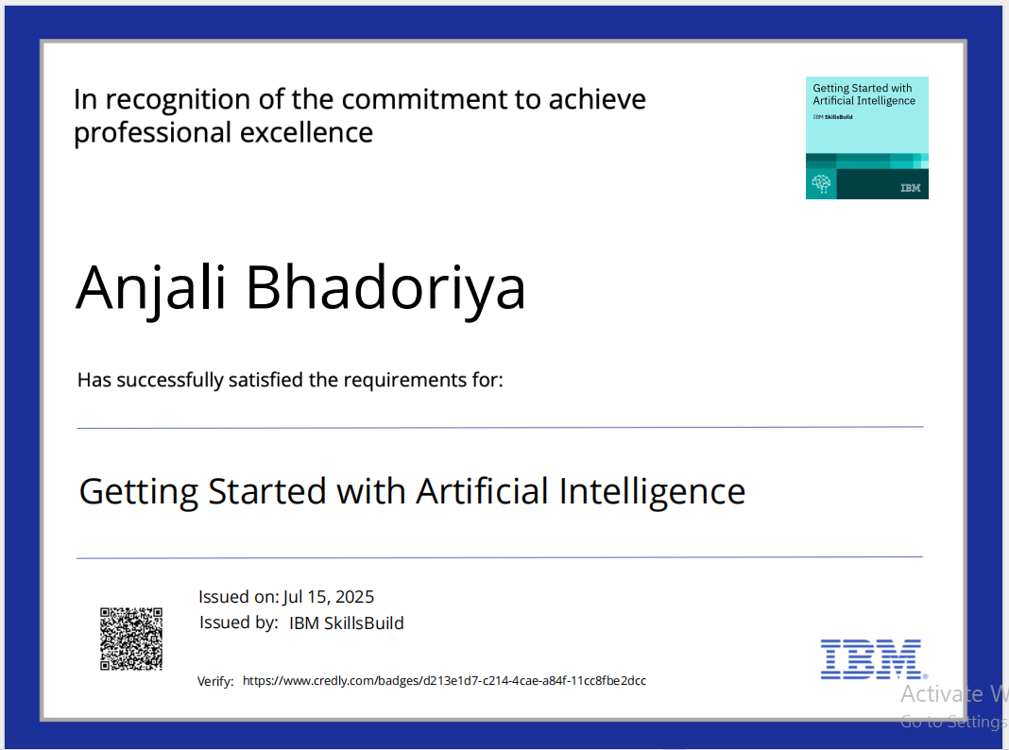
IBM Certifications

Slide 15
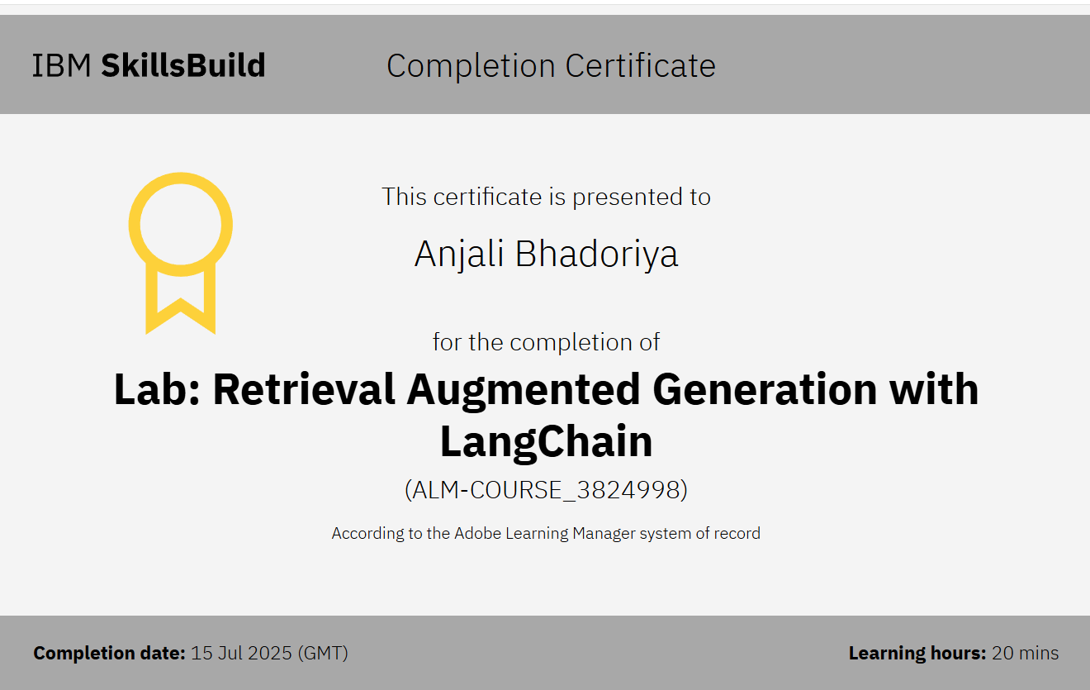
Attach your RAG LAB certificate here

Slide 16
THANK YOU

