Slide 1
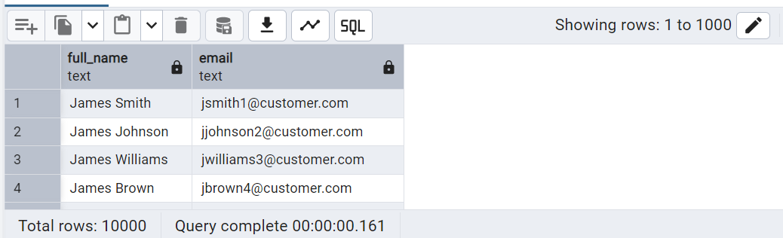
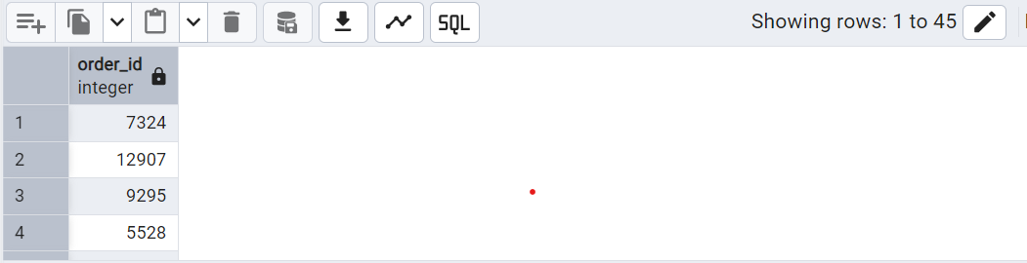
Q2.Retrieve all orders placed on '2023-11-27'.
Q1.List all customers with their full name and email.

Slide 2
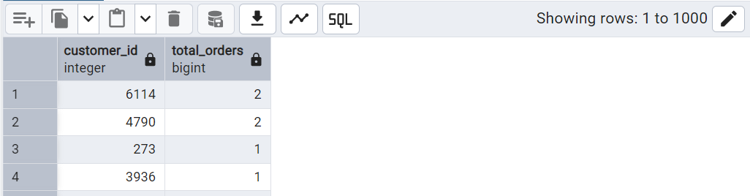
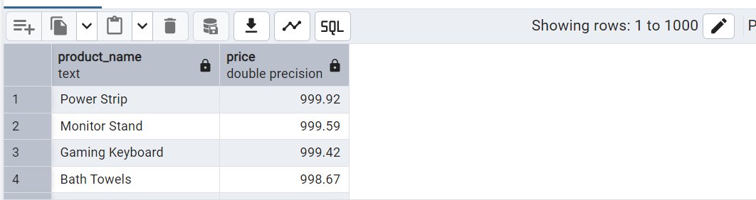
Q3.Find the total number of orders placed by each customer.
Q4.List product names and their prices sorted from highest to lowest.

Slide 3
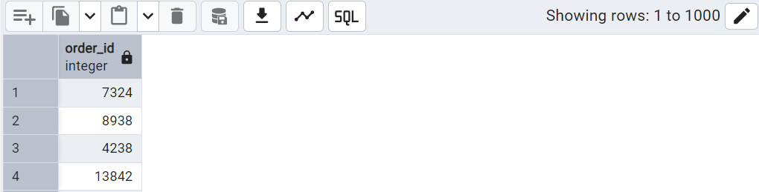
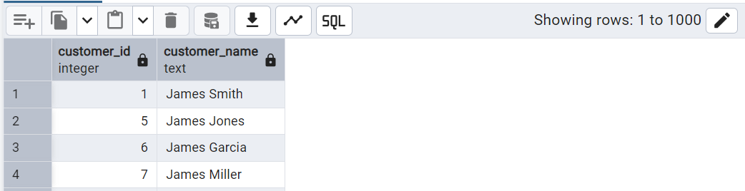
Q6.Get the names of customers who have placed more than 1 order.
Q5.Find all orders that have a total price greater than 500.

Slide 4
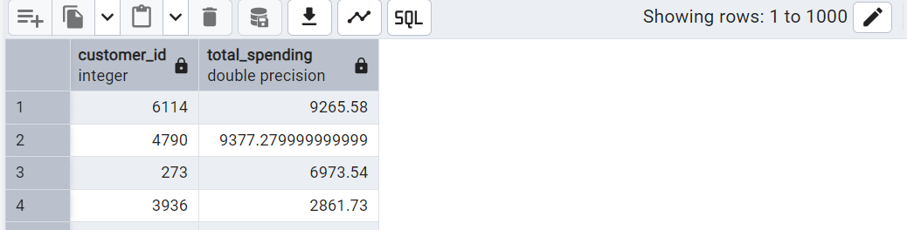
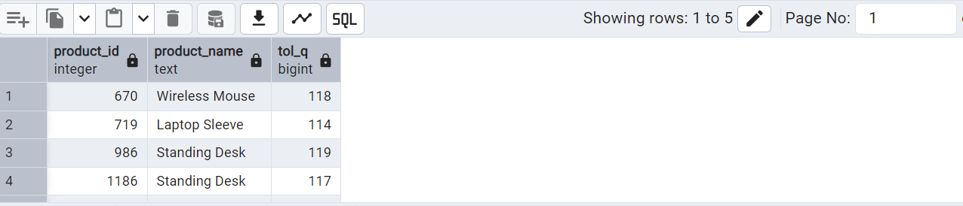
Q8. Find the top 5 products by total quantity sold.
Q7. List each customer's total spending based on order totals.

Slide 5
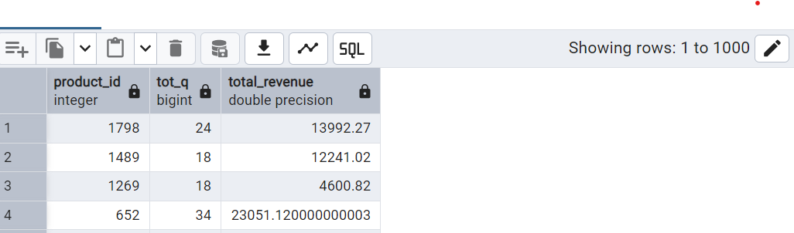
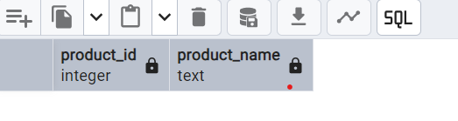
Q9.For each product, show the total quantity sold and the total revenue generated from sales.
Q10.List all products that have never been ordered.
An empty table indicating all the products listed
are ordered atleast once.

Slide 6
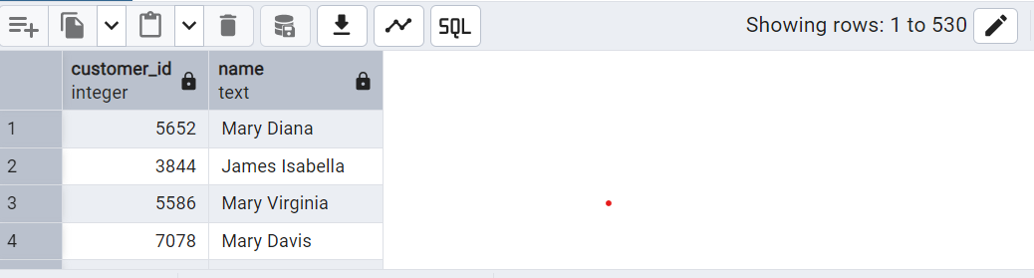
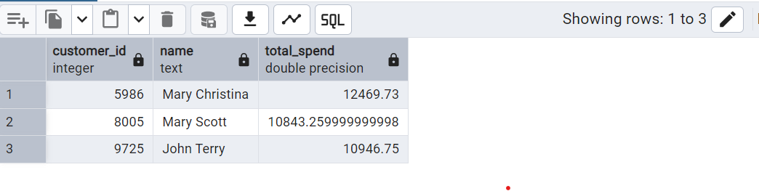
Q12.Identify the top 3 customers who spent the most in January 2024.
Q11.Find customers who ordered products from more than 3 different categories.

Slide 7
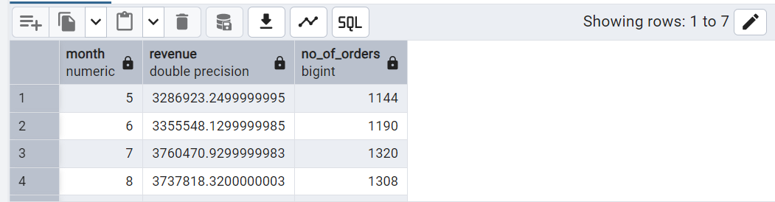
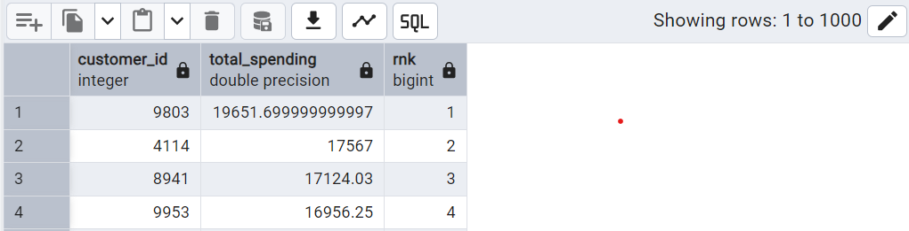
Q13. Calculate the monthly revenue and number of orders for the past 6 months.(present date be last order date)
Q14.Use a window function to rank customers by their total spending.

Slide 8
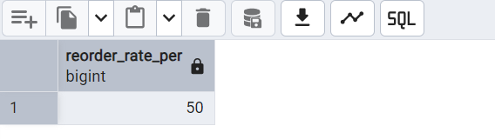
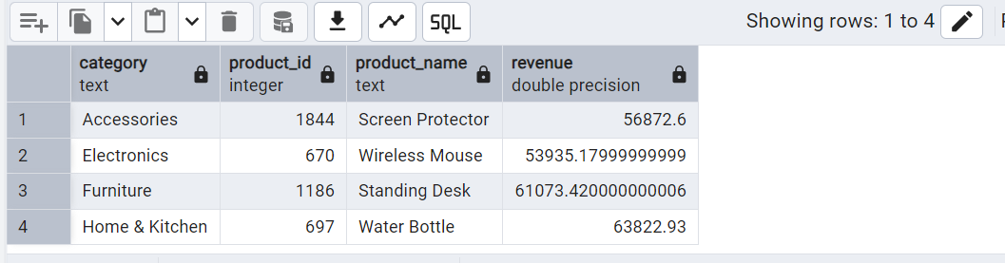
Q15.Find the reorder rate: what percentage of customers placed more than one order
Q16.Identify the product with the highest revenue per category.

Slide 9
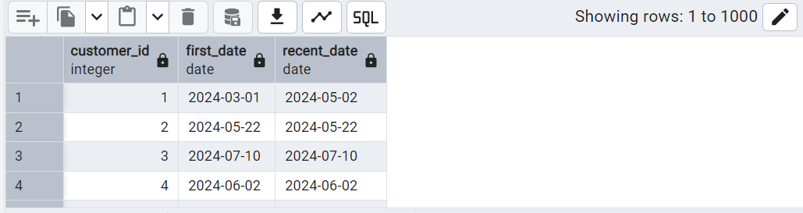
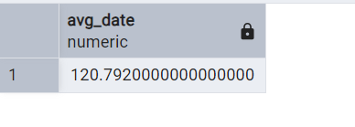
Q18.Determine the average number of days between a customer’s orders (for those with >1 order).
Q17.Get each customer’s first and most recent order date.

Slide 10
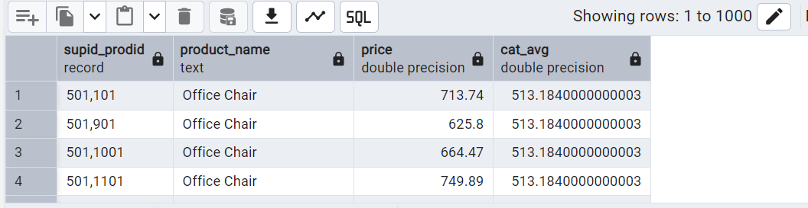
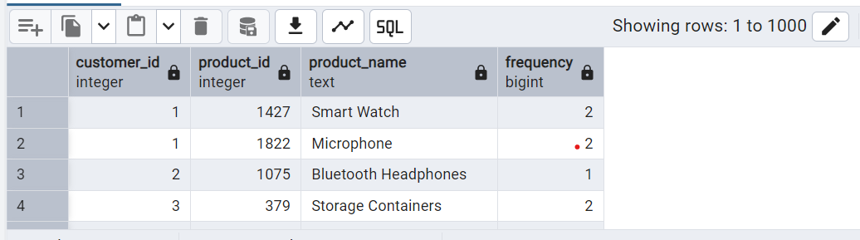
Q19.List suppliers_id whose products have a higher-than-average price in their category.
Q20.Find the most frequently purchased product for each customer.

